Slide 1

μ⁺ → e⁺γ 探索実験
MEG II の建設状況
(Construction status of the MEG II experiment searching for μ⁺ → e⁺γ)
25/September/2015
日本物理学会大2015秋季大会＠大阪市立大学
東大ICEPP 内山雄祐
他 MEG II collaboration

Slide 2
Abstract
MEG II is upgrade of MEG experiment, searching for μ→eγ
All the detectors are now under construction
To carry out a ‘pre’-engineering run in 2015
Toward starting data taking in 2016

Slide 3
Next μ→eγ Experiment
Aim at sensitivity of O(10⁻¹⁴)
  x10 improvement from MEG
By exploiting the full beam power available today,
  ~10⁸ μ⁺/s at PSI πE5
By upgrading the MEG detector
  Keep experimental concept
  in short (~5 years), at low cost
MEG II Experiment

Slide 4
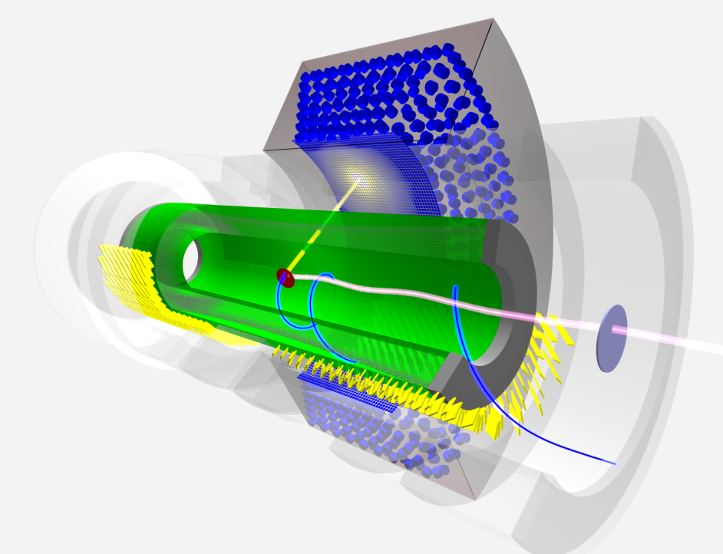
MEG II
Keep 3 keys of MEG
World’s most intense DC μ beam @ PSI
Innovative liquid xenon γ-ray detector
Gradient B-field e⁺-spectrometer
Double beam intensity,
Double efficiency,
Suppress BG factor ~30
Halve every resolution,
Add new detector to identify BG

Slide 5
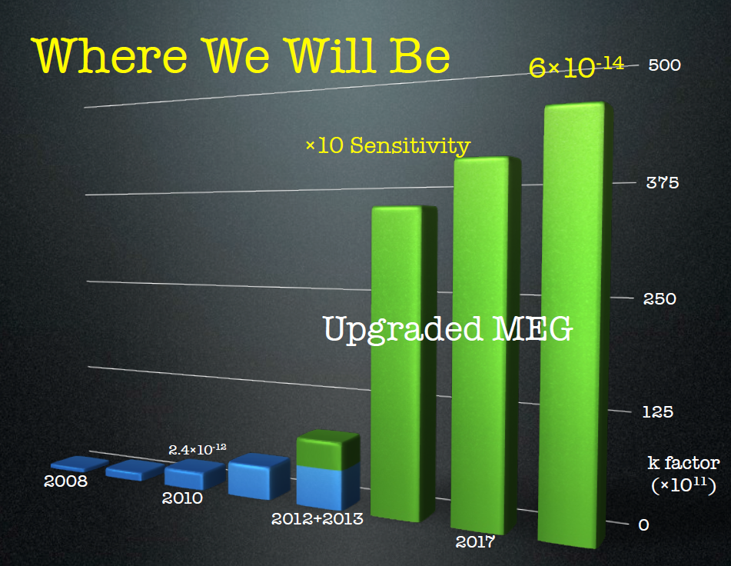
Timeline
4 ✕10⁻¹⁴
5×10⁻¹⁴
2012 | Start the project. Conceptual designing. Submit the proposal to PSI
2013 | Proposal approval.
2014 | Construction partially start.
2015 | Detector construction. Detector commissioning. Pre-engineering run.
2016 | Full engineering run. Data taking.
2017,2018
MEG I
DAQ
R&D

Slide 6
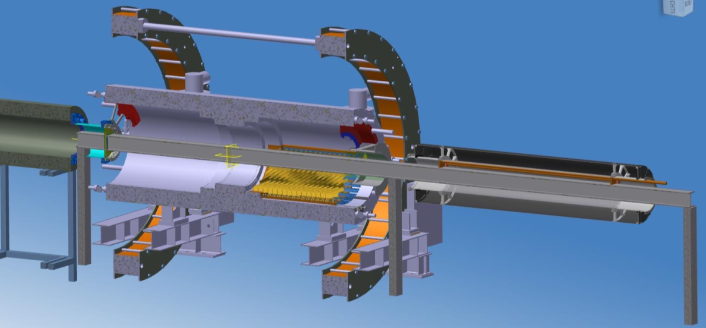
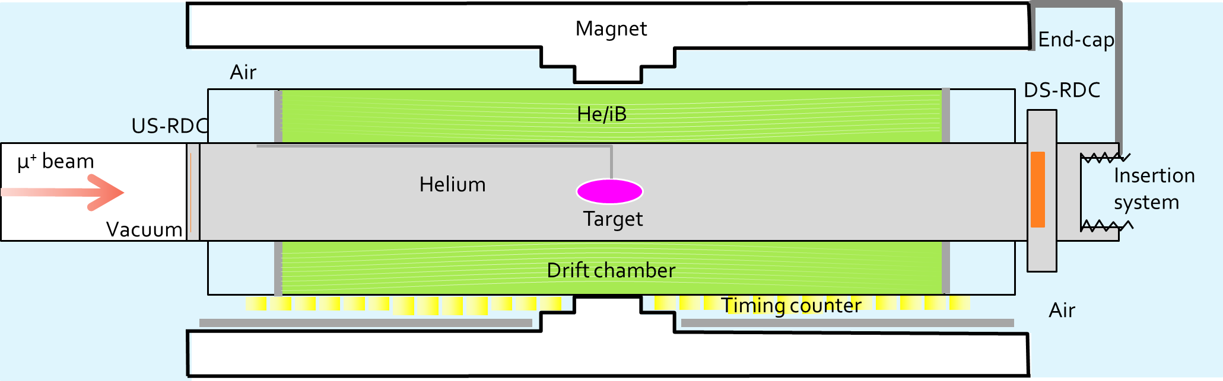
Goal of 2015
Check the mechanical integrity & functionality of the MEG-II upgrade design
  Enable design corrections & modifications well before Engineering run in 2016
Enable beam optimization & setup of new target
Aim at Michel beam test of DS Timing Counter system with limited readout

Slide 7
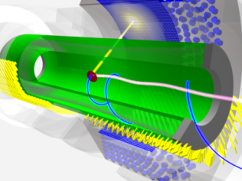
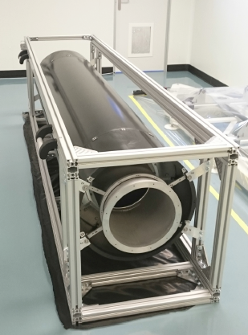
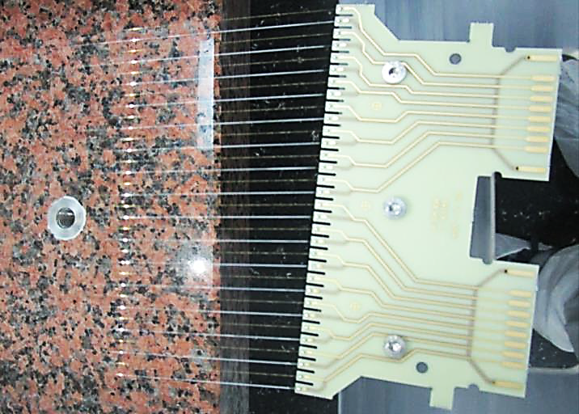
New Drift Chamber
Stereo-wire low-mass drift chamber
  1200 sense wires, 1.7×10⁻³ X₀ per track
Partially wired ‘mock-up chamber’ was built and being installed today.
  with HV & gas system
  for mechanical integration & operation test
Final chamber under construction.
  Wiring has been started (several months delay),
  takes ~half year.
  Full system will be ready by Aug. 2016. (~5 months delay)
200 cm
60 cm
Wires soldered on PCB
The ‘mock-up’ chamber

Slide 8
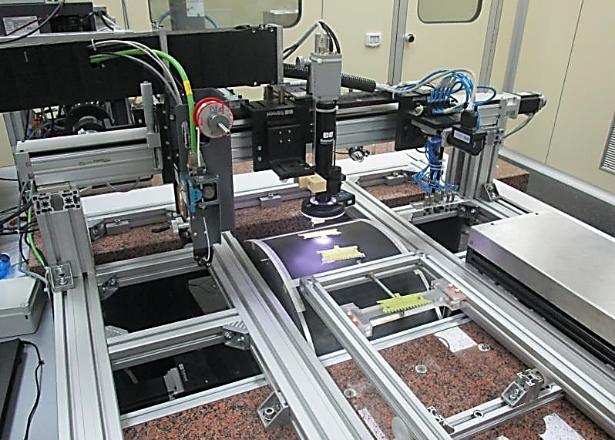
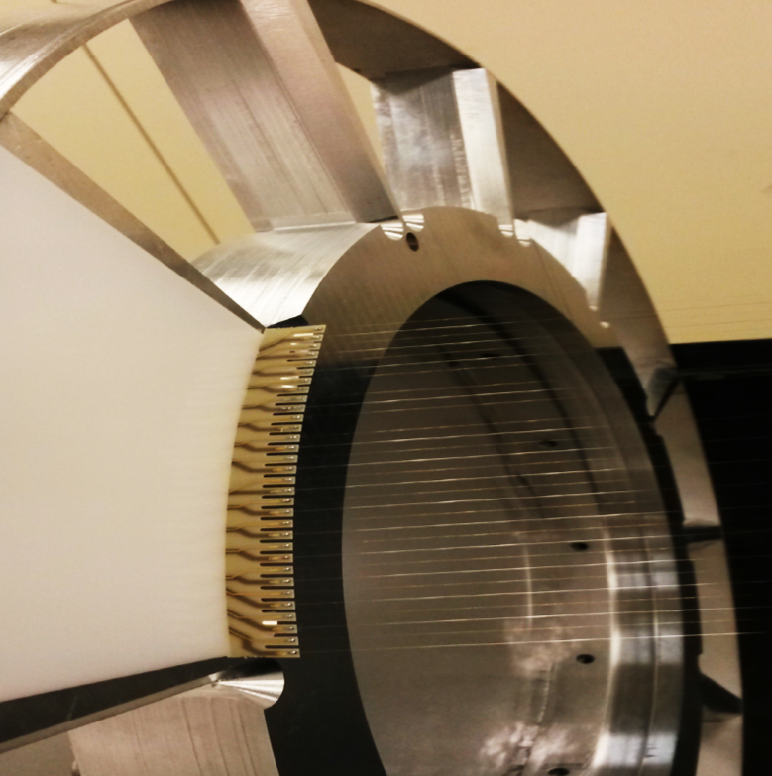
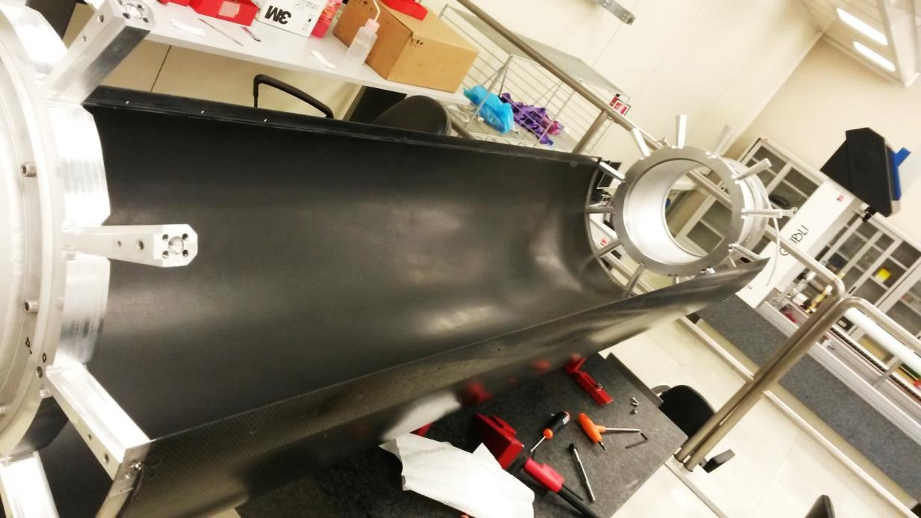
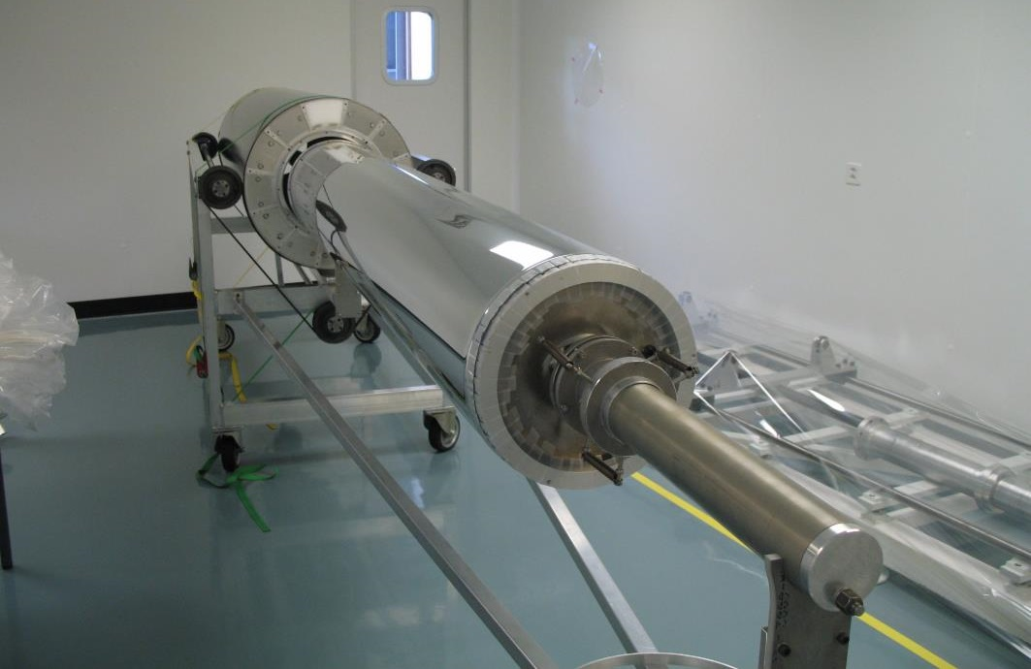
Wiring machine
Sense wire: 20 μm W
Field wire: 40 μm Al
Wiring scheme and PCB design were finalized
3 wires were broken
2 during assembly, 1 during transportation
The procedure is now modified
Inner foil
(20 μm Al-Mylar)
Carbon-fiber Outer frame
(2 mm^{t})

Slide 9
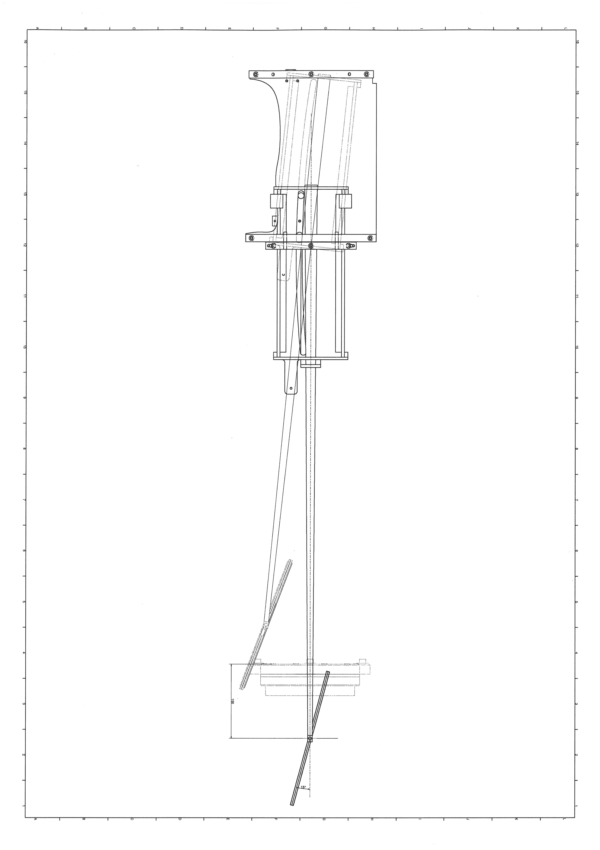
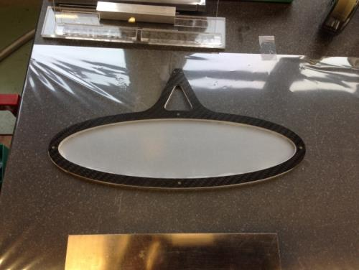
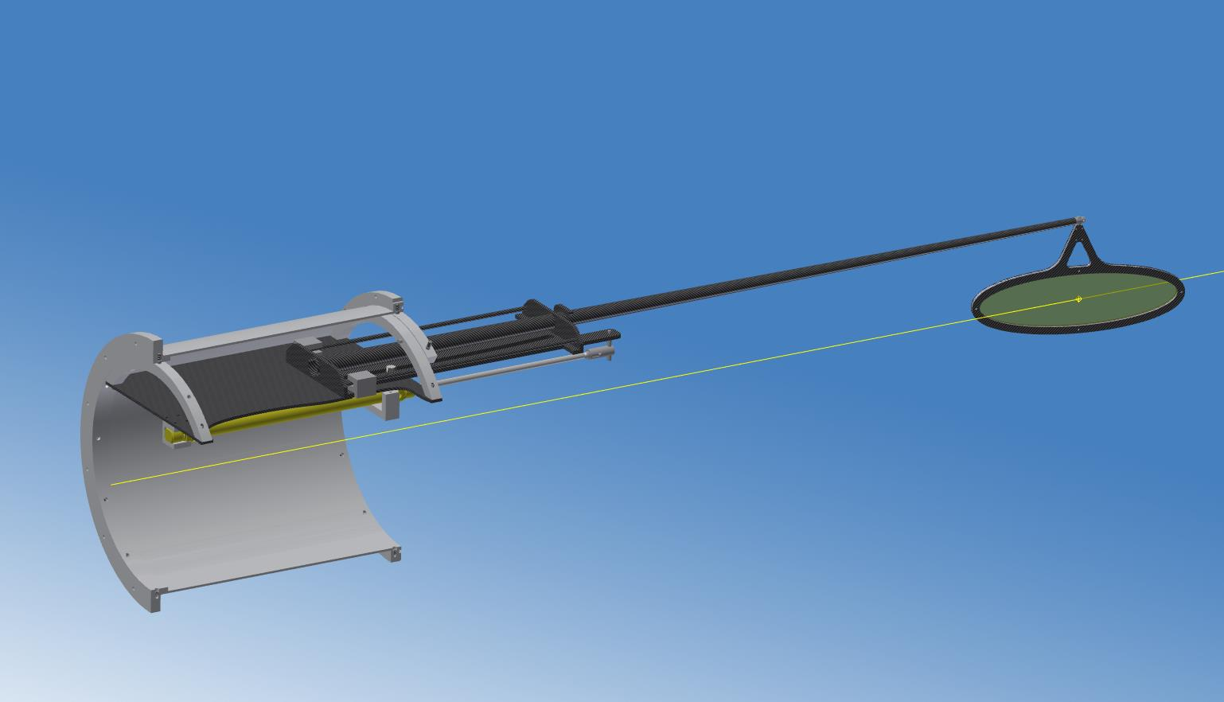
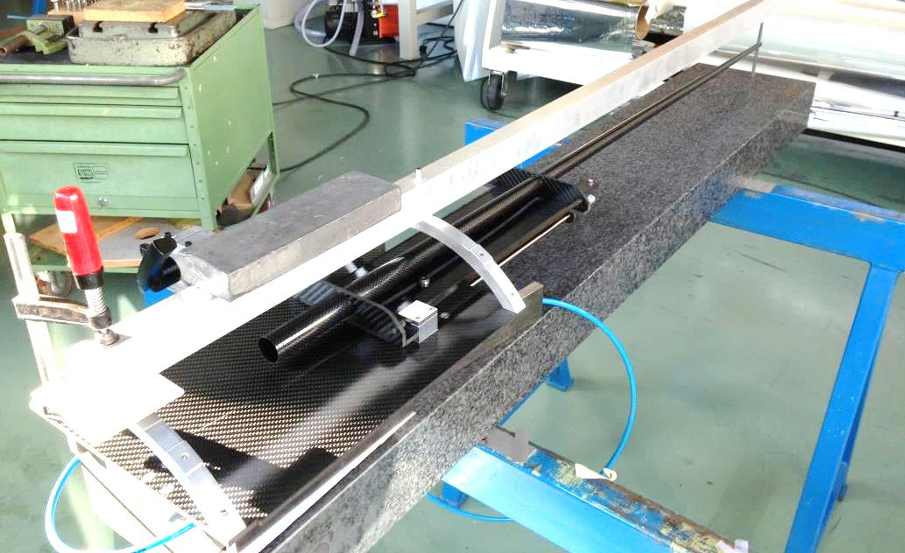
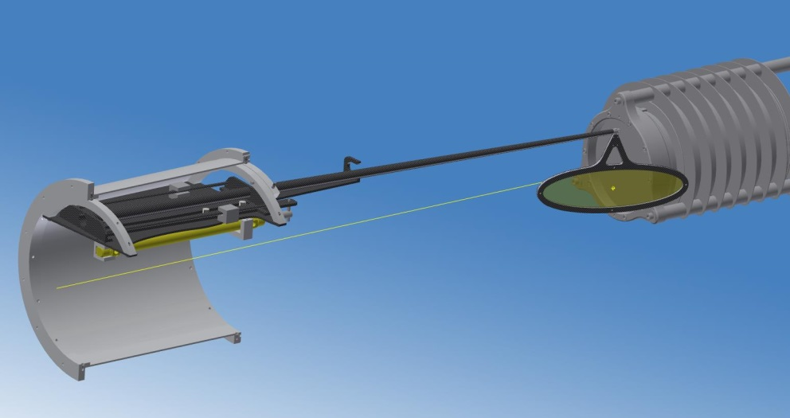
Target System
New μ-stopping target system for the new spectrometer
Target material under study
  Deformation issue in MEG I
  Polyethylene (140 μm)
  Beryllium (90 μm)
  Scintillator film (130 μm)
1st MEG-II target
(only for 2015)
140 μm Polyethylene
Rohacell + carbon
frame
p beam
Li target
Measuring position
(physics mode)
Parking position
(calibration mode)
μ⁺ beam
Notes:
Target material確認

Slide 10
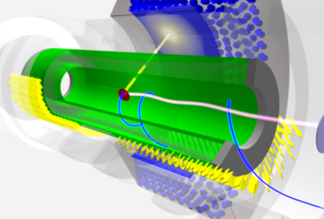
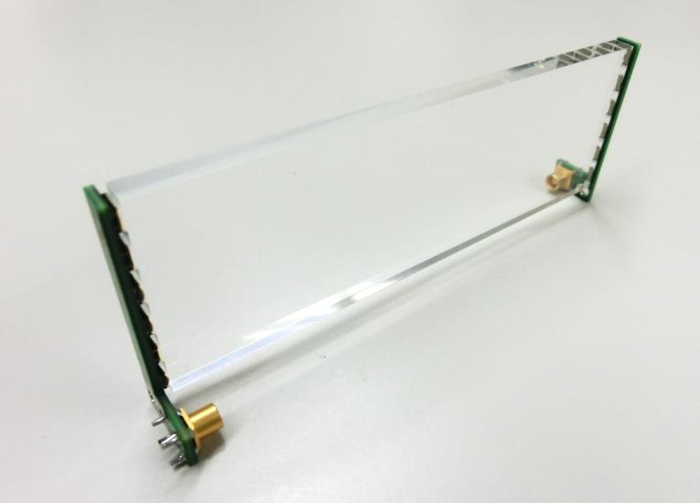
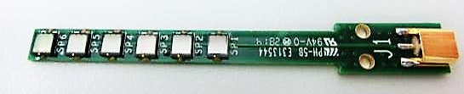
Pixelated Timing Counter
26aSN1,2,3
30-ps resolution counter system with segmented scint. counters
Engineering run with half of downstream (128) counters
  ~140 counters have been constructed
    Single counter resolution σ ~75 ps
    ~10 ps worse than expected due to lower PDE of mass-produced SiPMs (AdvanSiD)
    ⇒ 15% worse overall resolution: 28 → 32 ps
    Scintillator production failure (Saint-Gobain)
    Good production eff. ~35% . Reproduction on-going
  Mechanical & installation system ready
Test calibration system
Installation starts at mid-Oct.
Downstream
(256)
Upstream
(256)
BC-422
(120×40×5 mm³)
6 SiPMs at each end

Slide 11
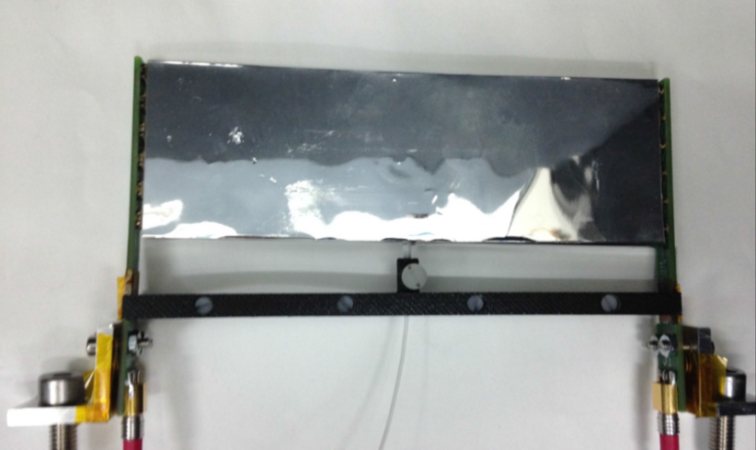
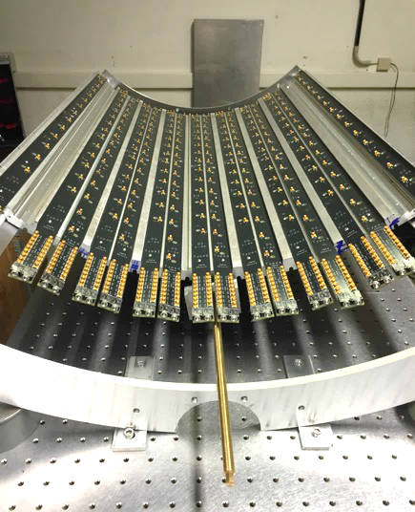
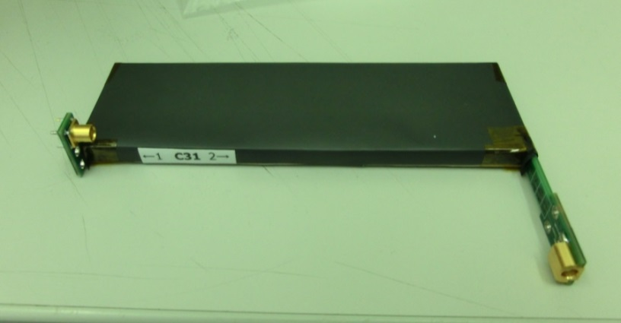
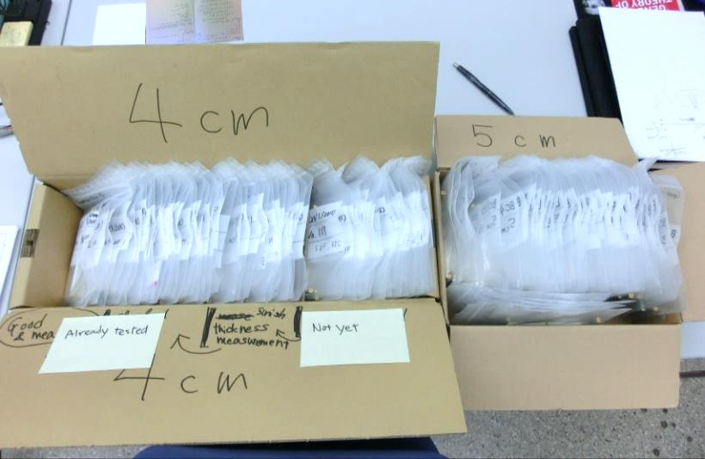
Wrapped in ESR film
26aSN1,2,3
Structure & readout PCBs
A counter
optical fiber
100 cm
Light shield with Tedlar film
Assembly & installation foreseen
after JPS meeting
~140 counters

Slide 12
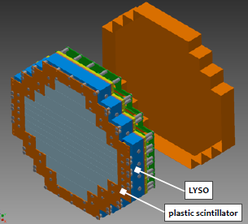
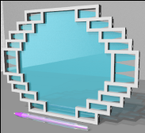
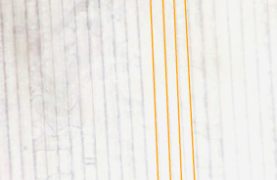
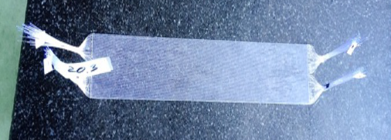
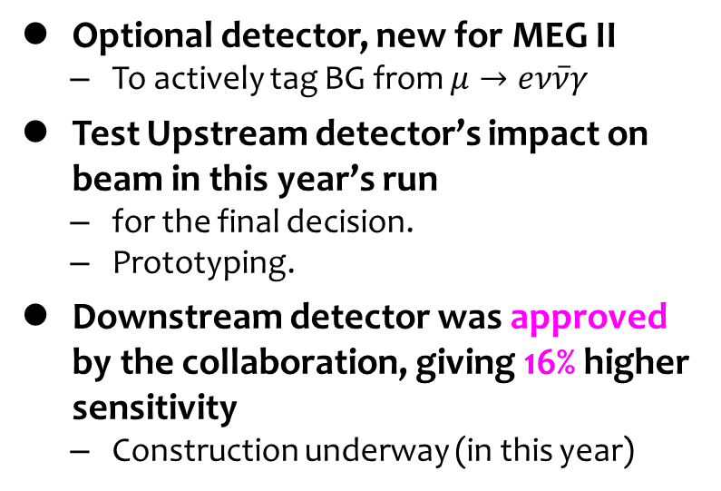
New BG Tagging Detector (RDC)
28aSG7,8
Optional detector, new for MEG II
  To actively tag BG from $μ→eν\overline{ν}γ$
Test Upstream detector’s impact on beam in this year’s run
  for the final decision.
  Prototyping.
Downstream detector was approved by the collaboration, giving 16% higher sensitivity
  Construction underway (in this year)
Downstream
Plastic scintillator
＋LYSO
Upstream
Scintillating fiber
128 fibers prototype
250 μm

Slide 13
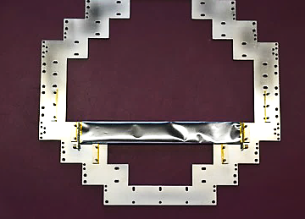
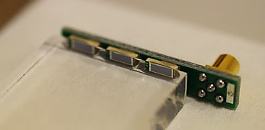
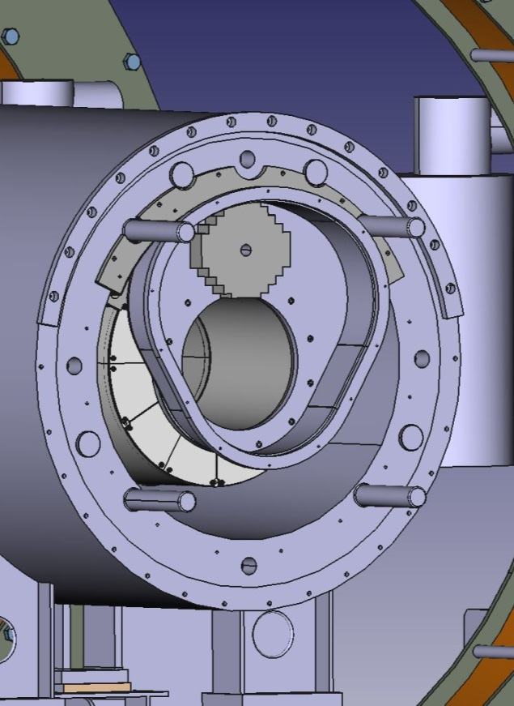
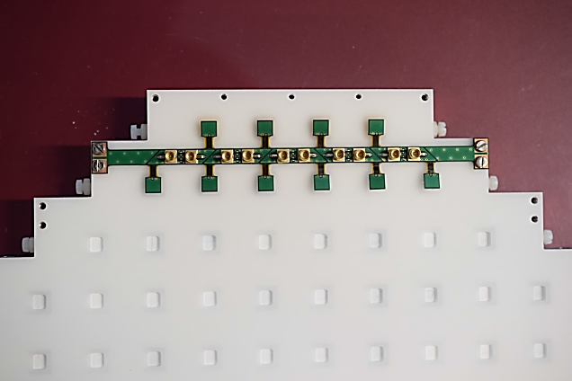
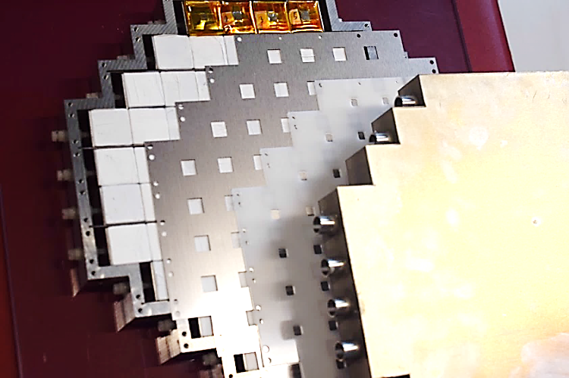
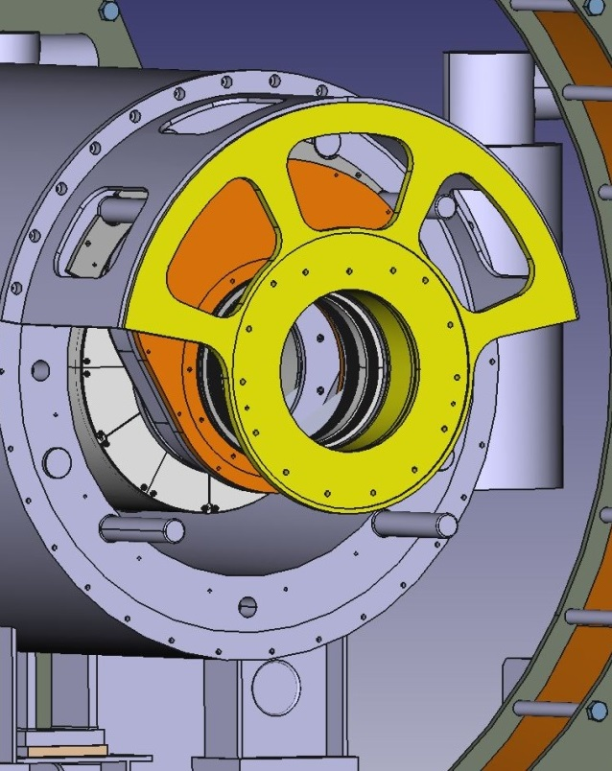
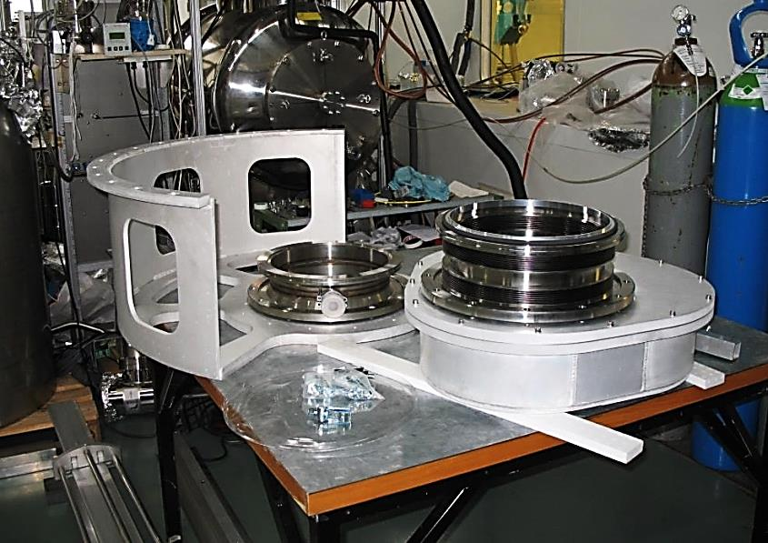
28aSG7,8
15 cm plastic scint.
MPPCs glued on scintillator
MPPC
2x2x2 cm³ LYSO crystals
MPPCs are not glued but
pressed onto LYSO with grease
Endcap
RDC is not installed this year
Detailed mechanical design is not yet fixed
(moving system, cabling, etc.)
RDC house

Slide 14
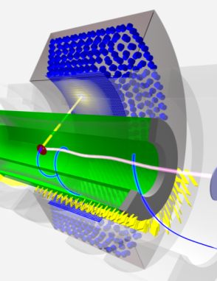
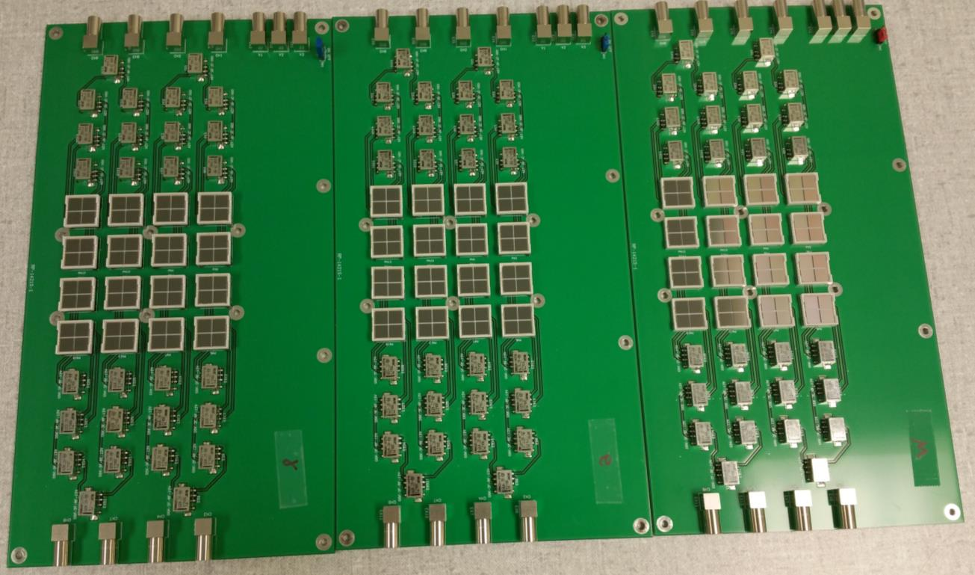
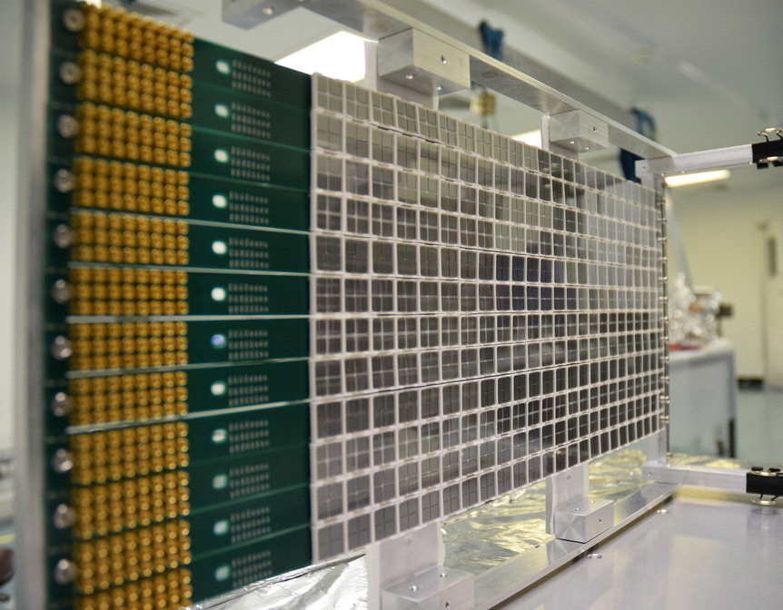
LXe γ-ray Detector
27aSN8,9,10
Replace inner-face PMTs with MPPCs
  must be sensitive to LXe scint. light (175 nm)
This year, concentrate on the construction (no engineering run), till April 2016.
Final MPPCs are being delivered and tested.
  3370 (out of 4200) were delivered, and 2450 were tested.
  ~2 months delay in delivery (Hamamatsu Photonics)
Mass test in room temp.
~40 MPPCs (~160 chips) are measured at once.
VUV MPPC (S10943-4186(X))
(12×12 mm²)
relays to change the readout
chips

Slide 15
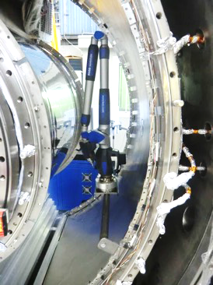
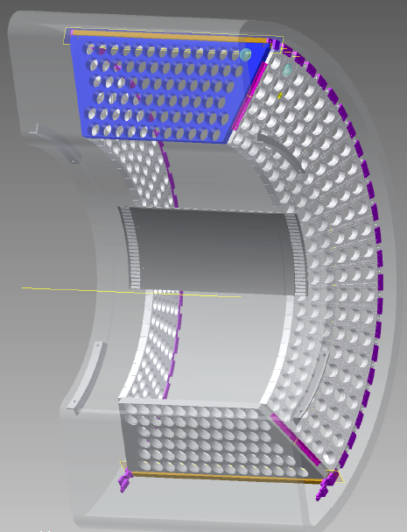
27aSN8,9,10
Survey with 3D laser scanner
Detailed measurement and mechanical test of cryostat done.
Modification of PMT holders is finalized, construction to be started soon.
Modified PMT holders
Empty cryostat
(All PMTs are disassembled)
Detector assembly starts in Nov. and will be completed by Apr. 2016
  ~half year delay
Installation & commissioning in spring–summer.
  Liquefaction, operation & signal test
MPPC
support

Slide 16
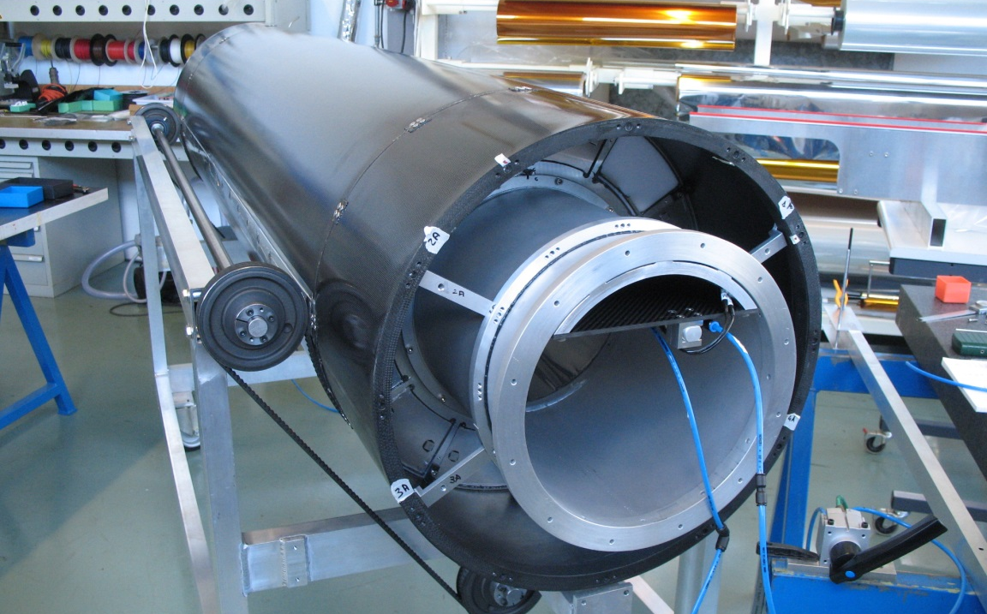
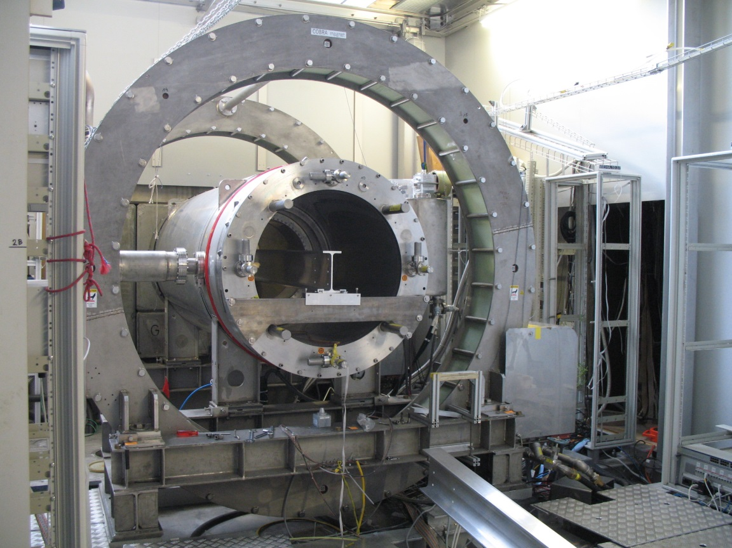
Schedule
The ‘mock-up’ chamber
2015 Beam time: started from this week until Xmas
2016 Beam time is not yet decided
Target system
installed
2015 Jul |  |  |  |  |  |  | 2016 Jan |  |  |  |  |  |  | Jul
7 | 8 | 9 |  | 10 | 11 | 12 | 1 | 2 | 3 | 4 | 5 |  | 6 | 7 | 8 | 9 | 10 | 11 | 12
Today
Superconducting
Magnet
DC mock-up
installation
Wiring
DC installation
*Beam time 2016 is not yet decided
DS TC
installation
Full TC construction
US DS TC installation
Beam tuning
Beamline
setup
Accelerator shutdown
Michel
run
Test beam, trigger
1st DAQ crate
Complete elec.
Muon data*
Purification,
calibration
LXe to Area
Liquefaction
Operation test

Slide 17
Conclusion
A very important step for MEG II realization
  All the detectors are now under construction
    With facing and solving many technical problems
    ~ half year delay
  We will carry out a ‘pre’-engineering run this autumn–winter (as scheduled)
    Test mechanical integrity
    Carry out Michel run with a Timing Counter
Toward starting data-taking in 2016
TC | 26aSN01
 | 26aSN02
 | 26aSN03
LXe | 27aSN08
 | 27aSN09
 | 27aSN10
RDC | 28aSG07
 | 28aSG08

Slide 18
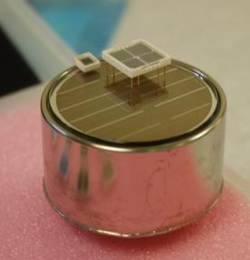
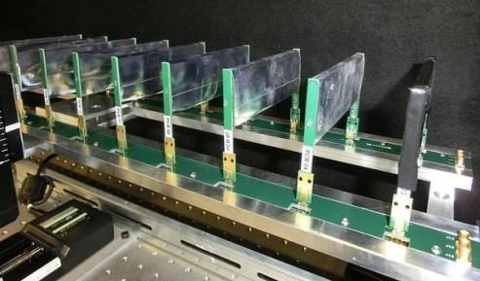
Detector technologies
Large-area VUV sensitive SiPM
  for the world’s largest LXe detector. (wavelength 175 nm)
30 ps precision time measurement
  with fast plastic scinti. & SiPMs
Low mass long stereo-wire drift chamber
  0.0017 X₀ for a particle
Compact, dense DAQ system
  To deal with increased channels
  Waveform digitizer & first trigger step in a same board
Prototypes

Slide 19
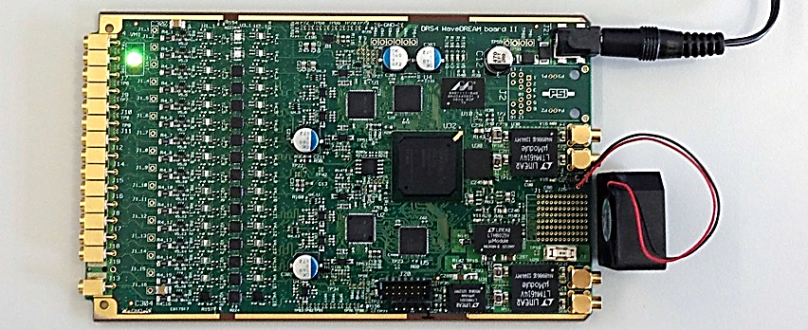
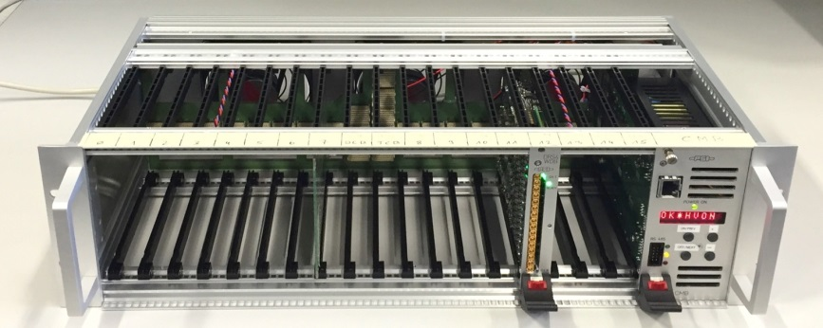
Electronics, DAQ
Innovative solution for Trigger & DAQ
  Waveform digitizer, frontend circuit, HV supply, 1st level trigger on a board
Prototype board under test
  Frontend circuit was tested with detector signal
First full crate (256 ch) available by Oct. this year
  tested in the pre-engineering run
Mass production will be started after the test
Complete system ready by spring 2016

Slide 20
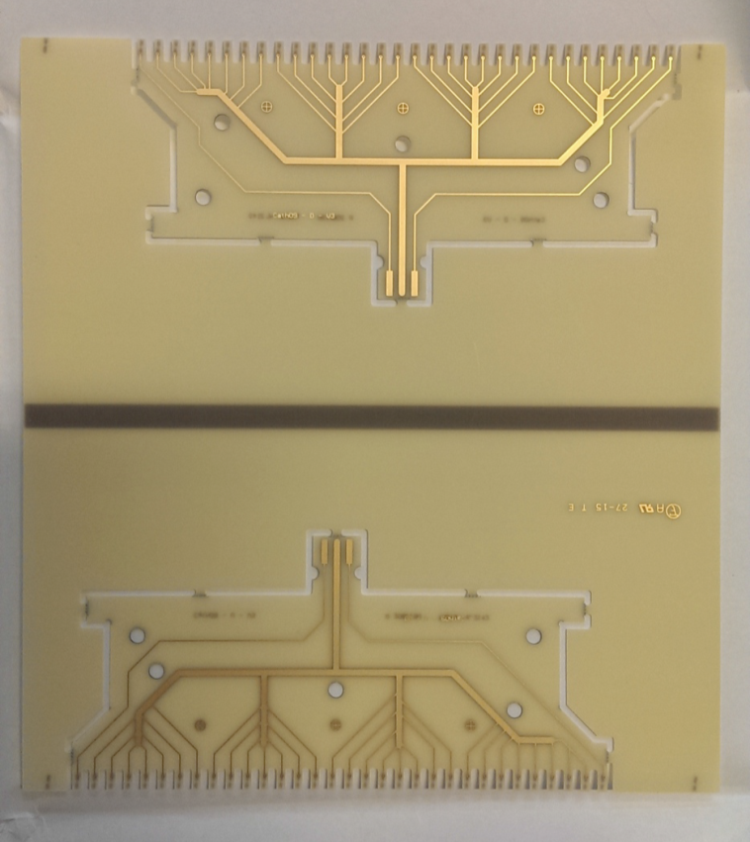
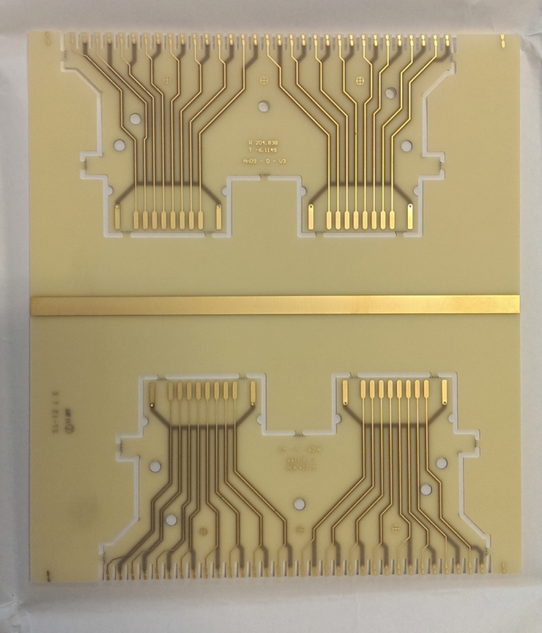
Drift Chamber Wire PCB
Final design fixed (4th version)
1st ver. in Feb
4th ver. in Sep

Slide 21
z
Magnet
End-cap
Air
DS-RDC
US-RDC
He/iB
μ⁺ beam
Helium
Insertion
system
Vacuum
Target
Drift chamber
Timing counter
Air

