Slide 1
Analysis of the First MEG Physics Data to Search for the Decay μ⁺→e⁺γ (MEG最初のデータによるμ⁺→e⁺γ崩壊の解析)
16/September/2011
日本物理学会２０１１年秋季大会
ICEPP, the University of Tokyo
内山 雄祐

Slide 2
μ⁺→e⁺γ search experiment, MEG started physics data taking in 2008.
We analyzed the first 3 months data.
The analysis and the result are presented.
Introduction
MEG experiment and apparatus
RUN2008
Analysis
Detector analysis & performance
μ⁺→e⁺γ search analysis
Discussion
Status & prospect
Conclusion

Slide 3
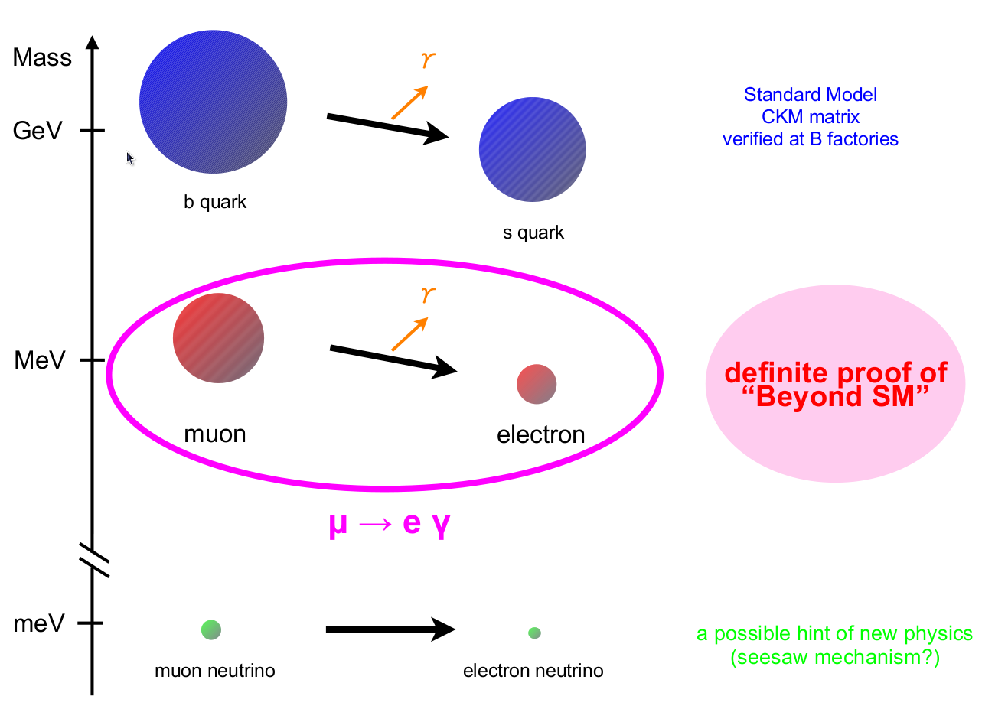
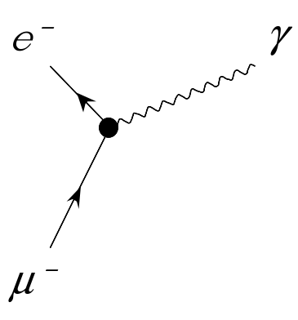
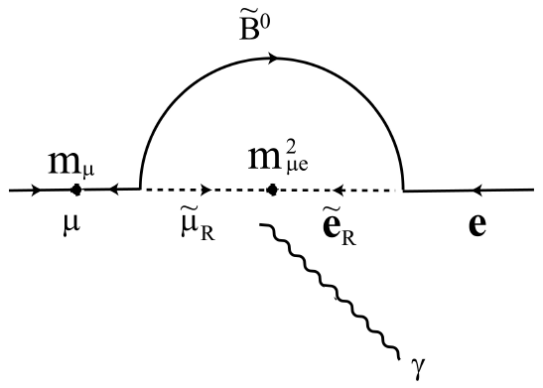
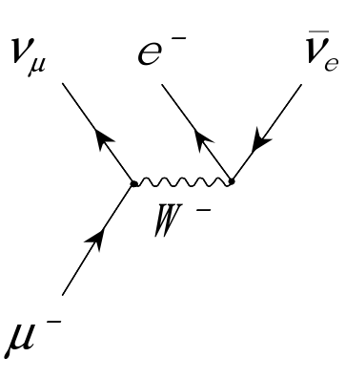
Subject of research
Lepton-flavor violating muon decay : μ→eγ
charged LFV : Forbidden in SM
Out of experimental reach with finite ν mass (BR<10⁻⁵⁴)
Clear probe to new physics beyond SM
Large BR is predicted in many new physics models
SUSY-seesaw, SUSY-GUT…
μ→eγ decay
CKM
ν oscillation
GUT
×
Normal muon decay
(Michel decay)
Lepton flavors are conserved

Slide 4
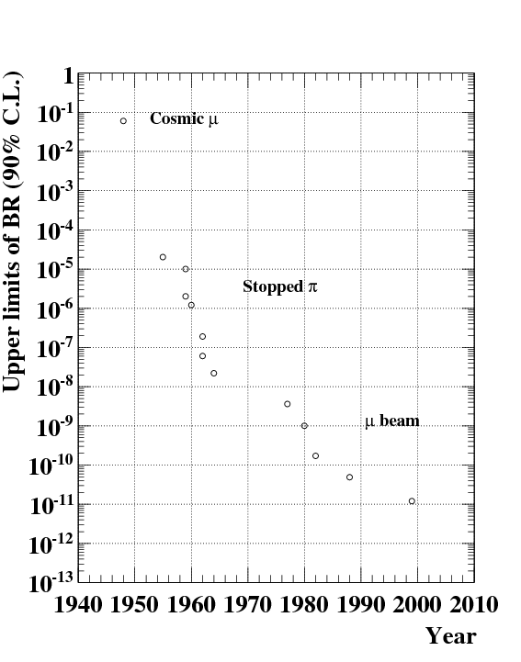
μ → eγ search
Existing experimental upper limit
B(μ→eγ)<1.2×10⁻¹¹ _{(90%CL)}
^{(1999, MEGA@LAMPF)}
A μ→eγ signal is a clear evidence for new physics
No SM background, no hadronic uncertainty.
MEG aims at searching down to O(10⁻¹³)
History of μ→eγ search
Predicted by SUSY-GUT
MEG

Slide 5
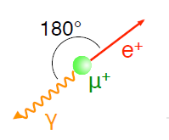
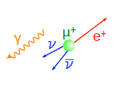
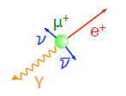
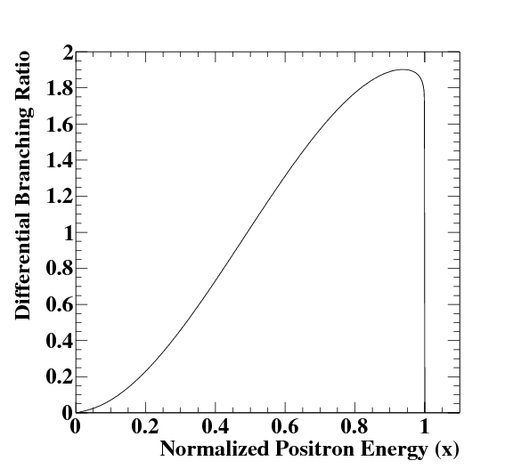
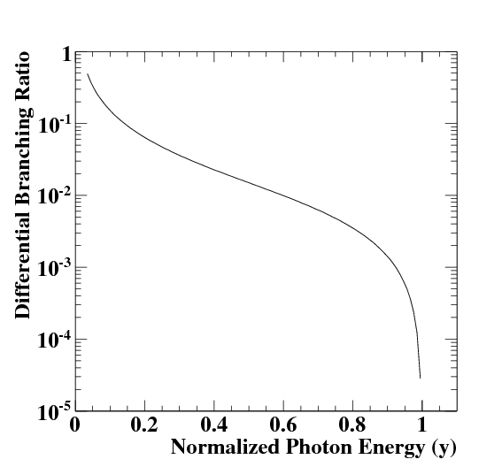
Signal & Background
Dominant
at rest
Accidental BG
<52.8MeV
Any angle
Random
Physics BG
(Radiative muon decay)
<52.8MeV
Any angle
Time coincidence
Signal
52.8MeV
Back-to-back
Time coincidence
R_{BG} ∝ R_{μ}²・f_{e}・f_{γ}・δω/4π・δt
signal
γ single spectrum
(Radiative muon decay)
e⁺ single spectrum
(Michel decay)
×
signal

Slide 6
Signal & Background
Dominant
at rest
Accidental BG
<52.8MeV
Any angle
Random
Physics BG
(Radiative muon decay)
<52.8MeV
Any angle
Time coincidence
Signal
52.8MeV
Back-to-back
Time coincidence
R_{BG} ∝ R_{μ}²・f_{e}・f_{γ}・δω/4π・δt
signal
γ single spectrum
(Radiative muon decay)
e⁺ single spectrum
(Michel decay)
×
signal
High rate e⁺ measurement
High resolution γ measurement

Slide 7
Requirements
High intensity DC μ⁺ beam
>10⁷/sec
High rate tolerable detectors
All of >10⁷/sec μ⁺ generate e⁺
Pileup of γs become a source of high energy BG
High resolution detectors
γ energy measurement is the most important
Angle and time measurements are also effective

Slide 8
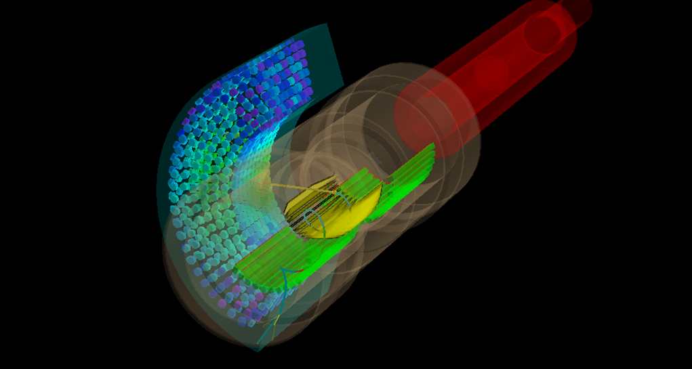
The MEG Experiment
World’s most intense DC muon beam @ PSI
High-rate tolerable e⁺ spectrometer with gradient B-field
High performance γ-ray detector with Liquid Xenon
πE5 beamline @PSI
~60 collaborators
μ＋ beam
γ
e⁺
COBRA SC magnet
Drift chambers
LXe γ-ray detector
Timing counters

Slide 9
MEG History
First result (2008 data) (Nucl.Phys.B834 1)
Sensitivity : 1.3×10⁻¹¹
90% UL : 2.8×10⁻¹¹
This talk
1999 |  | Proposal
… |  | … R&D …
2007 |  | Engineering run
2008 | Sep – Dec | 1st physics data acquisition
2009 |  | Analysis of 2008 data
 |  | Hardware upgrade
 | Nov – Dec | 2nd physics data acquisition
2010 |  | Analysis of 2009 data
 | Aug – Oct | 3rd physics data acquisition
2011 |  | Analysis of 2009&2010 data
now | July – Nov | 4th physics data acquisition
… |  | …
Preliminary result of 2009
(presented in conferences)
Sensitivity : 6.1×10⁻¹²
90% UL : 1.5×10⁻¹¹
Final result of 2009 & 2010
(arXiv:11075547, accepted PRL)
Sensitivity : 1.6×10⁻¹²
90% UL : 2.4×10⁻¹²

Slide 10
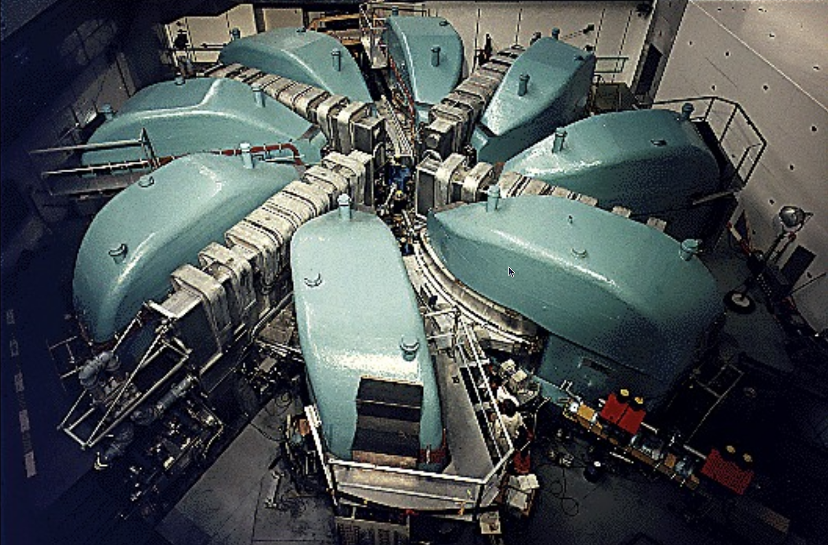
PSI 1.2MW proton ring-cyclotron
PSI
590 MeV
2.2mA
50MHz RF
Switzerland
cf.
MEGA used pulsed beam
6% duty cycle
Instant intensity 2.6x10⁸
average 1.3x10⁷
MEG
Duty cycle 100%
instant=ave 3×10⁷μ⁺/s
Provides world’s most intense DC muon beam
(surface muon)

Slide 11
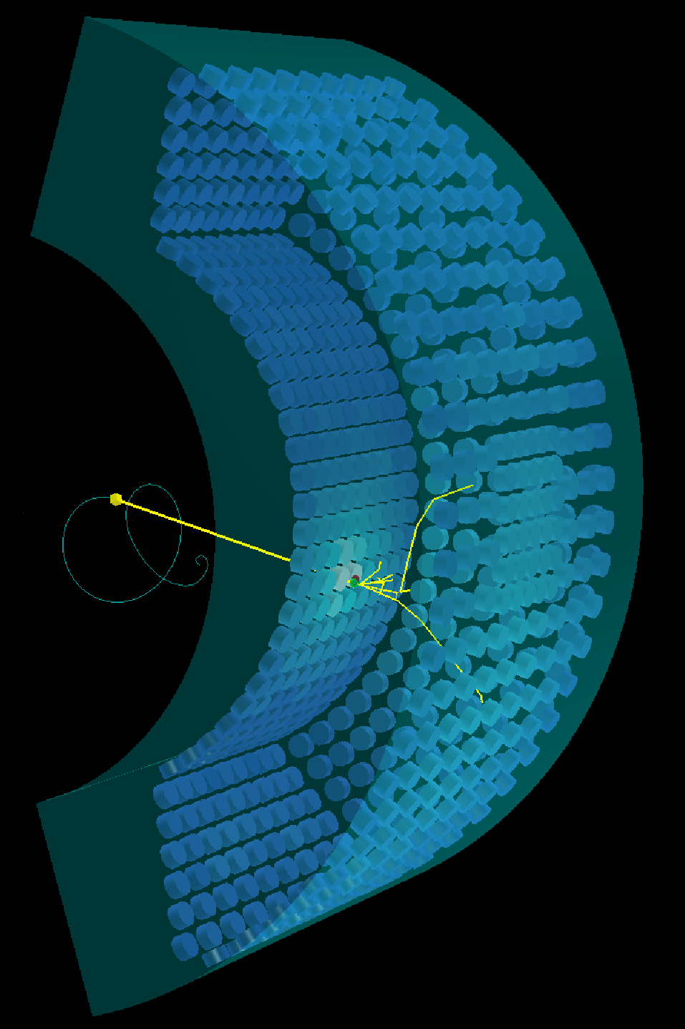
Liquid xenon γ-ray detector
Active volume ~800l
Ω/4π = 11%
846 PMTs
900 liter liquid xenon
Scintillation medium
High light yield (75% of NaI(Tl))
Fast response (τ_{decay}=45ns)
High stopping power (X₀=2.8cm)
No self-absorption
Uniform, no-aging
Challenges
Vacuum ultra-violet (178nm)
Low temperature (165K)
Need high purity
No segmentation
Measure energy, position, time at once
σ_{E}/E ~ 2% (@52.8MeV)
σ_{t} = 80 psec
σ_{x} = 5-6 mm
50cm

Slide 12
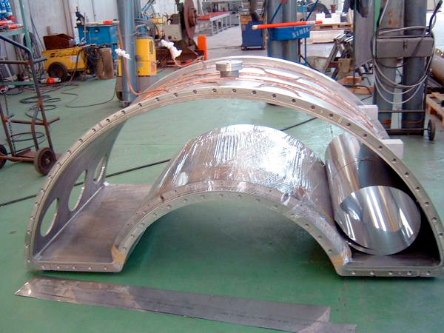
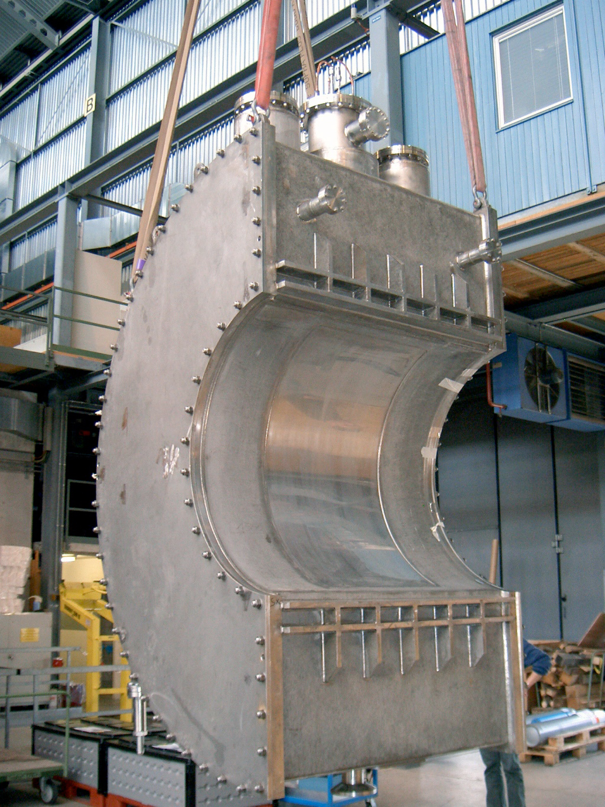
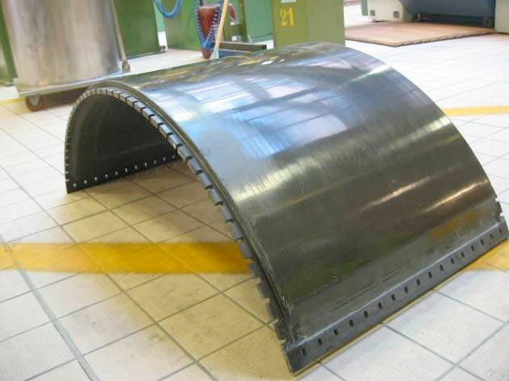
Cryostat
2 layers of vacuum-tight cryostat
Thin window for γ entrance face
Inner vessel
Entrance window with honeycomb structure

Slide 13
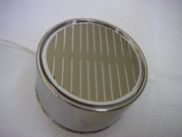
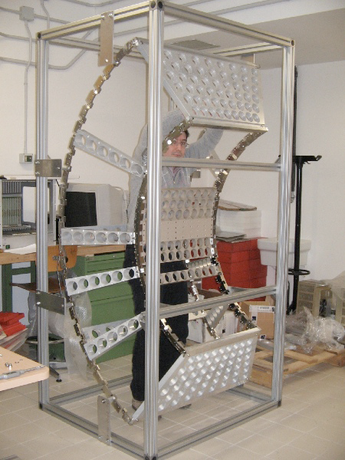
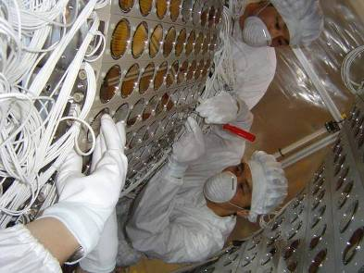
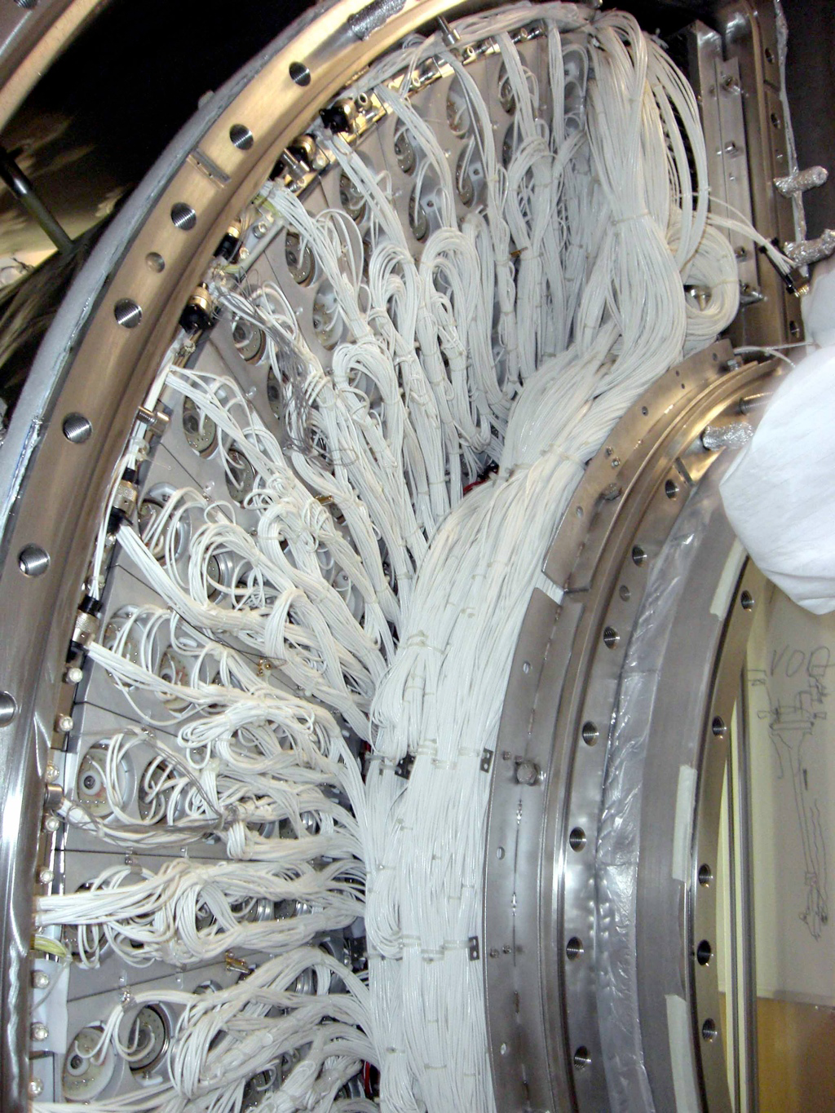
PMT installation
2”PMT developed for MEG
Quartz window for VUV
K-Cs-Sb photocathode
Al strip on photocathode
Metal-channel dynodes
Zener diode at last step of Bleeder

Slide 14
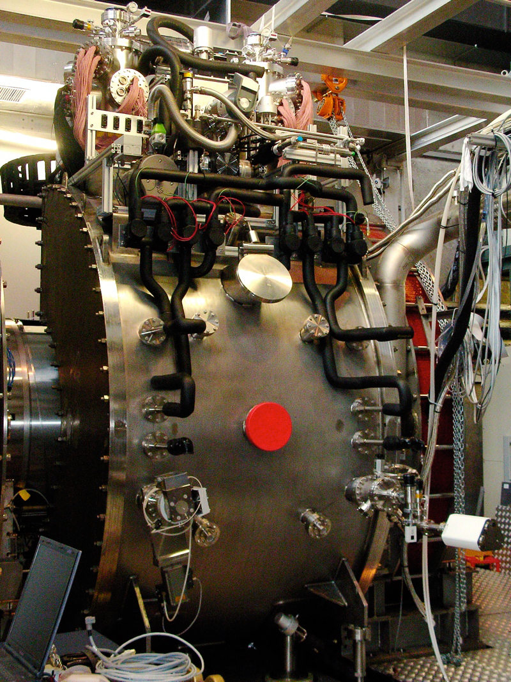
Completed in 2007
The first ton-scale LXe detector
in the world in use

Slide 15
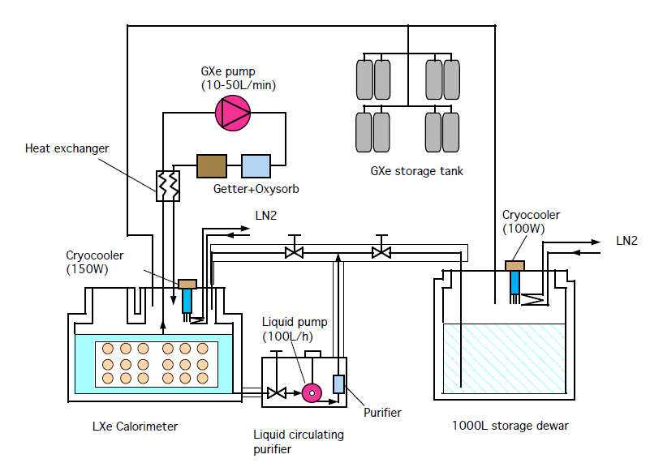
Xenon system
Gas phase purifier
High pressure
storage tank
200W pulse-tube
refrigerator
Detector
1000L liquid dewar
Liquid phase purifier

Slide 16
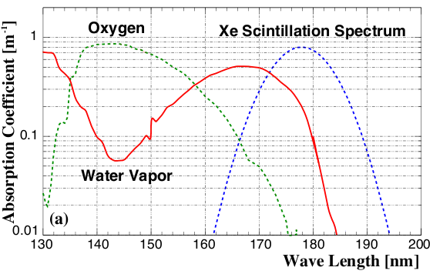
Xenon system:Purification
Gas phase purifier
High pressure
storage tank
Gas phase
purification
N₂,
O₂,
H₂O,
etc.
200W pulse-tube
refrigerator
Liquid phase
purification
O₂
H₂O
Detector
1000L liquid dewar
Liquid phase purifier

Slide 17
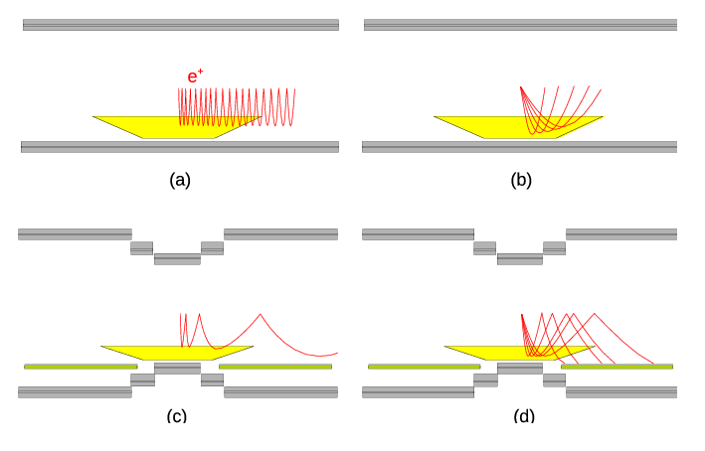
e⁺ spectrometer
Uniform B-field
μ⁺ beam
Gradient B-field
R
e⁺ quickly swept out
Constant bending radius independent
of emission angles

Slide 18
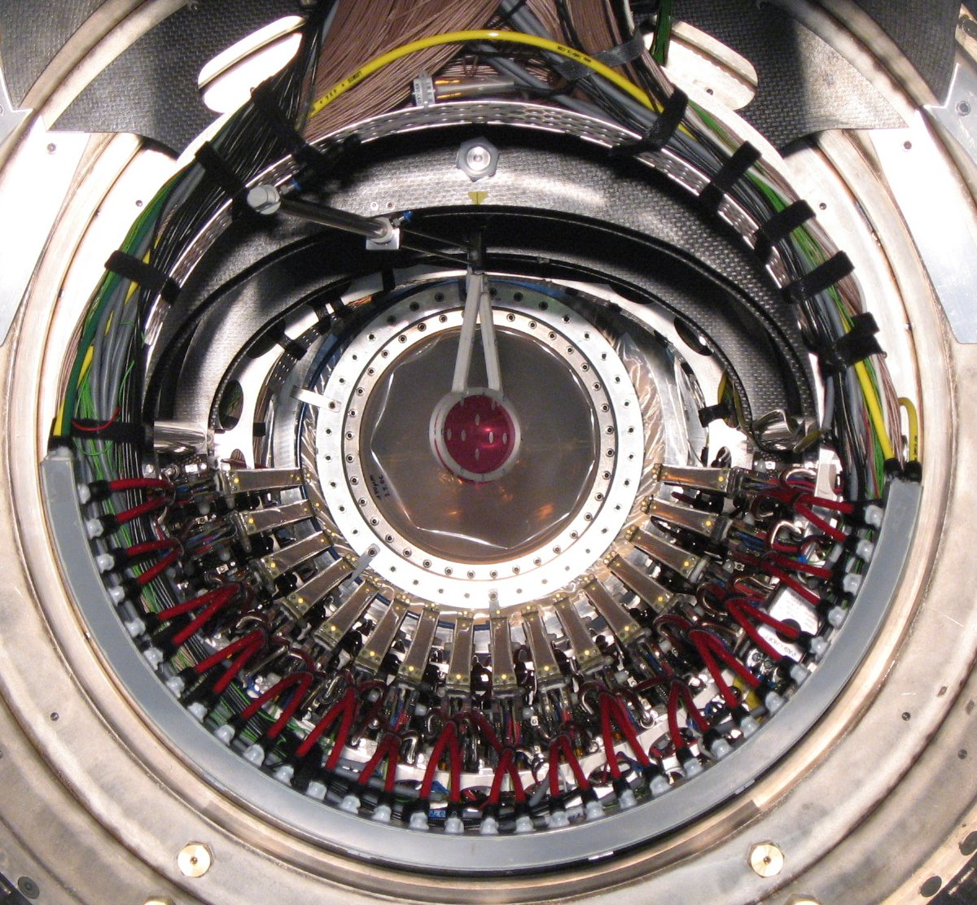
Drift chamber
16 modules
Aligned concentrically (10.5°)
2 layers per module
12.5 μm thick cathode foil with vernier pattern
He:ethane = 50:50
Ultra low mass chamber
Multiple scatter limits the performance
Suppress γ BG source
In total, along e⁺ trajectory ~2.0×10⁻³ X₀
Tracking with Kalman filter
Reconstruct e⁺ momentum vector on target
σ_{E}/E = 0.7 %
σ_{θ} ~ 18 mrad
σ_{φ} ~ 10 mrad
Stopping
Target
Helium
atmosphere
Magnet coil

Slide 19
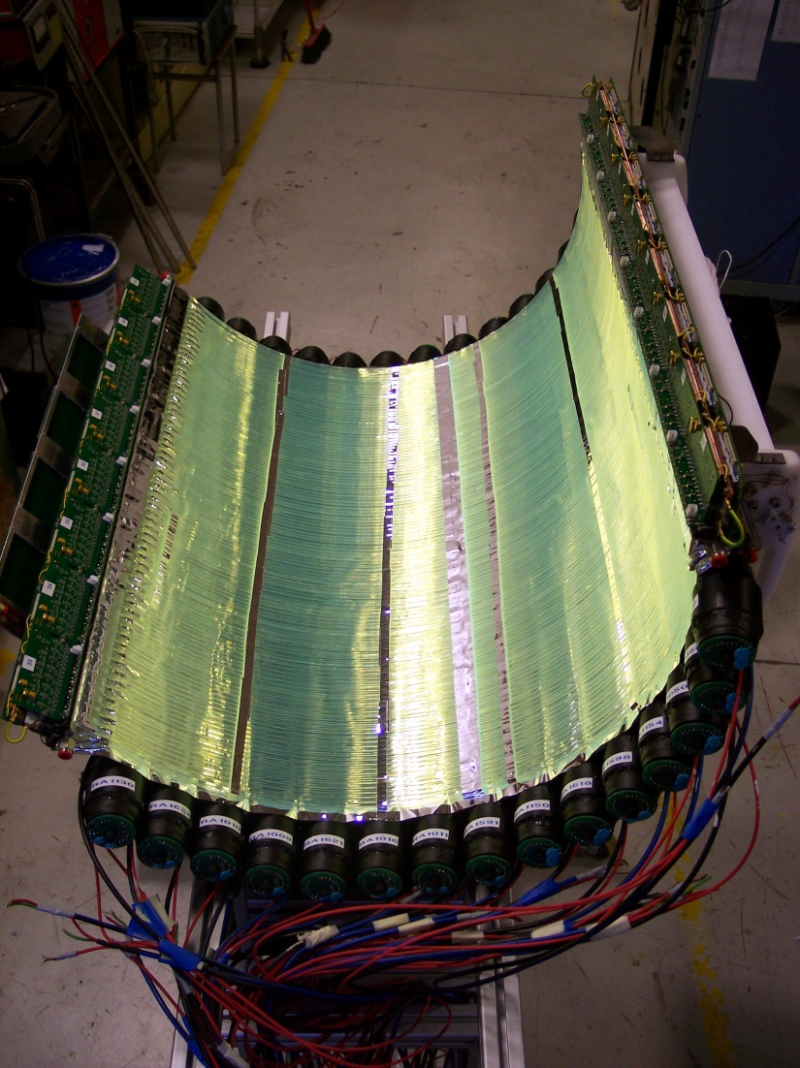
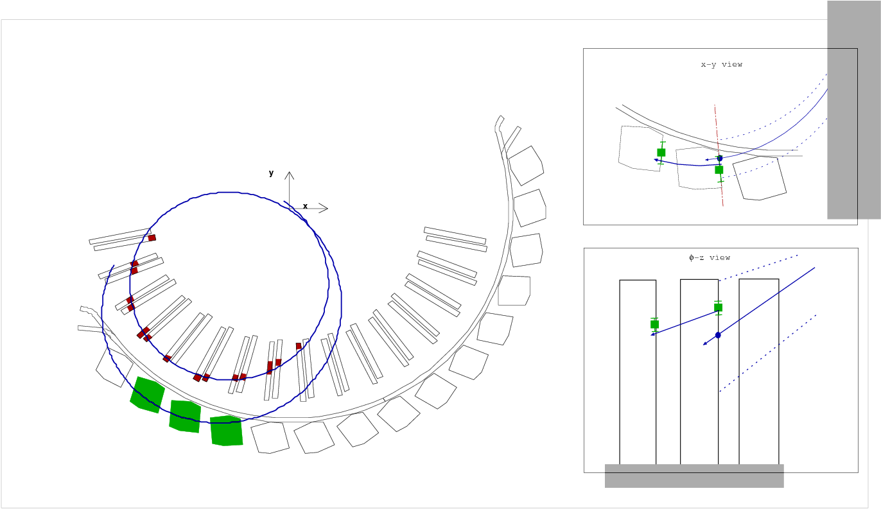
Timing counter
e⁺ time measured by a set of timing counter
Two layers of plastic scintillator
(z-measuring fiber counter is not used in 2008)
σ_{TC} ~ 65 psec
Reconstruct muon decay time
TC hit time - e⁺ flight length from DC
LXe hit time - γ flight length (line)
t_{eγ} = t_{e+} － t_{γ}
Total resolution : σ_{teγ} = 148 psec
6×6mm² fiber
+ APDs
beam-dir
4×4×80cm³ bar(BC404)
+ fine-mesh PMTs

Slide 20
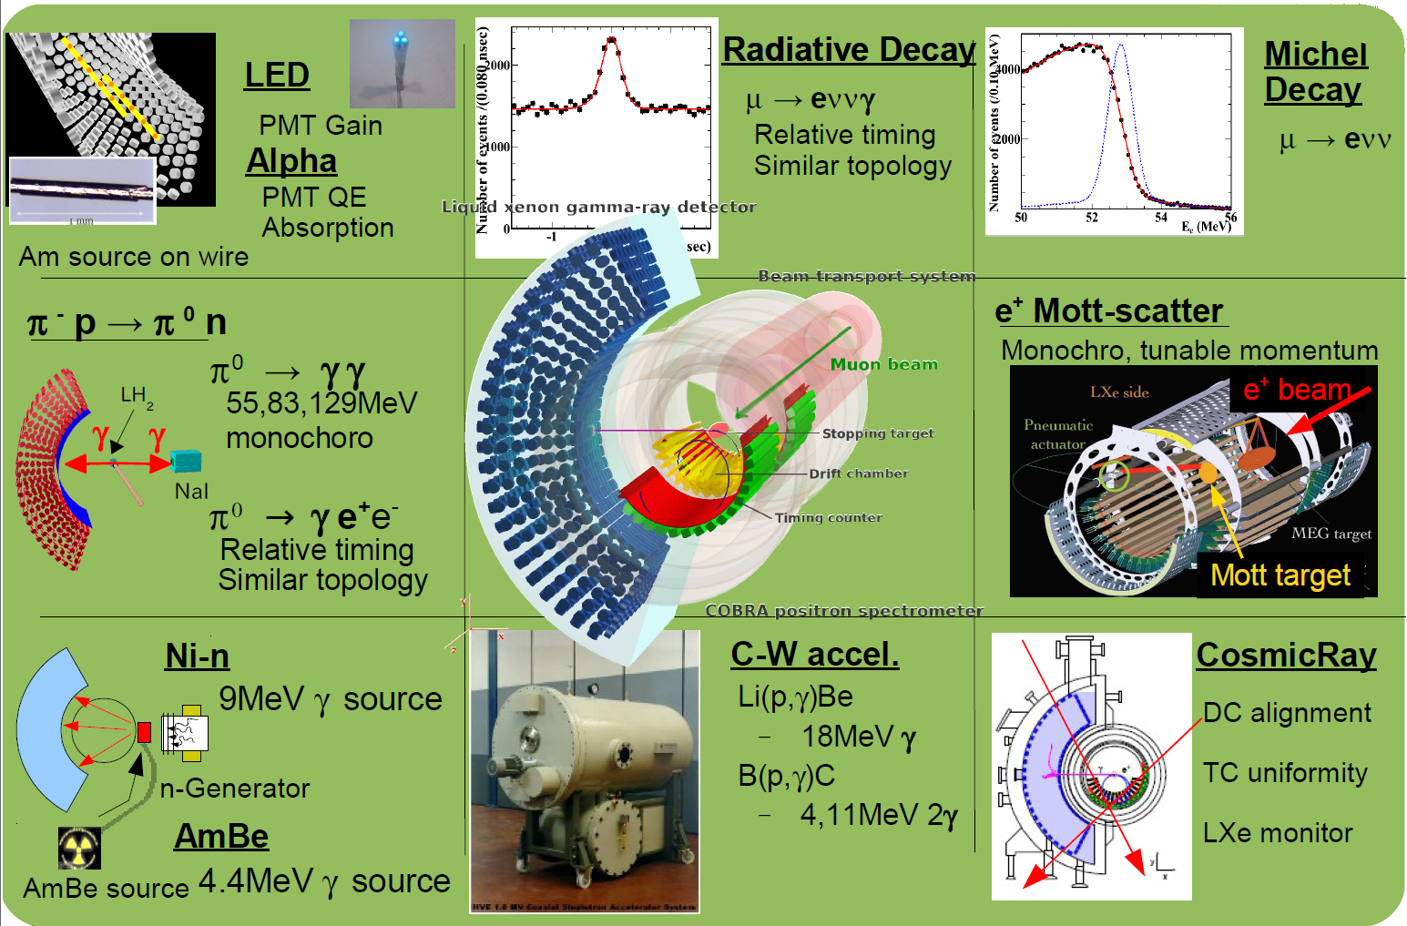
MEG Calibrations
Established

Slide 21
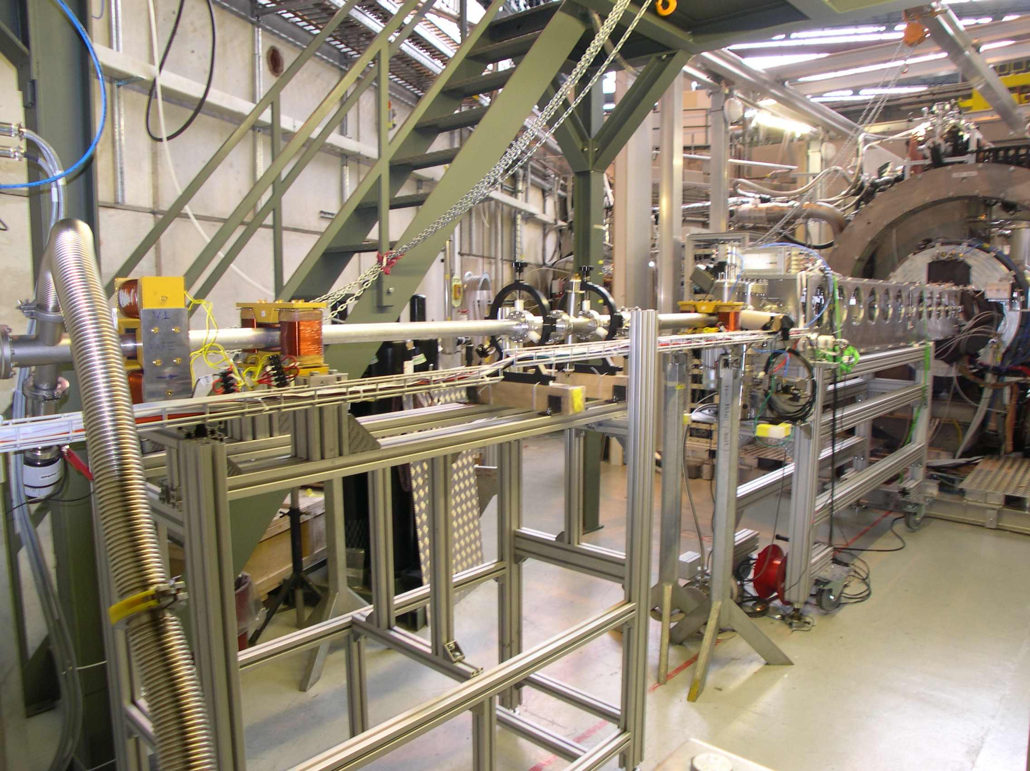
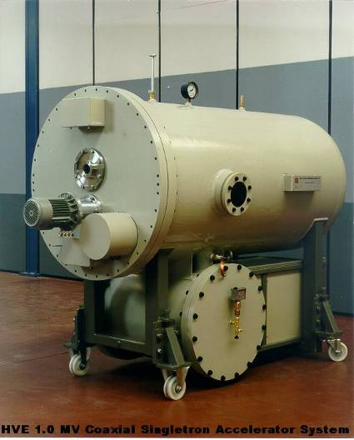
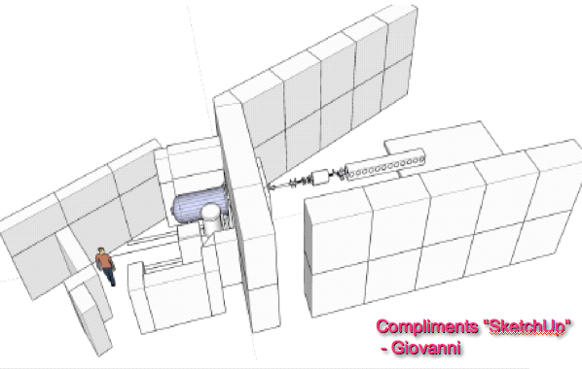
Calibration1: CW
17.6 MeV γ from Li(p,γ)Be reaction
Prepared dedicated Cockcroft-Walton accelerator
Shoot p beam from opposite side
Easy to switch (20min)
3 times per week
Non-uniformity calibration
Light yield monitor
μ⁺ beam
p beam
Cockcroft-Walton accelerator

Slide 22
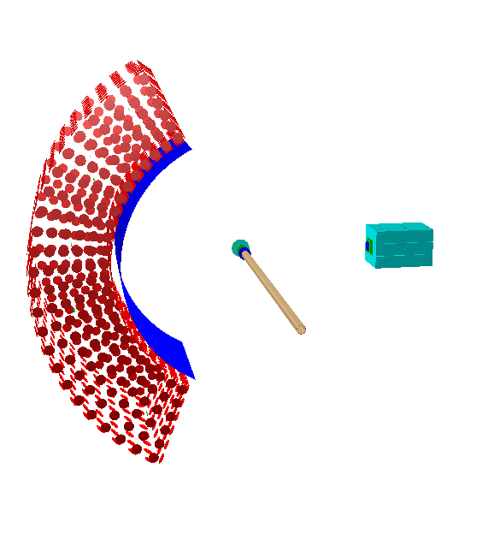
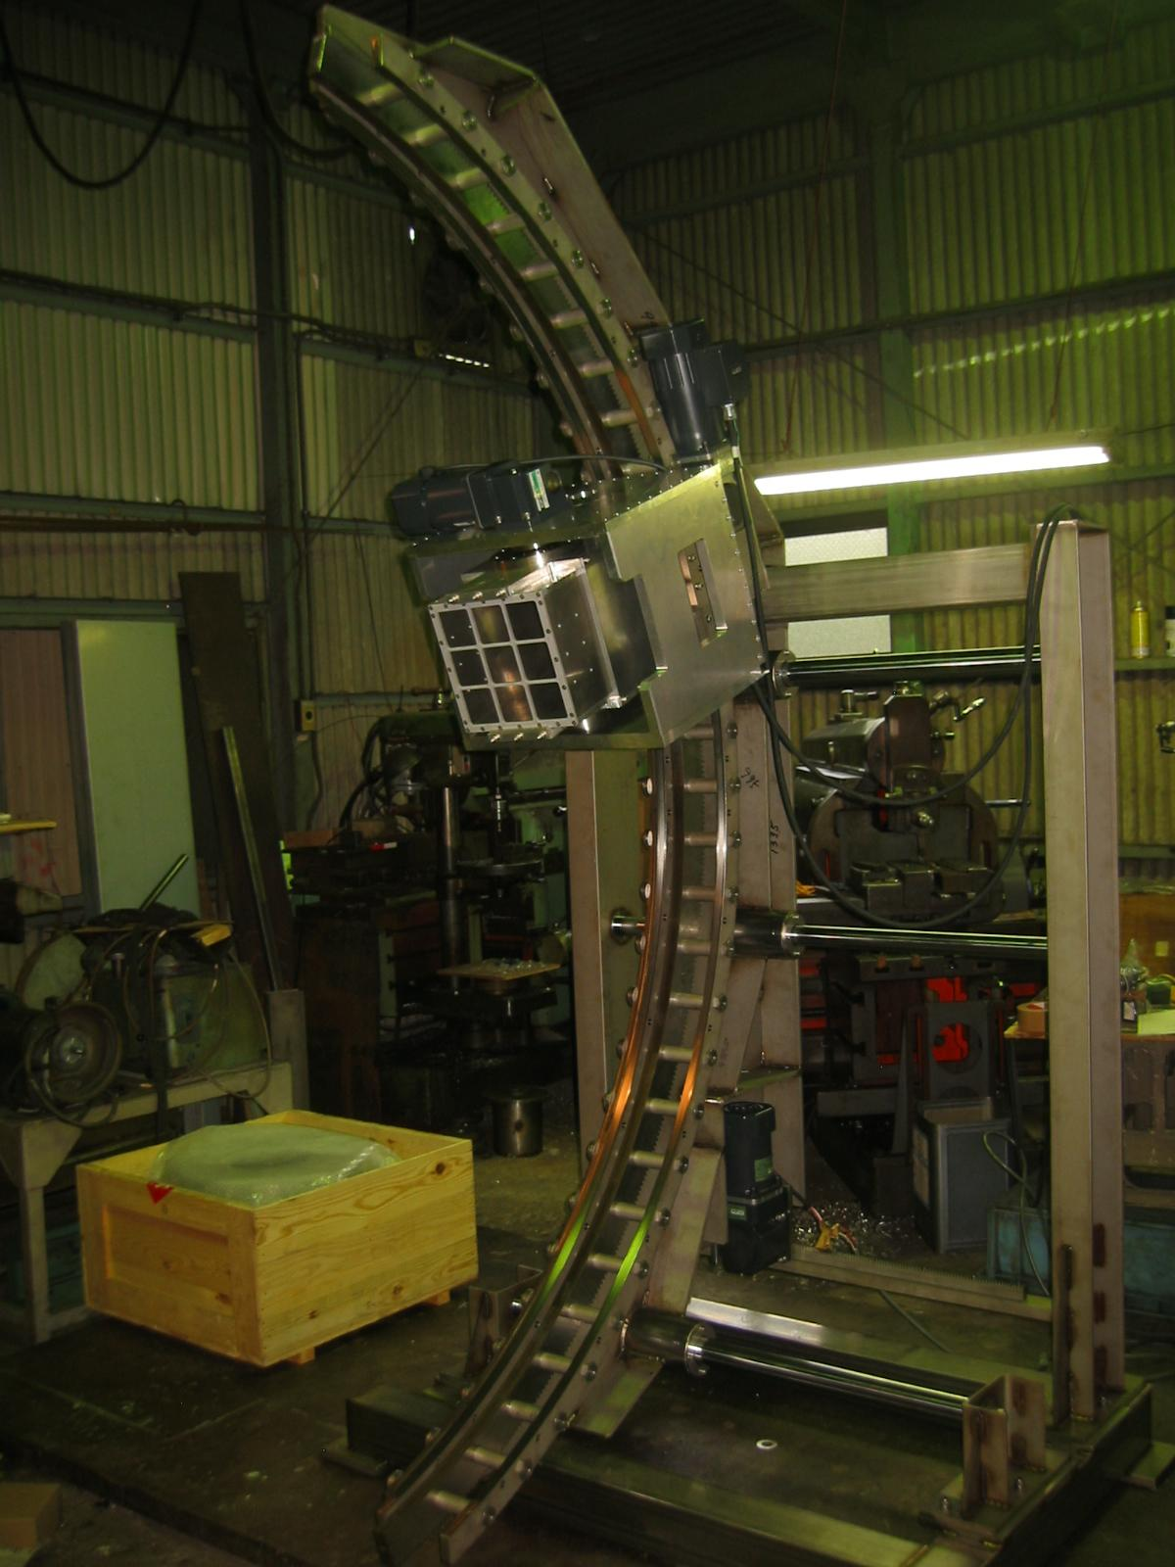
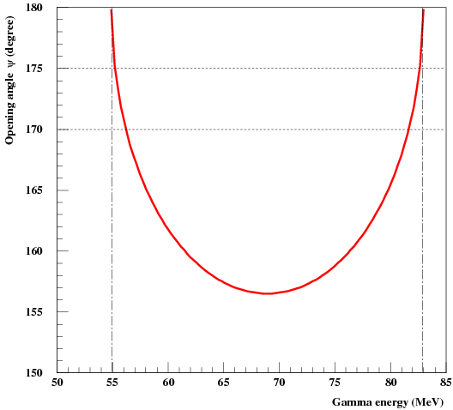
Calibration2: π⁰
LH₂
55MeV high-energy γ from π⁰ decay
Evaluate resolutions
(energy, position, time)
Calibrate energy scale
π⁻ from same beamline as μ⁺
LH₂ target
Take several days for setup
Conducted at beg. & end of physics run
Tag back-to-back γs with NaI detector
γ
γ
NaI
Tag back-to-back
π⁻ p → π⁰ n → γ γ n
180
170
opening angle (deg)
55MeV
83MeV
NaI detector mover
gamma energy (MeV)

Slide 23
RUN 2008

Slide 24
2008
2008
Apr.
May
June
July
Aug.
Sep.
Oct.
Nov.
Dec.
Maintenance
installation
π⁰ run
π⁰ run
Conditioning
&
Michel run
Trigger setup
BG study
Physics run

Slide 25
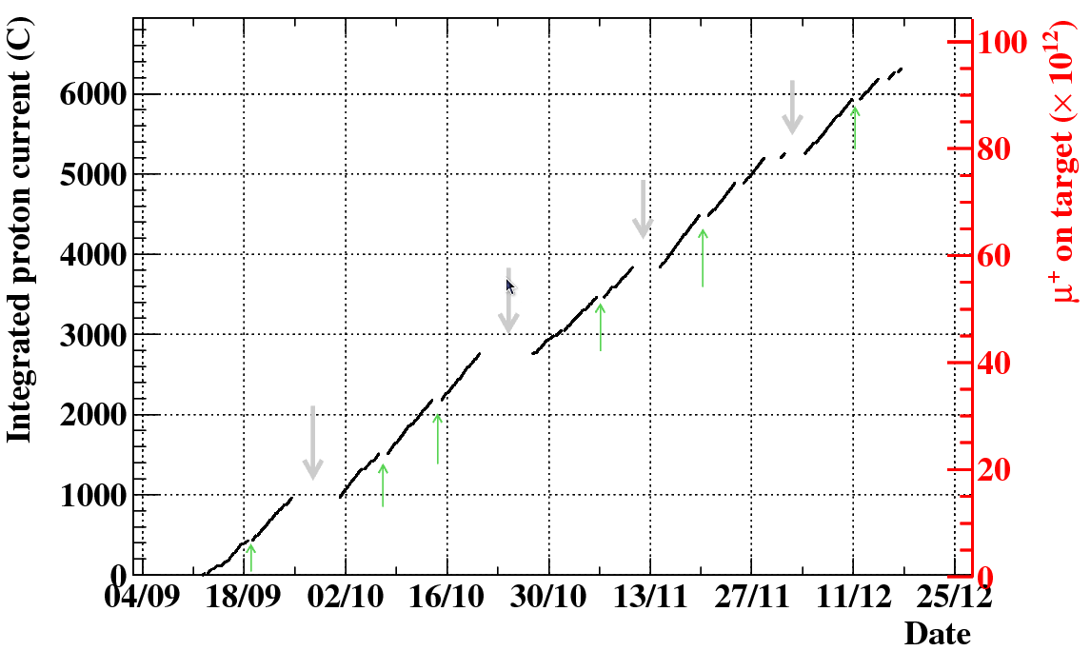
2008 Data
The first 3 months data of MEG
Normal physics data-taking
MEG run w/ 11 mixed trigger
Daily LED calibration w/ beam
3/week Full calibration sets
24h/week RD (low-intensity) run
Stopping rate | 3.0×10⁷μ⁺/sec
Trigger rate | 6.5 Hz, 9 MB/sec
Live time | 3.3×10⁶ sec (85%)
Total μ⁺ on target | 9.5×10¹³
Programmed
Accelerator shutdown
RD run

Slide 26
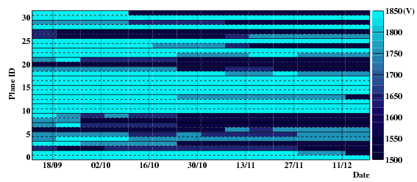
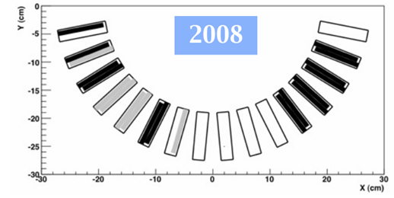
DCH discharge problem
DCH frequently discharged
After a few months,
Gradually some chambers started to discharge
Inside magnet is filled with pure-Helium
DCH-outside is exposed in He atmosphere (HV line)
Finally, out of 32 planes,
18 planes were operational
Only 12 planes worked at nominal voltage
Degradation of e⁺
measurement
(efficiency / resolution)
Helium permeated into HV line slowly...

Slide 27
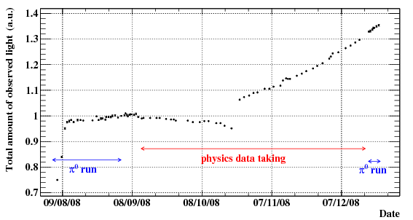
Variation of LXe light yield
Lower than expected
Recover by purification
Decrease by (possible) leak
Confirmed light yield monitoring
using several kinds of daily calibration
We decided to continue purification in parallel with DAQ
(gas phase: continuously, liquid phase: intermittently(beam shutdown))
Monitor Li(p,γ)Be
17.6MeV line
purification
Energy scale measurement
Finally, keep overall
energy scale
uncertainty under
0.4%

Slide 28
Analysis

Slide 29
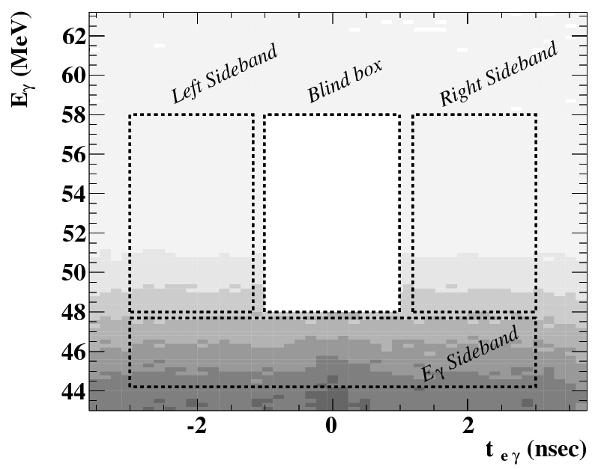
Analysis
Blind analysis
Hidden parameters: (E_{γ}, t_{eγ})
Any study (calibration, BG estimation, performance evaluation) can be done with events outside the box
Sideband
Accidental BG can be studied with off-time sideband
Radiative muon decay(RMD) can be studied with low-energy E_{γ} sideband
Normalization
Count unbiased Michel sample mixed in physics data
Wide analysis region for likelihood fitting
Estimate Sig & BG simultaneously.
PDFs mostly from data
μ→eγ
should be here
Random coincidence
RMD peak

Slide 30
Likelihood fit
μ→eγ signal
Accidental BG
Radiative muon decay
Extended unbinned maximum likelihood fit on number of events
3 fit parameters : (N_{sig}, N_{RMD}, N_{BG}), N=N_{sig}+N_{RMD}+N_{BG}
5 observables : x = (E_{γ}, E_{e}, t_{eγ}, θ_{eγ}, φ_{eγ})
Probability density functions (PDFs) for each event type (S, R, B)
Extract PDF from data
Fit in wide region (10σ) to extract signal & background simultaneously
relative angle (inverse e⁺ direction－γ direction )

Slide 31
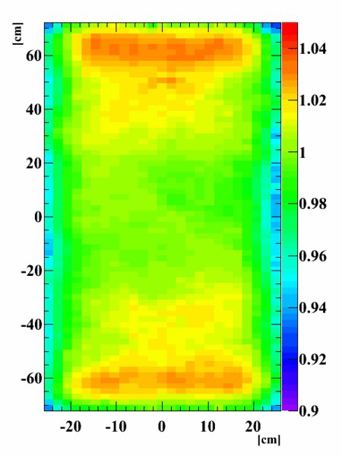
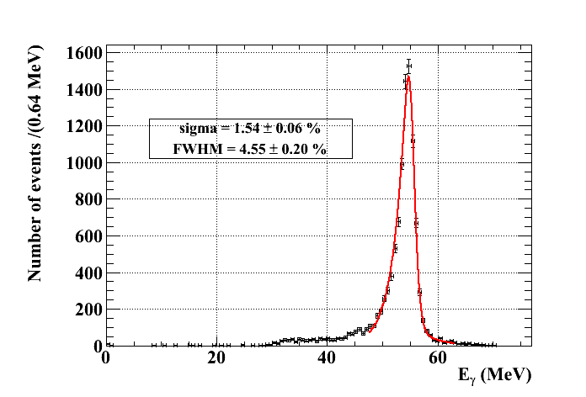
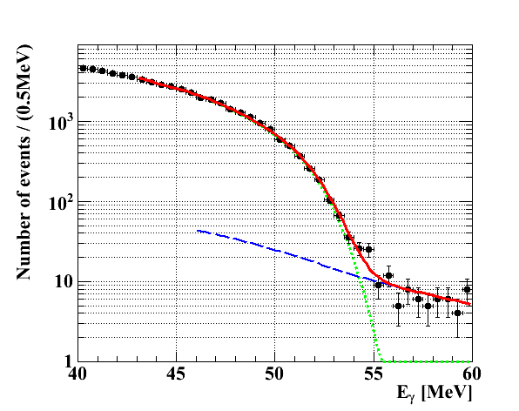
Gamma energy
Entrance face
Calibrate position-dependent response using CW-Li 17MeV γ
Measure response using π⁰-55MeV γ
extract position dependently
Cross check with BG shape fit
Response to
CW-Li line
π⁰ 55MeV
BG fit

Slide 32
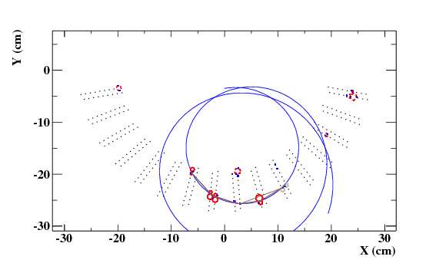
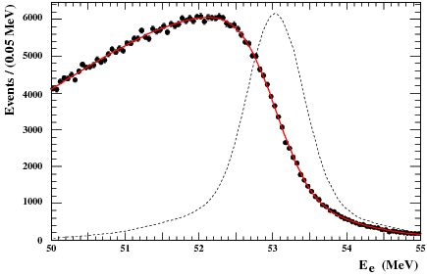
e⁺ momentum
tracking by Kalman filter
Evaluate momentum response by fitting kinematical edge (52.8MeV) of Michel spectrum
Data
Fit

Slide 33
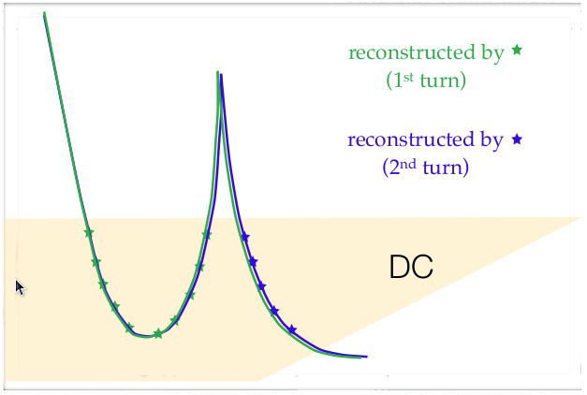
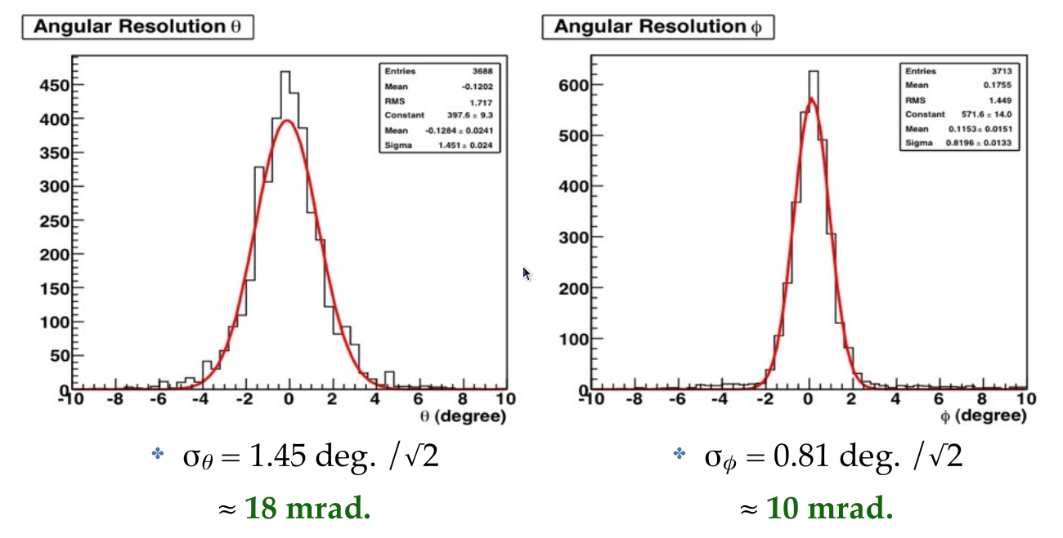
e⁺ emission angle
?
Evaluate angular resolution using 2-turn events
See difference of reconstructed angles by individual turns
σ_{θ} = 18 mrad
σ_{φ} = 10 mrad

Slide 34
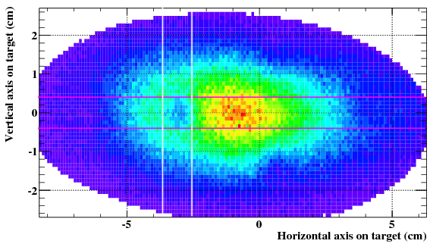
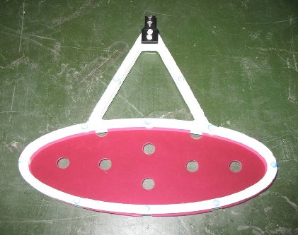
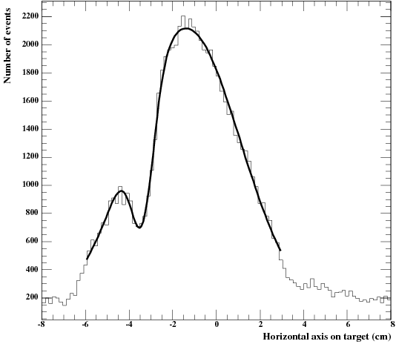
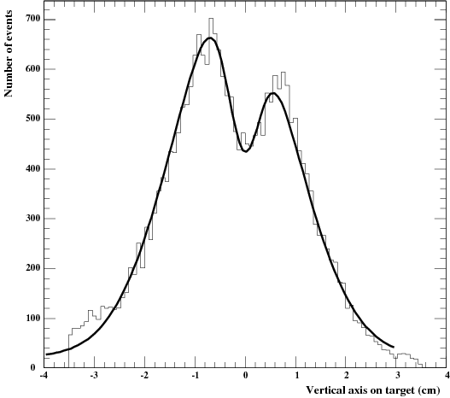
Muon decay vertex
μ stopping target
Reconstruct μ-decay vertex as a point crossing e⁺ track and target plane
Evaluate resolution with
Using holes on target
Using 2-turn events
σ_{x} = 4.5 mm
σ_{y} = 3.2 mm

Slide 35
Gamma position
Evaluate resolution with π⁰ run with Pb bricks
Shadow of brick gives resolution and bias
Results
σxy = 4.5~5mm, bias(RMS)=0.7mm
Compared with MC
1.8mm worse (in quadrature) than MC (← QE error)
Detailed study with MC
Take in the difference
Resolution dependence on relative position to PMT
project
Data
MC
σ_{xy} ~ 5 mm
σ_{r} ~ 6 mm

Slide 36
Opening angle
Not able to measure gamma direction
Direction of the line b/w μ-vertex and γ interaction point
Combined resolution: σ_{θeγ} = 20.6mrad, σ_{φeγ} = 13.9mrad

Slide 37
Time resolution
Reconstruct muon decay time
TC hit time - e⁺ flight length from DC
LXe hit time - γ flight length (line)
t_{eγ} = t_{e+} － t_{γ}
peak of radiative muon decay
Observe RMD peak in normal intensity data
Total resolution
small correction for E_{γ}
σ_{teγ} = 148±27 ps
Accidental
background
Physics data
low-Eγ region
RMD peak is a powerful time calibration tool,
measure all detector contribution at once,
in situ monitoring

Slide 38
Background I
Background rate
Measure with self-trigger data
Compare with MC
Reproduce well the rate and shape
MC
3.7×10⁷ μ⁺decay/sec
Convolve response
Uncertainty ~7%
Not a fit

Slide 39
Background II
Background level
Difficult to get feeling of BG with likelihood analysis
→ Define signal box by resolution (1.64σ)
Accidental BG
Estimate using sideband
Wider time & angle window
0.95±0.15 events
RMD events
0.02±0.004 events
* wider window for angle

Slide 40
Background III
Obtain BG PDF from time-sideband data
Positron
Gamma
Smooth function of fitted MC spectrum⊗response as PDF
Reduce systematic error from low statistics at high energy
Position dependent (γ)

Slide 41
Number of muons
Normalize signal events by # of muon decays counted in control samples
Normalization channel 1: Count Michel e⁺
Unbiased Michel trigger data mixed in physics run
Insensitive to beam-rate or detector-condition variations
Cross check with other methods
channel 2: Count RMD events
In E_{γ}-sideband
channel 3: Accidental BG rate
In time-sideband
Those three methods are complementary
Most of the systematics are independent.
Consistency check → good agreement
Normalization factor
B(μ⁺→e⁺γ) = N_{sig} / (5.2 ± 0.5)×10¹¹

Slide 42
Gamma efficiency
Detection efficiency
π⁰2γ: NaI single trigger
MC
μ data single spectrum
In analysis region
(46<E_{γ}<60 MeV)
ε_{det} = 66%
Analysis efficiency
Inefficiency by cuts
(pileup cut, CR cut)
5.5%
γ
γ
?
NaI
Consistent
within 5%
Tag
π⁰→2γ
Interact with material
before active volume
MC
ε_{γ} = (63±4) %

Slide 43
Sensitivity
Expected upper limit (90%CL) on ensemble of toy-experiments
Null signal assumption
Toy-experiment: generate events with obtained PDFs
Repeat toy-experiments and calculate UL in the same way as real data
800 experiments
<N_{sig} UL>=6.5
Sensitivity of RUN2008 : 1.3×10⁻¹¹
c.f. Existing best upper limit: 1.2×10⁻¹¹

Slide 44
Sideband analysis
Analyzed real data but off-timing
No signal in sidebands
Our dominant BG is accidental one
→ Good test of our sensitivity
μ→eγ
should be here
Results of likelihood analysis
B(μ→eγ)< 0.9×10⁻¹¹, 2.0×10⁻¹¹
consistent with the sensitivity
Fit to here

Slide 45
Result
Opened the blind box …

Slide 46
Fit to data (projected distributions)
E_{e}
E_{γ}
Total
Accidental
Radiative
Signal
θ_{eγ}
φ_{eγ}
t_{eγ}

Slide 47
Fit to data (likelihood function)
E_{e}
E_{γ}
1,1.645,2 σ contours
N_{sig} , N_{RMD} , N_{BG}
θ_{eγ}
φ_{eγ}
t_{eγ}
N_{sig} , N_{RMD} , N_{BG}

Slide 48
Upper limit on Nsig
Set confidence region with Frequentist approach
Feldman-Cousins method in (N_{sig},N_{RMD}) 2D plane
Scan on N_{RD} best-fit value
$$≈$$
N_{sig}
90% confidence interval contains N_{sig} = 0
The upper limit is given as N_{sig} < 14.5

Slide 49
Systematic uncertainties
Estimate the impact of systematics by performing fit with alternative parameters
See the variation of the best-fit N_{sig} value
UL : 14.5 → 14.7
ex) E_{γ} scale
Precision of 55MeV peak :0.08%
Trace of light yield :0.3%
Uncert of gain shift corr. : 0.2%
Total : 0.4%
Gamma: 6%
Positron: 7%

Slide 50
Discussion
Why the obtained UL is much larger than the sensitivity?

Slide 51
Candidate events
Rank events by event-type likelihood ratio S/B
Found the most signal-like event is double-pileup event
Pileup elimination only worked on the 1st pileup γ
If we eliminate the 2nd one as well, then E_{γ} was 47.7 MeV
Most likely, this event is an accidental BG
Signal
Data
BG
S/B

Slide 52
Impact of the candidate event
Investigate impact of the event
Set lower threshold for pileup search
to eliminate the 2nd pileup
Repeat the analysis
N_{sig} UL becomes 11.4 (←14.5)
Probability of N_{sig} UL > 11.4 is 5%

Slide 53
Cut analysis
box A
For cross-check and better understanding BG, performed cut analysis
Two signal boxes
A : 1.64σ box
B ; Optimized box
box B
BG are well consistent with the expectations

Slide 54
Discussion
The large UL is considered to be statistical fluctuation
A very rare event is observed accidentally
If we set different pileup threshold, then the result is well consistent with
Null result
Sensitivity
Cut analysis
Nevertheless, the obtained UL is statistically valid without any bias

Slide 55
MEG RUN2008 result
MEGA UL : 1.2×10⁻¹¹
MEG2008 sensitivity : 1.3×10⁻¹¹

Slide 56
Status & prospect
MEG 90% limit
MEG sensitivity(expected)
2008
Before 2009 run,
solved DCH discharge problem
reached full LXe light yield → stable
improved trigger efficiency (66→91%)
Many improvement in analysis
For the latest result, see talks in this meeting
17pSE2-3: LXe detector
17pSH1: e⁺ spectrometer
19aSD1: Detector performance
19aSD2: Physics analysis & result
MEG is running
Run at least until the end of 2012
to reach our goal of sensitivity a few ×10⁻¹³
MEGA limit
2009
2009+2010
B < 2.4×10⁻¹²

Slide 57
Conclusion
We started MEG data taking in Sep. 2008.
Searched for lepton-flavor violating decay μ⁺→e⁺γ with sensitivity 1.3×10⁻¹¹
Observed some excess, but still consistent with null signal
Set an upper limit:
The first result of MEG experiment
Could not give a record limit, but set an independent limit with a comparable sensitivity search
MEG is putting more & more stringent limit on new physics, with possibility of the discovery.
B(μ⁺→e⁺γ) < 2.8×10⁻¹¹ @ 90% C.L.

Slide 58
Thank you

Slide 59
Calibration1: PMT
LED, α source inside LXe volume
frequent & precise calibration
daily
Typical PMT gain evolution
1.8e6
1.5e6
1 month

Slide 60
LXe PMT rate dependent gain shift
LED peak
After correction
1.6%
10min
LED peak
1%
2 months
Observed shift of PMT gain
Time scale of some dozens of minutes
Rate dependent
However, the amount of the shift is stable over long period
Measure LED during beam on, correct with beam info
Correct with precision of 0.1 %
However, shift in π⁰ run was unknown
→ Uncertainty of energy scale
December π⁰ run

Slide 61
Time measurement
Monitor & correct t₀ with RMD peak in low intensity run
24 h/week, ×25 lower μ⁺ intensity
Much better S/N
Observe drift of t₀
due to change of LXe pulse shape
as improvement of purity
purification
Sep
Dec
Stability after the correction < 20 psec

Slide 63
MEG Detector
φ
θ
y
x
z
x

Slide 77
Summary of performance
e⁺ tracking slightly worse in 2010 due to noise problem
improvement by waveform digitizer upgrade in 2010

Slide 78
(p,γ) reaction

