Slide 1
MEG II実験陽電子タイミングカウンターの
コミッショニング2017 運用と試験
Commissioning of Positron Timing Counter
for MEG II Experiment in 2017 –Operation and test-
宇佐見正志、他MEG IIコラボレーション
日本物理学会第73回年次会、東京理科大学（野田キャンパス）
2018年3月25日

Slide 2

Outline
Introduction
  $μ→e γ$ search
  MEG II Experiment 2017 detectors
  Timing counter
  2017 Commissioning
Operation
Summary

Slide 3
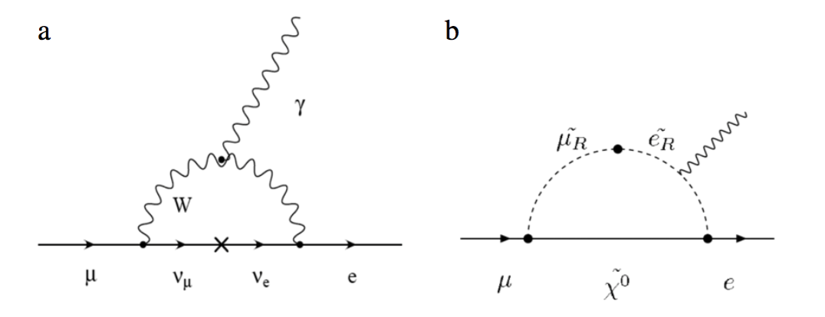
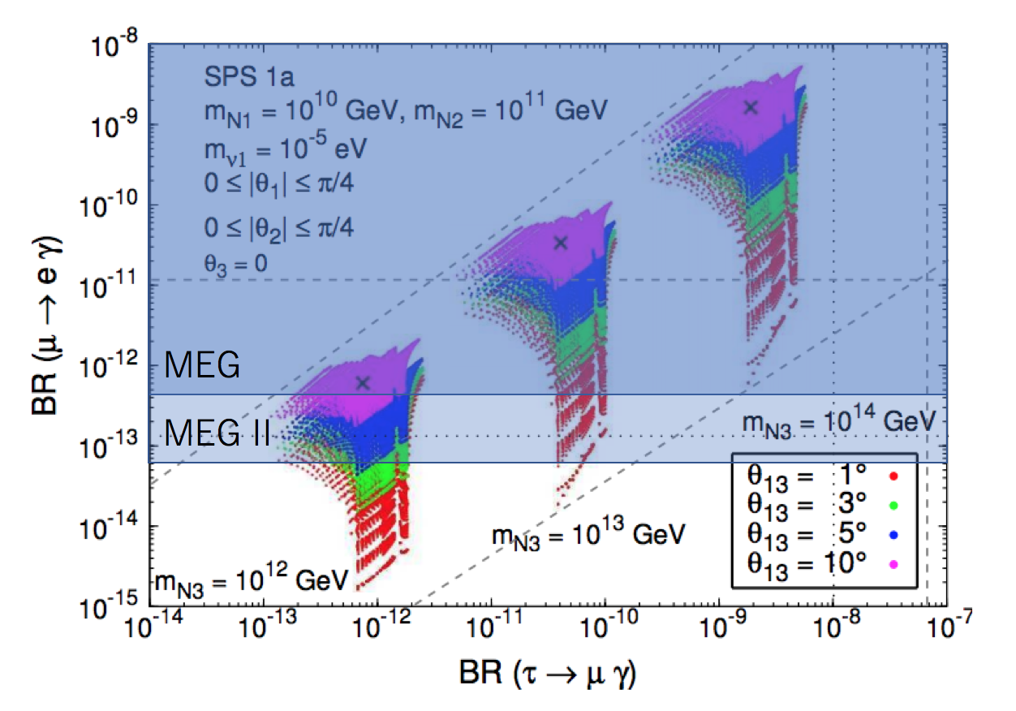
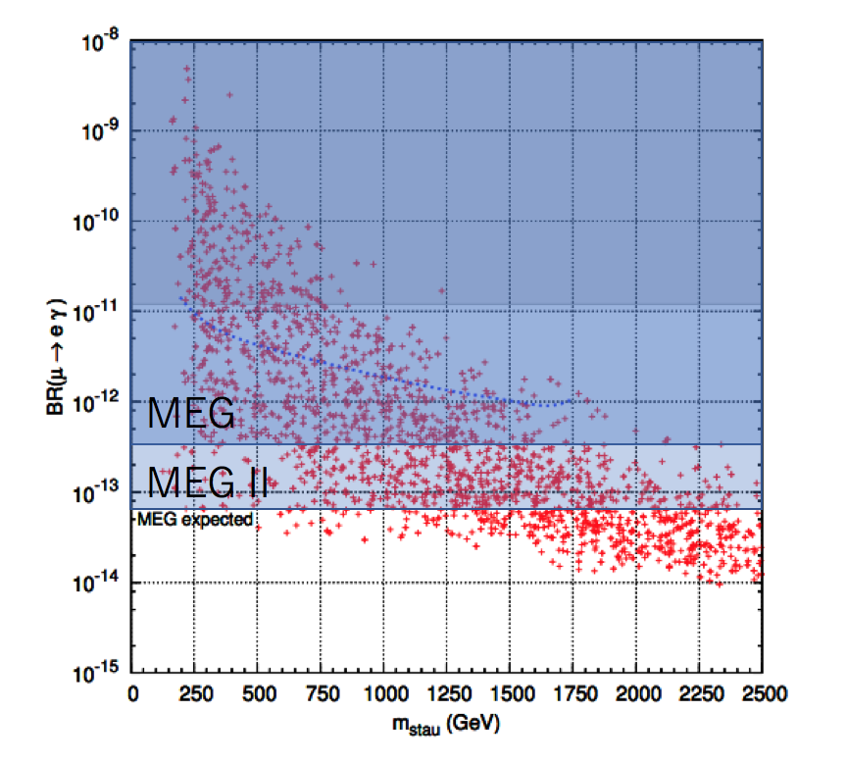
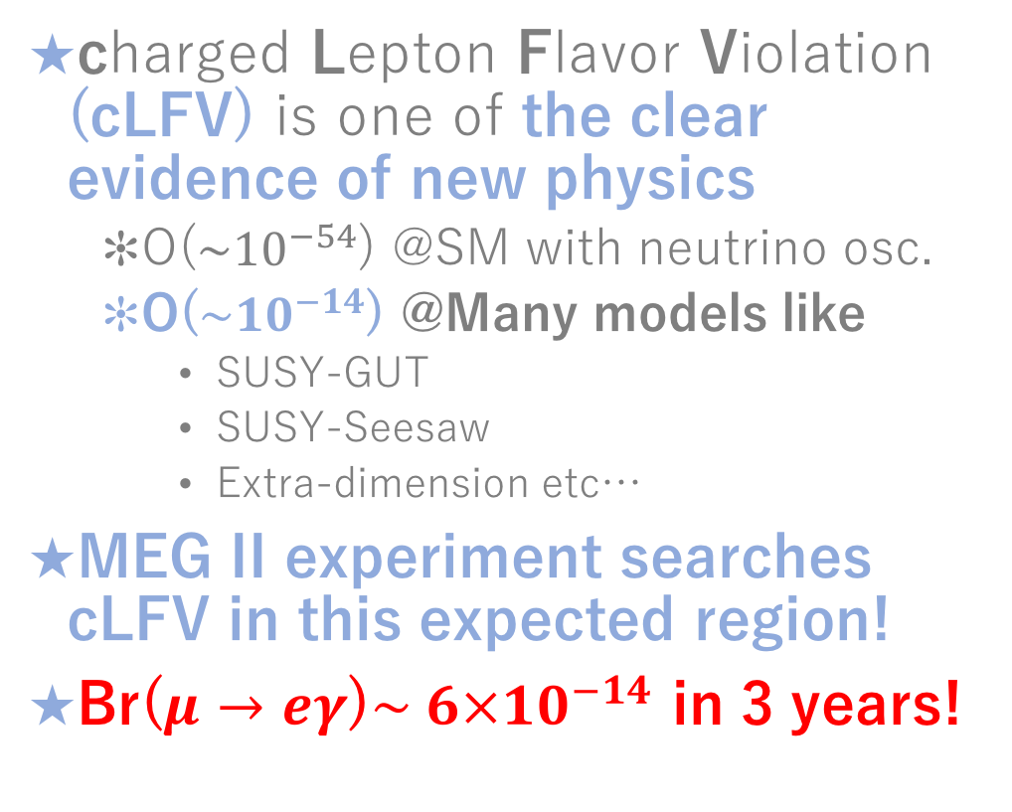
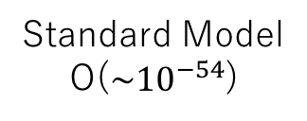
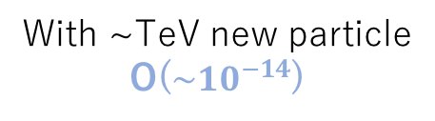
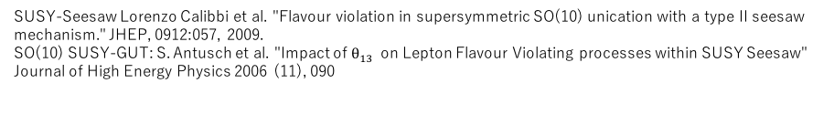
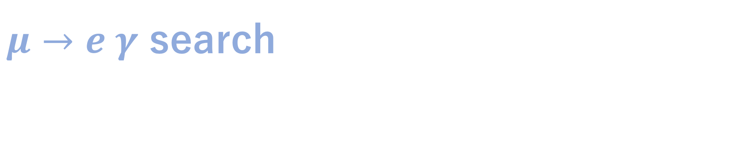
$μ→e γ$ search
T. Mori , W. Ootani, "Flavour violating muon decays",Progress in Particle and Nuclear Physics 79 (2014) 57 ‒ 94
charged Lepton Flavor Violation (cLFV) is one of the clear evidence of new physics
  O($\sim {10}^{−54}$) @SM with neutrino osc.
  O($\sim {10}^{−14}$) @Many models like
    SUSY-GUT
    SUSY-Seesaw
    Extra-dimension etc…
MEG II experiment searches cLFV in this expected region!
Br($μ→eγ$)$\sim 6×{10}^{−14}$ in 3 years!
Standard Model
O($\sim {10}^{−54}$)
With ~TeV new particle
O($\sim {10}^{−14}$)
SUSY-Seesaw
SO(10) SUSY GUT
SUSY-Seesaw Lorenzo Calibbi et al. "Flavour violation in supersymmetric SO(10) unication with a type II seesaw
mechanism." JHEP, 0912:057, 2009.
SO(10) SUSY-GUT: S. Antusch et al. "Impact of $θ_{13}$ on Lepton Flavour Violating processes within SUSY Seesaw"
Journal of High Energy Physics 2006 (11), 090
SUSY-GUT

Slide 4
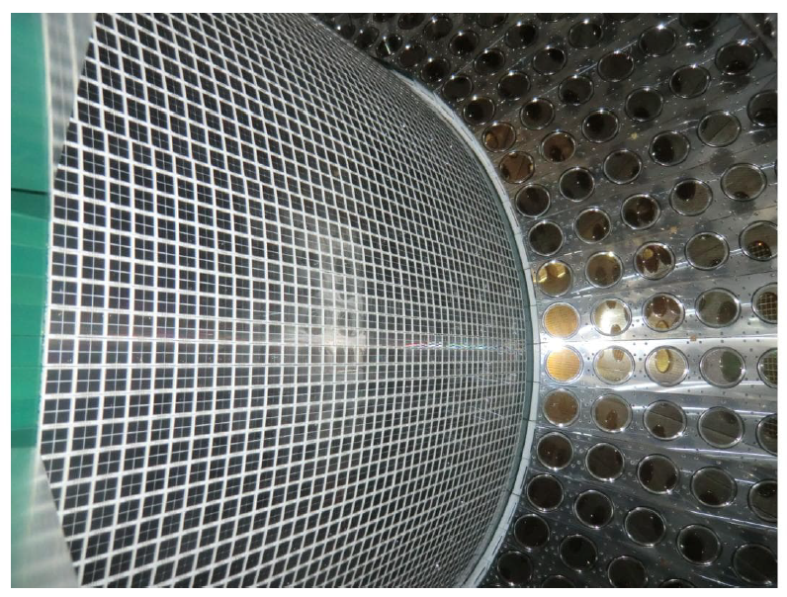
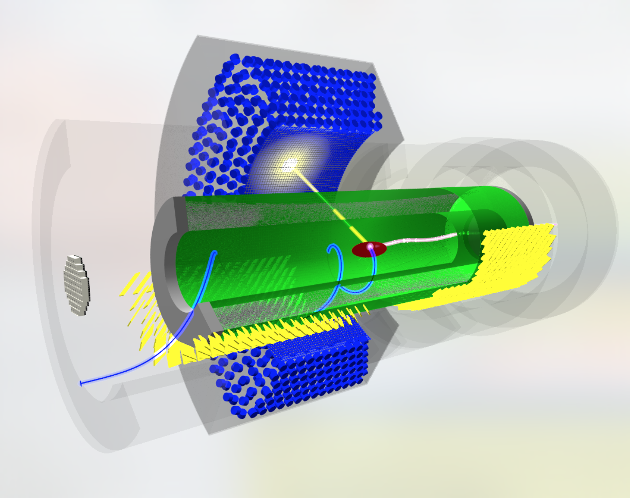
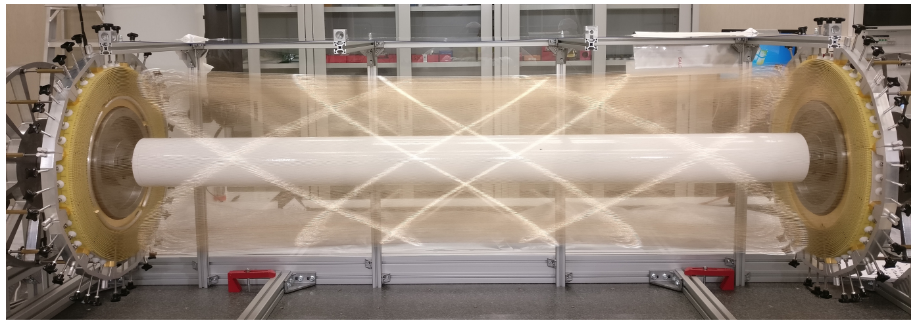
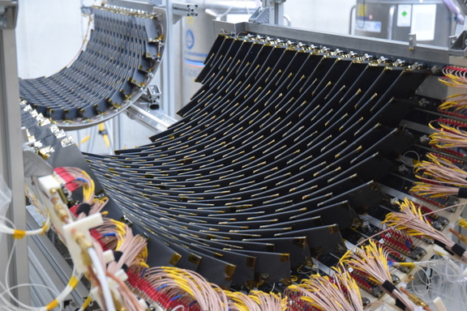
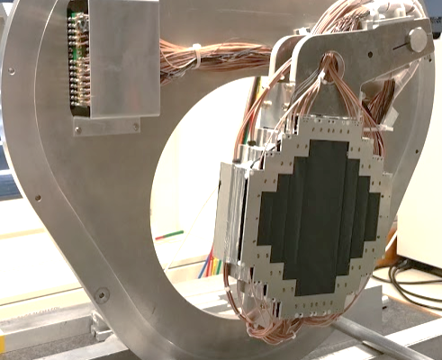

MEG II Experiment 2017 detectors
The most sensitive $μ^{+}→e^{+} γ$ search with world’s most intense muon beam in PSI
LXe detector
Drift Chamber
RDC
Timing Counter
Super conducting magnet
Successive Talks
Operation -> Calibration -> Evaluation
(-> Time calibration counter for LXe)
LXe & over all : A.M. Baldini et al. The design of the MEG II experiment
arXiv:1801.04688v1 [physics.ins-det] 15 Jan 2018
DCH : Taken by DCH group in Dec.
RDC : 2017年秋季大会大強度 μ⁺ 粒子ビーム中で動作する MEG II 実験輻射崩壊同定用カウンターの開発

Slide 5
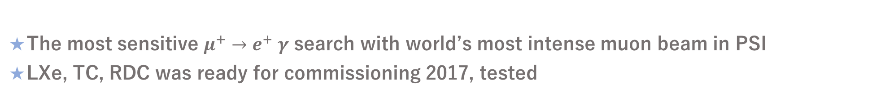
MEG II Experiment 2017 detectors
The most sensitive $μ^{+}→e^{+} γ$ search with world’s most intense muon beam in PSI
LXe, TC, RDC was ready for commissioning 2017, tested
Installed
LXe detector
Drift Chamber
Installed
Installed
RDC
Timing Counter
Super conducting magnet
Successive Talks
Operation -> Calibration -> Evaluation
(-> Time calibration counter for LXe)
LXe & over all : A.M. Baldini et al. The design of the MEG II experiment
arXiv:1801.04688v1 [physics.ins-det] 15 Jan 2018
DCH : Taken by DCH group in Dec.
RDC : 2017年秋季大会大強度 μ⁺ 粒子ビーム中で動作する MEG II 実験輻射崩壊同定用カウンターの開発
※

Slide 6
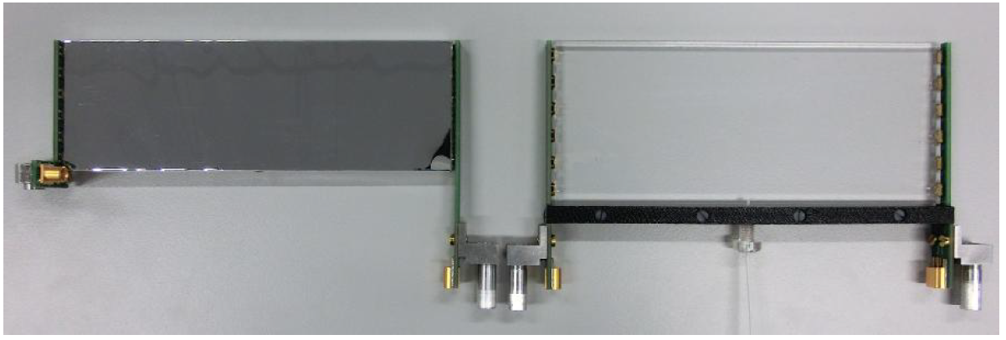
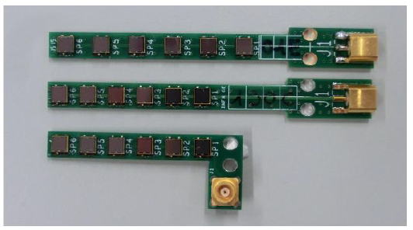
Timing Counter (TC)
TC is composed of small scintillation counters
  256 US + 256 DS = 512 counters
6 series connected SiPM (AdvanSiD) + ultra-fast scintillator
Using multi-hit information, achieve ~ 35 ps on average
6 SiPMs are connected in series
Ultra-fast scintillator (BC422)
12 cm
4 cm
5 cm
w/ reflector
Pictures: A.M. Baldini et al. The design of the MEG II experiment
arXiv:1801.04688v1 [physics.ins-det] 15 Jan 2018
Laser fiber

Slide 7
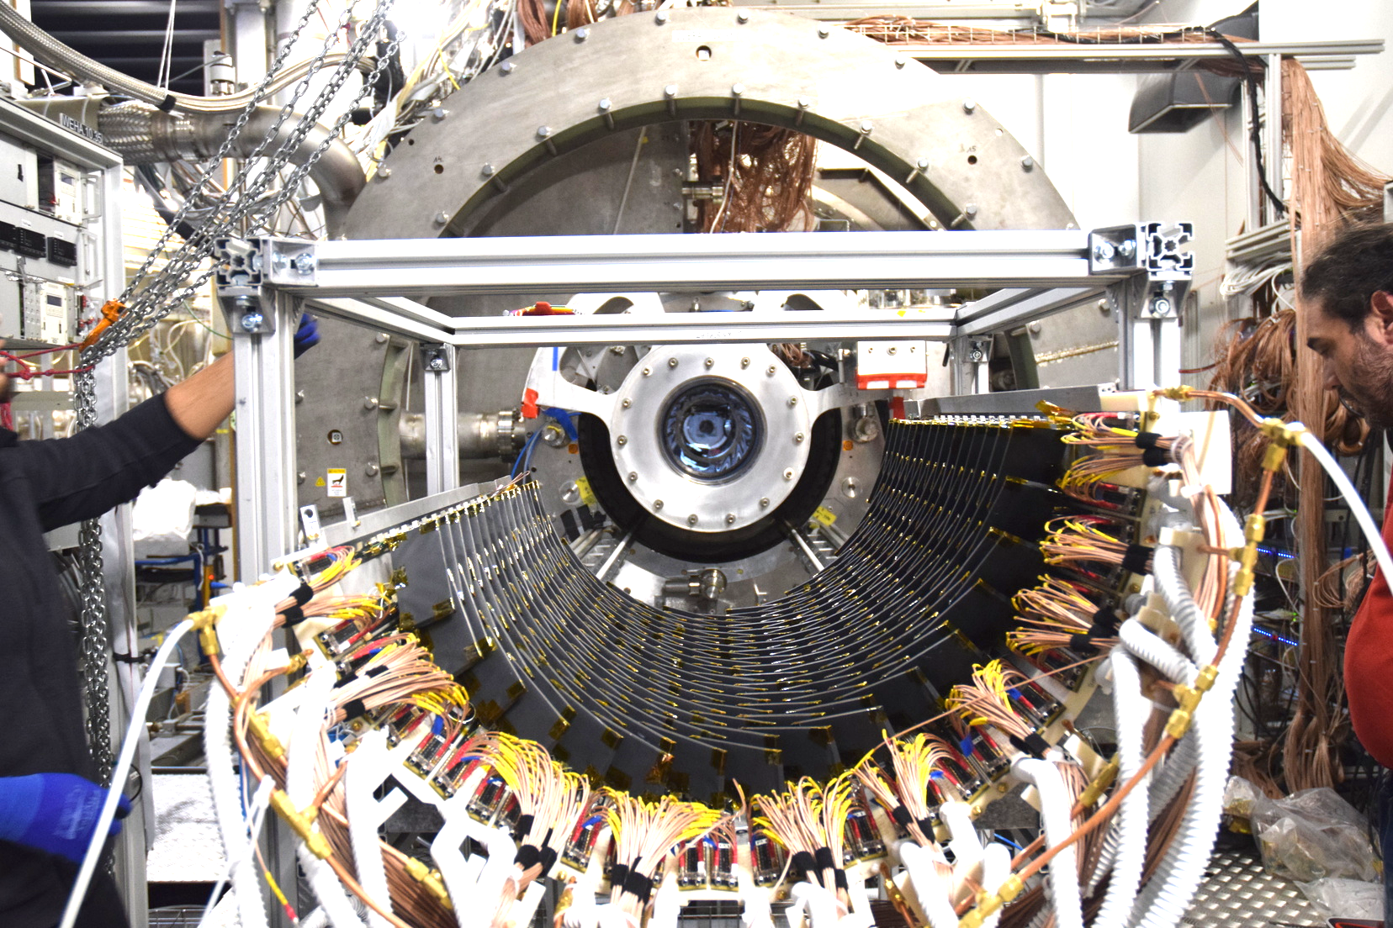
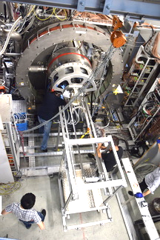
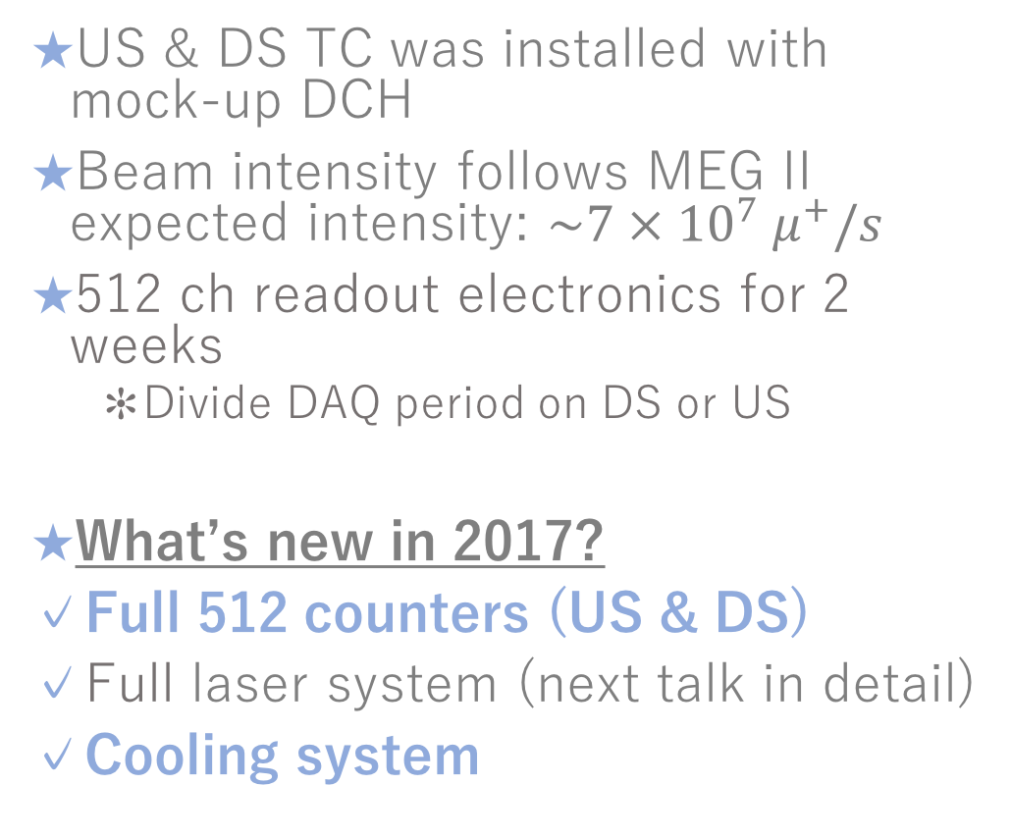
2017 Commissioning
~ Half-day work
US & DS TC was installed with mock-up DCH
Beam intensity follows MEG II expected intensity: $\sim 7 × {10}^{7} μ^{+}/s$
512 ch readout electronics for 2 weeks
  Divide DAQ period on DS or US
What’s new in 2017?
✓Full 512 counters (US & DS)
✓Full laser system (next talk in detail)
✓Cooling system
Started to install TC into COBRA
Mock up DCH
Finished to install
DS data taking
Mon | Tue | Wed | Thu | Fri | Sat | Sun
Nov. 27 | 28 | 29 | 30 | Dec. 1 | 2 | 3
4 | 5 | 6 | 7 | 8 | 9 | 10
Beam shut down
US data taking
2016: 128 pixels

Slide 8
Outline
Introduction
TC Commissioning 2017
Operation
  Cooling systems
    Chiller test
  Current monitor
  Maintenance work
Summary

Slide 9
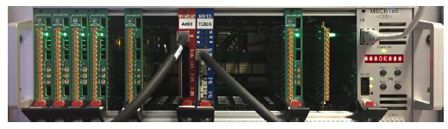
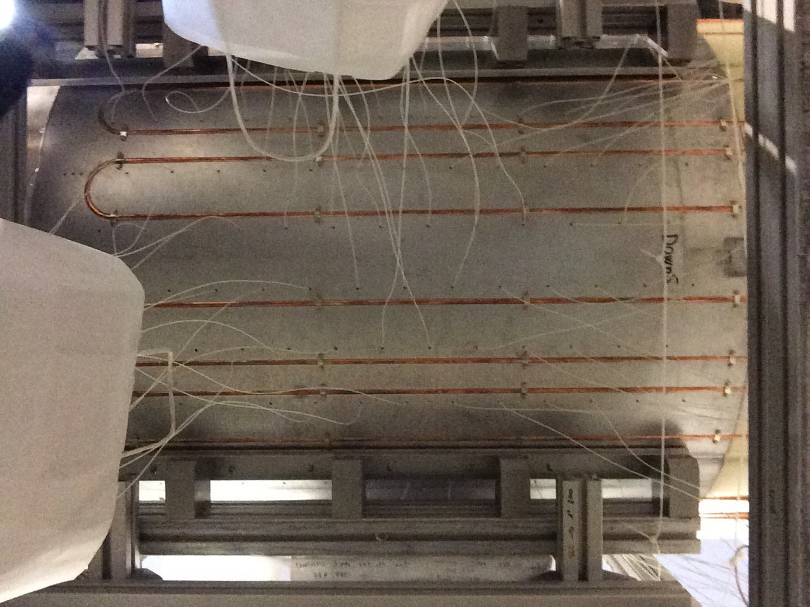
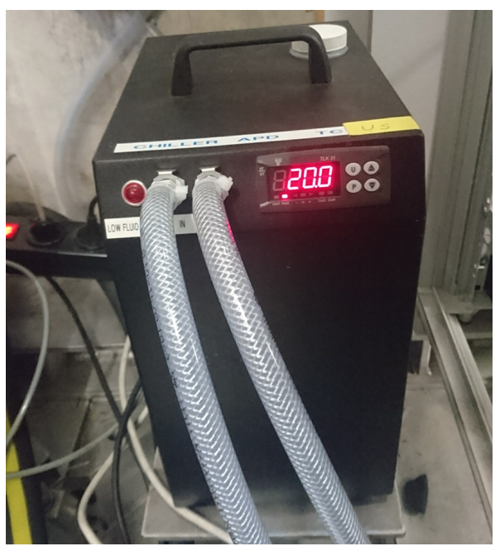
TC Slow Control Systems
DAQ system picture : The design of the MEG II experiment
arXiv:1801.04688v1 [physics.ins-det] 15 Jan 2018
Amplification, Waveform digitization, power supply
Monitor current, temperature, humidity, etc…
PCB
Pixels are mounted on PCB
Temperature sensor: humidity sensor:
DAQ system
Support structure
Signals of sensor & pixels
Counters
~ 1m
・・・
New in 2017
Cooling systems
Custom chill: CRAL300-230PE(400W)
TC viewed from above
Cooling System
Support structure picture
(Taken from under)
water

Slide 10
Cooling systems: chiller test @ 20℃
To determine the operation temperature, we checked the temperature stability of cooling systems
Radiation damage was one of the largest problem for TC operation
  ~30% time resolution deterioration @ 30 degree
  ~5% time resolution deterioration @ 10 degree
First we checked @ 20degree
4 x 3 =12 sensors readout are shown
US is stable within ~1 degree and daily change was suppressed

Slide 11
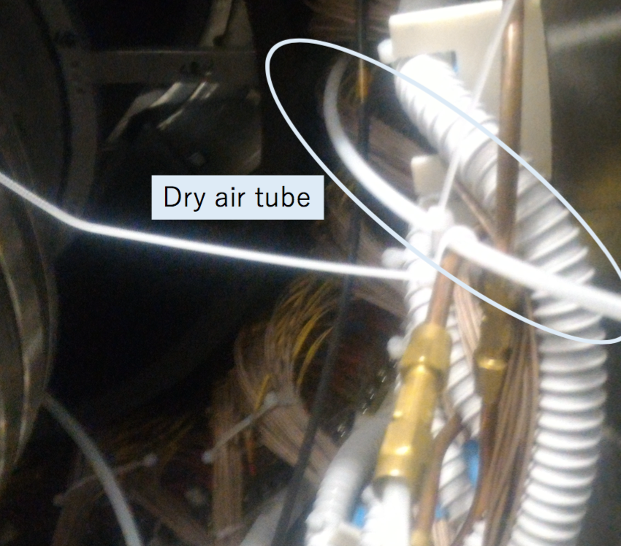
Cooling systems: chiller test 10℃
10 degree operation test was conducted
To avoid water due, we flowed dry air
  By dry air, we confirmed ~10% humidity suppression @ 20 degree
But dry air is room temperature, so temperature did not become stable
  Cool dry air system is needed
DCH
Flow dry air
Flow dry air
~20% deviation

Slide 12
Outline
Introduction
Operation
  Cooling systems
    Chiller test -> 20 degree operation
  Current monitor
  Maintenance work
Summary

Slide 13
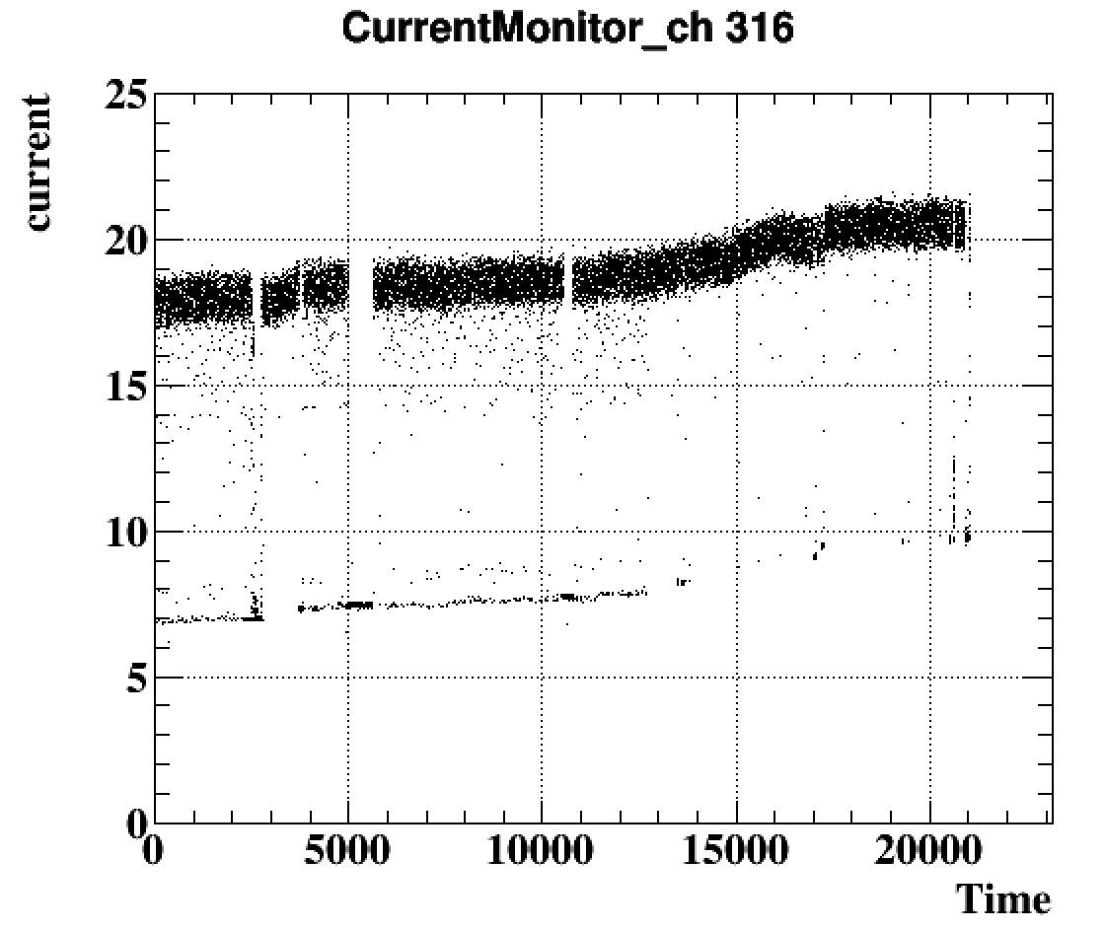
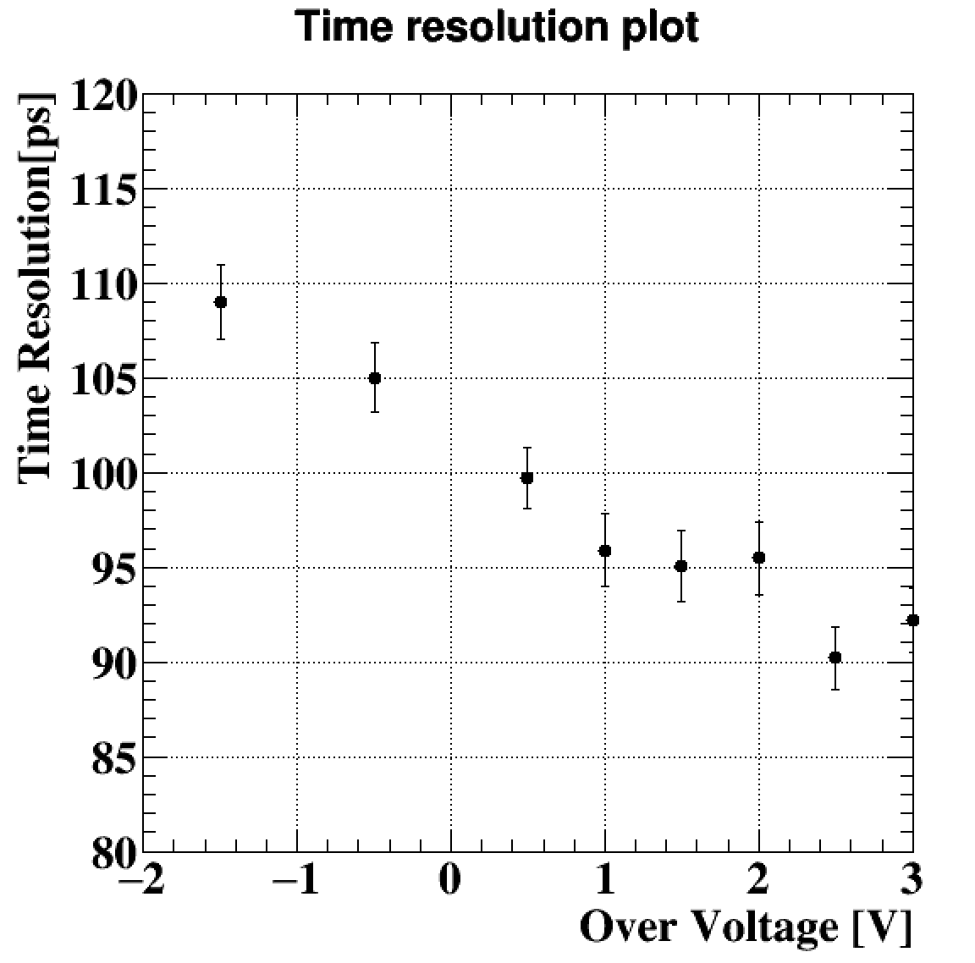
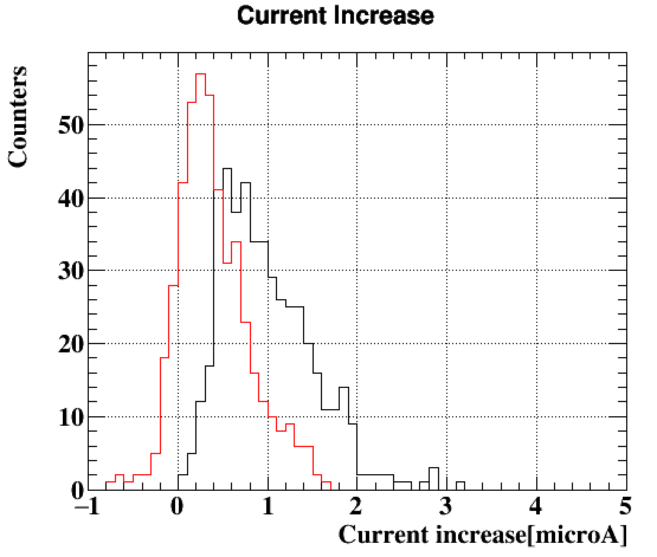
Current Monitor / Voltage Tuning
During beam test obvious current increase was observed due to radiation damage
This year’s operation voltage was 1V higher than previous year based on “laser bias scan”
Operation voltage should be tuned based on current & resolution check with laser signal
Constant fraction time pickup
with laser signal
1V shifted from last year
US: ~0.4μA/32h
DS: ~1μA/36h
 | Observed increase | Expected ~ 3 years
US counters | ~0.4 μA/32 hours | ~158μA
DS counters | ~1 μA/36 hours | ~394μA
2016 commissioning | ~0.24μA/32 hours | ~94μA
Vop+1V
~30% deterioration around 100μA
※2016 commissioning current increase is calculated @ ~28 degree

Slide 14
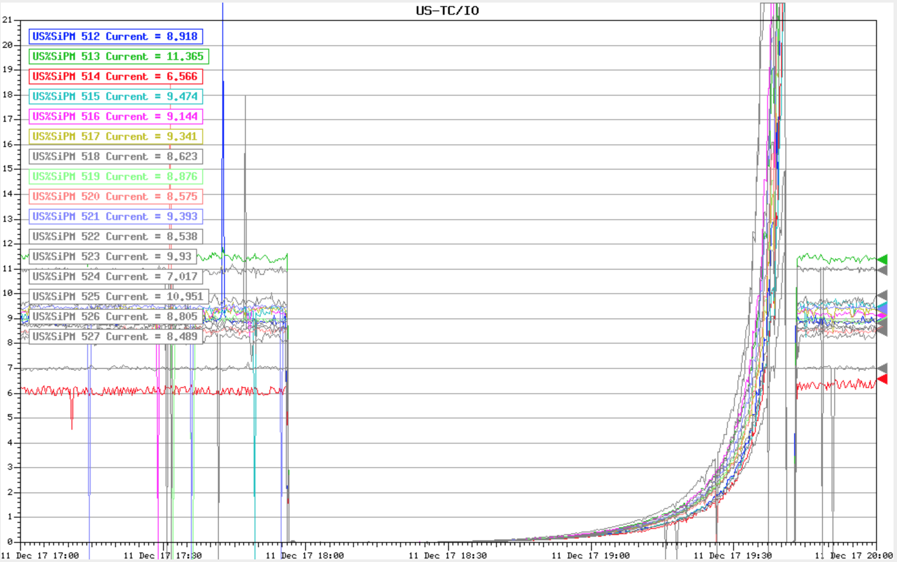
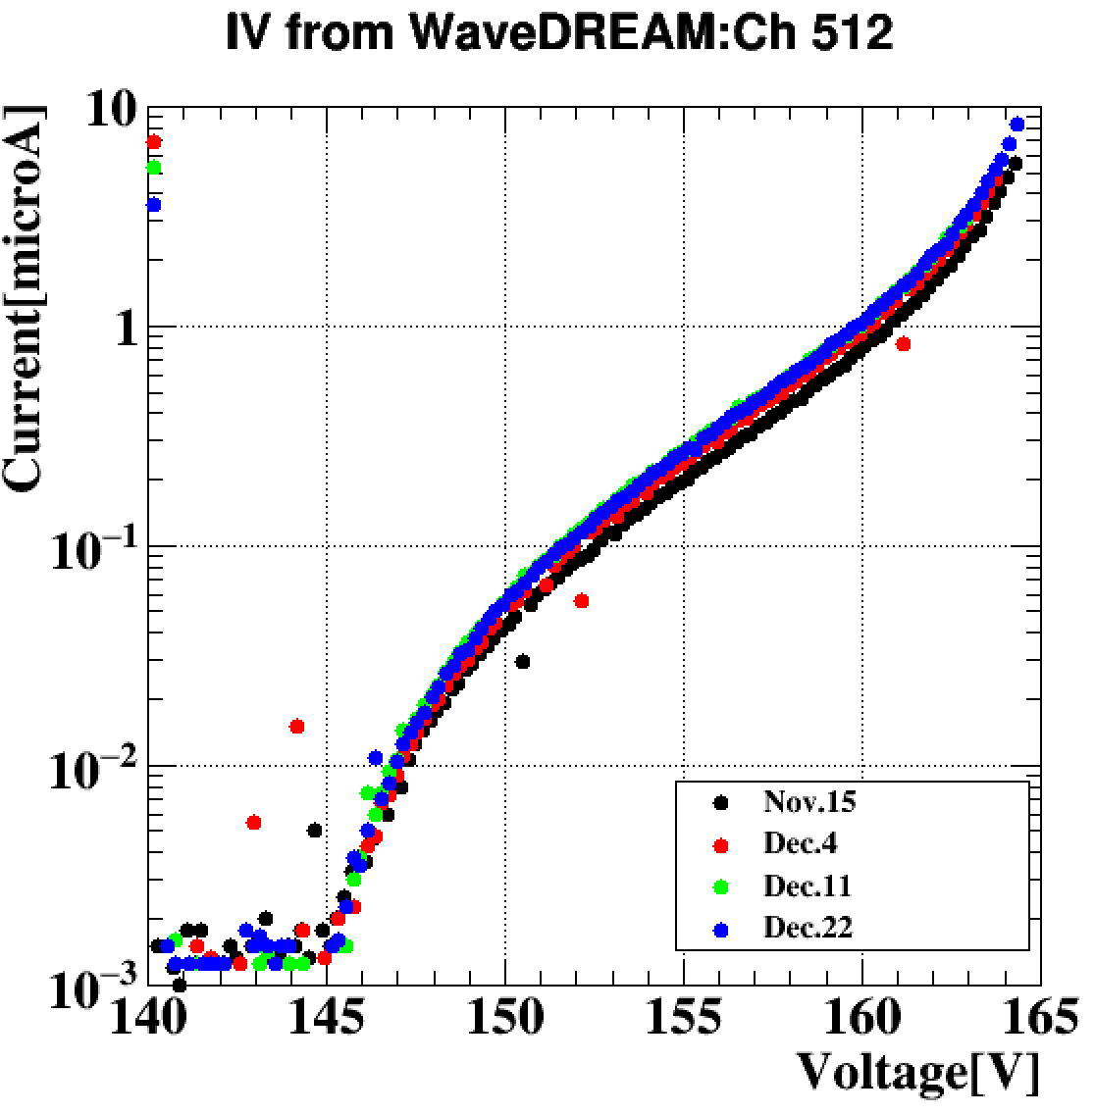
IV Monitoring
With the DAQ setup, we succeeded in continuously taking IV characteristic data of all US counters at once
Monitor as sensor to radiation damage, temperature and useful to determine the operation voltage etc ….
1μA
~3 hours
Leak current cannot be measured, so we added some offset
Temperature is a bit unstable@Nov.15 compared with the other data

Slide 15
TC Maintenance & Prospect
Some bad counters were found @ Maintenance work, but we succeeded to operate most of counters properly
Minor problems (Problem # / All #)
  Laser fiber broken (~11/512 fibers)
  Temperature sensor broken (~6/192 sensors)
  SiPM broken (~1/1024 channels)
  Chiller broken (when shutdown)
In 2018 autumn DCH will be installed
  TC will be installed and operated in best condition
  With full detector, engineering run will start

Slide 16
Summary
Commissioning for TC in 2017 was successfully finished
  ~2 weeks data taking, only 1 ch / 1024 ch broken
  Systems tested & worked well during commissioning
Cooling systems
  Chiller test was done for low temperature & stable operation
  20 degree operation was stable within ~1 degree, more dedicated system is needed for 10 degree operation
Current monitoring / Voltage optimization
  Obvious current increase due to radiation damage, higher than 2016
  Voltage tuning method with laser was developed
  Continuous IV data is sensitive sensor to radiation damage
In 2018 autumn, engineering run will start
  TC will be in best condition by maintenance work

