Slide 1
MEG II実験における 陽電子再構成アルゴリズムの開発 Development of positron reconstruction algorithm in MEG II experiment
西村美紀（東大）
他 MEGIIコラボレーション
日本物理学会 第72回年次大会
大阪大学（豊中キャンパス）

Slide 2
Content
Introduction of the MEG II Experiment
Positron Spectrometer
Positron Time Reconstruction
TC Tracking
Prospect and Summary

Slide 3
MEG II Motivation
In MEG II experiment we aim to search for charged lepton flavor violation (cLFV), μ⁺ $→$ e⁺γ decay.
The SM strongly suppress cLFV .
However sizable branching ratio is expected by many bSMs.
Most stringent upper limit of the branching ratio is given by the MEG experiment.
$4.2×{10}^{−13}$ 90% C.L.
(Eur. Phys. J. C 76 (2016) no.8, 434)
Target sensitivity of MEG II is
$\sim 4×{10}^{−14}$
Simplest Little Higgs Model (arXiv:1610.01266v2)
MEGII
MEG

Slide 4
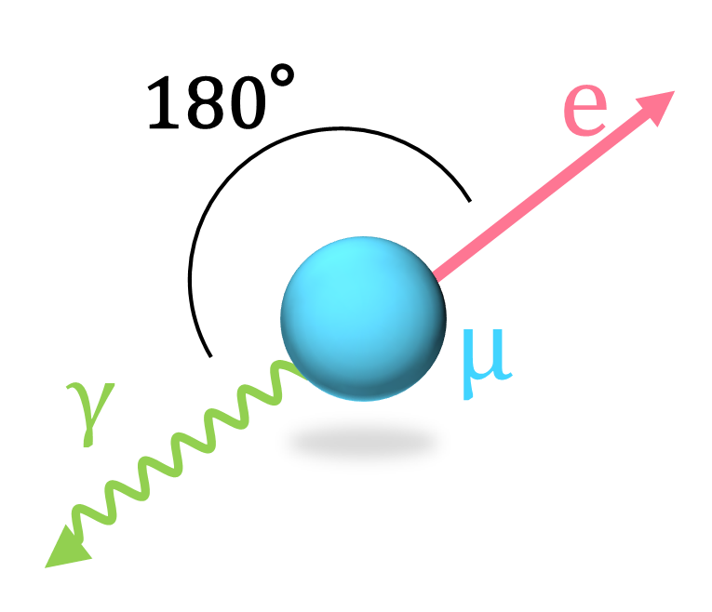
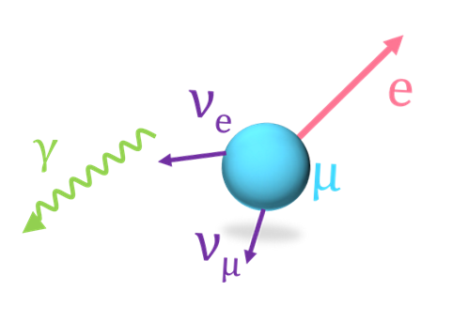
MEG II Requirement
Signal: two-body decay
Dominant BG: accidental
52.8 MeV
Opening Angle 180°
Time Coincident
<52.8 MeV
Any angle
Time Random
105.6 MeV
Precise measurement of emission angle, energy, and timing of both positron and γ is essential.
⇒ Today’s topic is performance of positrons time reconstruction.

Slide 5
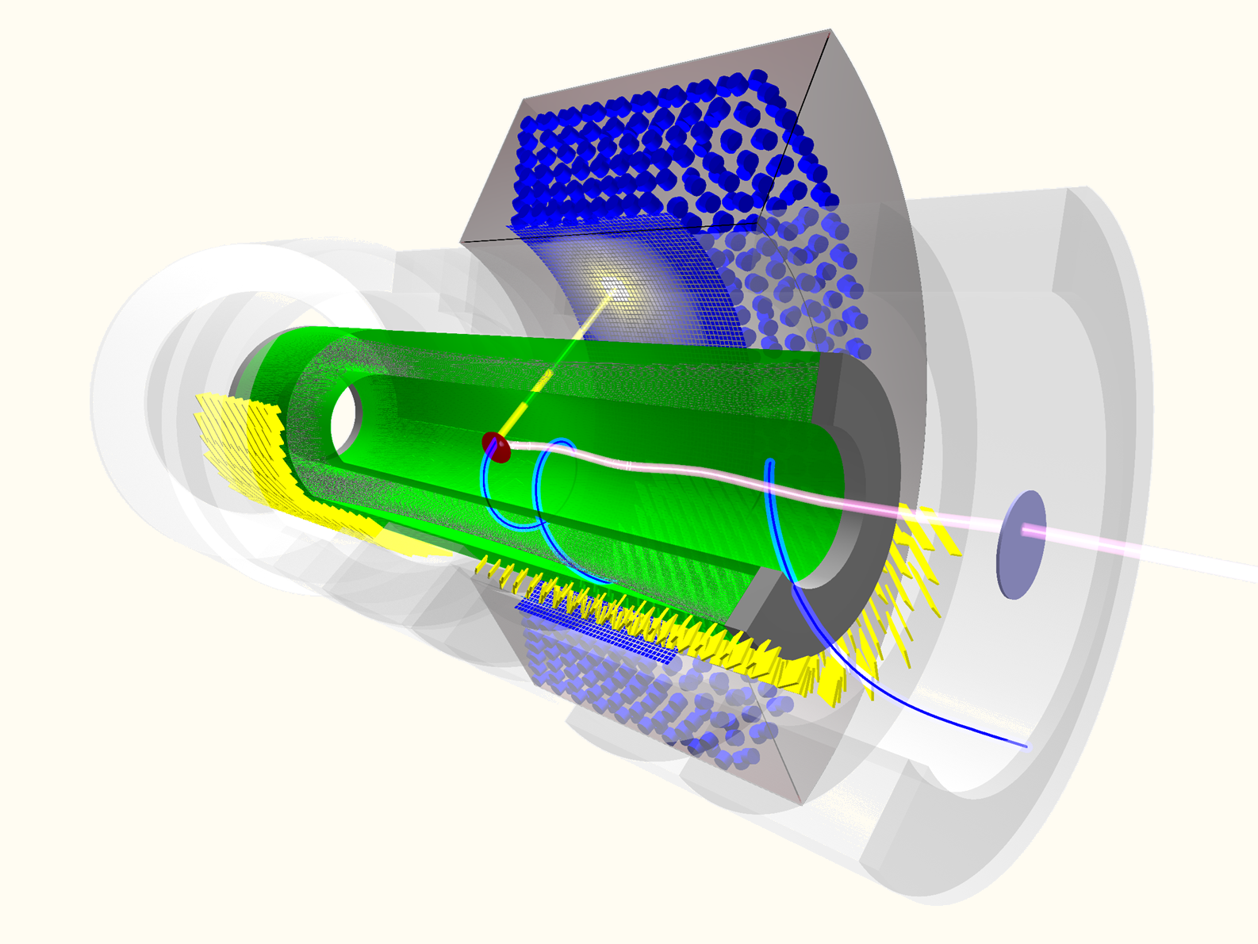
Detector
Liquid Xenon Gamma-ray Detector
Superconducting Magnet
Gamma-ray
Positron
Muon
Wire Drift Chamber
Pixelated Positron Timing Counter
Radiative Decay Counter

Slide 6
Positron Spectrometer
Liquid Xenon Gamma-ray Detector
Superconducting Magnet
Gamma-ray
Positron
Muon
Positron 1st turn
Wire Drift Chamber
Positron 2nd turn
Pixelated Positron Timing Counter
Radiative Decay Counter

Slide 7
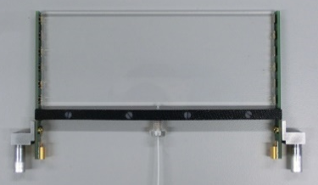
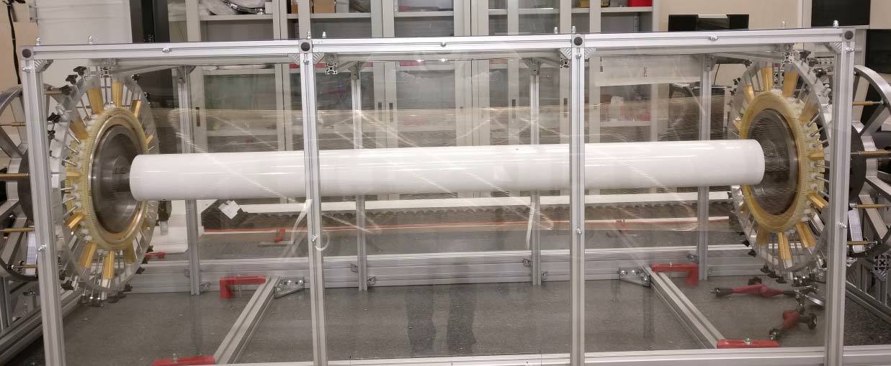
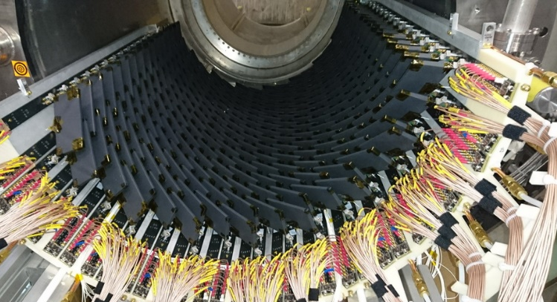
Positron Measurement
Wire Drift Chamber (DCH)
Single volume, low-Z gas mixture (He:iC₄H₁₀ = 85:15)
1200 sense wires (2 m long, 20 μm diameter)
Stereo angle (7°) configuration
Pixelated Positron Timing Counter (TC)
512 fast plastic scintillator counters (120x40/50x5 mm³)
6 SiPMs (AdvanSiD) are attached on both side of the counters.
Single counter
256 counters for down stream
DCH reconstructs
Momentum and vertex
Track length from vertex to TC
TC reconstructs
Positron passing time through each counter
Reconstruct positrons in each detector, then check matching

Slide 8
Performance Study with MC
Check the performance of positron spectrometer in detail with full analysis chain of the positron reconstruction.
Set up
Geant4
Signal positron mixed Michel positron @ 7 x 10⁷
TC: Hit smeared by their resolutions
DCH: waveform simulation
In this talk we’ll focus on timing reconstruction.
(TC Waveform simulation study
Usami’s talk 20aA12-1)

Slide 9
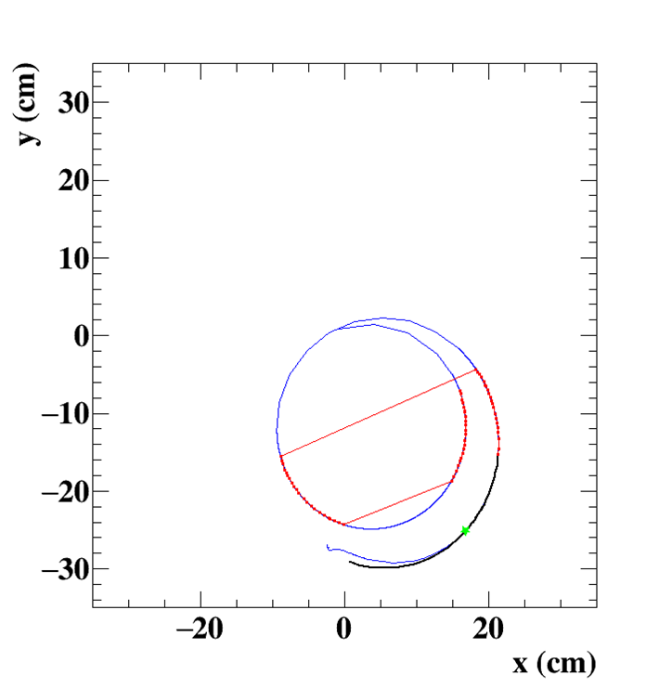
Positron Timing Reconstruction
An example with signal event (w/o pile up)
DCH reconstructs track from vertex to TC first hit. (L_{DCH})
TC reconstructs time at first hit by each counter.
$$T_{TC}={\sum_{i}^{N}{(T_{i}−L_{i}^{TC}/c)}}/N$$
― MC track
― propagated track
… DCH Reconstructed hits
DCH
region
TC
region
Measured time by i^{th} counter
X-Y
TC first hit
Path length from a first counter to i^{th} counter
$$T_{e^{+}}=T_{TC}−L_{DCH}/c$$

Slide 10
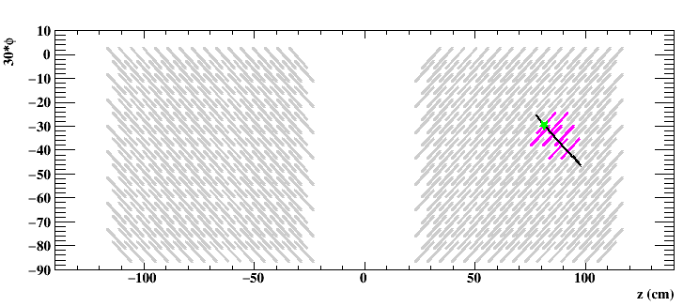
Positron Timing Reconstruction
An example with signal event (w/o pile up)
DCH reconstructs track from vertex to TC first hit. (L_{DCH})
TC reconstructs time at first hit by each counter.
$$T_{TC}={\sum_{i}^{N}{(T_{i}−L_{i}^{TC}/c)}}/N$$
T₁
T₂
$$L_{i}^{TC}$$
T_{i}
Measured time by i^{th} counter
Z-Phi
(w/ TC)
― propagated track
★ TC first hit
TC hit counter
Path length from a first counter to i^{th} counter
$$T_{e^{+}}=T_{TC}−L_{DCH}/c$$

Slide 11
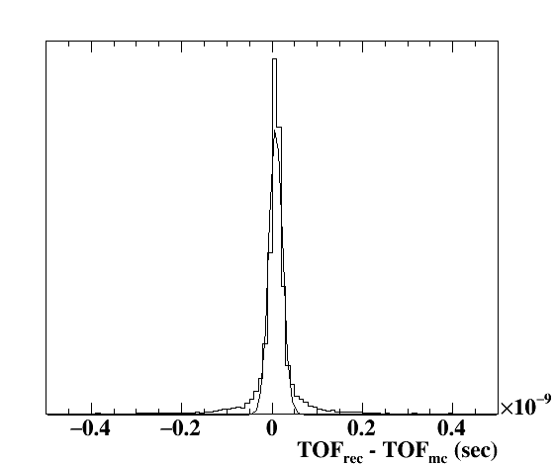
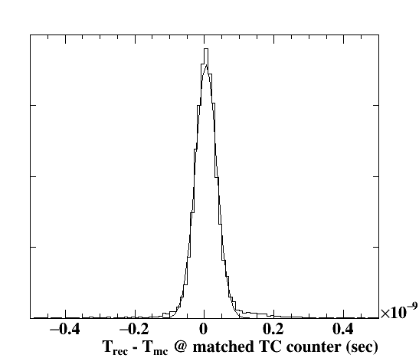
Time Resolution from Each Detector
1. Flight Time b/w Target and TC
2. Time Resolutions in TC
σ_{L} 14.8 ps
σ_{TC} 31.0 ps
${(L}_{DCH}^{rec}−L_{DCH}^{MC})/c$(sec)
$T_{TC}^{rec}−T_{TC}^{MC}$ @ first counter (sec)
Resolution coming from Track reconstruction is 14.8 ps.
(75 ps in MEG)
TC resolution is 31.0 ps.
(76 ps in MEG)

Slide 12
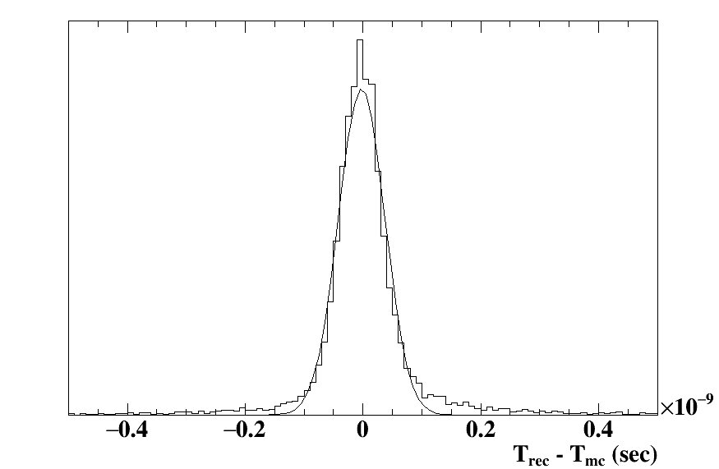
Overall Positron Time Resolution
σ = 39.5 ps
Overall positron time resolution is 40 ps.
(It was 108 ps in the MEG experiment.)

Slide 13
More Development

Slide 14
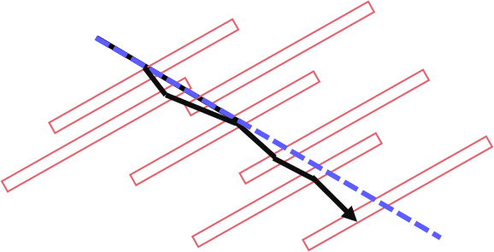
Effect of Multiple Scattering in TC
Track reconstructed by DCH
TC
σ_{TC} 31.0 ps
True Track
TC
σ_{TC} 27.0 ps
The effect of multiple scattering in TC is not so large, but if we’ll estimate them more accurate the time resolution should be better.

Slide 15
TC Tracking
Motivation is more precise estimation of path length in TC.
TC reconstructs hit position along length.
GENFIT: DAF(Deterministic Annealing Filter) is used.
It is almost Kalman Filter but with reweighted measurements against outlier hypothesis.
Initial information is a track reconstructed by DCH.
T₁
T₂
$$L_{i}^{TC}$$
T_{i}
t₁
t₂
$$l=0$$
$$T_{counter}= (t_{1}+t_{2})/2$$
$$l=v_{eff}(t_{1}−t_{2})/2$$

Slide 16
Hit Position Resolution
TC tracking recovers the effects of multiple scattering.

Slide 17
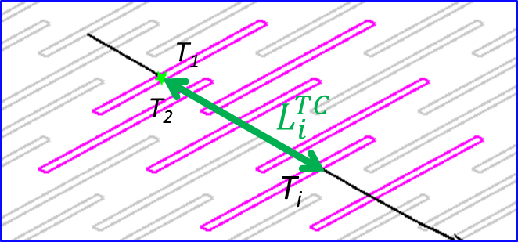
Time of Flight in TC
$L_{i}^{TC}$rec - $L_{i}^{TC}$MC (sec)
$L_{i}^{TC}$MC (sec)
However reconstructed path length does not change so much.
GENFIT does not have time fit.
More development is need.

Slide 18
Impact on Time Resolution
In this time, time resolution does not improve so much,
because calculation of path length does not improve.

Slide 19
Summary
The MEG II experiment aim to search for μ⁺ $→$ e⁺γ decay.
Positrons are reconstructed by DCH and TC.
Full chain of positron reconstruction algorithm is prepared and estimate overall performance.
Overall positron time resolution is improved to 40 ps from 108 ps in MEG.
There is room for improvement and it’s ongoing.

Slide 20
Back Up

Slide 21
Mix overall resolutions

Slide 22
Positron Detection Efficiency
Preliminary
Overall Efficiency: 71.1 %
DCH Efficiency: 81.0 %
Propagation miss to TC (Dominant ~50 %)
Contamination
Vertex reconstruction miss
TC Efficiency: 90.6 %
No Hit (9.2 %)
Clustering contamination > 40% in a cluster (the rest)
Matching Inefficiency (if both reconstruction is succeeded): 7.6 %
in the same turn (20.9 %)
Turn difference is just 1. (58.1 %)
6 % in matching inefficiency

Slide 23
Positron Reconstruction Chain
TC
Hit Rec.
Clustering
WF analysis
DCH
WF analysis
Hit Rec.
Track finder
Kalman Fit
Matching
Propagation to TC
b/w TC cluster and DCH track
Previous JPS
TC is pixelated by 512 scintillator counters.
Positron comes to the TC in high rate. (a few MHz in the TC region.)
→ Clustering of TC hits was developed.
Counters
* Hits
DCH is tracking just before TC.
cluster

Slide 24
Positron Reconstruction Chain
TC
Hit Rec.
Clustering
WF analysis
DCH
WF analysis
Hit Rec.
Track finder
Kalman Fit
Matching
Propagation to TC
b/w TC cluster and DCH track
Check this difference
Reconstructed position in TC
Propagated
Track from DCH

Slide 25
Time of Flight b/w Target and TC
Time Resolutions in TC
w/o Michel e⁺
w/ Michel e⁺
w/o Michel e⁺
w/ Michel e⁺
Tails are almost the same. These tails come from signal itself.
Multi turn or delta ray may be the reason.

Slide 26
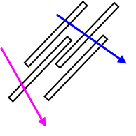
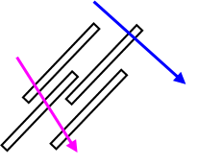
Tail events from multi turn
Tail in events come from hits from different turns of the same positron.
They affect final time measurement.
These kind of hits should be separated by
Tracking
More precise cut in clustering
2nd turn
$$T_{\text{1}}$$
2nd turn
$$T_{\text{3}}$$
$$T_{\text{3}}$$
<
$$T_{\text{1}}$$
$$T_{\text{4}}$$
1st turn
1st turn
$$T_{\text{2}}$$
$$T_{\text{2}}$$
$$T_{\text{4}}$$
$$\frac{T_{\text{1}}+T_{\text{2}}+T_{\text{3}}+T_{\text{4}}}{4}−T_{1}^{MC}$$
⇒ make negative tail.
$$\frac{T_{\text{1}}+T_{\text{2}}+T_{\text{3}}+T_{\text{4}}}{4}−T_{1}^{MC}$$
⇒ make positive tail.

Slide 27
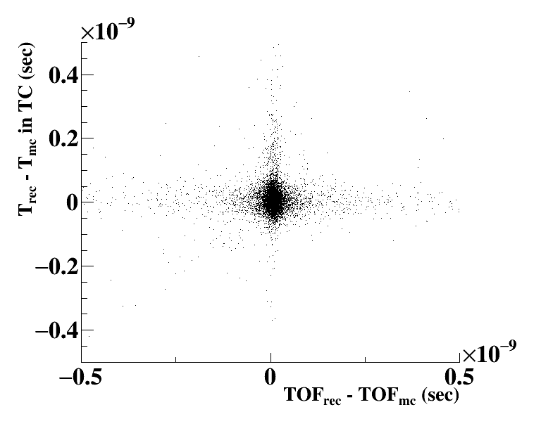
Time Resolution from Each Detector
Time of Flight b/w Target and TC
Time Resolutions in TC
Mean 8.3 psec
Sigma 14.8 psec
Mean 4.5 psec
Sigma 31.0 psec
Since these two reconstructions does not have correlation, .

Slide 28
Hit Position Reconstruction
Reconstructed position – mc position
R
Std Dev 1.5
→ 0.6
R
Counter local
cm
cm

Slide 29
Hit Position Reconstruction
R
Z
cm
cm
φ
L
rad
cm

Slide 30
Prospects
t₁
t₂
Weighted hit time by reconstructed hit position
Closer channel should have larger light amount than the other channel have.
Contamination cut
$$l=0$$
$$T_{counter}= (t_{1}+t_{2})/2$$
$$l=v_{eff}(t_{1}−t_{2})/2$$

