Slide 1
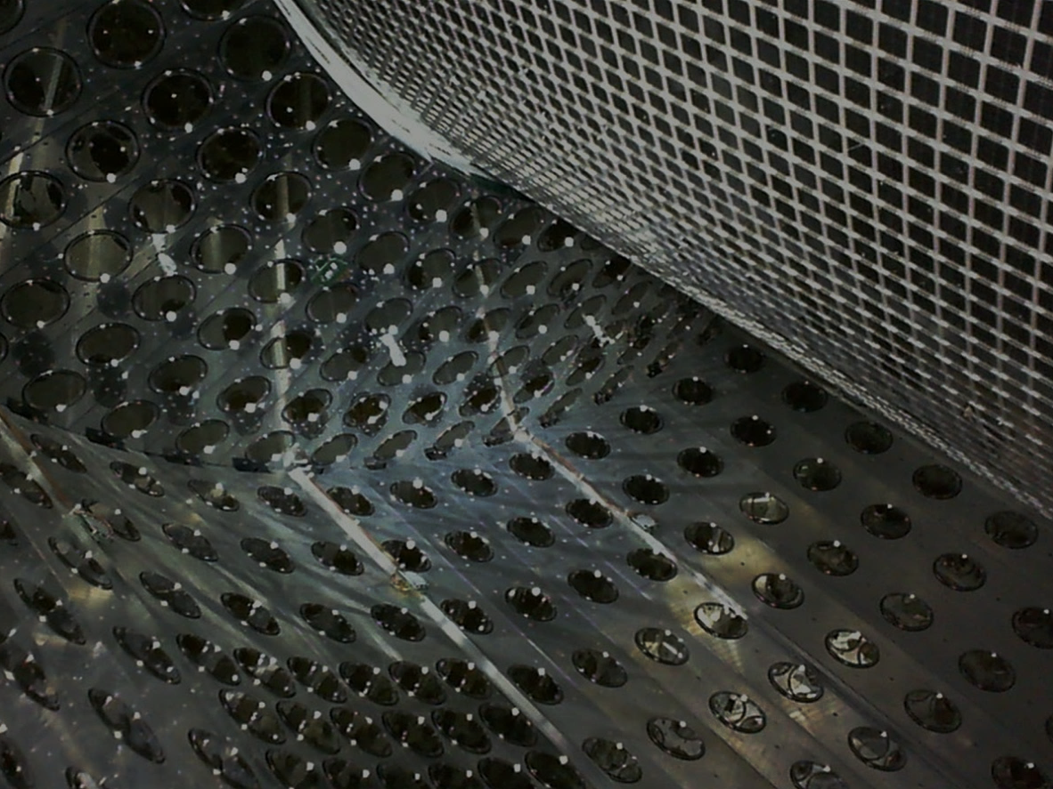
MEG II実験液体キセノン検出器の インストール及びセンサー試験
→ 次のトークで
家城 佳、
他 MEG II コラボレーション

Slide 2
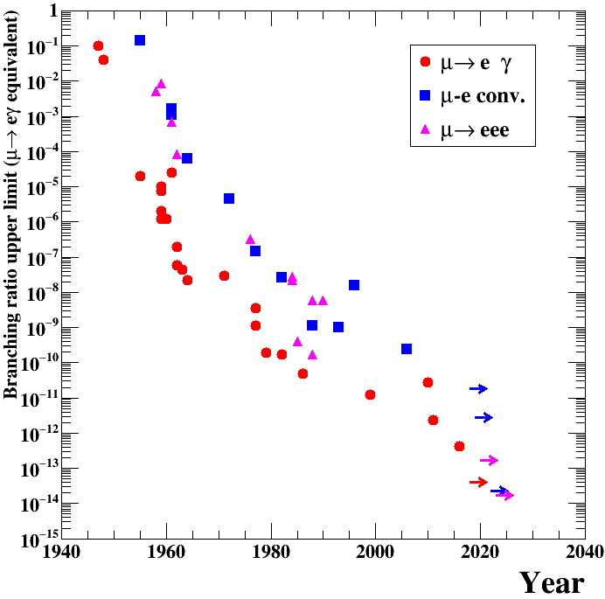
$μ→eγ$ search
$μ$LFV upper limit history
Observation of lepton flavor violation (LFV)
decay $μ→eγ$
μN$→$eN
Evidence of new physics!
e.g. $μ→eγ$ with SUSY
$$γ$$
$$\tilde{μ}$$
$$\tilde{e}$$
$$μ$$
$${\tilde{χ}}^{0}$$
$$e$$
DeeMe
COMET-I
New generation LFV experiments can explore the region predicted by BSM
BSM prediction
MEG
Mu3e-I
MEG II
Mu3e-II
COMET-II
Mu2e

Slide 3
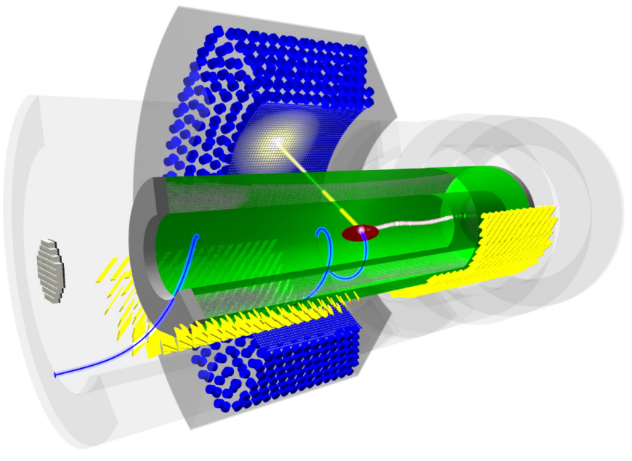
MEG II
900$l$ LXe $γ$ detector
γ
μ⁺
beam @ PSI
~7x10⁷ μ/s
Radiative decay counter
(BG identification)
e⁺
$e^{+}$ drift chamber + timing counter
Upgrades from MEG:
x2 beam rate
x2 detector resolution and efficiency

Slide 4
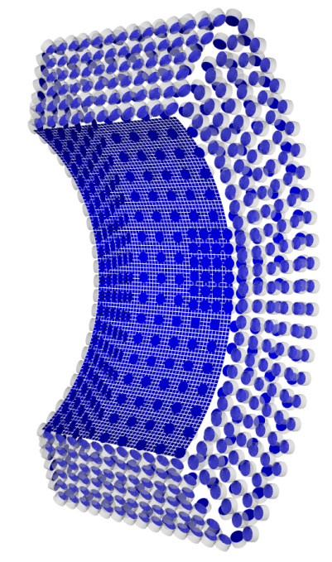
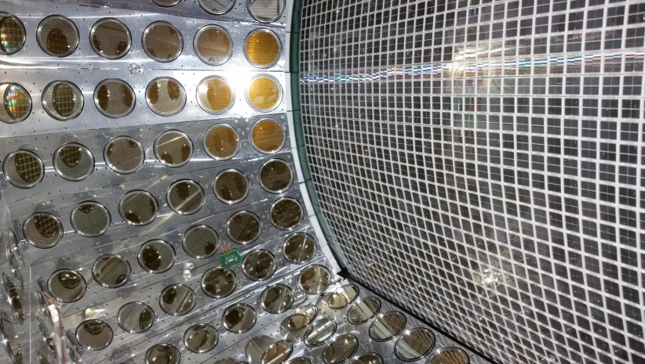
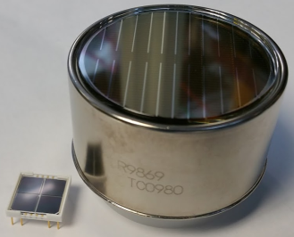
LXe detector
energy
position
Measures the of $γ$-rays.
Readout: 2” PMTs $×$ 668 + 12mm SiPMs $×$ 4092 → Granular& uniform coverage → Resolution will be improved from MEG
timing
Energy resolution ~1%
$$γ$$
Position resolution ~2.5mm
1 m
$$γ$$
PMTs on this surface are replaced with MPPC
2 inches
12 mm

Slide 5
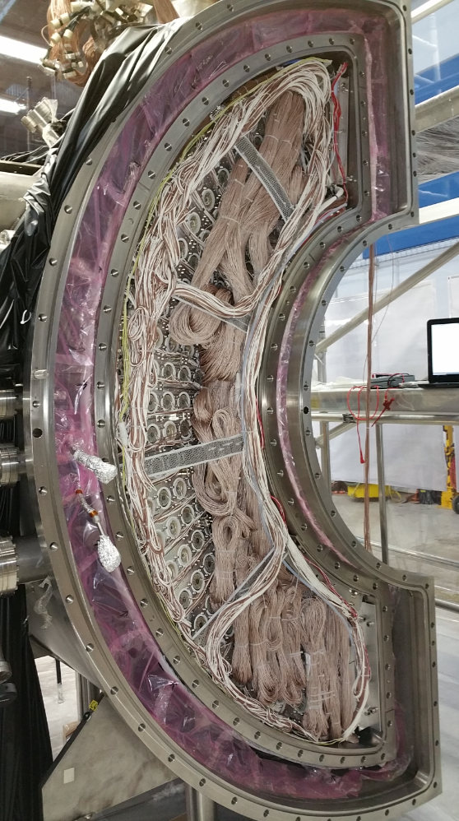
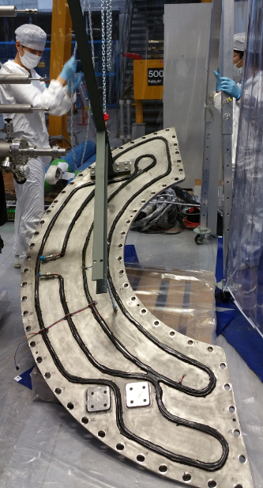
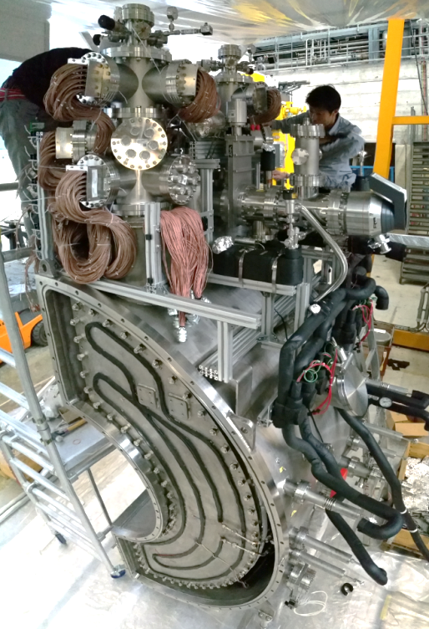
Final stage of construction
Cabling
Closing the lid
Closing the flanges

Slide 6
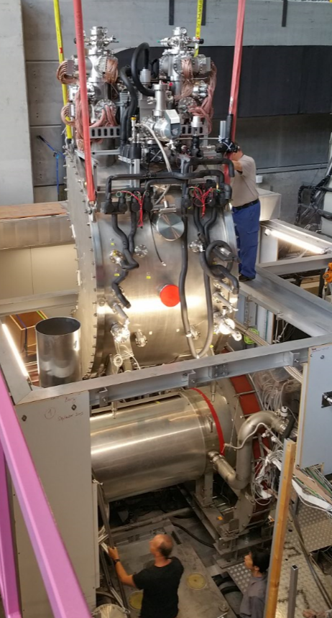
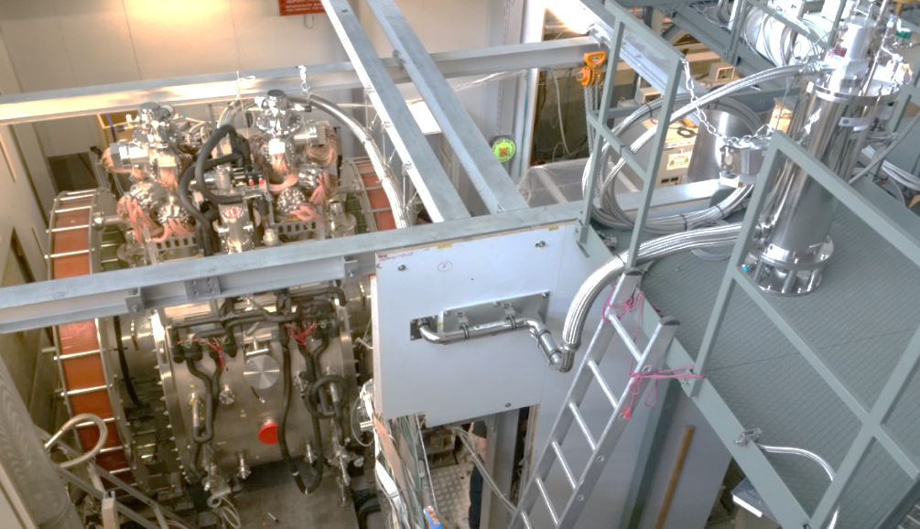
Installation & pipe connection
Installation
Pipe connection
LXe transfer tube
GM
refrigerator
(new)
μ

Slide 7
Filling LXe to the detector
Liquefaction (GXe storage tanks → 1000$l$ LXe tank)
Vacuum evacuation of the detector (to ~2x10⁻³ Pa)
Pre-cooling of the detector (~175K)
LXe transfer from 1000$l$ tank to the detector
purifier
(getter)
1000l
LXe tank
(cooled by refrigerator & LN₂)
detector
High pres.
GXe tanks
x10

Slide 8
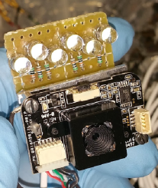
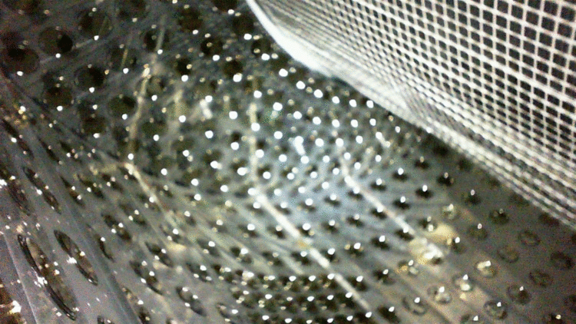
LXe transfer
View from a USB camera installed inside the detector

Slide 9
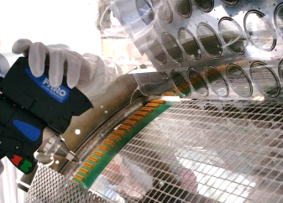
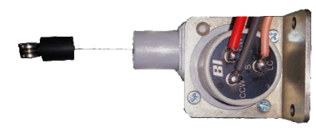
Position monitoring
outer cryostat
MPPC position was scanned with laser after installation↓
vacuum
inner cryostat
(filled with LXe)
wire pull out length is measured
wire position sensors
are attached to the outer cryostat.
However, inner cryostat deforms by heat shrink and LXe load.
→ Monitor the movement by position sensors

Slide 10
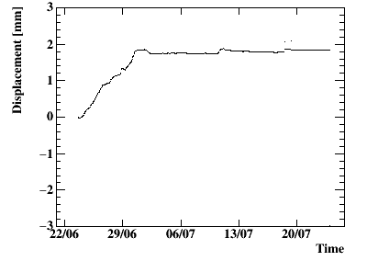
Position monitoring
3 sensors are installed at 4 different places.
Movement (top US sensor)
observed movement
pre-
cooling
LXe transfer
Moved mostly during the pre-cooling due to heat shrink. Result was roughly consistent with what we expect (~1.6x10⁻³mm/m/K heat shrink to bottom direction)
Cryostat is fixed at the bottom middle.

Slide 11
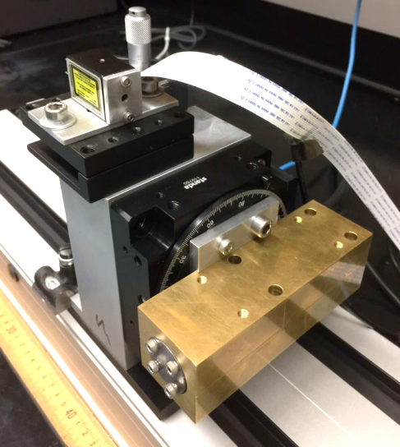
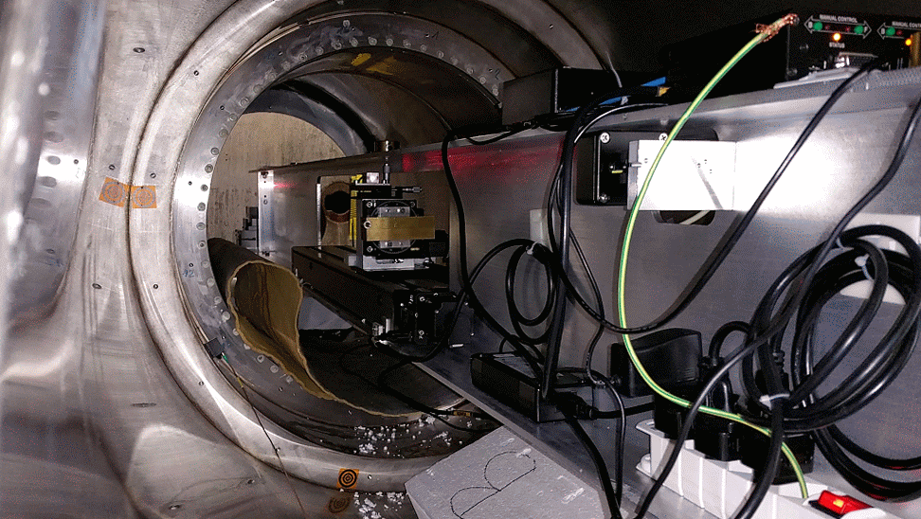
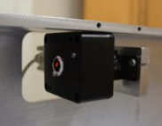
X-ray survey
Another method for position check: Measure MPPC signal from the X-rays.
⁵⁷Co source + collimator
X-ray
(124, 132 keV)
Position of the stage is measured by laser and monitored by laser and bubble level + camera.
moving stage & rotator

Slide 12
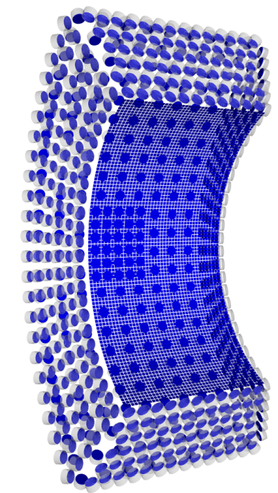
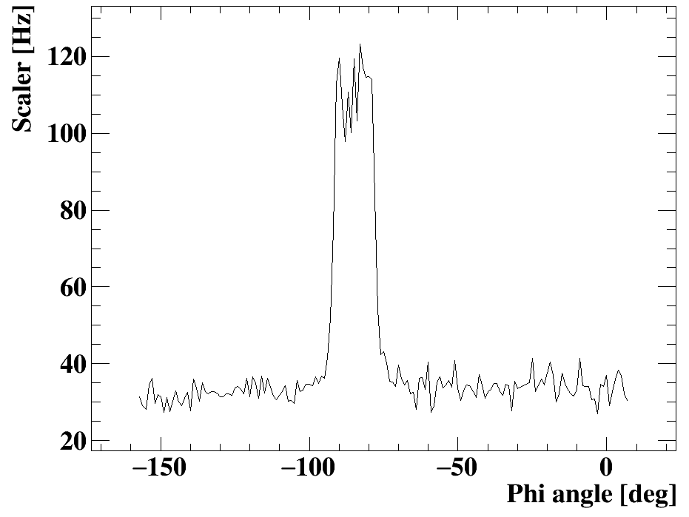
X-ray survey
Scan was performed in two directions in 1mm step.
X-ray spot size ~ 2 mm x 30 mm
Example of X-ray signal at one MPPC
MPPCs
X-ray beam
Background (cosmic-rays)
scanned region
15mm
15mm
Event rate increase was successfully observed around X-ray irradiated region.
Analysis is ongoing.

Slide 13
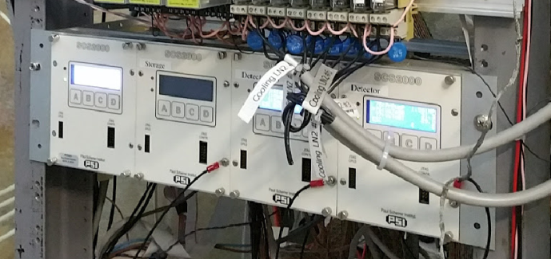
LXe monitoring & control
We built a slow control system using special modules (SCS2000) developed at PSI
pres. sensors
temp. sensors
SCS2000
readout
feedback
SCS2000 can:
- readout the sensors
- automatically or manually control the cooling power (refrigerators and LN₂)
- allow users to monitor & control via internet
pulse-tube refrigerator
GM refrigerator
pump
purifier
(getter)

Slide 14
LXe monitoring & control
Normal (stable) operation: Temperature & pressure is maintained by adjusting electric heater power.
refrigerator
electric
heater
LN₂ pipes
Emergency or special operation: Open LN₂ valves for additional cooling
Firmware of SCS2000 does the control automatically.
- Heater power adjustment (PI control)
- LN₂ valve open at high temp. or high pres.
- Issue an alarm in case of emergency

Slide 15
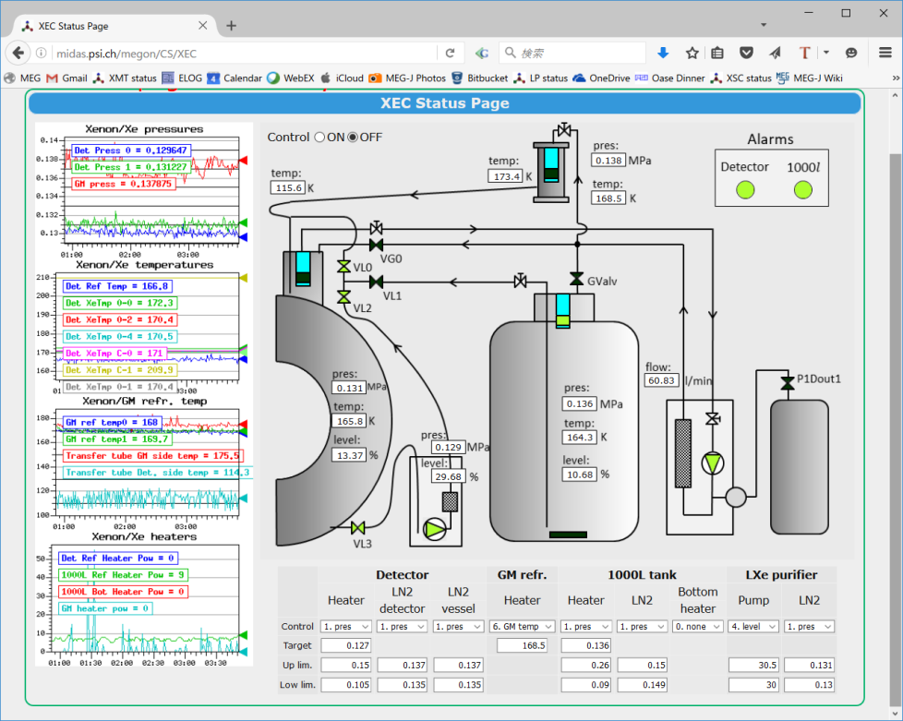
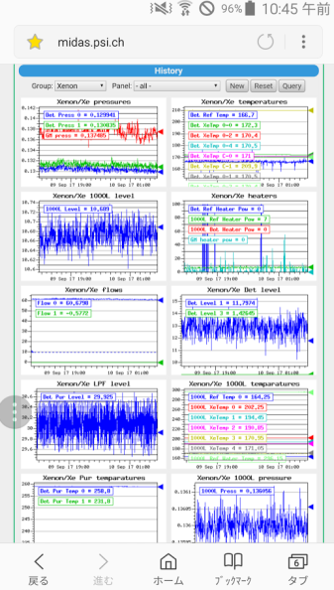
LXe monitoring & control
Overall system is monitored & controlled from web browser.

Slide 16
Purification
Purity of Xe affects the scintillation (light yield, attenuation, pulse shape)
GM refrigerator
Two types of purifications are ongoing in parallel.
pulse tube refrigerator
Gas phase (getter): Slow, remove H₂O, O₂, CO, CO₂, N₂, H₂ … Liquid phase (molecular sieve):
Fast, remove H₂O
Gas phase purification
Liquid phase purification
pump
molecular sieve
getter
pump

Slide 17
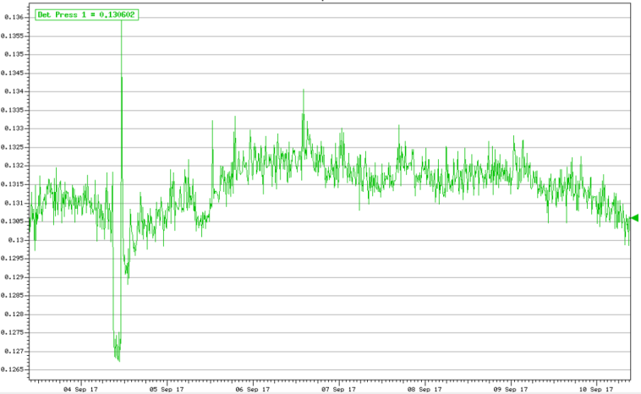
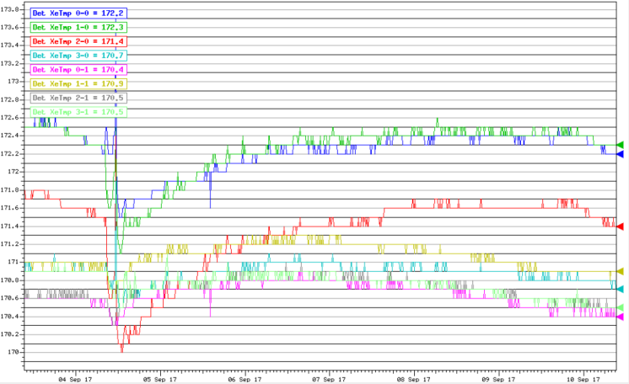
Detector stability
Xe purity is improving (light yield increased ~10 times over 2 month.) Currently the light yield is ~85% of what we achieved in MEG.
Temperature and pressure are sometimes unstable due to LXe purification pump trouble and due to heat income in LXe purification line.
→ Once we finish purification, the detector will be more stable.
Pressure variation (1 week)
Temperature variation (1 week)
0.04 deg
0.001MPa
pump trouble

Slide 18
Status & schedule
2017
2018
construction
commissioning & purification
engineering run
physics run
we are here
Construction is finished!
LXe operation started. Purification is ongoing.
MPPC & PMTs are being tested → Next talk (S.Ogawa) Only a limited amount of DAQ channels is available now (~1000ch)
Detector monitoring is started → Next talk (N. Matsuzawa)
Engineering run will start in the end of 2017

Slide 19
Summary
LXe detector is successfully installed.
Position of the detector is measured by wire sensors and X-ray.
Slow control system is built. Purification is ongoing. (so far achieved ~85% of light yield in MEG)
Commissioning of MPPC & PMTs is also ongoing.
Monitoring of the detector is started.

