Slide 1
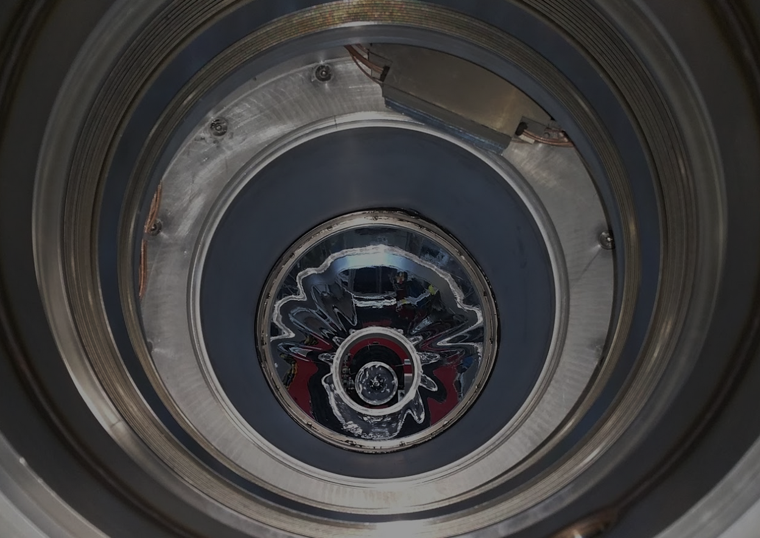
大強度$μ$粒子ビーム中で動作する MEG II実験 輻射崩壊同定用カウンターの開発
家城 佳、岩井 遼斗
他 MEG II コラボレーション

Slide 2
$μ→eγ$ search
γ
$μ→eγ$ is lepton flavor violating decay
Observation = Evidence of BSM physics
μ⁺
Current limit: 4.2x10⁻¹³ (90%C.L., ) by MEG
γ
e⁺
$$\tilde{μ}$$
$$\tilde{e}$$
BSM prediction: O(10⁻¹⁴) (e.g. SUSY-seesaw)
μ⁺
e⁺
MEG II goal:
4x10⁻¹⁴
BSM physics (e.g. SUSY)

Slide 3
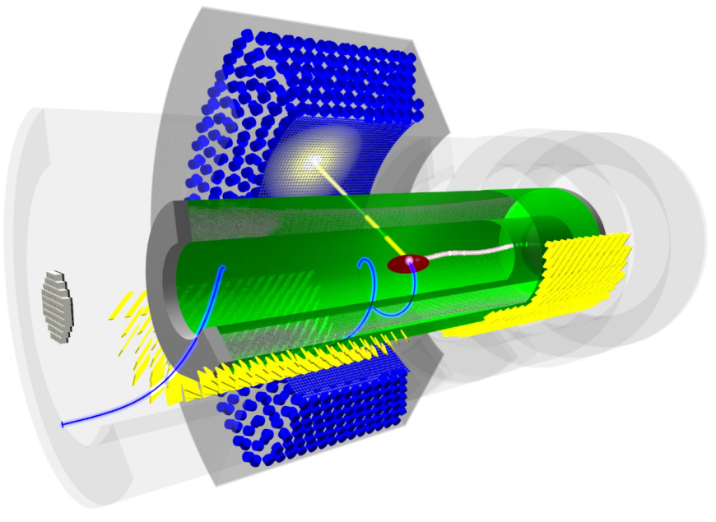
MEG II @ PSI
LXe $γ$ detector
MEG
γ
Upgrade
- x2 beam rate
- x2 resolution
- x2 efficiency
μ⁺
MEG II
x10 better sensitivity
e+ drift chamber + timing counter
e⁺
Radiative Decay Counter
Detector upgrade is completed except for e⁺ drift chamber!

Slide 4
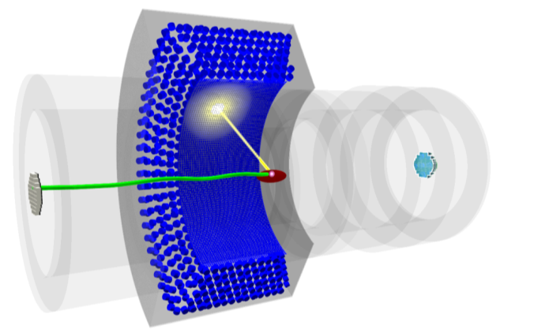
Radiative Decay Counter (RDC)
RDC identifies Radiative Decay
$μ^{+}→e^{+}ννγ$
γ
main source of BG$γ$
μ⁺
…by detecting time coincident low momentum $e^{+}$
e⁺
US
RDC
DS
RDC
Source of BG γ
(E_{γ}>48MeV)
AIF
RMD
(e⁺ Annihilation In Flight)
0
20
40
60
80
100%
DS
US
RDC detects these BG!

Slide 5
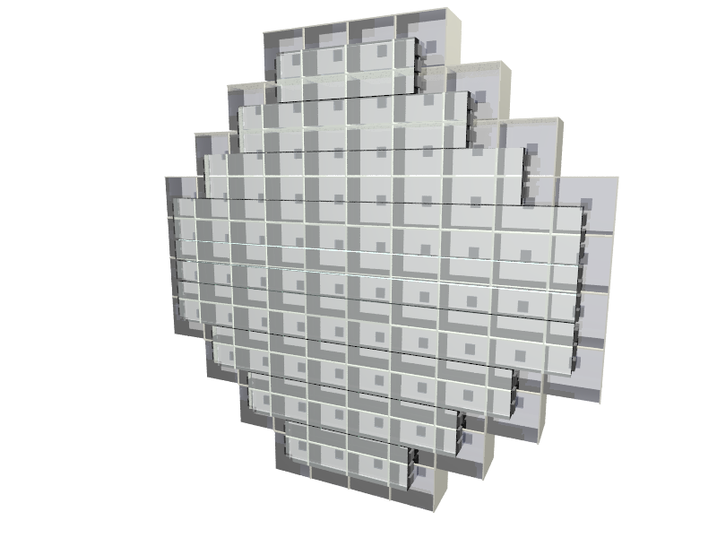
Downstream detector
Plastic Scintillators (PS)
Measure e⁺ timing
→ $μ→eννγ$ will have e⁺ & $γ$ time coincidence
12 fast plastic scintillators (BC418) + 2~3 MPPCs connected in series at both ends
LYSO crystals
Measure e⁺ energy
→ $μ→eννγ$ will have small energy (1~2MeV) compared to BG ($μ→eνν$)
76 LYSO crystals (2x2x2 cm³) + MPPC
20cm
Construction is finished.
Performance was tested in $μ$ beam.
(JPS2016Autumn 21aSE06)

Slide 6
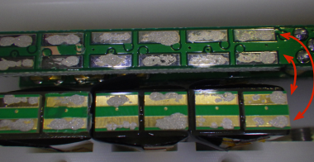
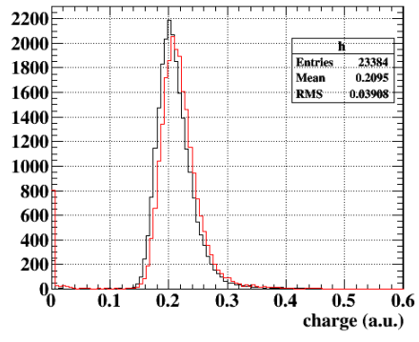
Re-production & test
Bad channels were found in the performance test.
Electric connection on plastic scintillator was unstable.
We used conductive epoxy instead of soldering to avoid heat damage → fragile
PCB
SiPM
Light yield with PS
All counters are reproduced by soldering.
Light yield did not change.
Resolution was measured to be good
for all ch (90~100ps, ⁹⁰Sr source)
Soldering
Conductive epoxy (different SiPM)

Slide 7
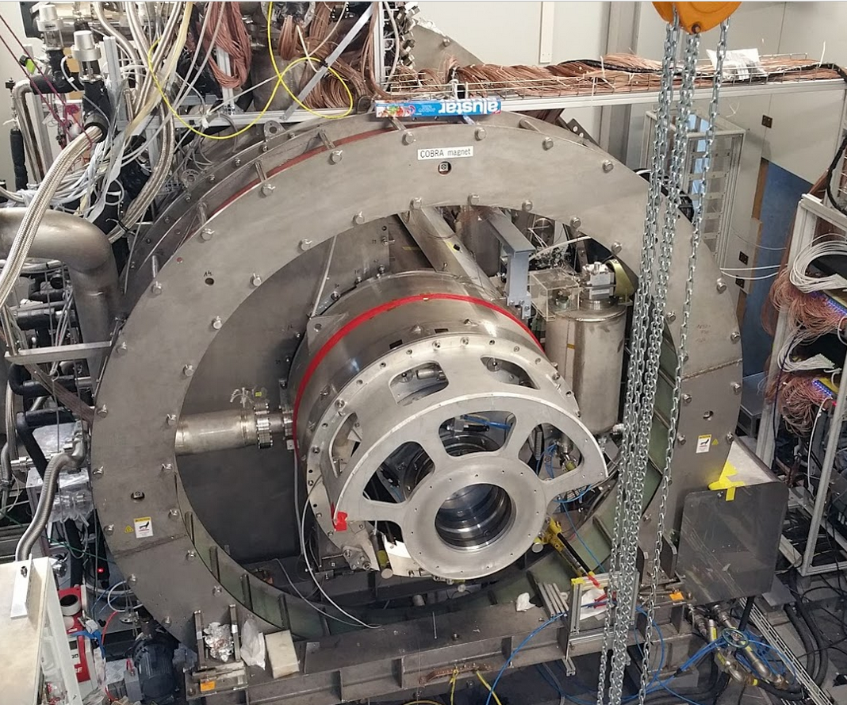
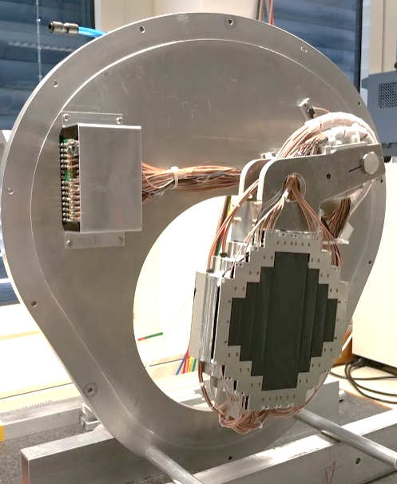
Installation
μ
feed-through
$$γ$$
RDC
e⁺
pneumatic pump mover
allows insertion of calibration target from DS
DS RDC is installed!
To be tested in $μ$ beam with LXe detector in the end of this year.

Slide 8
Upstream detector
Upstream detector is must be placed in the $μ$ beam before stopping target.
● Requirements
- Thin (not to affect the beam optics)
- Operational in high rate (~10⁸$μ$/s)
● Possible candidate 250 $μ$m scintillation fiber + SiPM readout
Thin, fast response → operational in high rate $μ$ beam
However, radiation damage might be serious.
<1/2 light yield decrease expected in 2 weeks.
JPS2017Spring, 18aK33-6

Slide 9
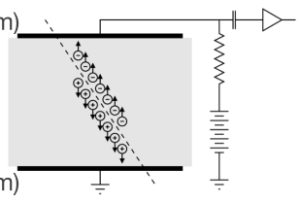
Diamond sensor
Diamond is an other candidate for US RDC.
It works similar to Si detector→
Properties:
☺ Radiation hard
☺ Can be very thin (~100$μ$m)
☺ Fast (<1ns)
😐 Small signal
e⁺ energy deposit is only ~50 keV for100$μ$m diamond.
Energy to create an e/h pair = 13eV (c.f. It is only 3.6eV for silicon.)

Slide 10
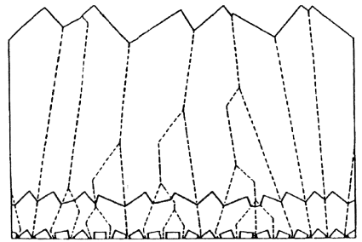
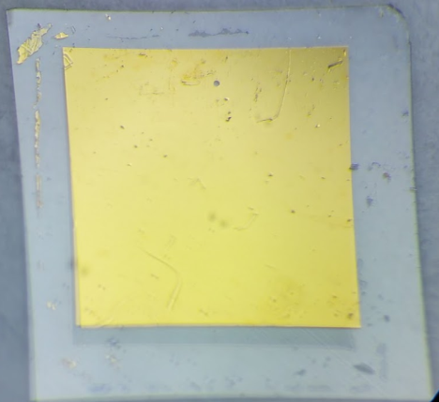
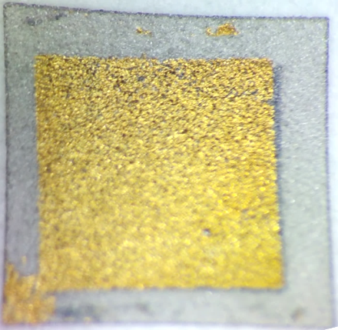
Synthetic diamonds
CVD (Chemical Vapor Deposition) diamonds are commonly used for sensors.
Two types of crystals are available:
Single crystal (scCVD): large signal, expensive Polycrystalline (pCVD): small signal due to trapping on boundaries, but cheap
polycrystalline diamond
Test of diamond samples: 4mm x 4mm x 100$μ$m, Applied Diamond, Inc.
Au (200nm) on both sides as electrodes
4 mm

Slide 11
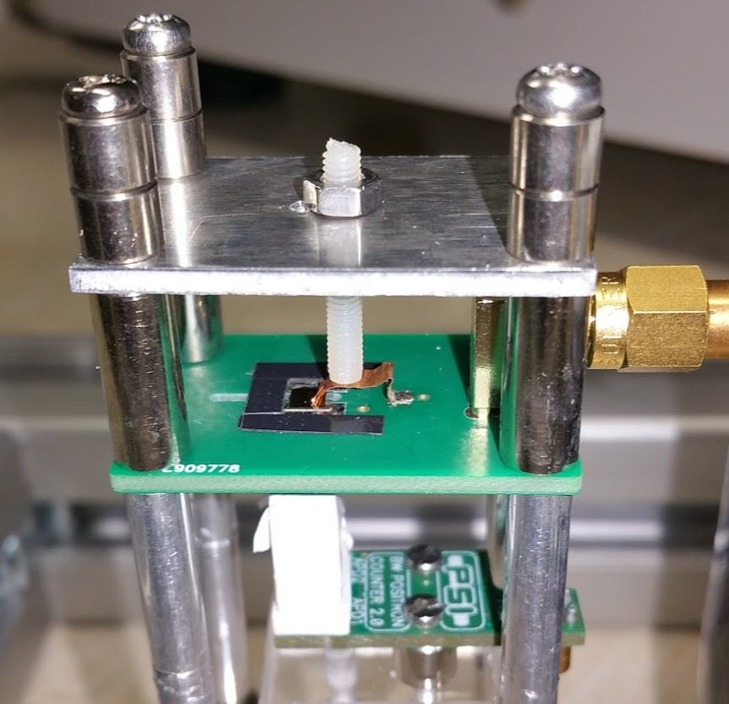
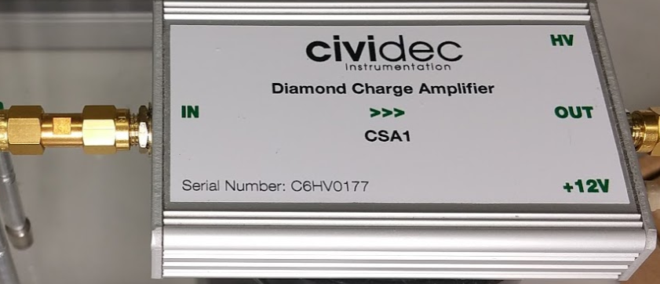
Test of diamond sensor samples
We tested diamond samples with radioactive sources placed on top of it.
diamond
electrodes
Charge amp (CIVIDEC C6HV0177), 5.7 mV/fC,
Readout:
Charge amp.
trigger scintillator
+ Waveform digitizer

Slide 12
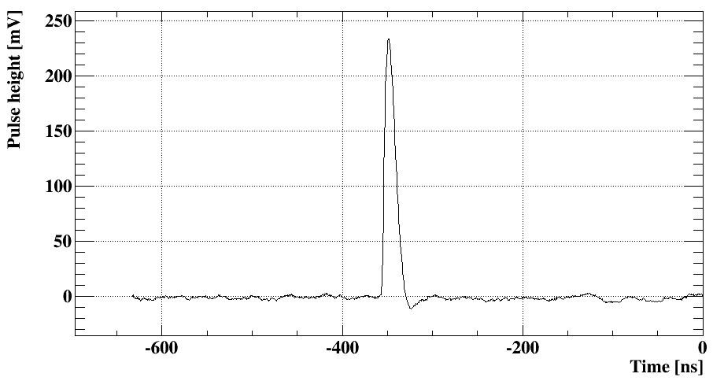
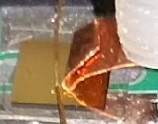
$α$ source signal
First, we checked the signal with ²⁴¹Am alpha source on wire.
α does not reach the trigger scintillator and stops inside diamond.
(Energy deposit ~ 5MeV)
diamond
²⁴¹Am on wire
Successfully observed the signal!
However, the signal was not observed for the pCVD sample (too small?).

Slide 13
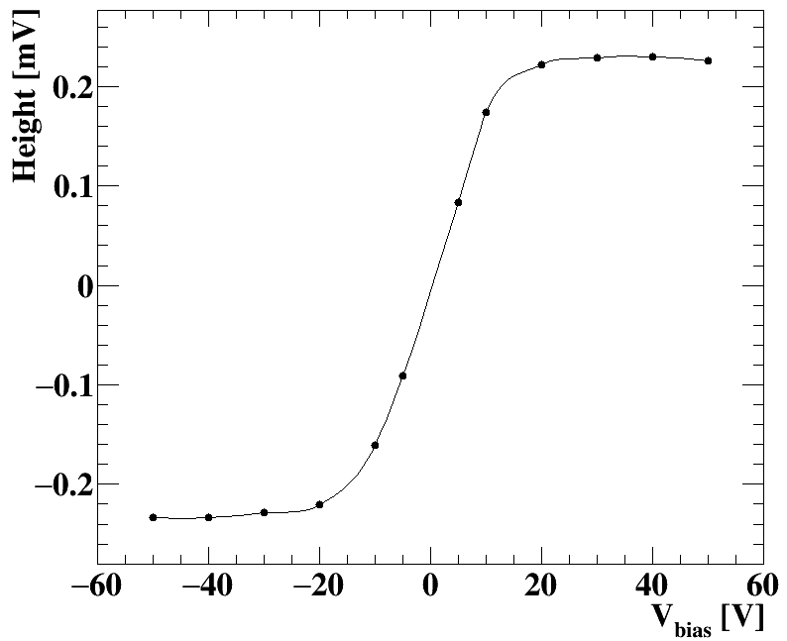
Pulse height vs. $V_{bias}$
Pulse height of $α$ signal is measured by changing $V_{bias}$ from -50V to +50V
Pulse height became maximum around ±20 V.
This is because the Charge Collection Distance (CCD) (= Average distance of e-h movement)
reached the size of the diamond thickness.
CCD increases are $V_{bias}$ increase.

Slide 14
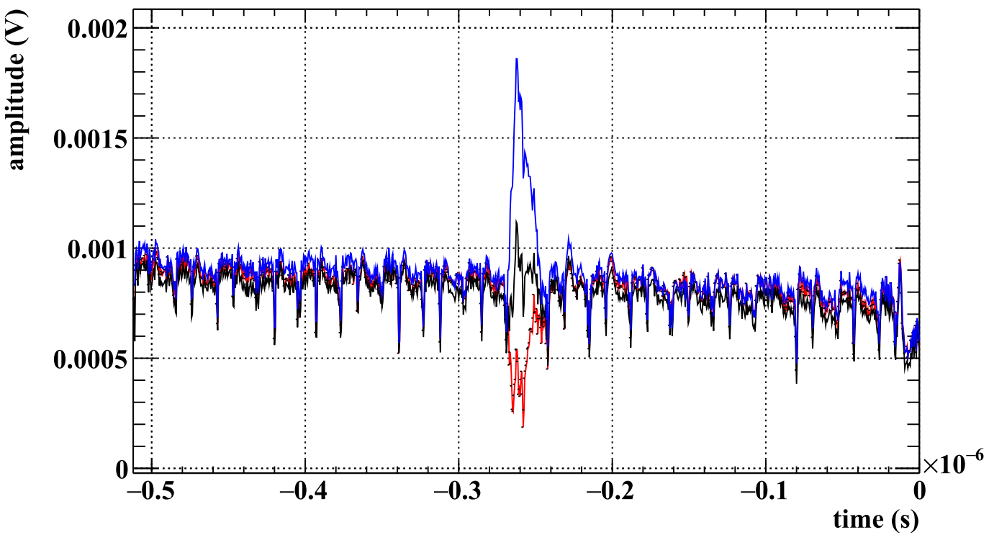
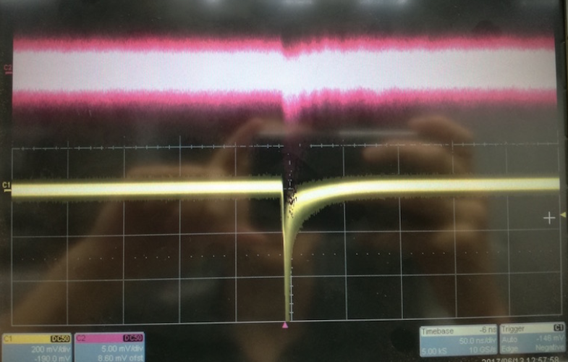
$β$ source signal
$β$ source signal is small. Energy deposit ~ 50keV.
The signal size (~2mV) was compatible with noise.
Therefore, it was not possible to distinguish the signal from noise.
The signal can be seen in the averaged waveform.
Averaged waveform
+50V
0V
-50V
5mV
diamond
trigger scintillator

Slide 15
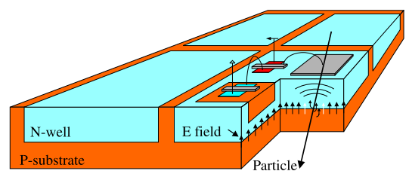
Next step
Possible approaches
- Amplifier modification (noise reduction?)
- Use silicon detector
Example:
50$μ$m thick silicon detector in Mu3e experiment @ PSI
Thin, fast, works in high rate
Availability? Radiation hardness?
If upstream RDC can detect radiative decay BG with 100% efficiency, $μ→eγ$ sensitivity will be improved from 4.3$×$10⁻¹⁴ to 3.9$×$10⁻¹⁴.

Slide 16
Summary
MEG II RDC detector identifies the main $γ$BG, $μ→eννγ$
Downstream RDC is already constructed and installed. It will be tested with LXe detector in $μ$ beam in the end of this year.
Diamond sensor was tested as a candidate for upstream RDC detector. Signal size was measured to be small for the electrons. Other possible solution: silicon detector?

