Slide 1
μ⁺ → e⁺γ 探索実験 MEG II の2015年コミッショニングの 結果と2016年の計画
Y. Uchiyama (The University of Tokyo) for MEG II collaboration
The 71st JPS Annual Meeting (19 Mar, 2016)

Slide 2
MEG final results are published.
But, this is not the end.
×10 improved sensitivity by MEG II

Slide 3
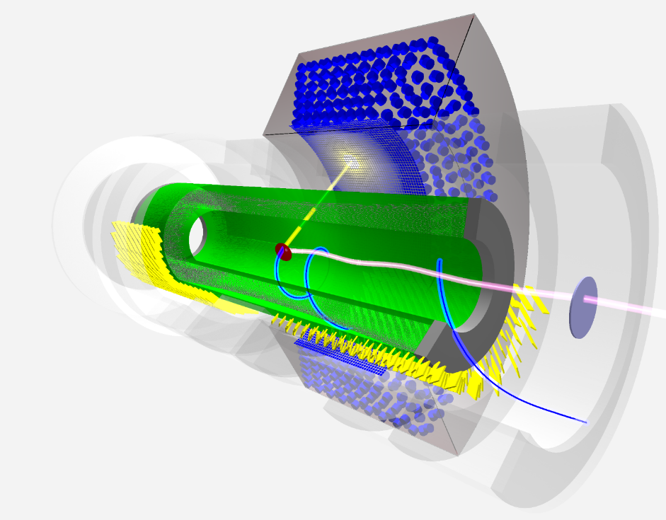
MEG II Experiment
Search for lepton-flavor violating μ → e γ decay
With unprecedented sensitivity 4 × 10⁻¹⁴
×10 improvement from MEG
High-intensity frontier experiment
Improve every resolution by factor 2
Aim at physics data taking from 2017
γ
e⁺
μ⁺

Slide 4
What we did in 2015
Test the mechanical integrity of the MEG II design
Complicated system of beamline–spectrometer
Beam study, tuning.
Then, finally a beam test with e⁺s from muon decays and a part of final timing counter.
In parallel, carry forward all the detector construction.

Slide 5
Best achievement in 2015
128 counters (half of downstream module)

Slide 6
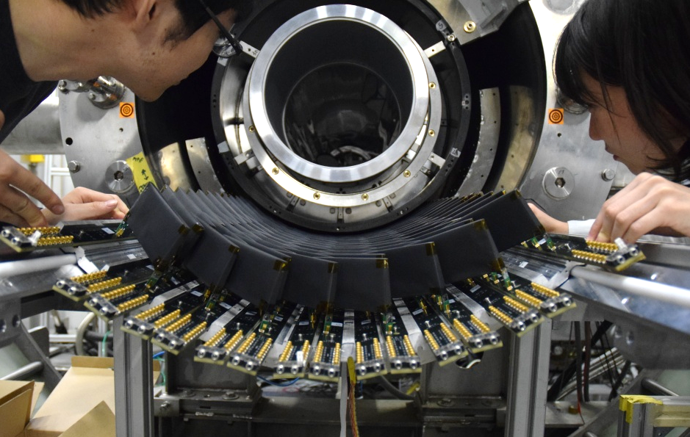
Spectrometer installation
Drift chamber (mock-up)
μ stopping target
SC magnet

Slide 7
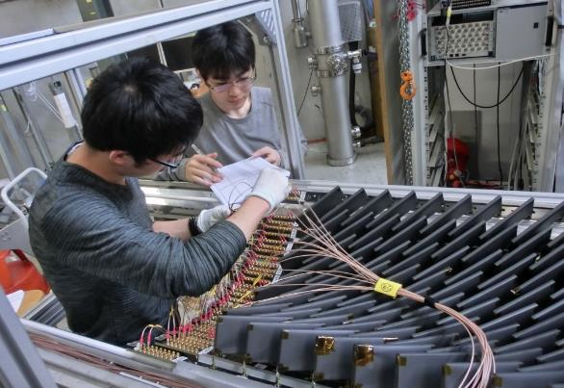
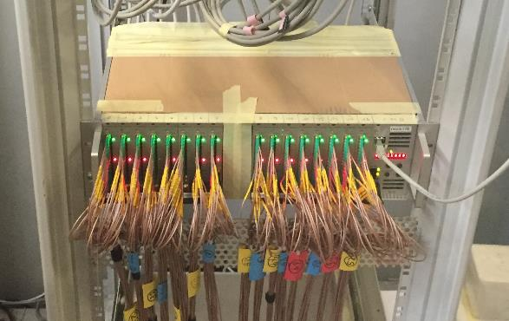
Pilot Run in 2015
We achieved
Build ¼ detector
Hardware works properly
NO dead channel
Test Laser calibration system
Laser pulse distribution into 8 counters.
Test MEG-II electronics system
Biasing OK, trigger works well.
Figured out several problems in readout system.
Test counters in MEG-II beam (Dec.)
Analysis of the data underway
19pCA-1 1 – 3
A 3U crate manages 256 channels

Slide 8
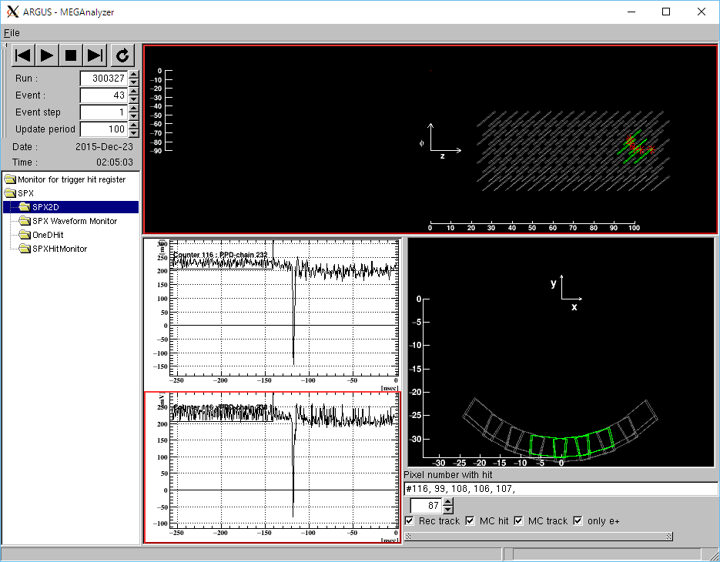
Typical clean event with multiple hits

Slide 9
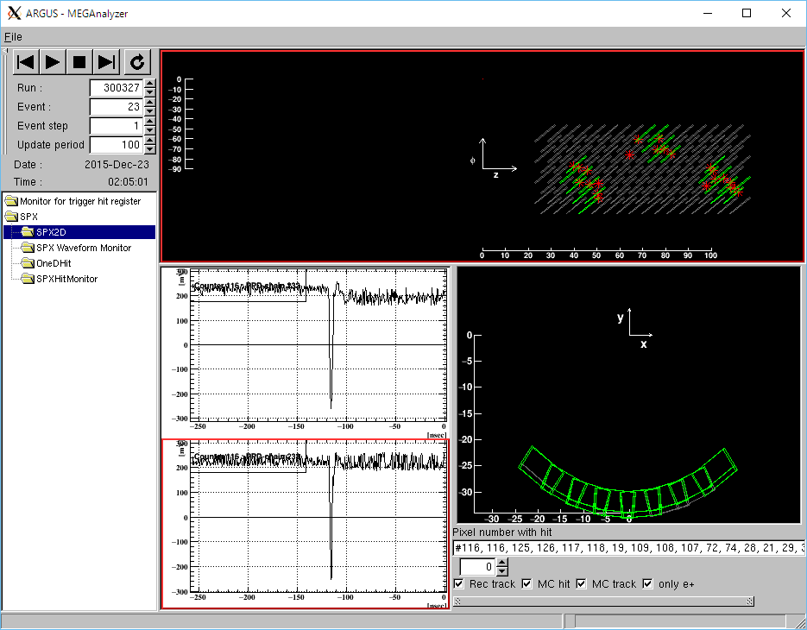
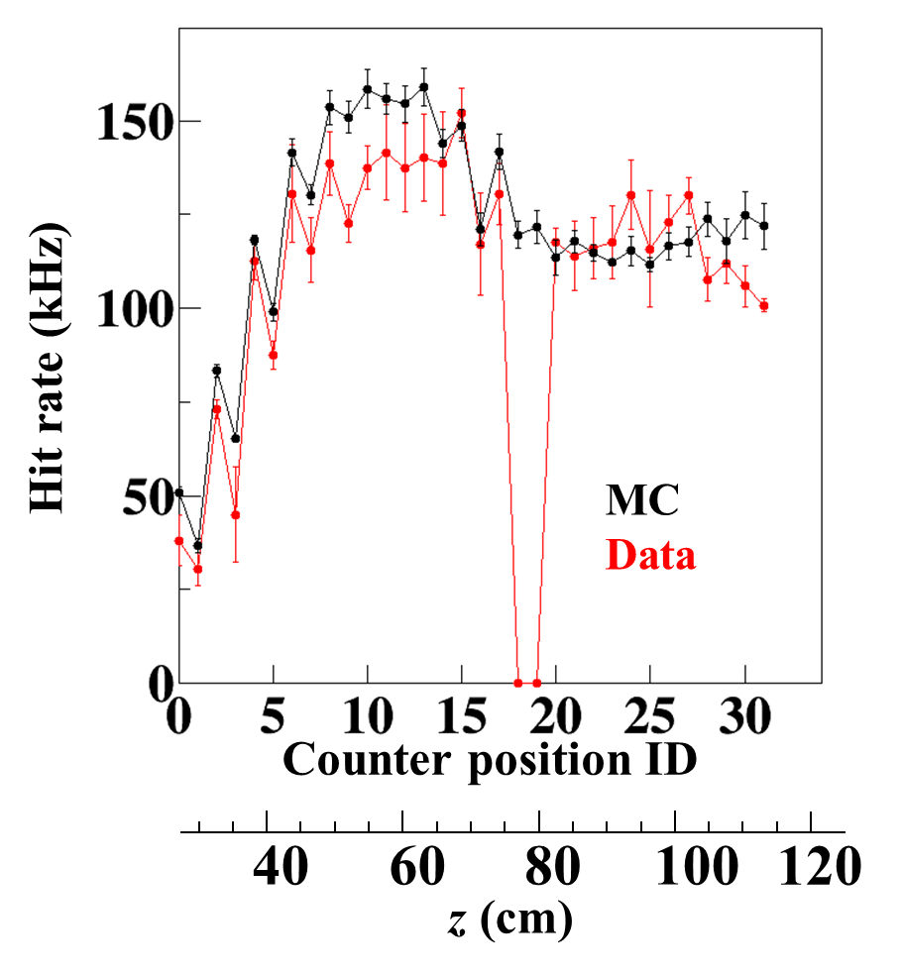
Event with multiple clusters

Slide 10
Electronics problems
WaveDAQ system
Multi-functional board
Amplifier, shaper, waveform digitizing, first level trigger & SiPM biasing.
First test in the pilot run.
Confirmed several functionalities
Biasing & triggering works well
Basic waveform sampling succeeded.
Figure out several problems
FPGA programming bug, mis cabling on board, lack of synchronization, missing calibration, and noise.
→ consequences
Data quality of the pilot run is not good.
Need intensive work to solve these problems before mass production
Carry out another pilot run with modified electronics in June
A 3U crate manages 256 channels
Electronics development takes more than expected
Before confirmation of all functionality, never order mass production.
Not possible full system to be ready in 2016

Slide 11
Status of detector construction

Slide 12
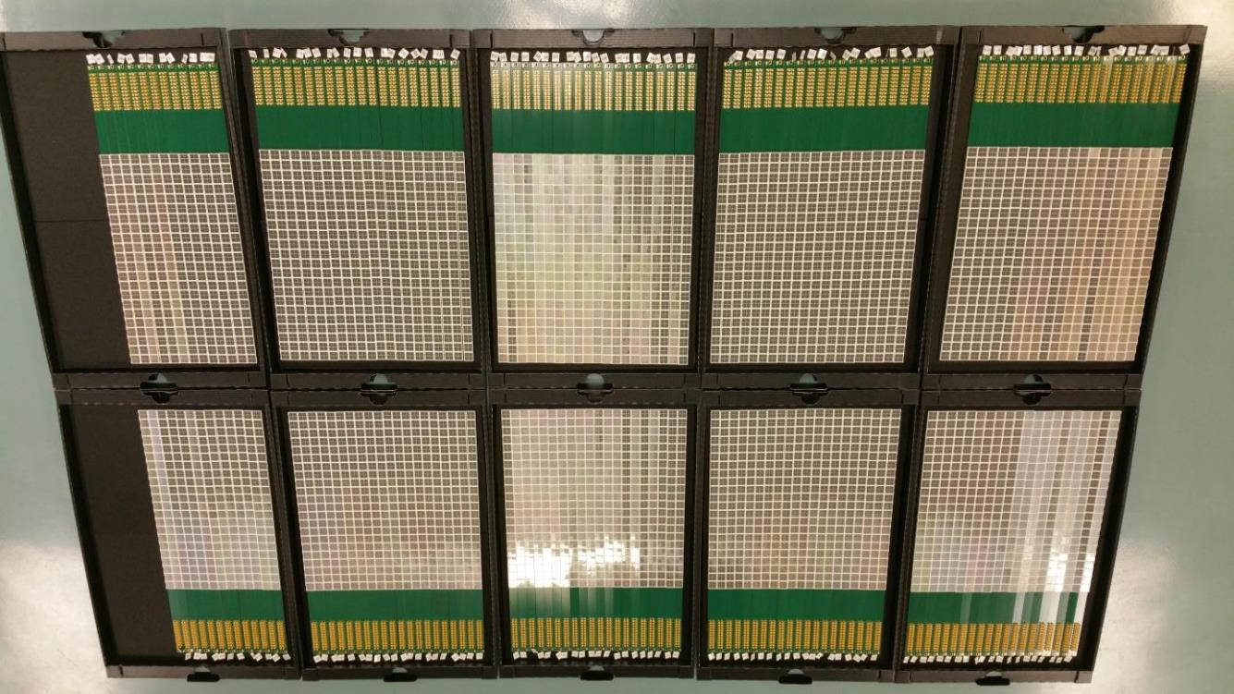
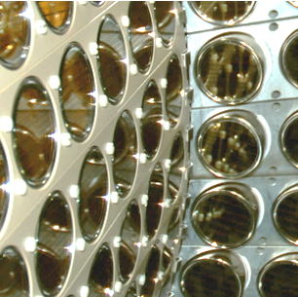
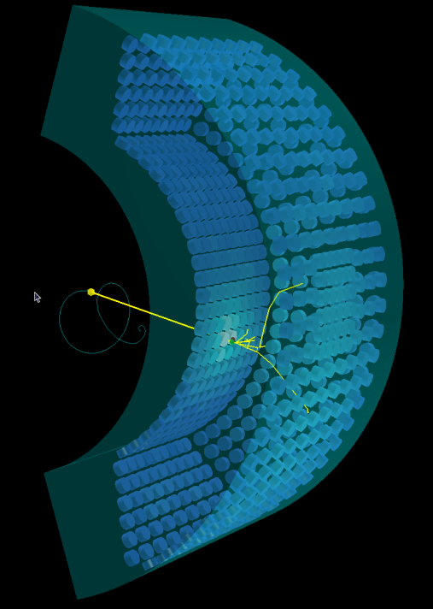
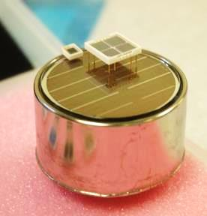
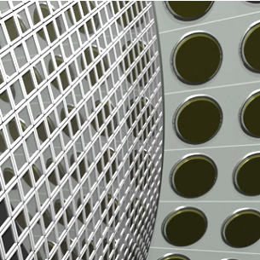
LXe photon detector
Normal MPPC (3×3 mm²)
VUV MPPC (12×12 mm²)
CG
2” LXe PMT
4092 MPPCs on 186 PCBs, ready for assembly.
Assembled detector will be installed in the area in Jul.
Test performance with 18-MeV γ line from Li(p,γ)Be (C–W accel.)
22pAN-3–4

Slide 13
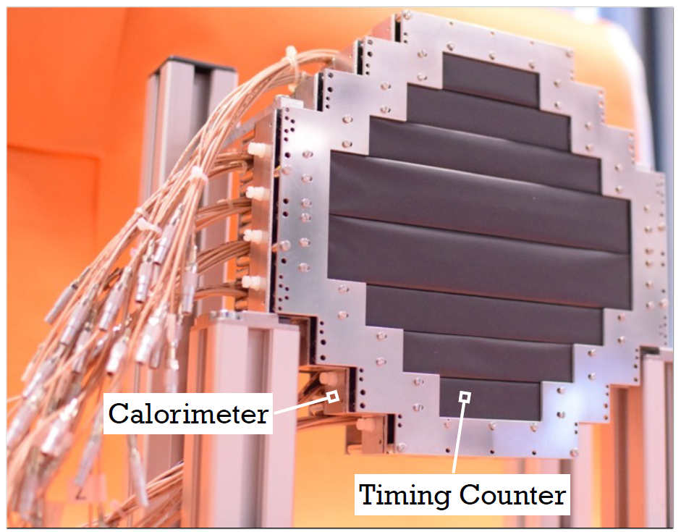
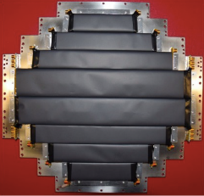
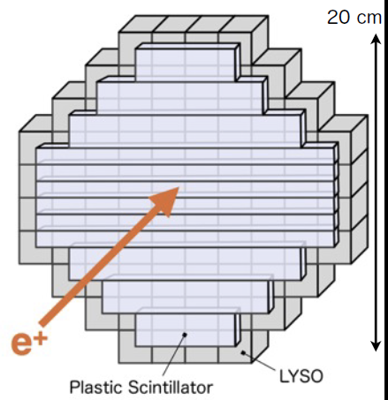
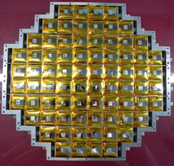
New BG-tagging detector (RDC)
Downstream detector was constructed
The functionality was tested with γ source (⁸⁸Y)
Upstream detector (scintillating fiber) study pushed forward
Influence on beam was directly tested in the beam study period
Small impact → positive for the adoption
19aAH-10–11
Put on the beam axis to detect
low-momentum e⁺ from μ→eννγ to tag high-energy γ
Low momentum
High energy → BG

Slide 14
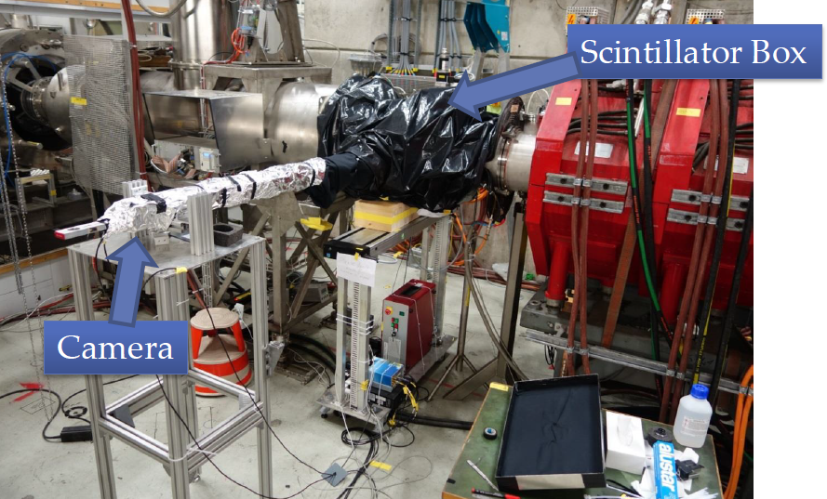
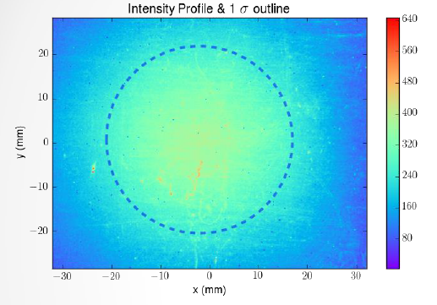
Target
In pilot run 2015
120-μm thick polyethylene target was used
with new target system implemented inside the DC inner wall
The new target system impact on beam will be carefully checked this May
Some beam transmittance loss observed last year. Due to the target system, too close to beam axis?
In pilot run 2016
Scintillating sheet target* will be used (130-μm thick BC-400)
An alternative candidate as target
Mechanically more rigid
Allow online monitoring of beam center/profile and intensity
Preliminary study done in 2015 shows a good result
* This is not an “Active target” with event-by-event reconstructing power

Slide 15
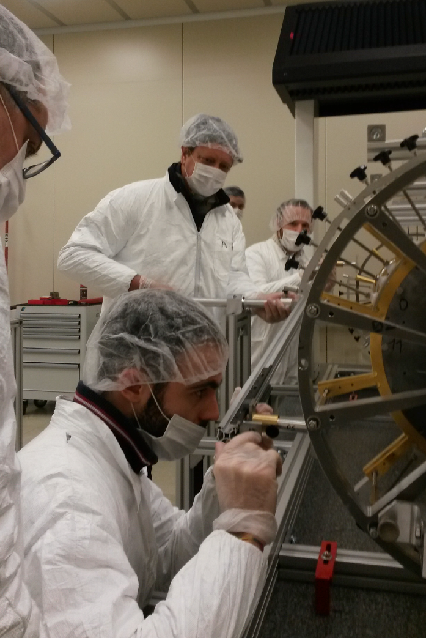
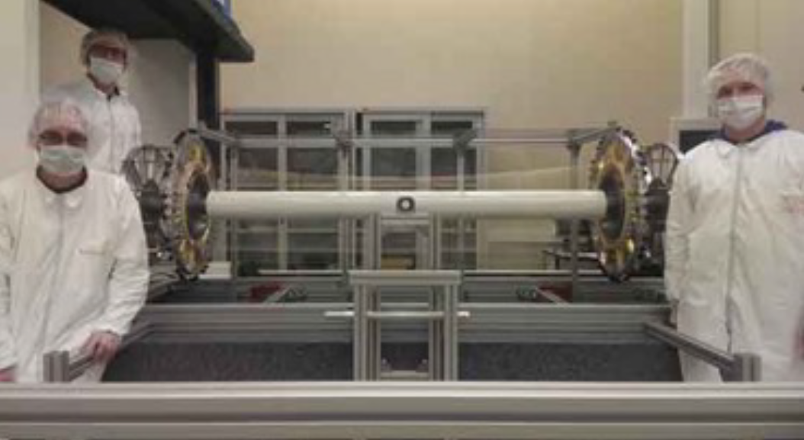
Drift chamber
2-m long stereo-wire drift chamber
completely new system for MEG II
Wiring on going
4 frames / day. 468 frames necessary.
To be continued till Aug.
However, an incident happened.

Slide 16
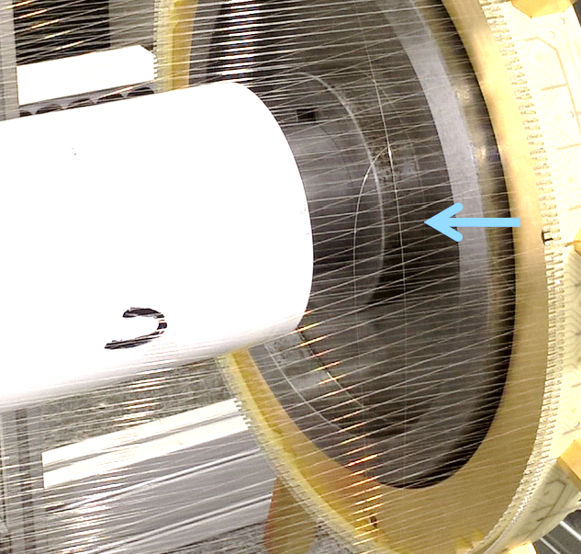
Wire break
On 8/Mar, during an elongation test (to nominal length)
13 50μm guard wires broke.
Later, other 4 guard wires + 1 cathode wire broke
Deep investigation is on going
So far, no clear reasons found
From the geometrical viewpoint, it is not possible.
Due to this incident, wiring is now stopped.

Slide 17
Schedule
PSI beam-time start
4 | 5 | 6 | 7 | 8 | 9 | 10 | 11 | 12
Beam & target test
DC installation
RDC test run
Michel run with TC & improved elec.
LXe test with C–W
LXe liquefaction, purification….
LXe installation
Another pilot run (with TC, RDC, & modified elec.) is planned in Jun–Jul
Full detector system will be ready in the end of this year.
Engineering run in 2017 with full elec. → physics run

Slide 18
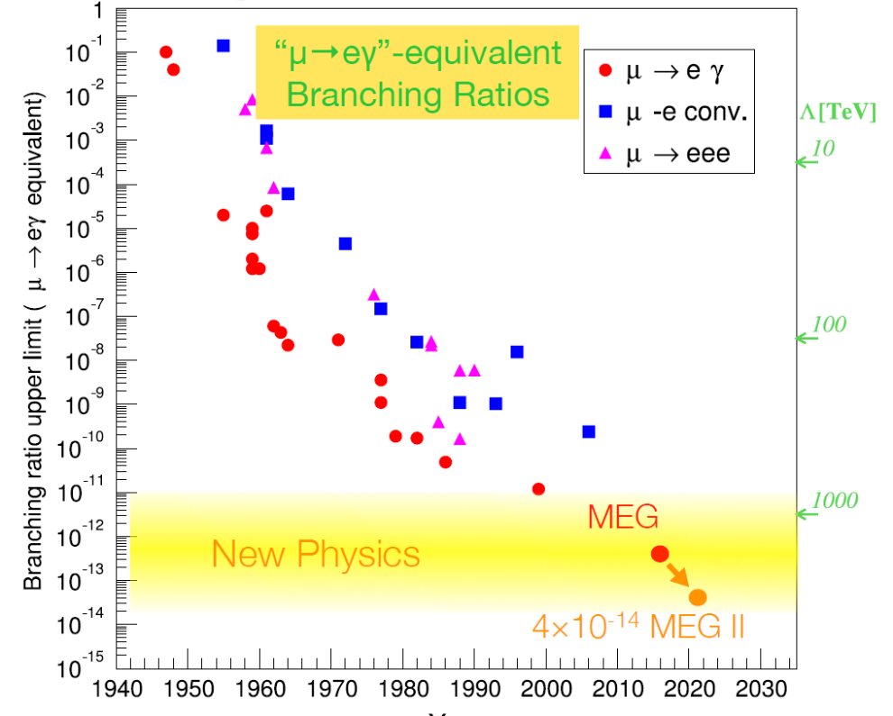
Summary
An important step was made in 2015
First pilot run with beam – TC – elec – Trigger/DAQ of MEG II
Detector construction progresses
Important issues were figured out to be addressed before the full MEG II run in 2017

