Slide 1
MEG II実験における 陽電子時間再構成法の研究 Study of Positron Timing Reconstruction in MEG II Experiment
西村美紀（東大）
他 MEGIIコラボレーション
日本物理学会 2016年秋季大会
宮崎大学（木花キャンパス）

Slide 2
Content
MEG II Requirement
Positron Spectrometer
Positron Timing Counter
Clustering of Positron Timing Counter Hits
Performance estimation with MC
Analysis with data
Prospects
Summary

Slide 3
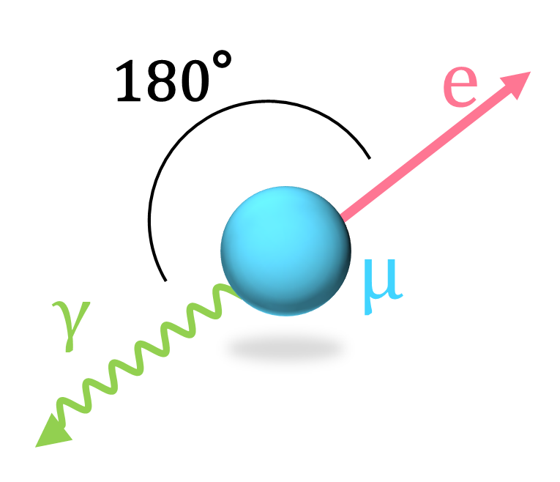
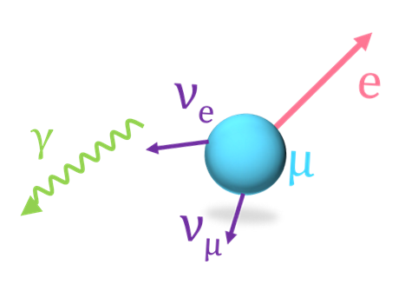
MEG II Requirement
In MEG II experiment we aim to search for charged lepton flavor violation, μ⁺ $→$ e⁺γ decay.
Signal: two-body decay
Dominant BG: accidental
52.8 MeV
Opening Angle 180°
Time Coincident
<52.8 MeV
Any angle
Time Random
105.6 MeV
Precise measurement of emission angle, energy, and timing of both positron and γ is essential.
⇒ Today’s topic is time measurement of positrons.

Slide 4
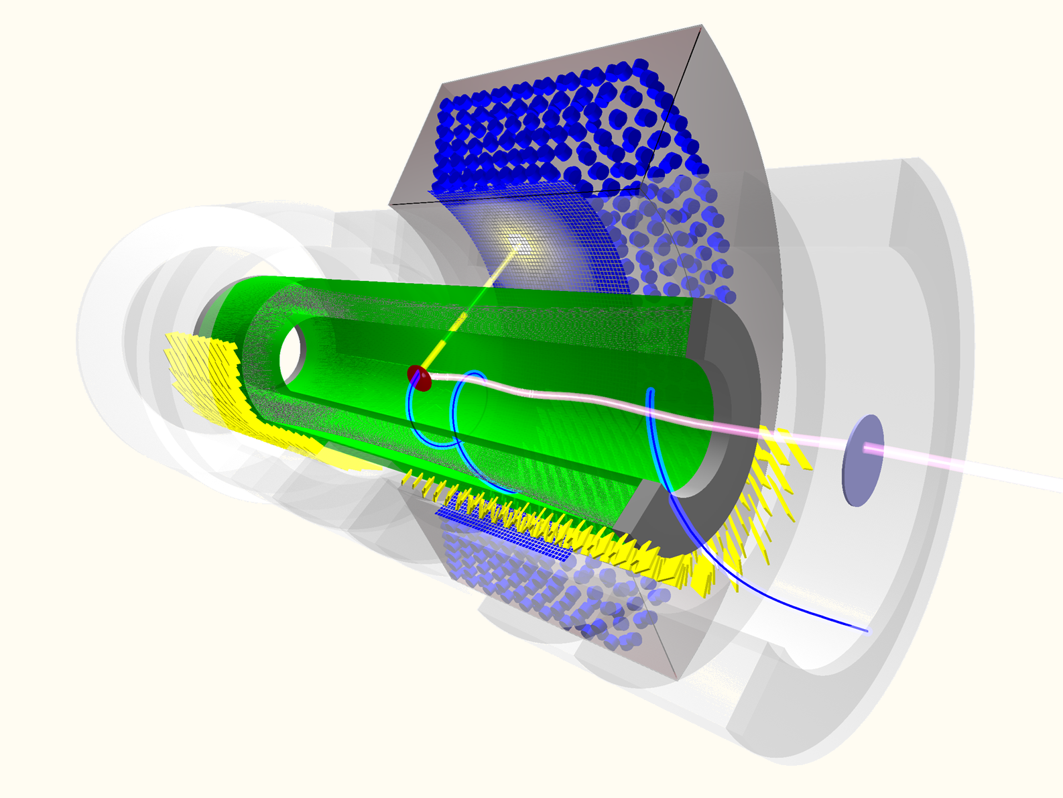
Positron Spectrometer
Liquid Xenon Gamma-ray Detector
Superconducting Magnet
Gamma-ray
Positron
Muon
Positron 1st turn
Wire Drift Chamber
Positron 2nd turn
Pixelated Positron Timing Counter
Radiative Decay Counter

Slide 5
Positron Spectrometer
Liquid Xenon Gamma-ray Detector
Superconducting Magnet
Gamma-ray
Reconstruct positrons in each detector, then check matching.
Positron
Muon
Positron 1st turn
Wire Drift Chamber
Positron 2nd turn
Pixelated Positron Timing Counter
Radiative Decay Counter

Slide 6
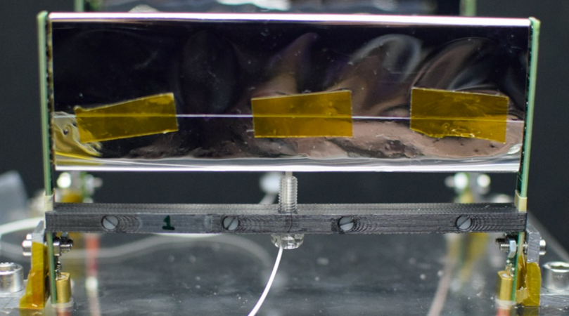
Timing Counter
6 SiPMs in series at the both ends
AdvanSiD (Italy) 3x3 mm², 50x50 um² pixels
12 cm
4 cm or 5 cm
256 x 2
(up and down stream) counters
Thickness 5 mm
PCB
Fiber for laser light
Fast Plastic Scintillator BC422
One Counter
Time Resolution: 70-80 ps
Position Resolution: ~ 1 cm
Since positron hits multi-counter, overall resolution is σ~30 ps (demonstrated in beam test)
Back plane
Long PCB ~80 cm
Multi layer, coaxial like
Cable（RG178）
Non-magnetic

Slide 7
Clustering
The TC is pixelated by 512 scintillator counters.
Positron comes to the TC in high rate. (a few MHz in the TC region.)
→ Clustering of TC hits is necessary.
Counters
* Hits
DCH is tracking just before TC.
cluster
All hits from the same track and the same turn should be included in a cluster. Following parameters should be checked.
Cluster reconstruction efficiency
Miss hit in a cluster
Contamination hit of a cluster

Slide 8
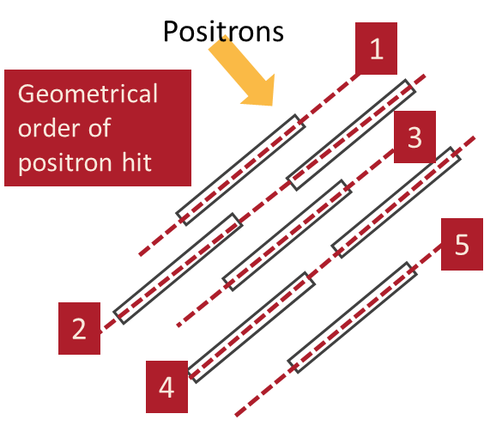
Clustering Methods
Geometrical order of positron hit
Local Geometrical Clustering
Make chain with geometrical order of positron hit one by one.
Good: Don’t need any calibration among the counters.
Bad: The effect of contamination hit is large. Geometrically far hits are separated into the different clusters.
Global Clustering (NEW)
Use relationship b/w hit time and counter position information.
Good: less affected by contamination hits. Combine geometrically far hits.
Bad: Need good time calibration among the counters.
MC
(signal and 1st turn)

Slide 9
Global Clustering
③
1 ns width
②
Measured time (sec)
Found peak
Geometrical order
Projected time (sec)
Closer view
Algorithm
① Make projection for every hit time with geometrical order dependence.
② Peak Search
③ Make clusters in certain region (1 ns) from each peak.
① projection

Slide 10
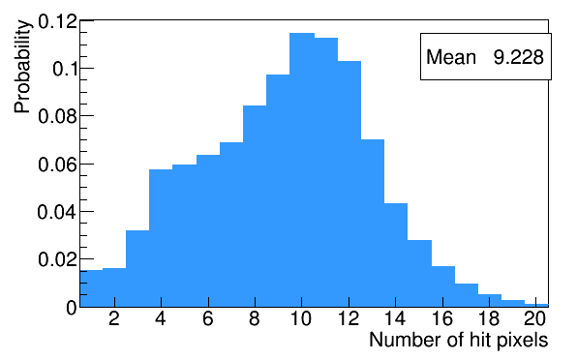
Study of clustering performance with MC
Estimate the clustering performance with MC.
Performance is estimated for “target cluster”
Cluster of 1st turn in TC
Incident Momentum > 35 MeV
Vertex of muon decay is on target
The positrons from muon decay out of target are identified by DCH.
# of hit > 3
MC Set Up
Geant4
Generate muons, which are stopped on a target.
Positron from normal muon decay hits the TC.
Muon mixing rate is 7x10⁷ μ/s (same as pilot run)
Detector implementation follows a pilot run conducted on June to compare to data.
¼ TC, No DCH
Signal positron
Michel positron
(> 35 MeV, first turn)

Slide 11
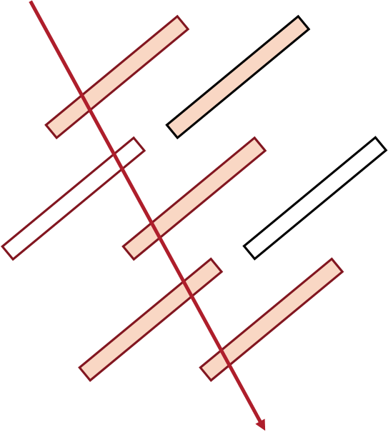
Cluster Quality
%
contamination
10
8
6
4
2
Miss hit
0
Reconstructed Clusters
True Cluster
%
10
8
Clusters which have miss hit are not so many. (~ 1%)
However some clusters (~15 %) have contamination hit.
→ Cut with the fit result or reconstructed position will be studied.
6
4
2
0

Slide 12
Efficiency vs Incident Momentum
Cluster reconstruction efficiency :
(reconstructed cluster)
(# of true cluster of 1st turn)
Matching b/w reconstructed cluster and true cluster is done with first hit in reconstructed cluster.
Efficiency
Nhit > 3
Incident Momentum (MeV)
Around the signal region 99.3 % efficiency is achieved.

Slide 13
Efficiency vs Incident Momentum
Cluster reconstruction efficiency :
(reconstructed cluster)
(# of true cluster of 1st turn)
Matching b/w reconstructed cluster and true cluster is done with first hit in reconstructed cluster.
Efficiency
Nhit > 3
Incident Momentum (MeV)
Incident Momentum (MeV)
N = 5
N = 10
At larger # of hits, efficiency is better.

Slide 14
Performance of Time Reconstruction
Check the performance of time reconstruction with difference b/w reconstructed first hit time and true time of it.
N = 8: As an example
σ(Reconstructed time - true hit time)
Expectation from known counter resolutions
σ = 30.4
σ is larger than expectation in N hit > 8
⇒Limit of the linear fit for hits.

Slide 15
Comparison with Data
Apply this clustering algorithm to data in pilot run.
¼ TC in the MEG II site.
Muon beam (MEG II nominal rate. ~7x10⁷ μ/s on target)
Trigger: > 1 hit in TC
To check consistency
Standard deviation of projected times of clustered hits.
(RMS of projected time)/$\sqrt{N−1}$ → resolution @ large # of hits
Comparison with the resolutions with the different analysis
Check the resolutions with certain counter combinations.

Slide 16
Standard deviation of projected times
Data, MC (all), MC (target cluster)
Resolutions of 28.5 ps (MC), 31.1 ps (Data) at n hits = 8.
The distributions are consistent with MC, especially at smaller # of hits. At larger # of hits, the accuracy of the timing calibration affects them.

Slide 17
Resolution Estimation for Data
Even-Odd analysis
To be estimate the TC multi-hits resolutions.
Choose combination of the counters to be analyzed.
$(\sum_{i}^{N/2}{T_{2×i}})/N−(\sum_{i}^{N/2}{T_{2×i+1}})/N$
N: number of hits
Its resolution should be the same as $(\sum_{i}^{N}{T_{i}})/N$ if each time measurement does not have any correlation with each other.
$$T_{\text{3}}$$
$$T_{\text{5}}$$
For example
at N=6: $({(T}_{\text{1}}+T_{\text{3}}+T_{\text{5}})/3−(T_{\text{2}}+T_{\text{4}}+T_{\text{6}})/3)/2$
$$T_{\text{1}}$$
$$T_{\text{2}}$$
$$T_{\text{4}}$$
$$T_{\text{6}}$$

Slide 18
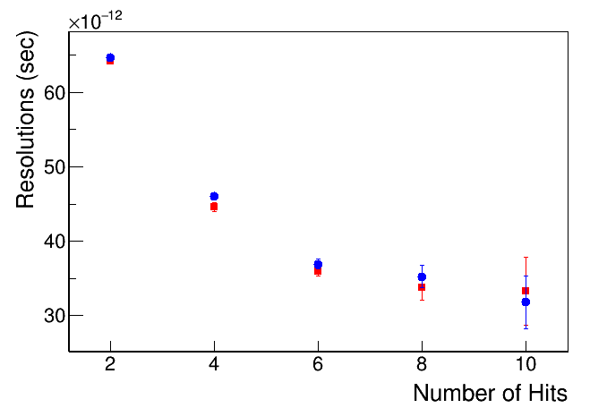
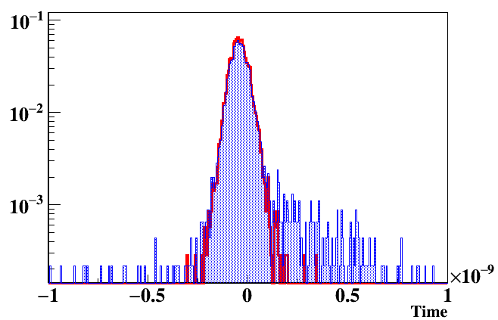
Even-Odd analysis w/ and w/o clustering
@ n = 4
w/o clustering
w/ Clustering
w/o clustering
w/ Clustering
Since the tail event are reduced due to the new clustering algorithm, the resolutions become better.
Resolutions of 33.7 ps w/ clustering, 35.1 ps w/o clustering at N = 8
(31.1 ps (Data) at n hits = 8 from standard deviation. )

Slide 19
Prospects
Use reconstructed position of TC instead of geometry order
Iteration
Cut contamination hits
Combine miss hits
Combine with DCH reconstruction and the additional iteration.

Slide 20
Summary
μ⁺ $→$ e⁺γ search requires precise timing measurement of positron.
New clustering algorithm for TC is developed.
Its performance is checked.
Miss hit and contamination are checked. It have room for improvement with detailed cut.
Efficiency around signal region is 99.3 %.
Clustering is applied to data.
The distribution of the RMS/$\sqrt{N−1}$ is checked as estimator for the analysis and ~30 ps resolution is obtained.
The new clustering analysis improves the resolution with even-odd analysis.

Slide 21
Back Up

Slide 22
In this case, two clusters are made.
No Hit

Slide 23
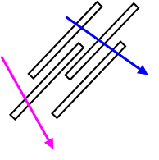
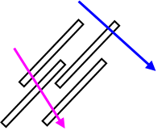
Tail events
Tail in “clean” events come from hits from different turns of the same positron.
They affect final time measurement.
These kind of hits should be separated by
Tracking
More precise timing cut in clustering
$$T_{\text{1}}$$
2nd turn
$$T_{\text{3}}$$
2nd turn
$$T_{\text{3}}$$
$$T_{\text{1}}$$
$$T_{\text{4}}$$
1st turn
1st turn
$$T_{\text{2}}$$
$$T_{\text{2}}$$
$$T_{\text{4}}$$
$$({(T}_{\text{1}}+T_{\text{3}})/2−(T_{\text{2}}+T_{\text{4}})/2)/2$$
⇒ make positive tail.
$$({(T}_{\text{1}}+T_{\text{3}})/2−(T_{\text{2}}+T_{\text{4}})/2)/2$$
⇒ make positive tail.

Slide 24
Cluster quality (n = 10)
N = 10

Slide 25
Cluster quality (n = 5)
N = 5

Slide 26
The cut for the clustering
After cut
w/ every hits (including 2nd turn)
The time difference b/w a peak and its next peak.

