Slide 1
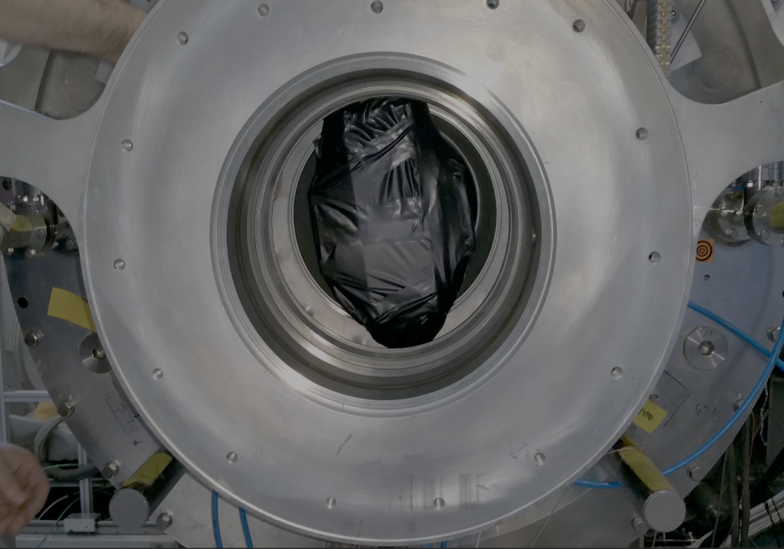
Engineering run of the MEG II downstream Radiative Decay Counter in the muon beam
II
家城 佳,
他MEG IIコラボレーション

Slide 2
MEG II
RDC detector
Engineering run

Slide 3
MEG II
RDC detector
Engineering run

Slide 4
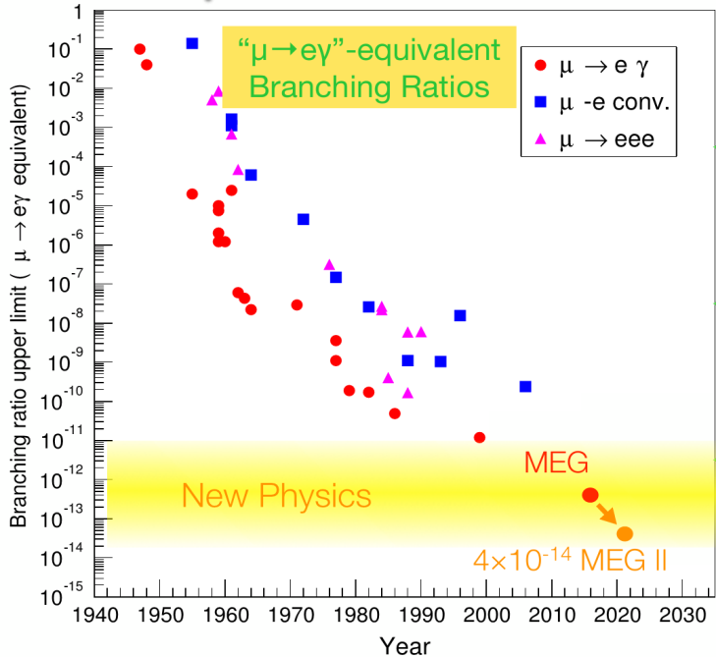
μ → eγ search
$μ→eγ$ is the good probe for new physics.
γ
μ⁺
γ
e⁺
$$\tilde{μ}$$
$$\tilde{e}$$
MEG$4.2×{10}^{−13}$
μ⁺
e⁺
BSM
(ex. SUSY)
MEG II$4.0×{10}^{−14}$
MEG II will search for $μ→eγ$ with 10 times better sensitivity!

Slide 5
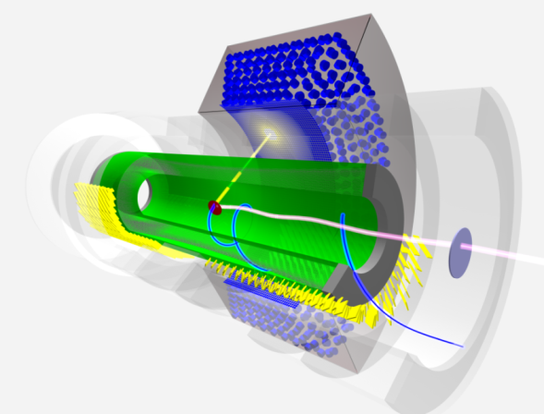
MEG II experiment
LXe γ detector
小川, 松澤
22aSF-9,10
Summary talk
内山 21aSE-1
Additional detector to identify BG events家城、岩井
21aSE-6,7
all resolutions
$×$2
$×$2
gradient
B-field
γ
e⁺ efficiency
e⁺
e⁺ drift chamber
& timing counter
西村、中尾、宇佐見
23aSG-3,4、23aSF-9
μ⁺ beam
intensity $×$2 7$×$10⁷ μ/s
Detectors will be ready by 2017!

Slide 6
MEG II実験
RDC detector
Engineering run

Slide 7
Radiative Muon Decay
$μ→eγ$ signal
Main BG (accidental)
γ
γ
$$ν_{e}$$
$$\overline{ν_{μ}}$$
μ⁺
+
μ⁺
e⁺
E_{e}=E_{γ}=52.8 MeV
Back to back
Time coincidence
e⁺
Sources of BG γ (E_{γ} > 48MeV)
Radiative Muon Decay Annihilation In Flight (RMD, $μ→eννγ$) (AIF, e⁺e⁻ → 2γ)
RDC aims to identify RMD
2 : 1

Slide 8
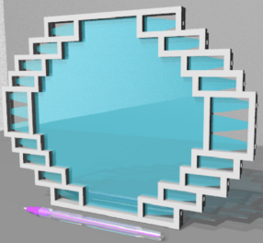
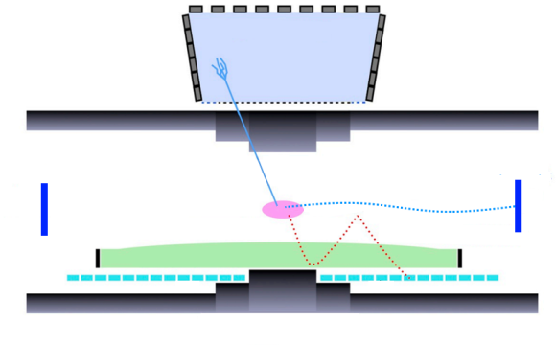
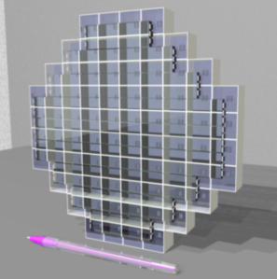
Radiative Decay Counter (RDC)
RMD events can be identified by detecting low energy e⁺ which is coincident in time with γ detected by LXe.
US RDC
DS RDC
※not
approved yet
LXe detector
→ next talk
RMD γ
RMD e⁺
→ this talk
μ beam
accidental e⁺
e⁺ drift chamber
e⁺ timing counter
RDC may reduce the γ BG to half and improve the μ→eγ sensitivity by 23%.

Slide 9
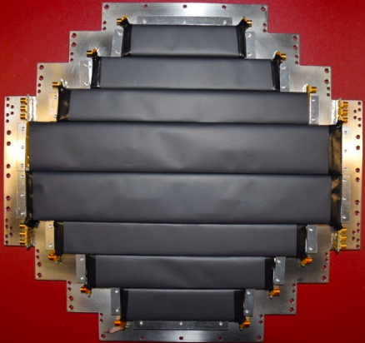
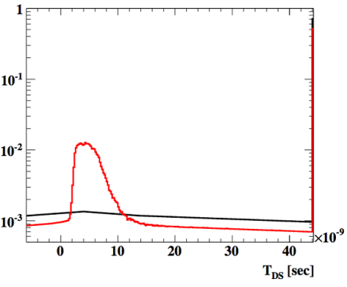
DS RDC (Plastic Scintillator)
Plastic Scintillator (PS) detects the timing of e⁺.
12 counters with
reflector & light shielding
2 or 3 MPPCs (S13360-3050PE) at both ends,
connected in series
19cm
LXe-PS timing diff (MC)
RMD peak
Accidental e+
RMD + AIF (γ at LXe)

Slide 10
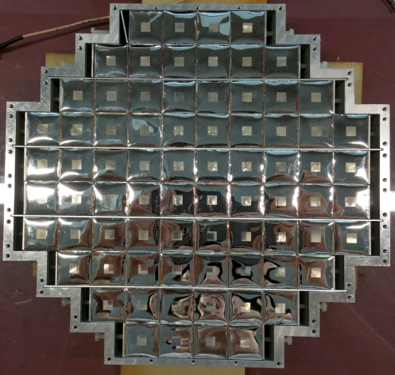
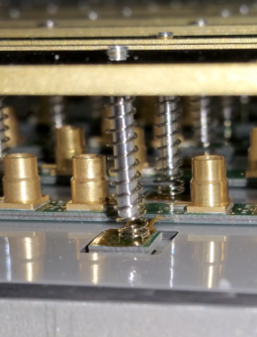
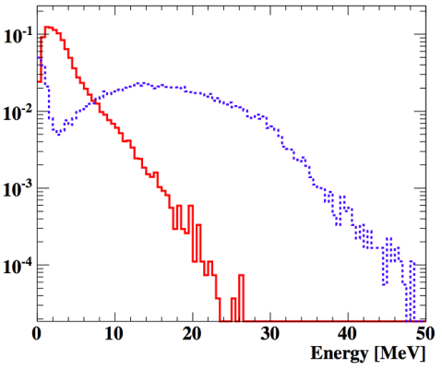
DS RDC (LYSO crystal)
2cm cube crystal $×$ 76
LYSO distinguishes RMD e⁺ and Michel e⁺ by energy.
MPPCs (S12572-025P) are pushed with spring
Energy distribution (MC)
RMD e⁺ (E_{γ}>48MeV)
Michel e⁺

Slide 11
MEG II
RDC detector
Engineering run
Setup & calibration
Analysis of RMD event

Slide 12
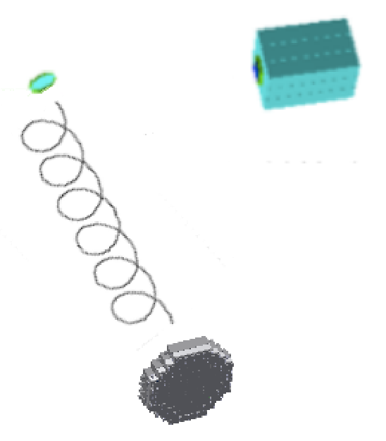
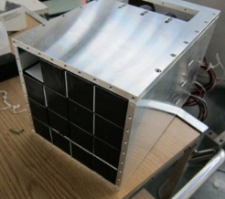
Engineering run
Operation test of complete detector in the μ beam for the first time
μ⁺
Purposes:
- RMD detection capability test
- Identify problems
BGO
^{γ}
Date:
30 Jun. ~ 8 Jul. 2016
BGO crystals were used as γ detector instead of LXe detector.
e⁺
BGO detector
4.6cm
20cm
RDC

Slide 13
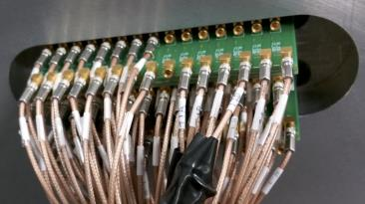
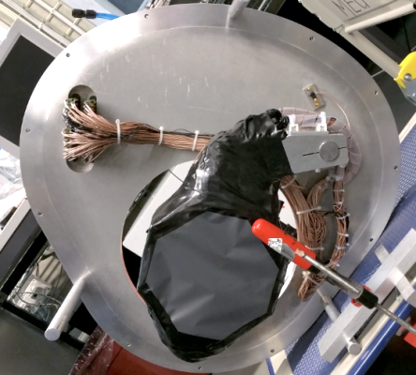
Mounting & signal check
feed-through
Moving arm RDC is mounted on moving arm which allows the LXe calibration target etc. to be inserted from DS.
Feed-through A PCB-based feed-through transmits the signal from vacuum to outside.
Signal check Unfortunately, we found 4 bad channels in PS out of 24. The conductive epoxy that connects MPPCs on board was mechanically weak. → To be repaired
movable
RDC

Slide 14
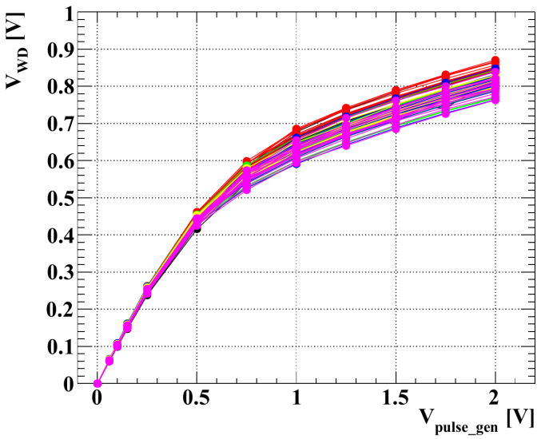
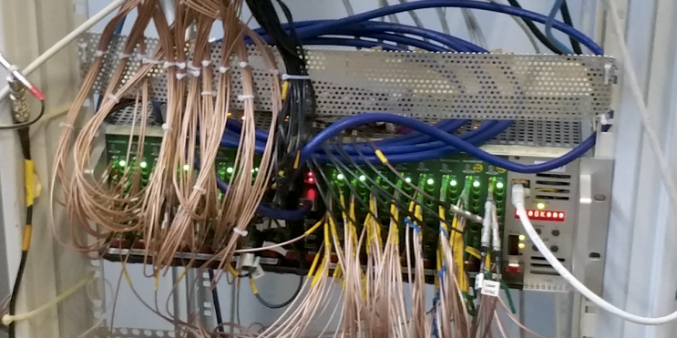
Electronics: WaveDream
WaveDream: Waveform digitizer + Amp. & shaper + HV Being developed @PSI for MEG II
WD readout vs. pulse gen. input
We used this board for all detectors.
Board 2
Board 3
Board 4
Board 5
Board 6
Board 7
Non-linearity was found in the waveform input/output. We correct this effect by using a response function obtained by using pulse gen.
Current of the LYSO channels were above the maximum rate (~500$μ$A) for the central part of crystals, so we had to lower the HV.
→ We can fix these issues in the next time.

Slide 15
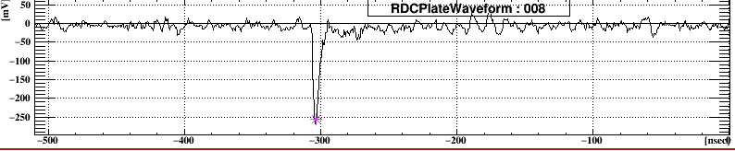
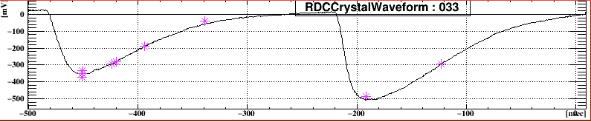
Waveform analysis
Example of PS waveform
Gain 100, shaper on
Example of LYSO waveform
Gain 1, shaper off
PS hit was reconstructed by requiring a coincidence of both side of MPPCs.
LYSO energy is calculated for each pulse by integrating the waveform.

Slide 16
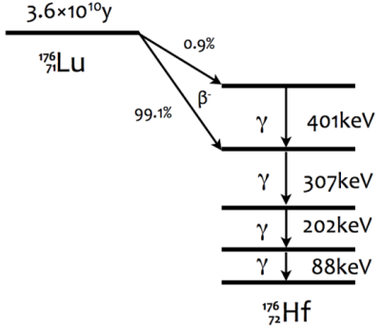
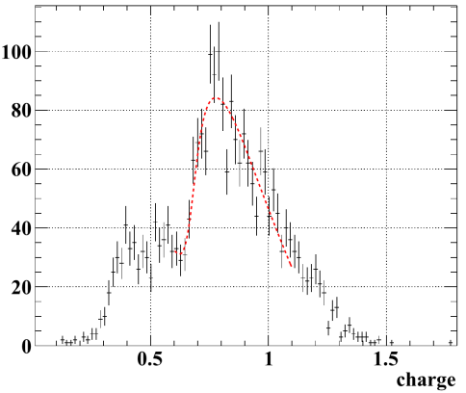
Calibration of LYSO
We calibrate LYSO crystals using intrinsic radiation signal.
Fit function is:
(γ peaks + β decay spectrum) ⊗ Gaussian smearing (σ = E_{res})
Example of the fit
307+202 +88
202 +88
307 +88
88
Energy

Slide 17
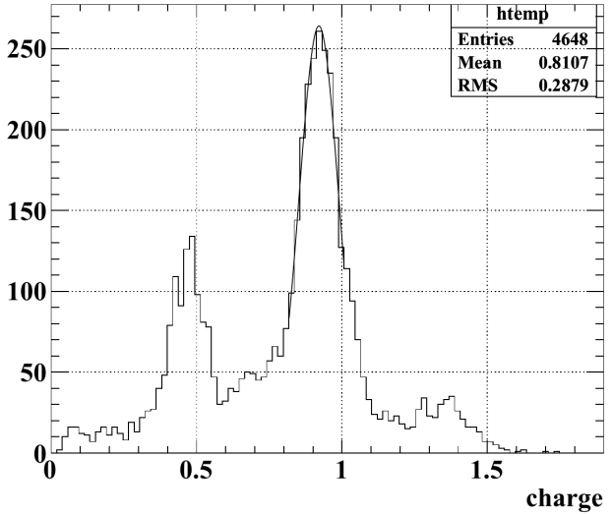
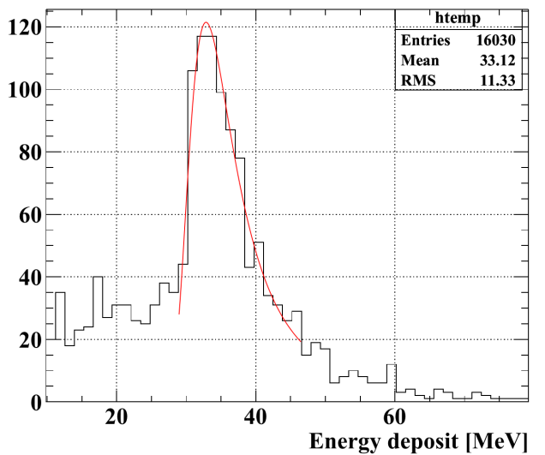
Calibration of BGO detector
The absolute energy of BGO crystal is calibrated by using ⁸⁸Y source.
Channel-by-channel relative calibration is done by using cosmic-ray.
Cosmic-ray energy
⁸⁸Y charge
γ 1.836MeV
γ 0.898MeV
Energy scale problem:
The energy deposit of cosmic-ray is ~20% lower than expected.

Slide 18
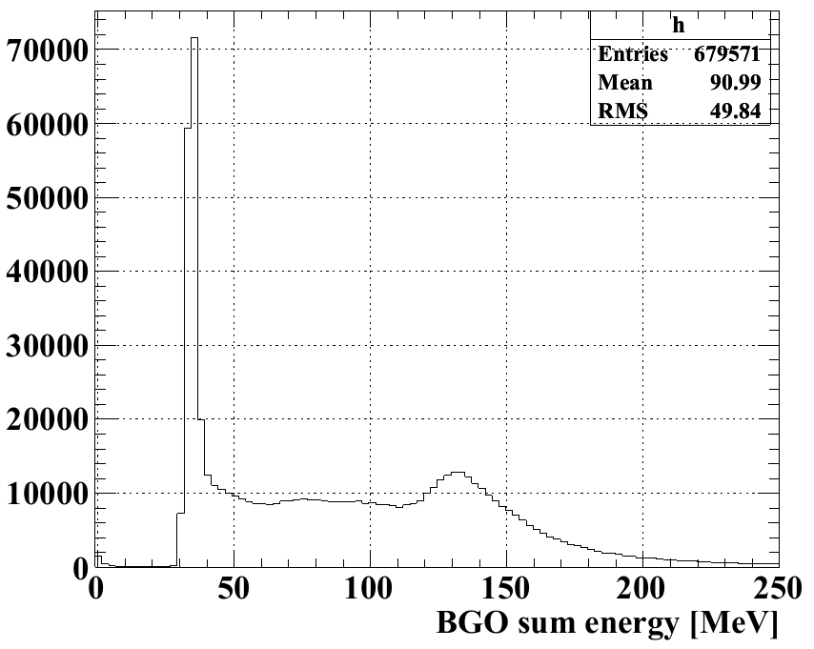
Physics data taking
We took data with MEG II μ beam intensity.
Trigger: Any hit in BGO, ~70k events
BGO energy spectrum
Trigger threshold for BGO was ~ 35 MeV, if the calibration with ⁸⁸Y is correct.
(It was thought to be ~44 MeV assuming that the CR energy is correct.)

Slide 19
MEG II
RDC detector
Engineering run
Setup & calibration
Analysis of RMD events

Slide 20
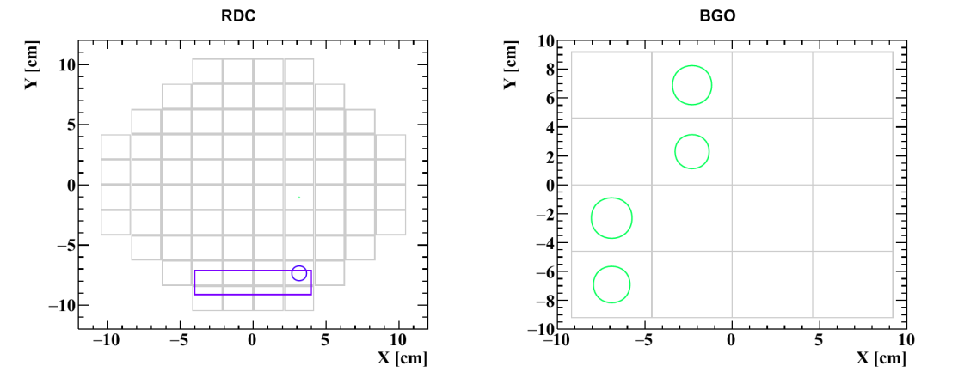
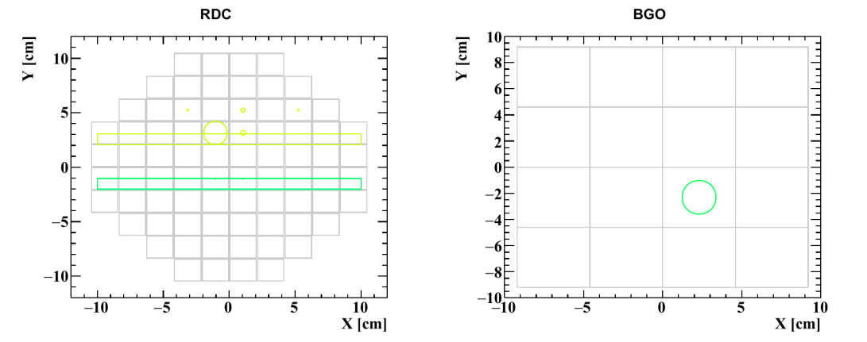
Example of events
Example of CR candidate
marker size ∝ energy
color ∝ time
Example of RMD candidate
Cosmic-ray events needs to be removed in event selection.

Slide 21
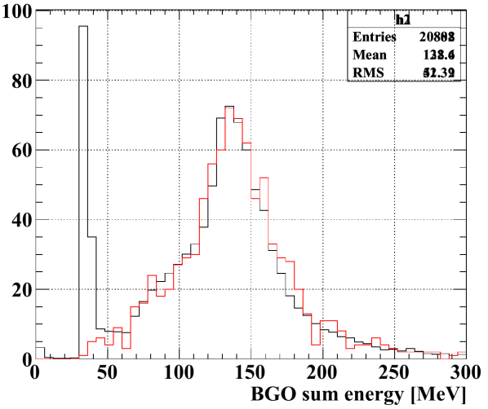
RMD event selection
BGO energy sum
Example of RMD candidate event
select
Beam on data
Beam off data
(CR only)
fiducial volume
We require that the largest hit in BGO to be found in the central four crystals.
2. Then, the energy sum in BGO must be below 55 MeV.
→ 98% of CR events are removed

Slide 22
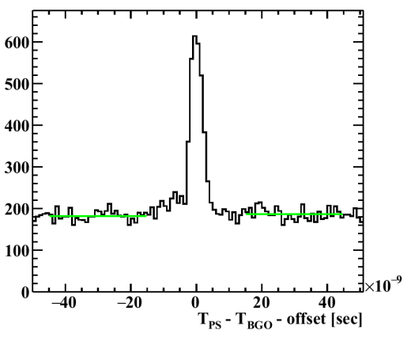
PS-BGO time coincidence
PS-BGO timing difference
RMD peak
Preliminary
flat region: Accidental Michel e⁺
A clear peak that correspond to RMD events is observed.
BGO energy scale problem needs to be understood for the quantitative comparison of data and MC.

Slide 23
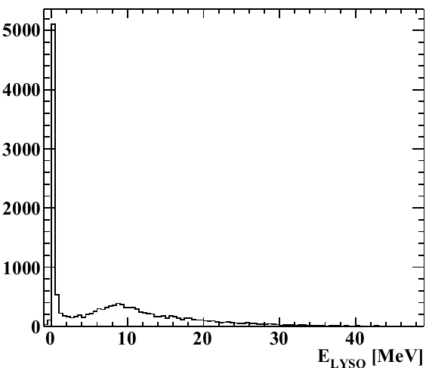
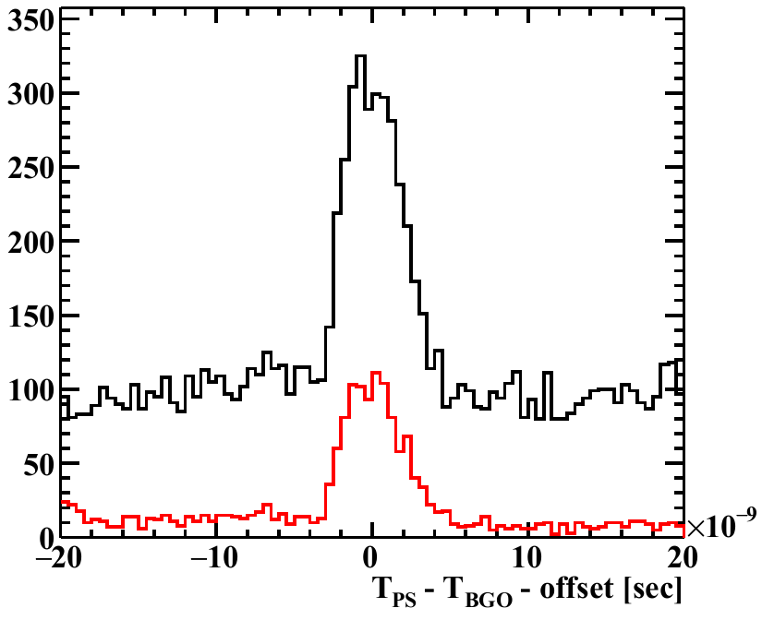
LYSO energy cut
LYSO sum energy
PS-BGO timing diff
select
Preliminary
w/o LYSO cut
w/ LYSO cut
(CR veto is applied)
1/2
LYSO sum energy = sum of hits in coincidence with BGO
1/10
RMD e⁺?
Michel e⁺?
As expected, accidental BG reduces by applying a cut in LYSO energy.
RMD events also reduced too much with this cut, which is probably because the BGO energy threshold is too low and the energy of RMD e⁺ is high.

Slide 24
Summary
MEG II RDC detector is constructed and tested with the μ beam for the first time.
Operation of the RDC detector was in general successful.
Preliminary result of the analysis is shown. RMD events were clearly seen in the PS-BGO timing difference plot.
Analysis is ongoing to compare the performance of the detector with simulation.

Slide 25
Backup slides

Slide 26
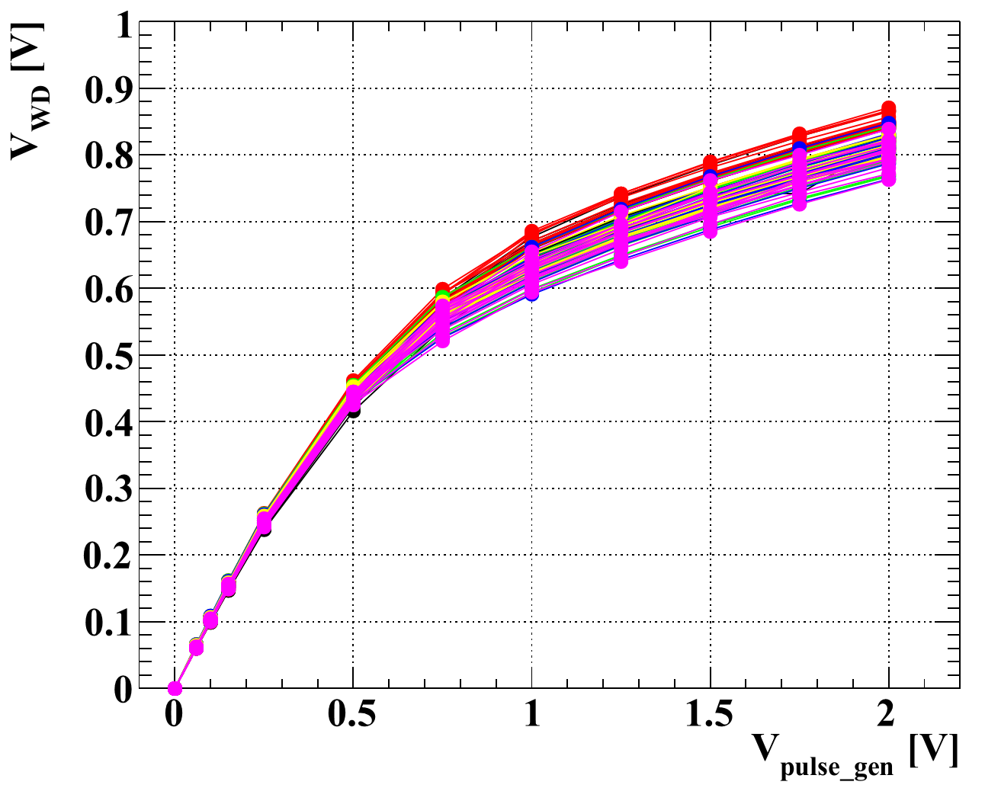
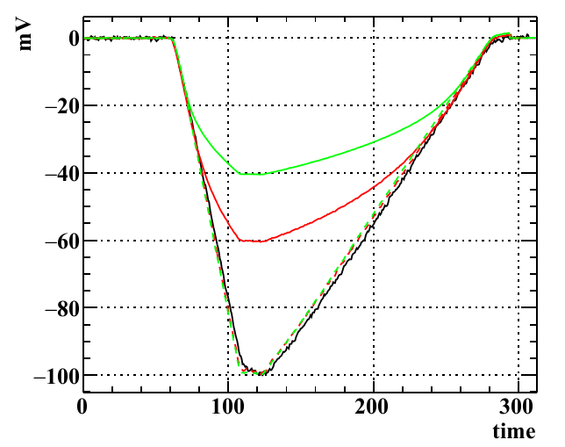
Non-linearity
Example of averaged waveforms
(input: function generator)
WD readout vs. pulse gen. input
Input height [mV] = 100, 1000, 2000
Scale = 1, 1/10, 1/20
Board 2
Board 3
Board 4
Board 5
Board 6
Board 7
before correction
after correction
The linearity of the response was found to be bad.
Ryoto measured pulse height of the pulse generator signal as a function of input pulse height.
Correction is applied for each bin in the waveform, using the input/output response measured with function gen.
Correction seems to be good.

Slide 27
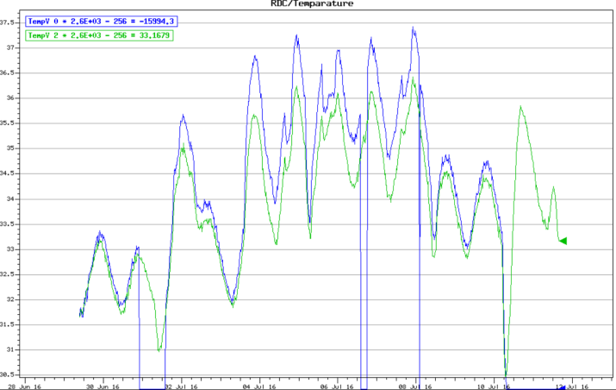
Calibration: to do
PS energy calibration (using Michel e⁺) is not done.
Temperature correction is not implemented.
RDC temperature history
sensor 0 (inside light shielding)
sensor 1 (outside light shielding)
(Temperature inside the light shielding seems to become high when the beam is on.)

Slide 28
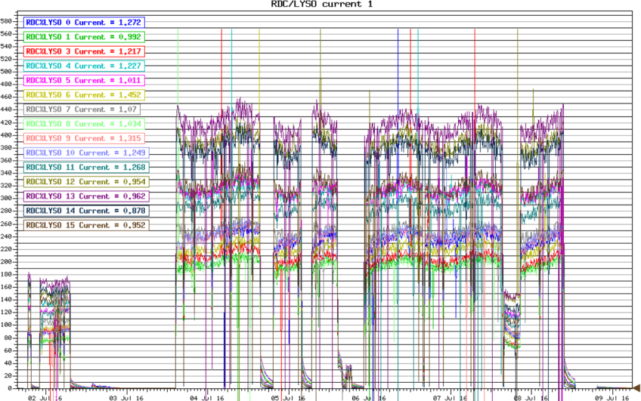
LYSO current history

Slide 29
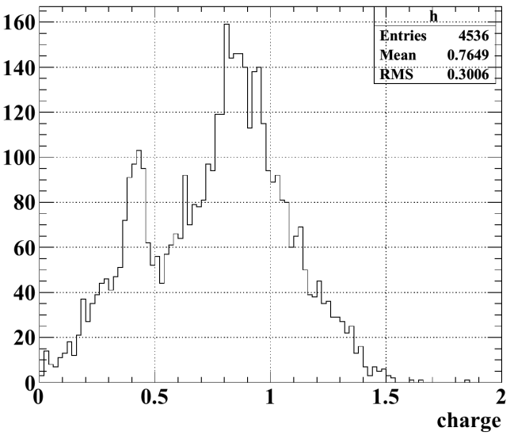
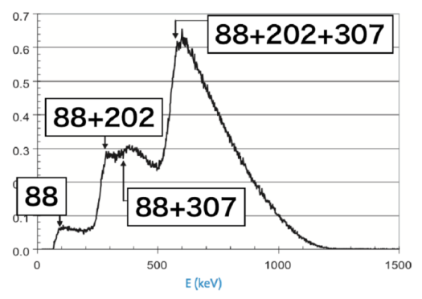
Calibration: LYSO intrinsic
Fitting function is provided by Ryu. It is a convolution of:
(gamma peaks + beta decay spectrum) ⊗ gaussian smearing (σ = E_{res})
Example of charge distribution
(Shota’s
MSC thesis)
In the data, we found a sharp peak below the main peak, which does not agree with fit function. It seems to be caused by intrinsic radiation γ escaped from the crystals in the neighbor. We remove those events by requiring N_{hit}=1 in event.

Slide 30
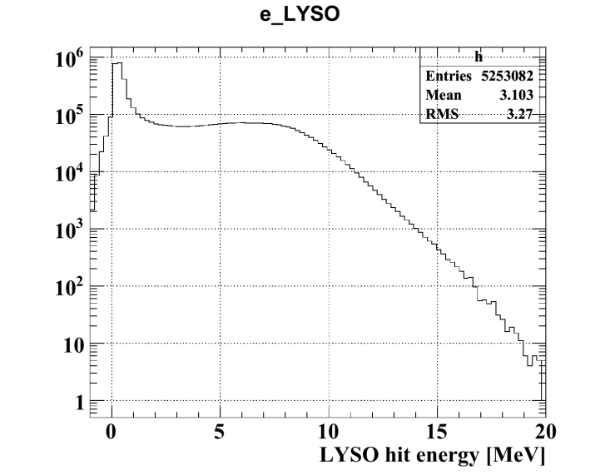
Beam data: raw energy distributions
BGO energy sum
LYSO hit energy
We took data assuming that the threshold is around 44 MeV, but in fact the threshold is around 35 MeV.
This might be wrong by ~20%.

Slide 31
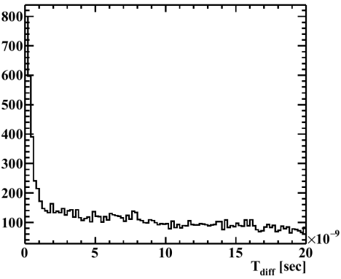
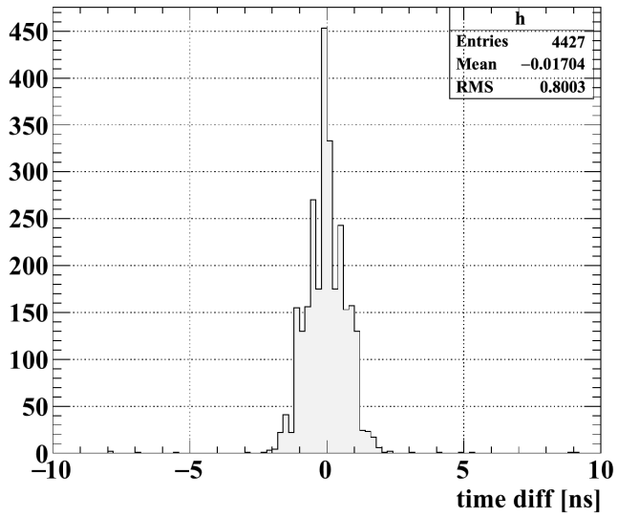
PS hit & clustering
“Hit”
Pulse from two sides of the plate are combined to a single hit, when the time difference is less than 5ns.
“Cluster”
Hits with time difference < 5ns are clustered.
Time difference hits from two sides of the same plate
Time difference of plate hits

Slide 32
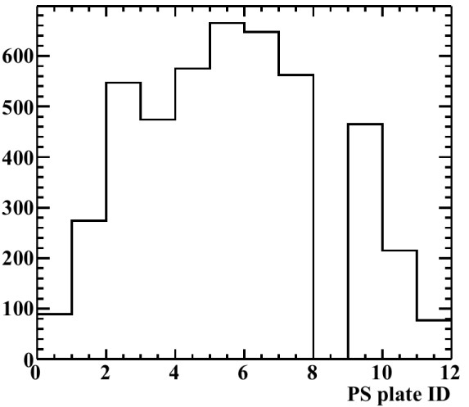
Number of RMD events
We compared the number of RMD events with expectation in the following way.
N_{RMD} = (N_{events} in ±15ns region) – N_{BG} = 2367.6
from the fit in the flat region
N_{RMD_expected} = N_{trig} * (US/DS ratio) * (acceptance) * (fraction of working ch) * (RMD/(RMD+AIF))
15447 after CR veto
0.48
0.88 when E_{γ}>48MeV
90.6%
0.65
= 3869.2
Plate hit distribution
E_{γ}>48MeV is assumed for the expectation, but this cut is not applied in this analysis.
Acceptance and RMD/(RMD+AIF) are overestimated.
dead ch
In order to do the comparison correctly, BGO energy calibration problem needs to be understood.
CR veto is applied.
|T_{diff}|<5ns is required.

Slide 33
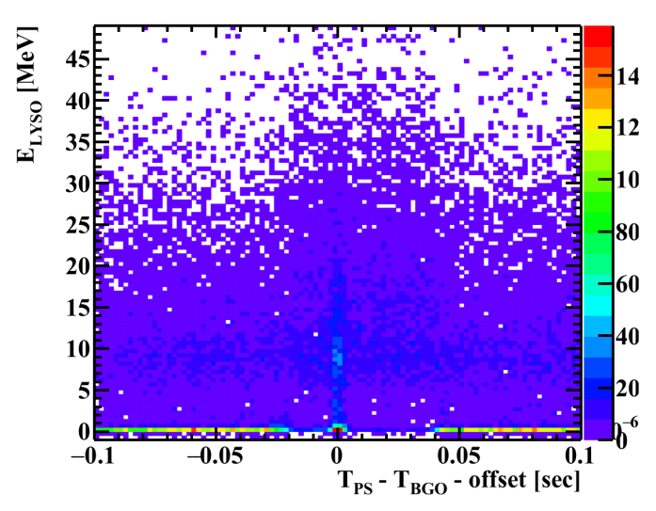
LYSO energy vs. PS-BGO timing

Slide 34
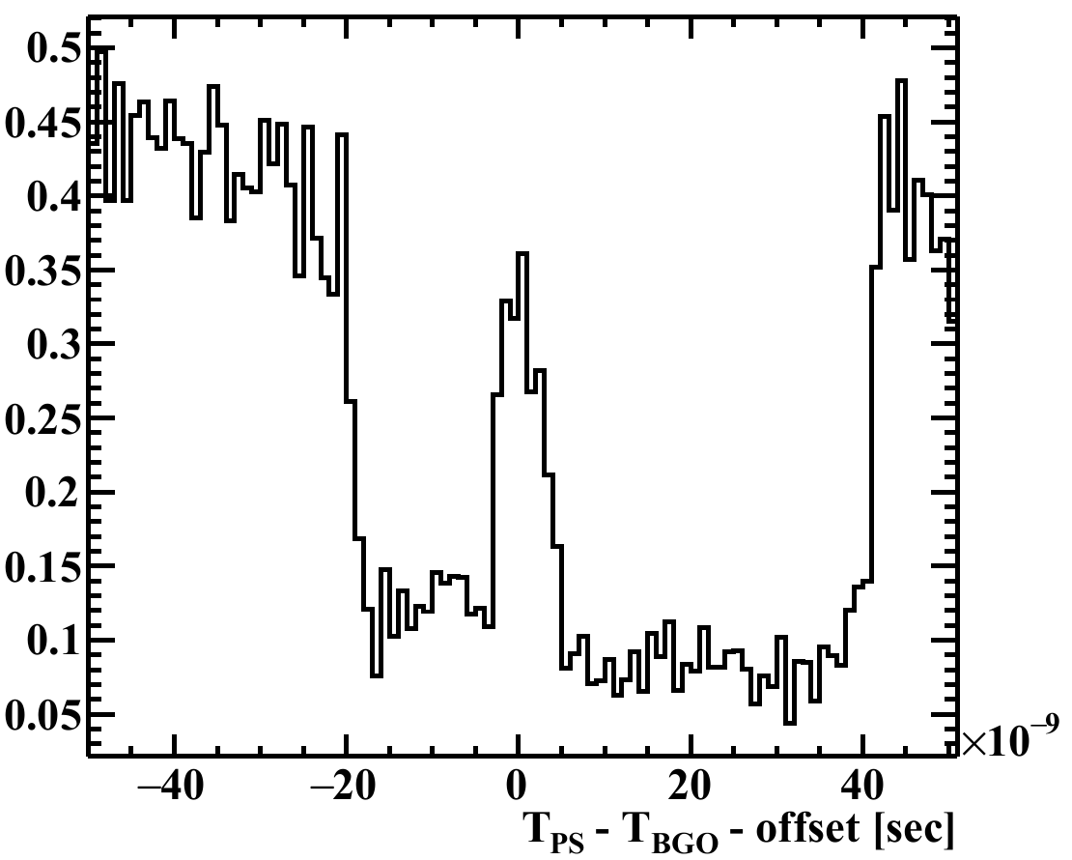
Event reduction by LYSO cut
After / before cut

