Slide 1
MEG II 実験のための 陽電子タイミングカウンターの開発 PSIでのハイレートビーム試験 Development of Positron Timing Counter with SiPM for MEG-II Experiment Beam Test Result in the high rate environment at PSI
西村美紀 （東大）
他 ＭＥＧコラボレーション
日本物理学会 2015年 第７０回年次大会
早稲田大学 早稲田キャンパス

Slide 2
Contents
Physics Motivation
MEG II Experiment
Positron Timing Counter
Beam Test ＠PSI (←MEG II Site)
Status & Schedule

Slide 3
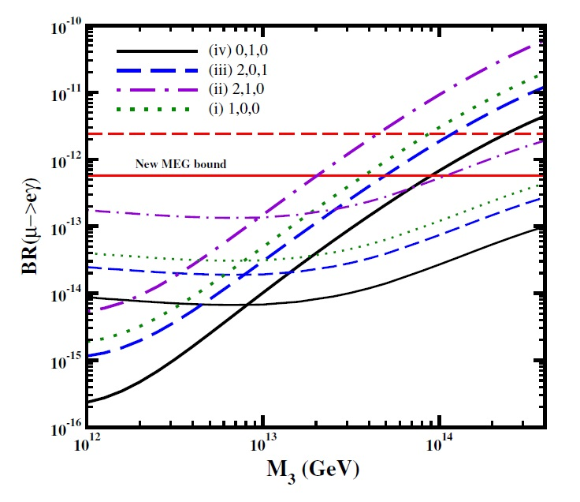
Physics Motivation
Search for cLFV (charged lepton flavor violation), μ⁺ $→$ e⁺γ decay
Forbidden in the SM
Sizable branching ratio is expected by many bSMs
Most stringent upper limit of the branching ration is set by the MEG experiment;
$5.7×{10}^{−13}$ 90% C.L. (Phys. Rev. Lett. 110(2013) 201801)
Already started exploring bSM region!
An example, the expectation of the BR from SU(5) SUSY-GUT
M. Cannoni et.al., Phys. Rev. D 88, 075005 (2013)
Mass of right handed neutrino
Upgrade MEG experiment (MEG II)

Slide 4
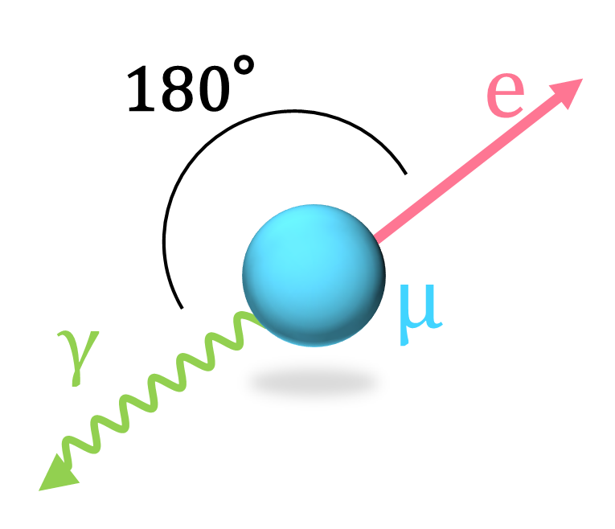
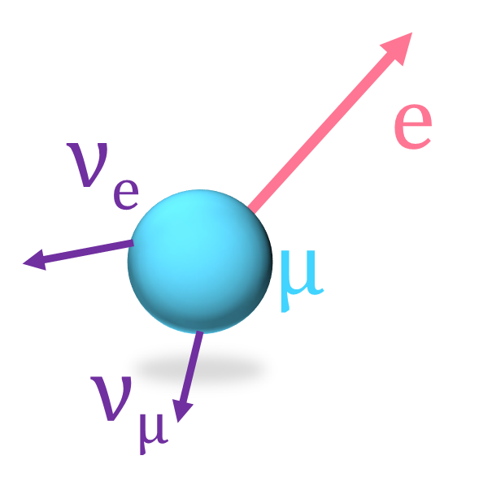
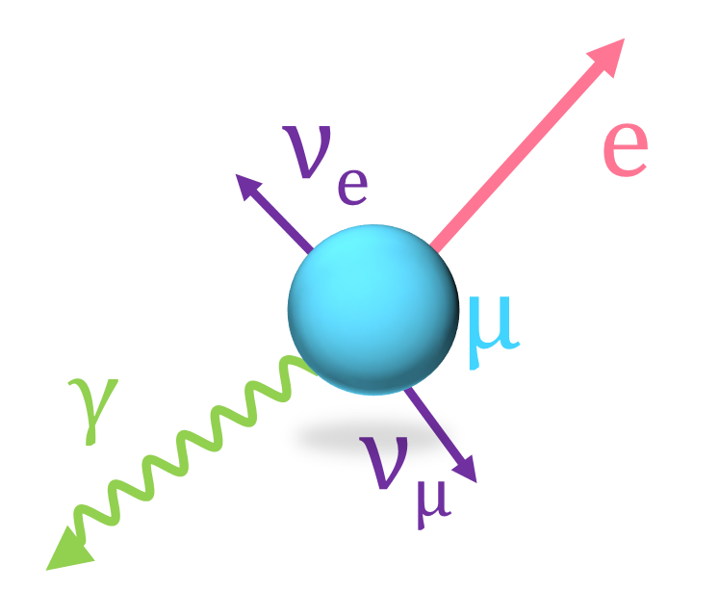
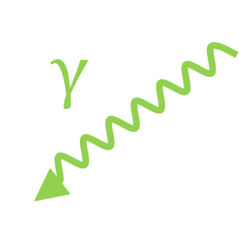
What should we measure?
Signal
Background
Accidental BG
Dominant
Physics BG
We should measure
Timing・Position・Momentum precisely.

Slide 5
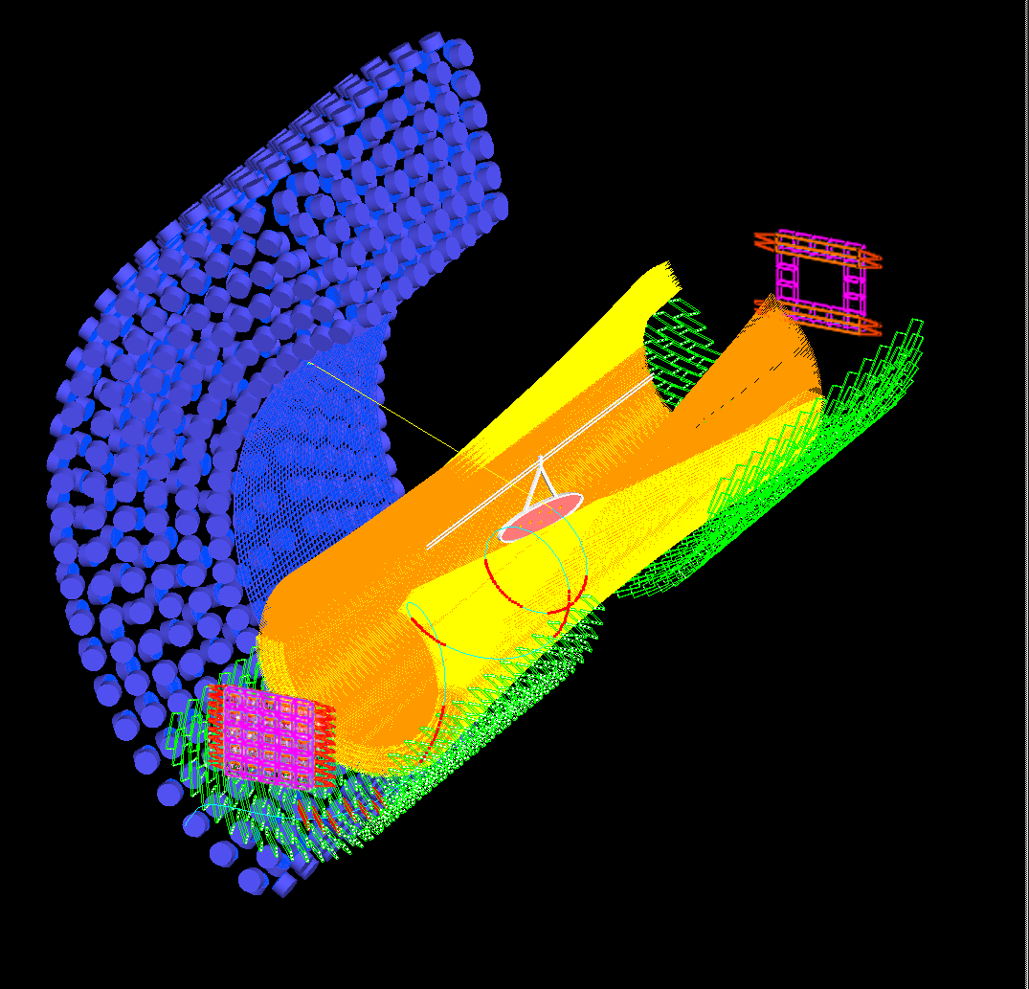
MEG II
Xenon Calorimeter
SiPM readout
Stereo wire drift chamber
Tracking the positron till near TC
澤田・家城・小川
(21pDK4,5,6)
µ
twice higher beam intensity
（stopping µ ~7×10⁷）
γ
中浦 24aDL11
Radiative Decay Counter
e
This talk, and next talk 吉田
(24aDL10)
Pixelated Positron Timing Counter (TC)
sensitivity $4×{10}^{−14}$

Slide 6
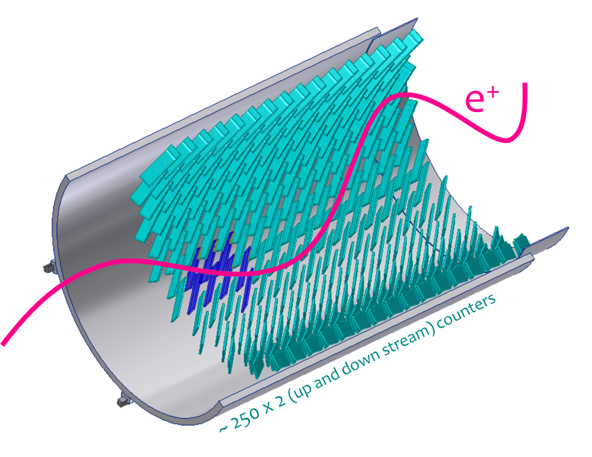
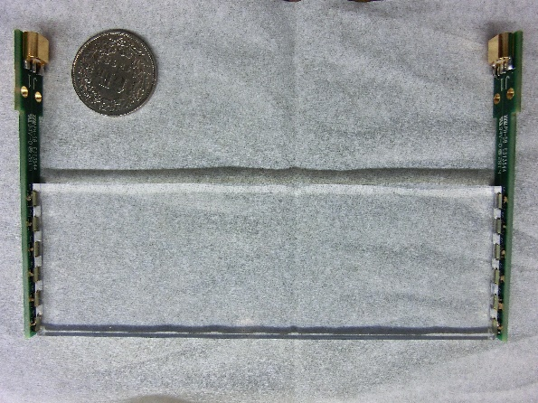
Pixelated Positron Timing Counter
× 512
target
4 cm or 5 cm
12 cm
${\tilde{N}}_{hit}=$ ~9
${\tilde{N}}_{hit}=$ ~9

Slide 7
Pixelated Positron Timing Counter
6 SiPMs in series at the both end
AdvanSiD (Italy) 3x3 mm², 50 um
12 cm
4 cm or 5 cm
Thickness 5 mm
PCB
PCB
Fast Plastic Scintillator
BC422, rise time 0.35 ns
attenuation length 8 cm
Cable（RG178）
Non-magnetic
Back plane
Long PCB ~80 cm
Multi layer, coaxial like

Slide 8
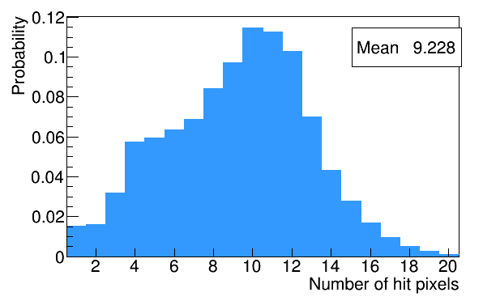
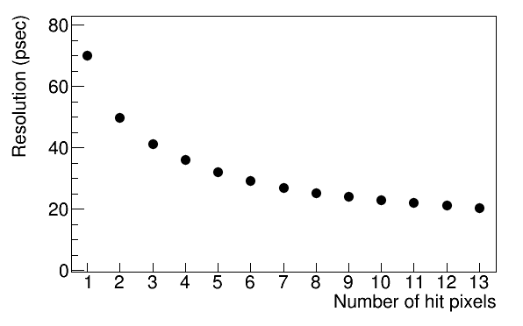
Principle
Number of hit counters (MC)
MEG I: 80 cm scintillator bar （with 2 PMTs） ×15
σ_{single} = 65 ps
*contribution from DC; 75 ps
MEG II: 12 cm scintillator counter ×250
σ_{single} = 65 ps *contribution from DC; 11 ps
Resolution vs. # of hit counters
Many hits
Averaging timing information, final TC resolution improve.（We already prove the principle in the other beam tests.）
Pile Up Reduction
Beam intensity becomes higher in MEG II
Able to track the positron
σ ~30 ps
~30 ps
~5 ps
$${σ^{2}}_{total}^{}\left(N_{hit}\right)=\frac{{σ^{2}}_{single}^{}}{N_{hit}}+\frac{{σ^{2}}_{inter−counter}^{}}{N_{hit}}+{σ^{2}}_{MS}^{}\left(N_{hit}\right)$$

Slide 9
Status
Prototype test
Good single counter performance was already demonstrated.
Multiple hit scheme was proved by beam tests in a quiet environment.
Positron beam at BTF in Italy
50 Hz, 1-2 positrons in a bunch
Calibration (next talk)
Laser
Michel positron
Software development
Timing reconstruction method

Slide 10
Beam test

Slide 11
Motivation
Previous beam test was conducted at low positron rate. (~50 Hz)
However in MEG II , TC will suffer high rate positron backgrounds (>~45MeV, <~180kHz)
Operate TC in this high rate environment.
From MC study (height is 4 cm)
Length [cm] | Average Rate (kHz) | Highest Rate (kHz)
12 | 70.2 | 174
muon normal decay

Slide 12
Set up
Coincident Trigger
Michel Positron
Normal decay from stopping muon
The same as real background
We can get time uniform background.
2 small counters
5x5x5 mm³, 1 MPPC
Teflon wrapping
Time Reference
Muon Beam
πE5 beam line at PSI
~10⁸ Hz DC beam
Collimator
Back plane
8 Prototype Counters
6 for 120x40x5 mm³, 2 for 120x50x5 mm³
AdvanSiD w/o new technology -> w/ new technology
Scintillator BC422 -> EJ232
Reflector 3M Mylar film, light shielded
Digitizer (DRS)
1.6 GHz
We had to use scintillators and SiPMs of bad performance due to quality control issues of vendors.

Slide 13
…
Counter C
Counter B
Counter A
Prototype Counters
Reference
Counters
Back Plane
Positrons

Slide 14
Rate
We adjusted the beam slit for rate scanning (3 points)
Three hit rate conditions
Low rate; 17.8 – 64 kHz
Expected rate; 53 – 166 kHz
High rate; 89 – 290 kHz
Expected rate in MC
From MC study (height is 4 cm)
Length [cm] | Average Rate (kHz) | Highest Rate (kHz)
12 | 70.2 | 174
A
B
C
D
E
F
G
H
5 cm height

Slide 15
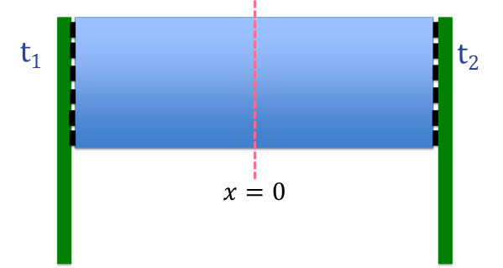
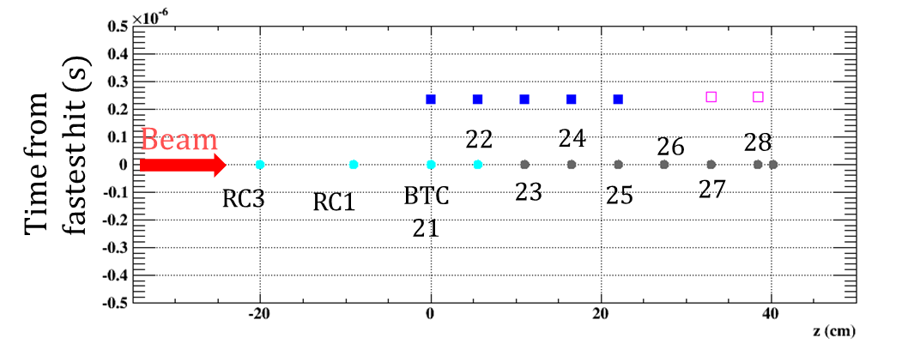
Analysis
Single Counter
Timing $(t_{1}+t_{2})/2$
Position $x=v_{eff}(t_{1}−t_{2})/2$
Clustering
Clustering based on reconstructed time.
Cut the pile up hits
Tracking
Using reconstructed position
Far hits from trajectory are removed.
Notice: There is trade-off b/w strict cut and efficiency.
We should optimize the parameter for final analysis

Slide 16
Single Counter Resolution
Back plane seems to pick up noise
A
B
C
D
E
F
G
H
Small degradation of the resolutions from higher rate can be observed.

Slide 17
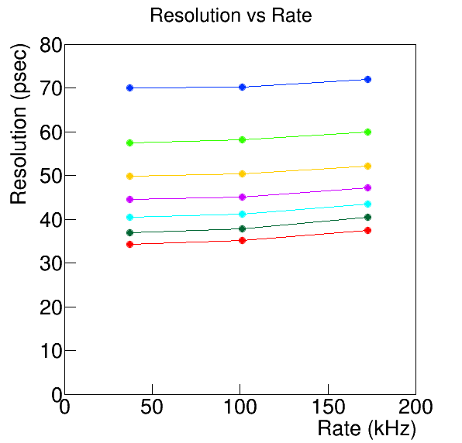
Overall Resolution
N = 2
N = 3
N = 4
N = 5
N = 6
N = 7
N = 8
(*Average)
Only small degradation of the resolution up to the expected hit rate.

Slide 18
Overall Resolution
The difference becomes larger in higher rate. However the difference is not so effective especially b/ lower rate and expected rate.
At n = 8, the overall resolution is ~35 ps.
This number will improve with final counters because the single resolutions will improve from ~90 ps to ~65 ps.

Slide 19
Schedule & Status
In this beam test, we demonstrated good performance in high rate environment expected in the experiment.
It is time to construct and test the final detector.
Construction
SiPMs were already delivered and tested.
Support structure is under construction.
SiPMs array will be tested soon.
Counter mass production and mass test
TC DS engineering run is planned in Dec.
Down stream of TC will be installed and tested with the muon beam.
Number of readout electronics channels are limited. (Half of the DS TC channels can be readout at one time)
Next spring TC US will be installed.
Summer in 2016, the engineering run will start.
Following the engineering run, physics run will start.

Slide 20
Summary
The MEG II experiment will search for μ→eγ decay at a unprecedented sensitivity of 4x10⁻¹⁴.
The Pixelated Positron Timing Counter of 30 ps resolution is in preparation.
We conducted a beam test with prototype counters under the MEG II beam condition.
We obtained the excellent resolution of 35 ps with 8 counters.
The final performance of TC will be better by using better counters.
Preparation for TC DS engineering run in Dec. is underway.

Slide 21
Back up

Slide 22
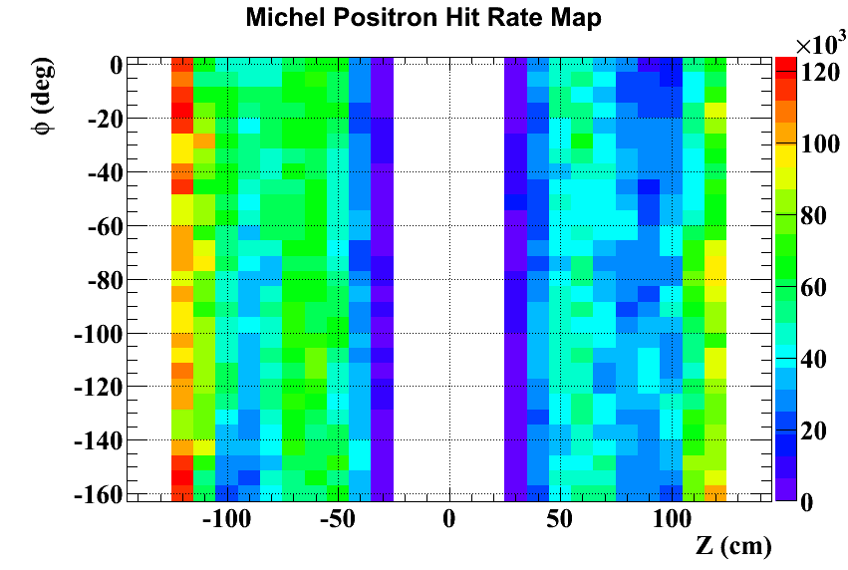
Pileup Study
Michel positron (4π, all momentum)
Hit rate of Michel positron depends on position.
The highest rate position
90x30x5 pixels
The bins correspond to the each pixel.

Slide 23
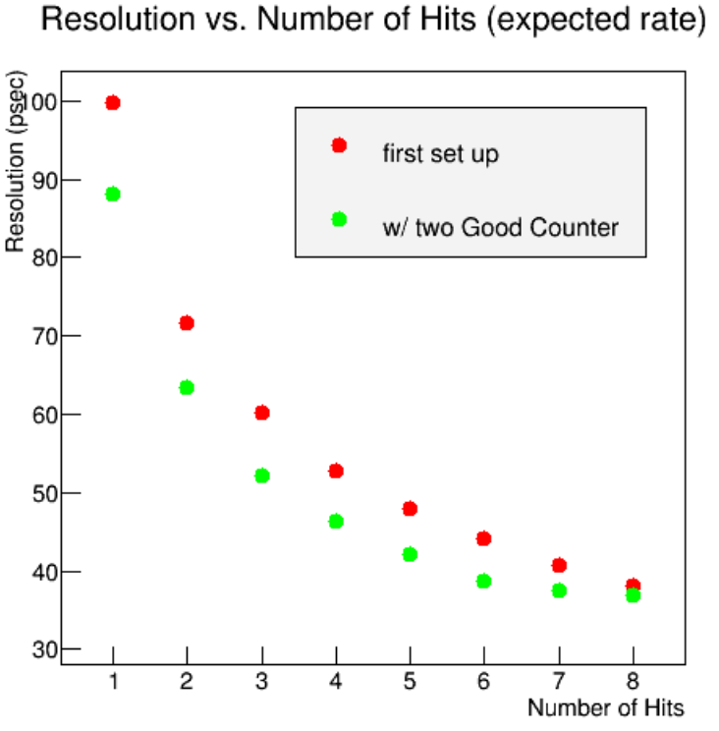
Final Performance
We could measure the final prototype counters. (only two counters)
The TC performance improved.
In the final detector better performance is expected.

Slide 24
Time line
Sun | Mon | Tue | Wed | Thu | Fri | Sat
12 | 13 | 14 | 15 | 16 | 17 | 18
19 | 20 | 21 | 22 | 23 | 24 | 25
26 | 27 | 28 | 29 | 30 | 31 | 1
2 | 3 | 4 | 5 | 6 | 7 | 8
9 | 10 | 11 | 12 | 13 | 14 | 15
16 | 17 | 18 | 19 | 20 | 21 | 22
Beam tuning
TC set up delivered
Beam
investigation
Michel
Beam tuning
TC set up
Beam investigation
Michel
Beam investigation
Beam tuning for Positron
Beam
We lost ~6 days for the investigation.
Data taking
WD test
TC alignment
Mott
Beam shat down
ATAR beam time

