Slide 1
Mass test of MPPC with a prototype of MEG II liquid xenon detector
II
家城 佳, 他 MEG-II collaboration

Slide 2
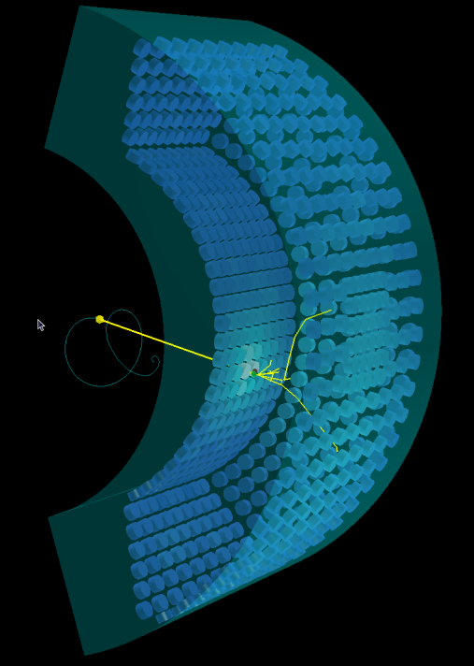
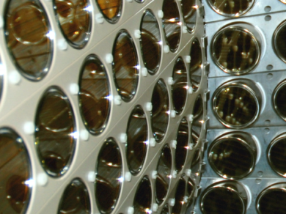
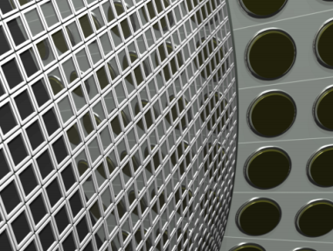
MEGII liquid Xe (LXe) detector
upgrade!
(CG)
inner face
2inch PMT× 216
12x12mm² MPPC × ~4000
Granularity will improve
→ γ energy resolution & position resolution expected to improve by a factor of 2!
1m
Requirements for the MPPC:
- sensitive to VUV scintillation light
- large area (less number of readout ch)

Slide 3
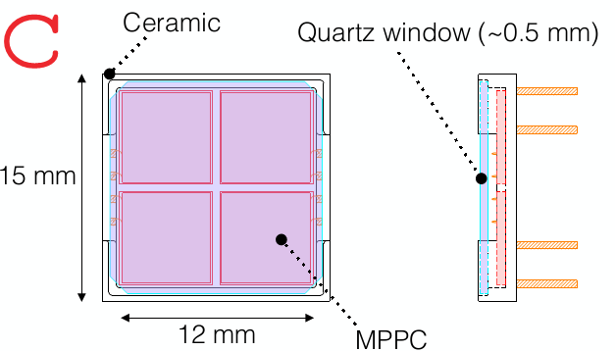
VUV sensitive large area MPPC
Hamamatsu S10943-3186(X)
Successfully developed a new type of MPPC! - PDE for VUV light > 20% - Large area
fall time < 50ns with series connection
- 50μm pitch pixel
- Four chips
- metal quench resister
Performance tests so far:
- Mass test (600 pcs) in room temperature
- Test of small subsamples in LXe
This talk: mass test (~600 pcs) in LXe

Slide 4
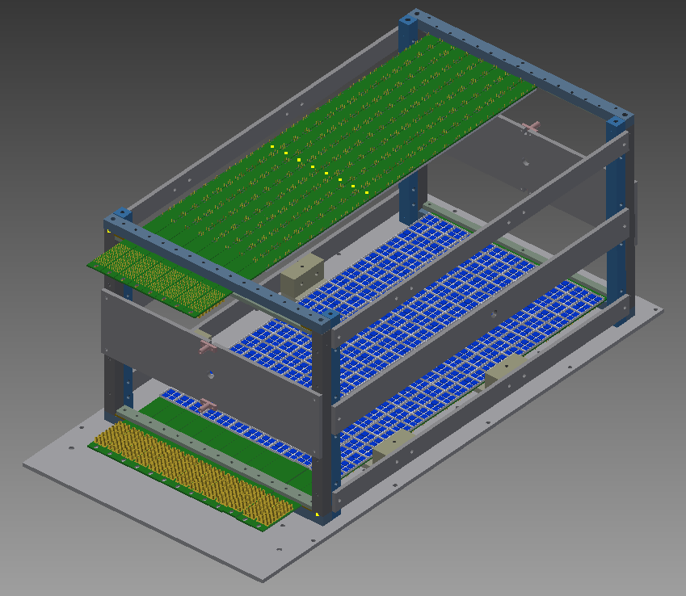
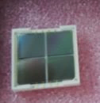
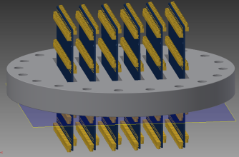
Mass test in LXe
In LXe
MPPC x 568 pcs
12mm
pre-final model
(no crosstalk suppression)
α sources
²⁴¹Am
New PCB and new feed-through
LED
We would like to check if everything work OK in LXe.
PCBs
(12+12)
PCB
24MPPCs / PCB
feed-through
two types of series connection of four chips for each MPPC
or
2seg
4seg

Slide 5
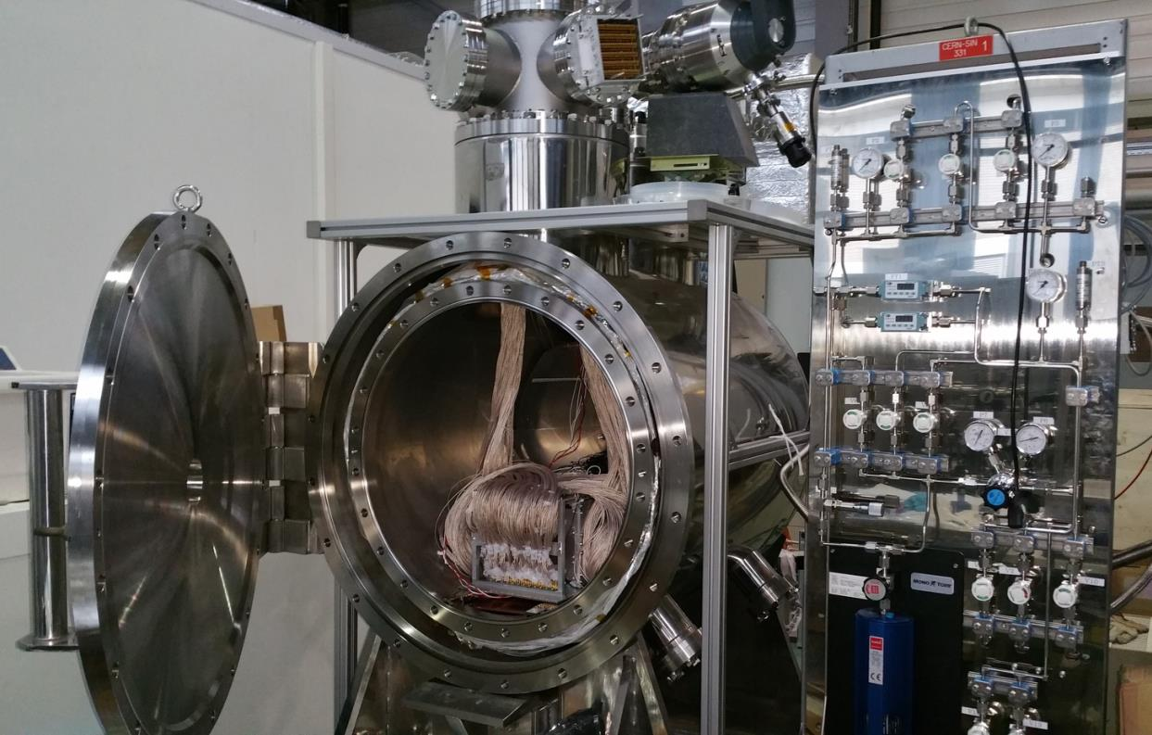
Setup
feed-through
MPPC &
support structure
Xe gas panel

Slide 6
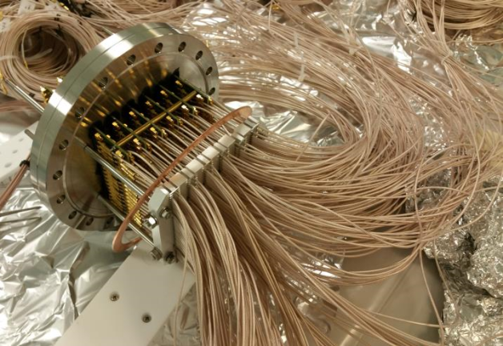
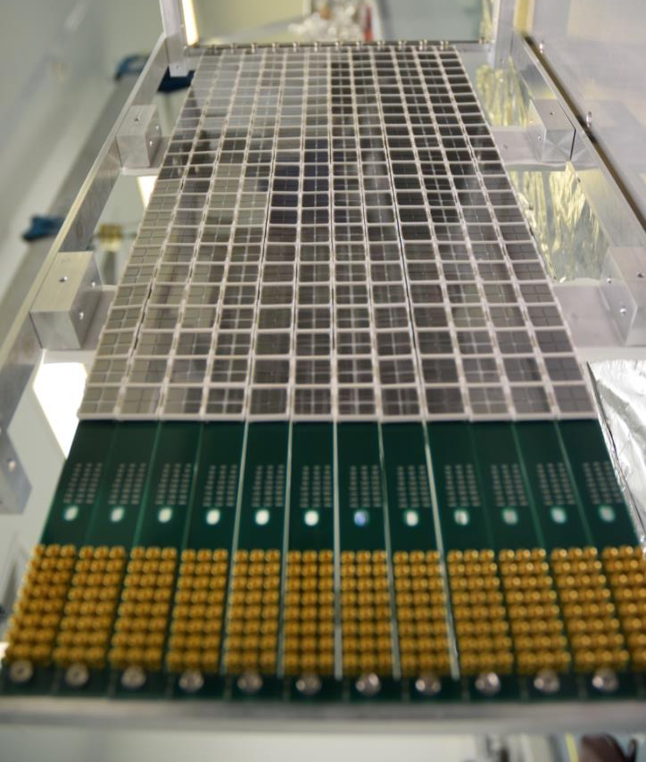
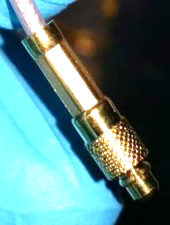
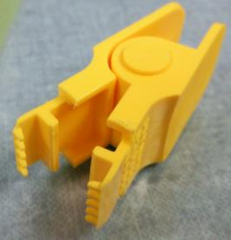
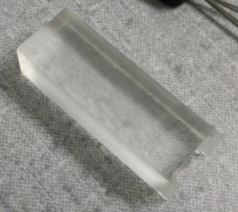
Setup
feed-through
MMCX cable
3mm
cable remover
It was difficult to handle small connectors in a limited space.
MPPCs mounted on PCBs
jigs to mount / dismount MPPCs

Slide 7
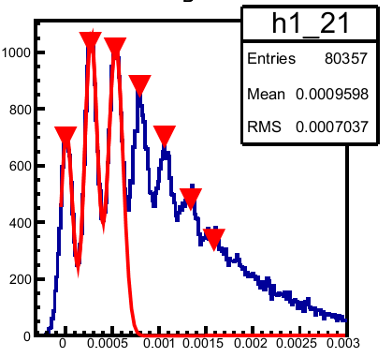
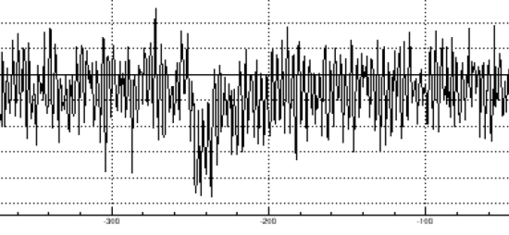
Data taking
Waveforms are recorded with waveform digitizer.
24 channels are read out for each measurement.
LED trigger
Example of charge distribution
V_{over} ~ 2.6-3.3 V, 0.1V step
1p.e.
….
0p.e.
Example of waveform
5mV
100ns
charge integration
Charge
→ Breakdown voltage (V_{bd}), gain, crosstalk+afterpulse (CTAP)
Alpha trigger
V_{over} ~ 3.0V
→ PDE
We finished the measurement on 7 Mar. → Preliminary results in this talk

Slide 8
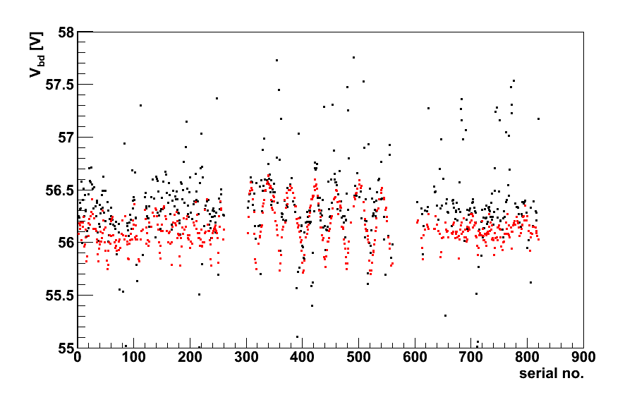
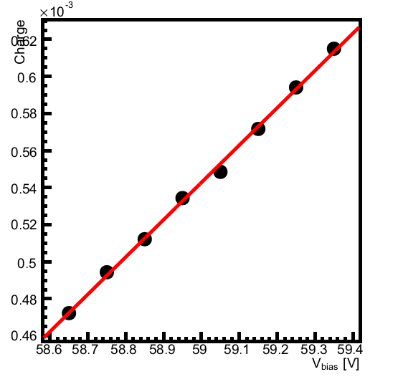
Results: breakdown voltage
Example of 1p.e. charge vs. V_{bias}
V_{bd} vs. serial no.
Preliminary
V_{bd} (measured)
V_{hama} – 10.5V
Looks OK except for some bad channels.
I will explain this later

Slide 9
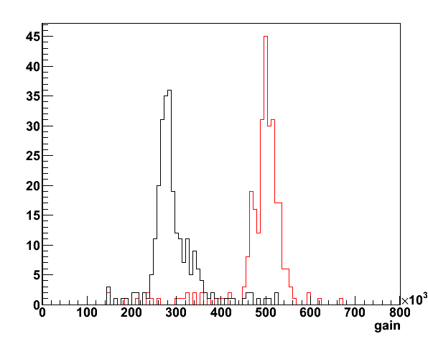
Results: gain
Gain for all MPPCs
Preliminary
4seg serial connection
2seg serial connection
@ V_{over} = 3.0V
Looks OK except for bad/strange channels.

Slide 10
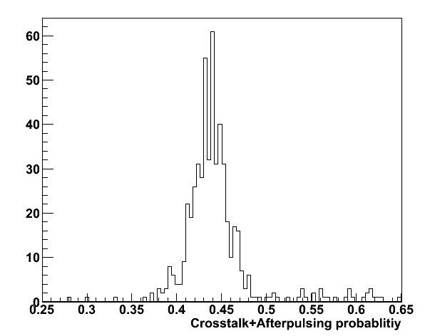
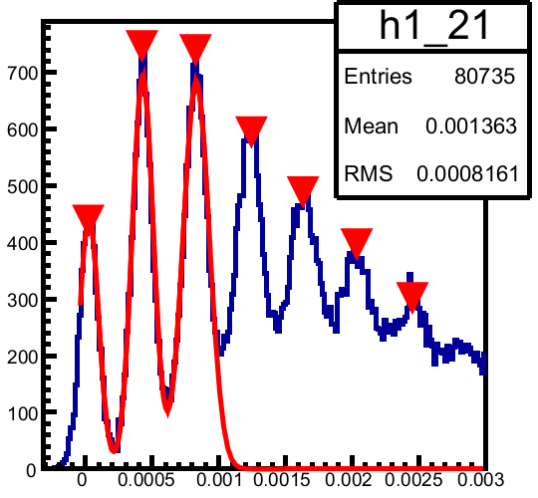
Results: crosstalk + afterpulse
CTAP effect
CTAP prob. for all MPPCs
2p.e.
Preliminary
1p.e.
3p.e.
@ V_{over} = 3.0V
0p.e.
Charge
CTAP prob.
Measured num of 1p.e. events
=
1 -
Expected num of 1p.e. events
Looks OK except for bad/strange ch.
Estimated from 0p.e. peak, assuming Poisson statistics.

Slide 11
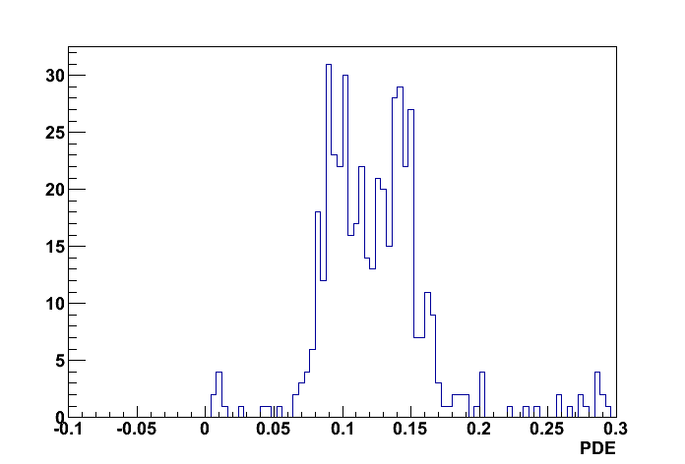
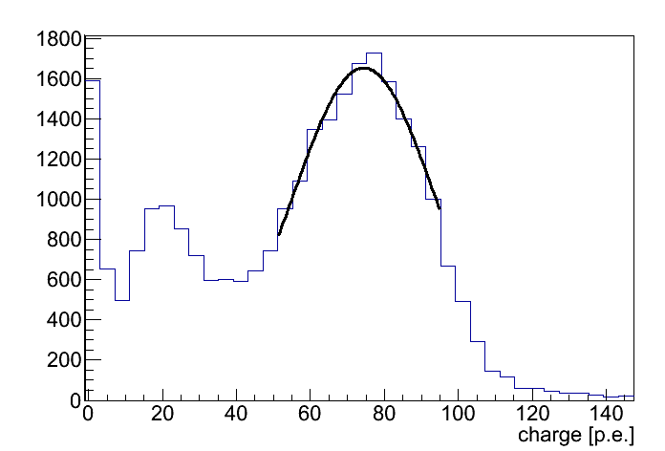
Results: PDE
peak of charge distribution
corrected for CTAP
Distribution of PDE
PDE = (Measured p.e.) / (Expected p.e.)
Very Preliminary
α energy / Xe scintillation yield * solid angle
@ V_{over} ~ 3.0V
Example of alpha charge distribution
The measured PDE is lower than the PDE which we measured in the small chamber (~20%). → We will check this in more detail.

Slide 12
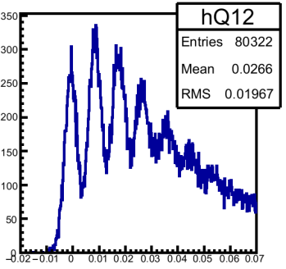
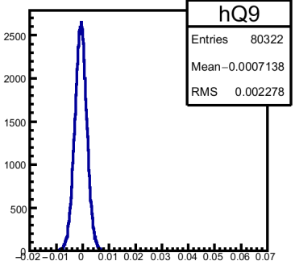
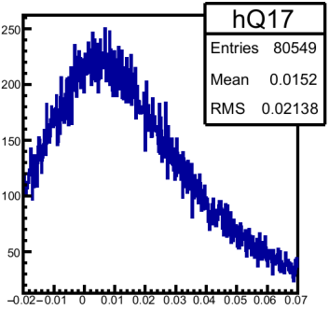
Bad channels
Several types of bad channels are found
good channel
dead channel
strange channel
x 16
x 9
7 out of 16 dead channels were OK in the signal check which we did before liquefaction of Xe.
We found 8 dead channels in the signal check before liquefaction. 5 of them look OK now.
It is likely that the connections of MMCX cables are bad at the PCBs or at the feed-through. We will check this in more detail.
We also plan to improve the design of the PCB and feed-through.

Slide 13
Summary
We performed a mass test of MPPCs in LXe. New PCB and feed-through were also tested.
Preliminary results of the test is presented. Performance of most of the channels looks OK, as we expected from the previous tests.
We found some bad channels. It is likely that the connections of the cables are bad. We will check this in more detail. Design of the feed-through will be improved.

Slide 14
Backup

Slide 15
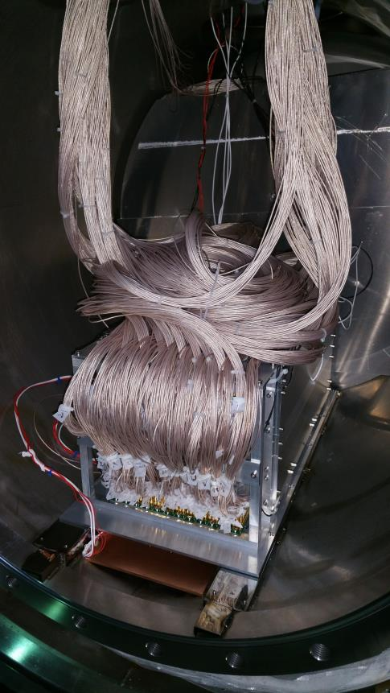
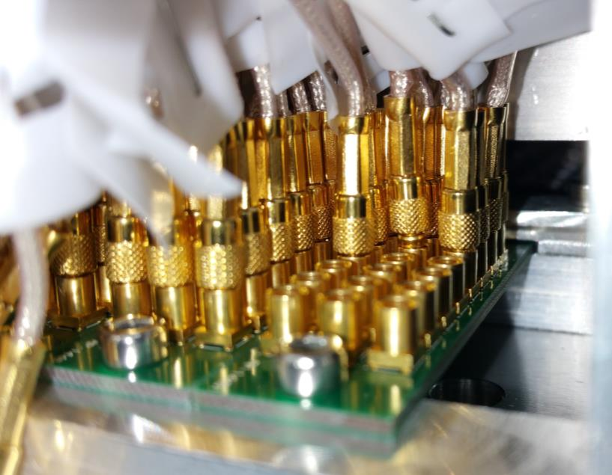
PCB
3列→2列に変更

Slide 16
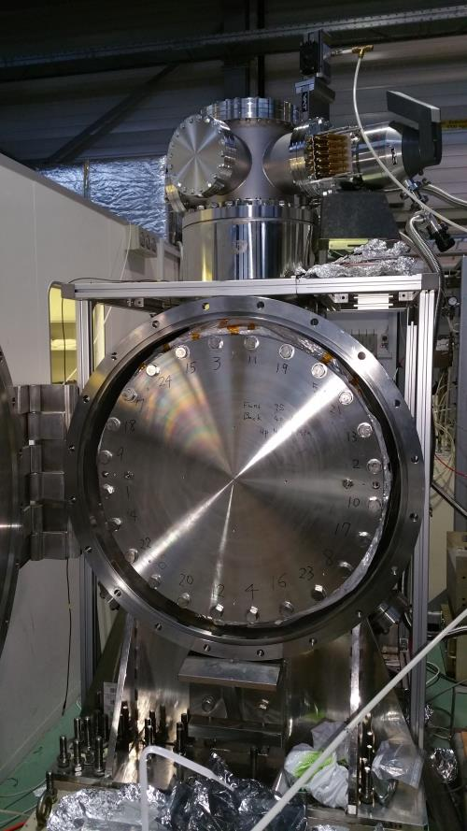
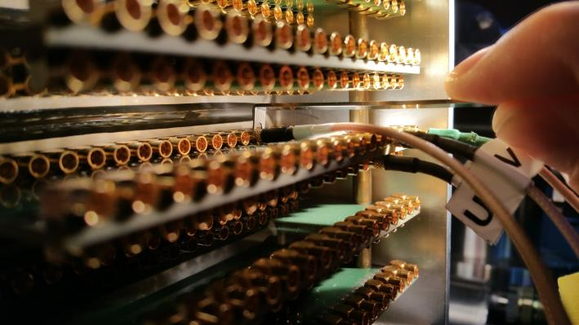
Feed-through
最初からケーブルが半田付けされた
デザインに変更する。

Slide 17
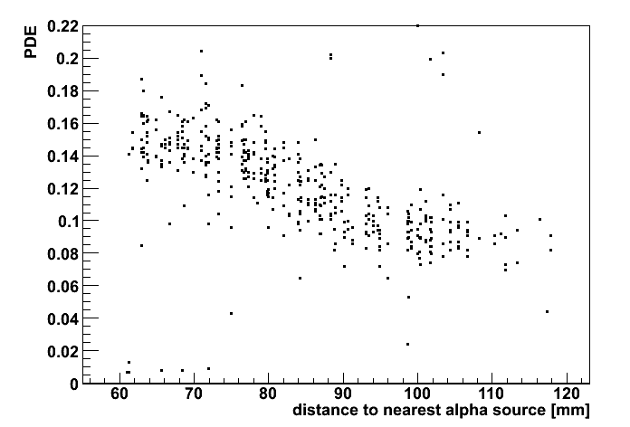
PDE vs. distance
直近のαのピーク
(距離~6cm)
離れたα wireのピーク
(距離~12cm)
αのほぼ真下のchの光量分布

