Slide 1


MEG II 実験液体キセノンガンマ線検出器に向けた再構成法の研究
Development of the event reconstruction method for MEG II liquid xenon detector
小川真治、 他MEG IIコラボレーション
@日本物理学会 2015年秋季大会

Slide 2
Table of contents
1. Introduction of LXe detector in MEG II.
2. Performance of LXe detector
3. Signal readout method comparison
4. Effect from the uncertainty of PDE
5. Summary

Slide 3
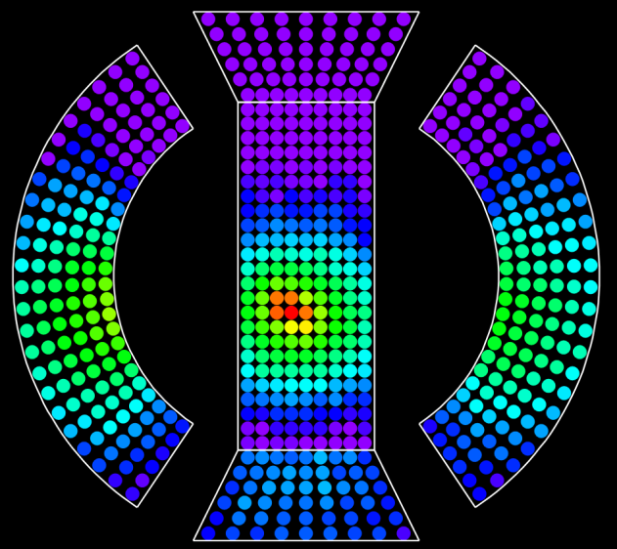
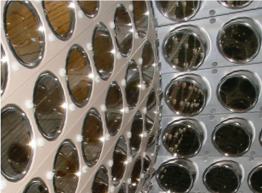
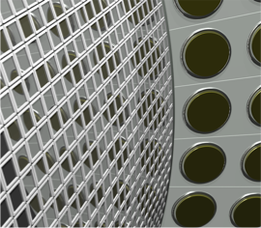
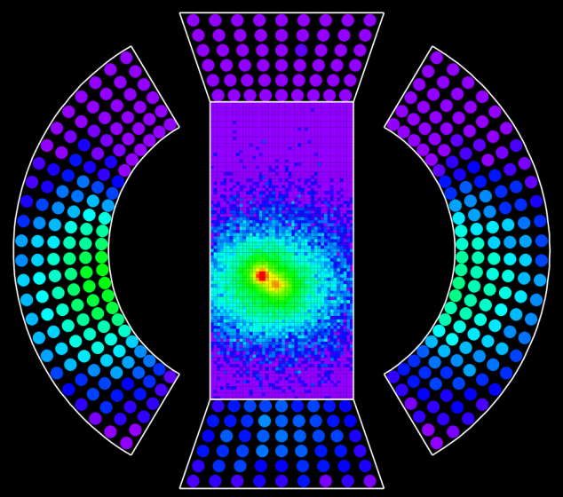
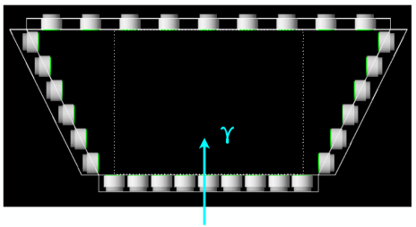
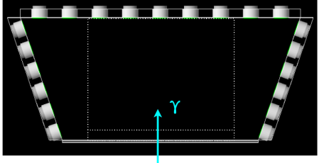
Upgrade of LXe detector for MEG II
Replace PMT of γ-entrance face to MPPC
  Photon collection efficiency becomes uniform
Change PMT alignment of lateral face
  Energy leak decreases
MEG
MEG
MEG II
(CG)
γ
γ
12×12 mm²
MPPC
2 inch
PMT
log scale
Imaging
power
improves
MEG II
MEG
MEG II
wider
log scale

Slide 4
2. Performance of LXe detector

Slide 5
Performance estimation
Performance improvement of LXe detector has already been confirmed
by MC simulation.
  “MEG Upgrade Proposal (arXiv:1301.7225)”
  日本物理学会第70年次大会 21pDK-6
We carried out the performance estimation again.
  Finalized design of the detector
  Improved and optimized analysis
Position resolution vs. depth
Energy Distribution for signal γ
MEG I:red
MEG II:blue
depth < 2cm
40% of events
MEG I:red
MEG II:blue
depth > 2cm
60% of events
Eσ
2.4%
↓
1.1%
Eσ
1.7%
↓
1.0%
MEG I:red
MEG II:blue

Slide 6
Detection efficiency
Detection efficiency for signal γ-ray in the detector acceptance.
  Defined as the fraction of events whose energy deposit in LXe is over 48MeV
  Design of the material before γ entrance face has been finalized.
Improvement by 9% is observed from MEG I.
  Thanks to the reduced amount of material in the entrance face,
  Consistent with rough estimation in previous study (69%).
Material before entrance face
(not to scale)
ceramic
 | MEG I | MEG II (this study)
Efficiency | 64.7% | 70.4%
MPPC
package
quartz
silicon
silicon
2.5mm
ceramic
Filled
with LXe
spacer (FR4)
1.4mm
Assembly PCB (FR4+Cu)
1.6mm
spacer (FR4+Cu)
1.4mm
9% improvement
Support structure (CFRP)
7mm
Cryostat wall

Slide 7
Event reconstruction
Waveform simulation is performed for each MPPC and PMT.
  Based on the measured properties of MPPC, PMT.
  Crosstalk, after pulse, saturation of MPPC are simulated.
  Same noise level with MEG I is assumed.
Timing and # of p.e. of each MPPC, PMT are obtained
by analyzing simulated waveform.
Same reconstruction algorithm with MEG I, optimized to MEG II.
  Position is reconstructed from the number of p.e. distribution on the entrance face.
  Energy is reconstructed from the summation of the photon for all channels, taking into account of different coverage for each channel.
  Timing is reconstructed by fitting the time of each channel, considering TOF and timewalk.
MC simulation
waveform
simulation
waveform analysis
hit of scintillation
photon
simulated
waveform
Hit position
Energy
Timing
of γ-ray
# of p.e.
timing
Event
Reconstruction
1p.e. waveform

Slide 8
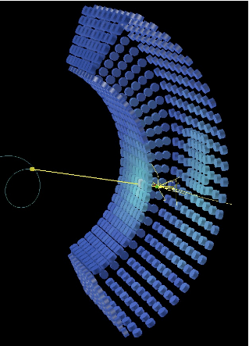
Resolution of LXe detector
Estimated resolution for
MEG II LXe detector.
Better resolution than
previous estimation.
  Thanks to the
  analysis optimization
Resolution | MEG II (shown in last JPS) | MEG II (this study)
u/v/w (mm) | 2.7/ 2.3/ 3.7 | 2.2/2.0/2.3
E_{γ} (w<2cm) | 0.62% | 0.65(4)%
E_{γ} (w>2cm) | 0.53% | 0.49(2)%
t_{γ} (ps) | 71 (preliminary) | 56(1)
v
Reconstructed Eγ
t(rec) - t(MC)
u
v
u
w
γ
w
depth<2cm
depth>2cm
ns
Energy (MeV)
Energy (MeV)

Slide 9
3. Signal readout method comparison

Slide 10

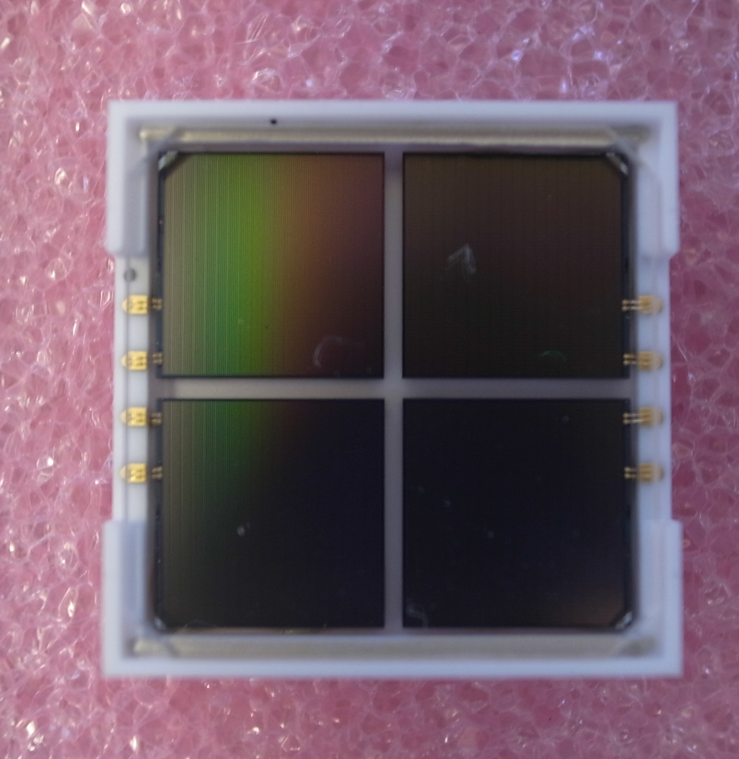
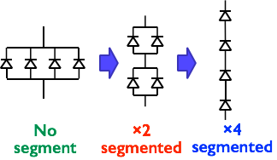
Signal readout method comparison
Series connection of MPPC will be used.
  To avoid the long time constant caused by the large area MPPC.
  Two candidates for signal readout method
    2p2s (2parallel 2series) connection
    4s (4series) connection
Performance of the detector can be affected.
  Different S/N ratio can affect position, energy, and timing resolution
  Different time constant of waveform can affect timing resolution and pileup.
12mm
@7V over voltage | 2p2s connection | 4s connection
gain | 1.6×10⁶ | 0.8×10⁶
leading time | 6.5ns | 2ns
trailing time | 49ns | 33ns
Four independent
MPPC chip
on one package
2p2s
connection
4s
connection
※Definition of time constant:
[0]*(exp(-t/leading_time) - exp(-t/trainling_time))

Slide 11
Signal readout method comparison
Two kinds of noise level are assumed.
  MEG I noise level, higher noise level.
Same resolution for position and energy.
Better timing resolution for 4s connection even under higher noise condition.
We decided to use 4s connection.
MEG I noise level (0.3mV) | 4s connection | 2p2s connection
u/v/w (mm) | 2.4/2.2/3.1 | 2.4/2.2/3.1
E_{γ} (σ of upper Edge) | 0.67(2)% | 0.68(2)%
t_{γ} (ps) | 60(1) | 69(2)
Higher noise level (1.0mV) | 4s connection | 2p2s connection
u/v/w (mm) | 2.4/2.2/3.1 | 2.4/2.2/3.1
E_{γ} (σ of upper Edge) | 0.74(3)% | 0.79(3)%
t_{γ} (ps) | 70(2) | 75(2)
※These resolutions are estimated before analysis improvement.

Slide 12
4. Effect from the uncertainty of PDE

Slide 13
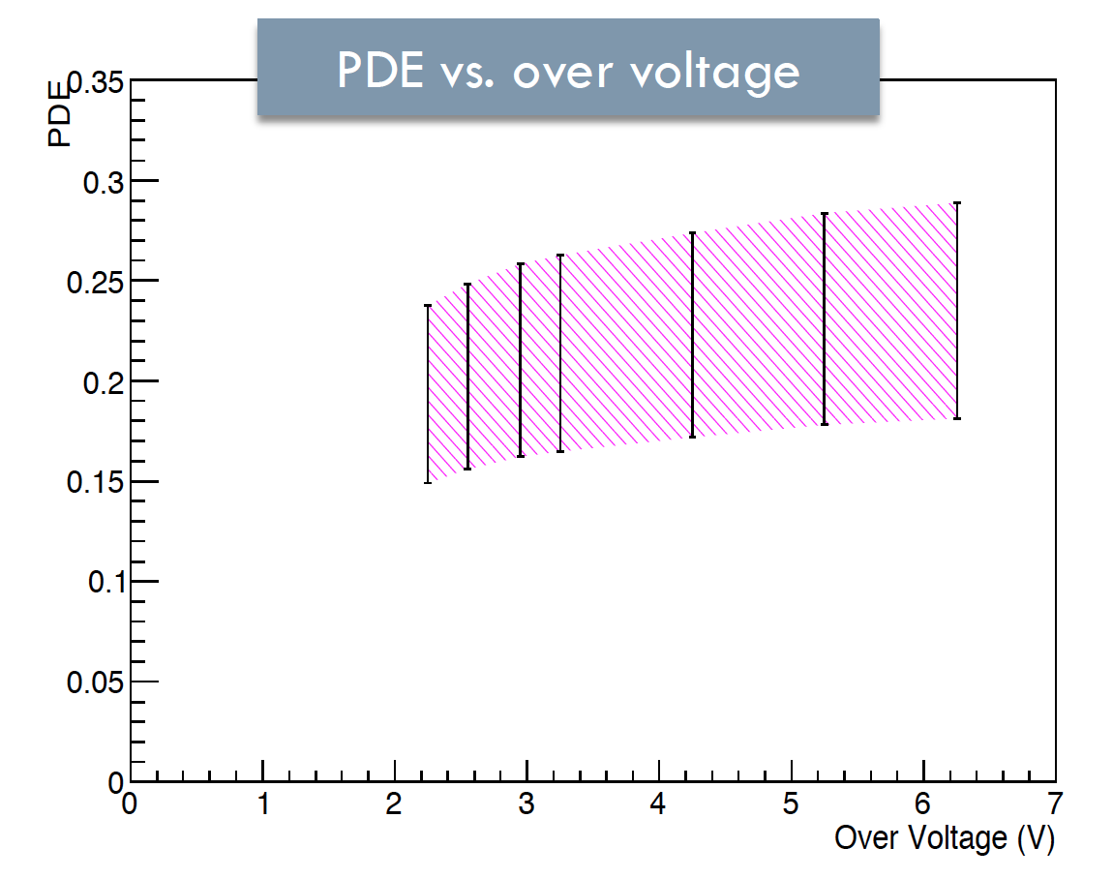
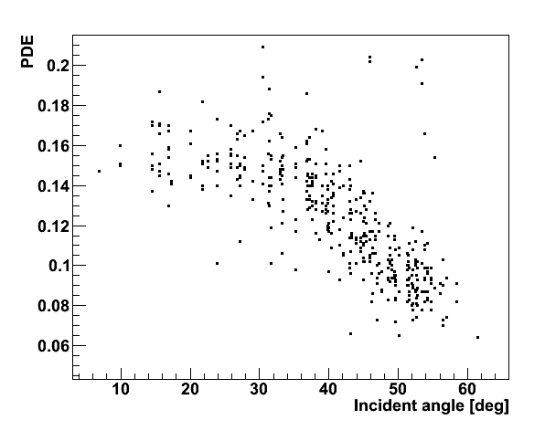
Uncertainty of PDE
There is the uncertainty of PDE of MPPC.
  Absolute PDE of MPPC is not well-known.
  Broad distribution of PDE is observed in mass test.
  We may not be able to measure the PDE correctly
  for each MPPC in the final detector.
  PDE may have an angular dependence which
  is not consistent with the expectation
  from the reflection at silicon surface.
Effects of these uncertainty to the detector performance are estimated.
  MC truth of #of p.e. and timing for each MPPC,PMT are used for simplicity.
PDE vs. over voltage
17-27%
@6.5V over voltage
PDE distribution measured in mass test
PDE vs. incident angle
Broad
distribution
angular
dependence
incident angle (deg)

Slide 14
Effect of absolute PDE
Position resolution
Absolute PDE can be smaller than our previous assumption.
We checked the degradation of resolution through statistical contribution at smaller PDE.
We observed the degradation of resolution
at very small PDE, but effect seems negligible in the range of our measured PDE.
red:u
blue:v
green:w
measured PDE
Energy resolution
Timing resolution
Red:all depth
Green:depth<2cm
Blue:depth>2cm
measured PDE
measured PDE
※Reconstructed from MC truth of # of p.e. and timing.
Resolution from waveform analysis result is 55ps @ PDE 22%.

Slide 15
Effect of PDE ratio b/w MPPC and PMT
We will use two kinds of sensors, MPPC and PMT.
We have to estimate the ratio between PDE of MPPC and QE of PMT
correctly for the energy reconstruction.
  Energy is the summation of the number of the photon, and PDE (QE) is used for converting # of p.e. to # of photons.
  Event by event fluctuation of the ratio of # of p.e. detected in MPPC and PMT can cause the degradation of energy resolution, if our assumption of the PDE ratio is wrong.
Resolution becomes worse if assumed
relative PDE ratio is wrong.
We can estimate the true ratio by
scanning assumed PDE in the analysis
and finding the PDE at which energy
resolution becomes best.
Energy resolution by assuming
several PDE for MPPC
true PDE:22%
Red:all depth
Blue:depth>2cm
Green:depth<2cm
(Assumed PDE ratio)/ (True PDE ratio)

Slide 16
Effect of PDE estimation error
Broad distribution of PDE is observed in the mass test of MPPC.
PDE(QE) of each MPPC(PMT) will be estimated by using alpha source in the final detector. Error of PDE(QE) estimation can cause the degradation of resolution.
Effect from this error to the detector resolution is estimated.
  Error of both PMT and MPPC are taken into account.
  Currently observed distribution is the upper limit of the estimation error.
  Events are simulated with PDE variation and reconstructed by assuming constant PDE.
PDE measured in mass test
(at small incident angle )
QE measured in MEG I
MPPC
PMT
relative
sigma:6.5%
relative
sigma:16%

Slide 17
Effect of PDE estimation error
We compared three cases.
  case A: no estimation error for both MPPC and PMT
  case B: no estimation error for MPPC, 16% estimation error for PMT
  case C: 6.5% estimation error for MPPC, 16% estimation error for PMT
Degradation of the resolution is observed for the energy resolution.
Correct estimation of PDE seems important.
Energy resolution
Resolution | case A | case B | case C
u/v/w (mm) | 2.2/2.0/2.3 | 2.2/2.0/2.3 | 2.6/2.4/2.6
E_{γ} (σ of upper Edge) | 0.57(1)% | 0.71(2)% | 0.78(2)%
t_{γ} (ps) | 39(1) | 38(1) | 40(1)
Red:all depth
Blue:depth>2cm
Green:depth<2cm
case A
case B
case C
※Reconstructed from MC truth of # of p.e. and timing.
Resolution from waveform analysis result is 55ps @ PDE 22%.

Slide 18
Effect of angular dependence of PDE
Effect of the angular dependence of PDE is estimated.
  Angular dependence observed in the mass test is assumed in the simulation.
  Information of angular dependence is not used in the reconstruction.
Angular dependence changes the p.e. distribution on the inner face, and reconstructed depth is shifted to shallower.
  Shift is 3-20mm depending on the depth
angular dependence of PDE
PDE
incident angle (deg)
depth(rec) -depth(MC) (2cm<depth<4cm)
Shift of reconstructed depth vs. depth
reconstructed
depth
becomes
smaller
cm

Slide 19
Effect of angular dependence of PDE
Position resolution
  Small degradation for depth
Timing resolution
  Little effect to timing resolution
Energy resolution
  Decrease of the # of p.e. can be recovered by weighting # of p.e. detected on MPPC.
  Same energy resolution can be obtained even with angular dependence.
Sum of # of p.e. (all MPPCs)
blue: w/o angular dependence
red: w/ angular dependence
25% decrease
Resolution | w/o angular dependence | w/ angular dependence
u/v/w (mm) | 2.2/2.0/2.3 | 2.2/2.0/2.7
E_{γ} (σ of upper Edge) | 0.57(1)% | 0.58(2)%
t_{γ} (ps) | 39(1) | 41(1)
※Reconstructed from MC truth of # of p.e. and timing.
Resolution from waveform analysis result is 55ps @ PDE 22%.

Slide 20
How to deal with uncertainty of PDE
Effect of absolute PDE
  Little effect to performance.
Effect of relative PDE ratio btw/ MPPC and PMT
  Relative PDE ratio is important for energy reconstruction.
  Can be estimated in the calibration run.
Effect of PDE estimation error
  Effect to the energy is not negligible.
  PDE (QE) estimation for each MPPC and PMT is important.
Effect of angular dependence of PDE
  Reconstructed depth is shifted.
  If we can know the angular dependence, this shift can be corrected.
  A new measurement of angular dependence is being planned (see 27aSN-9).
  Method to know the angular dependence in the final detector will be studied.

Slide 21
Summary
Performance of MEG II LXe detector are estimated with realistic settings
together with the several improvement and optimization of analysis.
For signal readout, 4s connection will be used as it has better timing resolution.
Effects from the uncertainty of PDE are estimated.
Some of them are not negligible (especially shift of depth by angular dependence).
How to decrease these effects are being studied.
  We are planning another measurement to further investigate
  the PDE variation and angular dependence.
 | MEG I | MEG II (in last JPS) | MEG II (this study)
efficiency | 64.7% | not estimated | 70.4%
u/v/w (mm) | 5/5/6 | 2.7/2.3/3.7 | 2.2/2.0/2.3
E_{γ} (depth<2cm) | 2.4% | 0.9% | 0.9%
E_{γ} (depth>2cm) | 1.7% | 0.9% | 0.8%
t_{γ} (ps) | 67 | 71 (preliminary) | 56
0.7% contribution are
assumed for MEG II
(from unsolved difference between MC and
real detector in MEG I)

Slide 22
Backup

Slide 23
abstract
MEG実験のアップグレードであるMEG II実験では!LaTeX$\mu \rightarrow e \gamma$ 崩壊の探索感度を一桁向上させることを目指している。
MEG II実験では約4000個のMPPCを用いた液体キセノンガンマ線検出器を使用する予定であり、位置分解能およびエネルギー分解能の大幅な改善を見込んでいる。
シミュレーションを用いた評価により物理目標達成に必要な分解能がすでに確認されているが、さらなる性能向上を目指して再構成法の改良および信号読み出し手法の最適化を行ってきた。
本講演では開発の現状および結果について報告する。

Slide 24
Layout of PMT on top/bottom face
Energy resolution vs. v
We observed that events near
top/bottom face show worse energy
resolution than other events.
We tried to improve this,
by modifying the layout of PMT
on top/bottom face.
  Number of PMT increases
  from 54 to 73 for each face.
  PMT is placed staggered
  to improve photon collection uniformity.
Improvement of energy resolution near top/bottom can be seen.
(though it is not so clear)
black: old layout
red:new layout
fiducial volume
Old Layout
New Layout

Slide 25
Detection Efficiency
Efficiency(%) | MEG I | MEG II
region 1 | 55.9 | 61.5 ± 1.4
region 2 | 55.0 | 60.3 ± 1.8
region 3 | 61.7 | 70.6 ± 1.2
region 4 | 56.3 | 62.3 ± 1.0
region 5 | 63.8 | 69.0 ± 0.6
region 6 | 66.5 | 71.9 ± 0.6
region 7 | 67.1 | 73.5 ± 0.6
region 8 | 67.9 | 72.9 ± 0.8
Averaged with area | 64.2 | 70.0
Averaged with MEG I weight | 64.7 | 70.4
67.9
65
59
3
9
15
20.9
23.9
v(cm)
fiducial
volume
u(cm)
fiducial volume

Slide 26
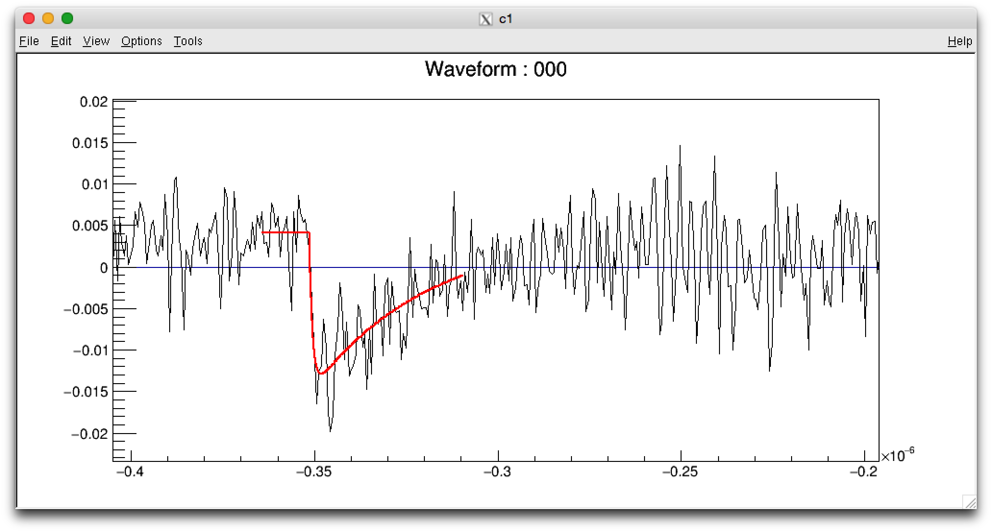
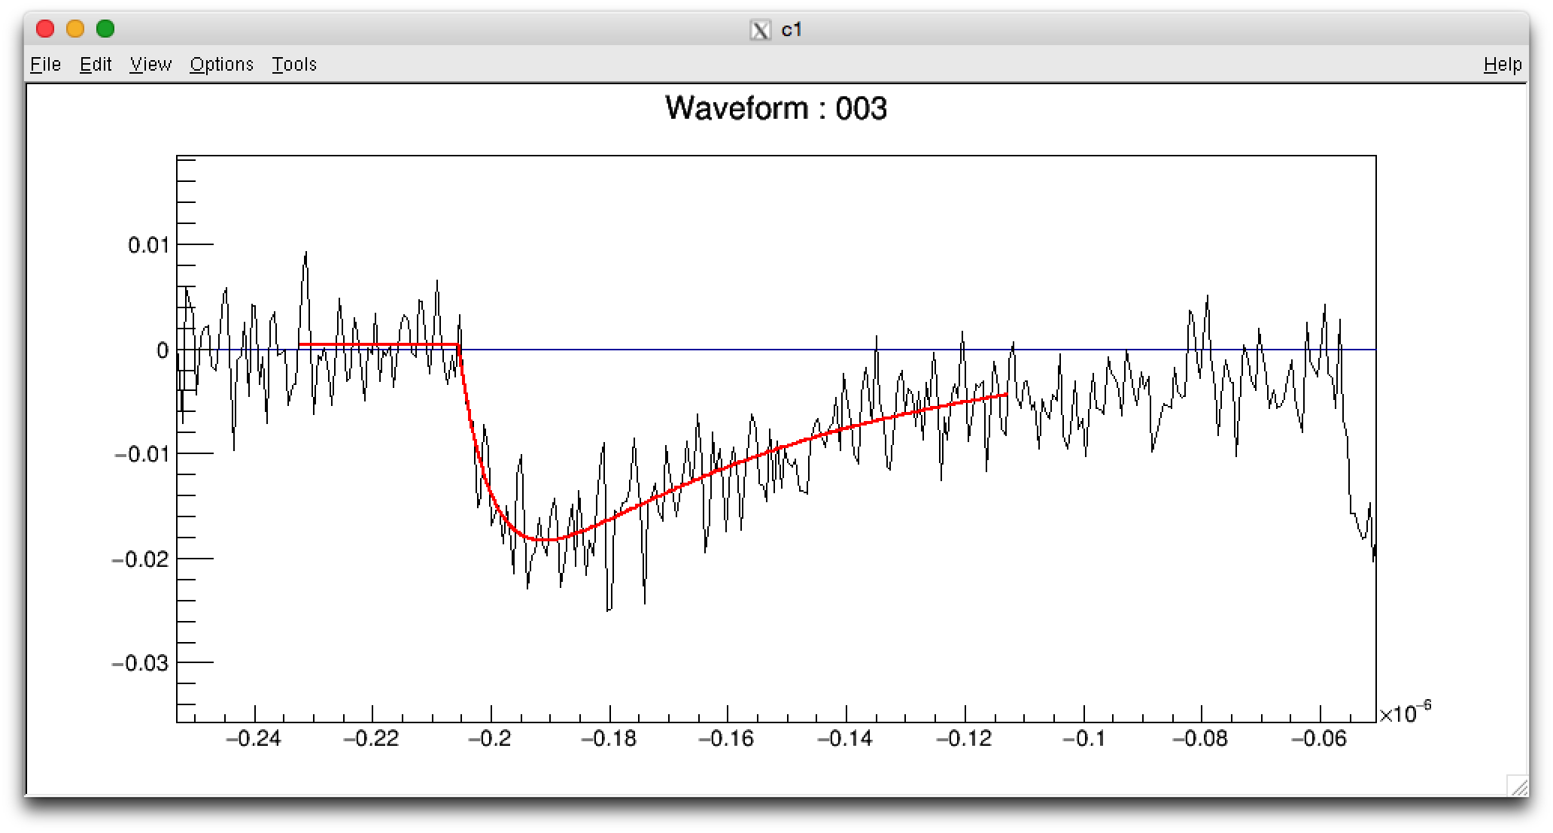
Setting for MC
PDE | Gain | Crosstalk Prob. | Afterpulse Prob.
22% | 0.8 ×10⁶ | 15% | 15%
Event by event fit | 2p2s | 4s
trailing time const. | 49ns | 33ns
leading time const. | 6.5ns | <2ns
22% PDE
PDE vs. over voltage
0.8M Gain
15%
Crosstalk Prob.
17-27%
@6.5V over voltage
measured waveform of 1p.e.
measured waveform of 1p.e.
4s
2p2s

Slide 27
Waveform analysis
In waveform analysis, charge (# of p.e.) and timing are calculated.
Charge is calculated from fixed integration range.
Constant fraction method is used for timing calculation
(with 10% of pulse height threshold)
simulated waveform
constant
fraction time
pulse height * 0.10
integration range 200ns

Slide 28
Waveform analysis for over range channel
As PDE and gain increases, 35% of event have at least one channel
in which pulse height becomes higher
than dynamic range of waveform digitizer (950mV).
We can avoid over range by decreasing amp gain
but it leads to worse SN ratio, and it may result in worse resolution. (Quantitative estimation has not done yet.)
However, appropriate waveform analysis to these over range channel is important for reconstruction as they have large # of p.e.
Pulse height vs #ofp.e.
Number of over range
channel per event
some channels
become over range
35% event have
over range channel
black:MPPC
red:PMT

Slide 29
Waveform analysis for over range channel
For these over range channel, TOT (Time Over Threshold) method
are used for charge calculation in MEG I.
Same method can be used for MEG II.
Relation between TOT and charge
are calculated beforehand.
In this study, over range channels
are not used for timing calculation.
(#of p.e. from wf analysis)
/(#of p.e. of MC truth)
simulated waveform (over range ch)
TOT
150mV
0.2% rms
4% rms
DRS
dynamic
range
Red:Over Range
channel
(Npe>5000)
Blue:Normal
channel
(Npe~4000)

Slide 30
Position reconstruction
Position is reconstructed by fitting # of p.e. distribution of inner face
with the solid angle from conversion point to each MPPCs.
Correction of shower direction is applied.
We estimated position resolution
by comparing with MC truth.
v
u
v
w
u
γ
w
古い絵差し替え
Notes:
\chi ^2 _{pos}=\sum_{i} \frac{N_{pe,i} - c \times \Omega _i (u,v,w)}{\sigma(N_{pe,i})}

Slide 31
Global Correction
Global correction for U is coming from average shower direction.
Shower direction is not perpendicular to inner face in UR space.
This is not the case for V, as inner face is perpendicular to in VR space.
Global correction for W is basically
a offset depending on FitRange.
UR space

Slide 32
Global Correction
with FitRange[0]
16 MPPC
U,W is corrected as a function of U,W
u(rec)-u(MC)
v(rec)-v(MC)
w(rec)-w(MC)
average
shower
direction
u(rec)
v(rec)
w(rec)
offset
u(rec)
v(rec)
w(rec)

Slide 33
Shower Correction
Correction of event by event fluctuation of shower direction.
If we use wider fit range, the effect from shower direction increases.
Information of shower direction can be derived from difference of the fit result using different fit range.
This correction is applied for UV.
Dependence can be seen also
for W, it is also corrected.

Slide 34
Shower Correction U
y axis: u(rec,iRegion) - u(MC)
x axis: u(rec,iRegion+1) - u(rec,iRegion)
U before correction
iRegion=0
iRegion=1
iRegion=2
iRegion=3
iRegion=4

Slide 35

W threshold optimization
Wthreshold[6] is decided from resolution for each fitting range.
with Global correction,
and Shower correction
Resolution of U vs W
Resolution of V vs W
Resolution of W vs W
Wthreshold[6]={3,5,9,14,14,40}

Slide 36
Energy reconstruction
Energy is reconstructed by the summation of
the number of photon (not photoelectron) from all channels
taking into account of different coverage for each channel.
Correction as a function of position is applied.
× relative weight
between
MPPC & PMT
# of p.e.
(PMT,MPPC)
# of photon
(PMT,MPPC)
×1/PDE
Correction of
crosstalk & after pulse
× factor
(coverage
around sensor)
× Conversion
factor to
energy
MC truth or
waveform analysis
Reconstructed
Energy
Reconstructed Energy
w/o position correction
Correction as a
function of u,v,w

Slide 37
Timing reconstruction
Timing is reconstructed by fitting the time at each sensor, taking into account of TOF from the reconstructed conversion point.
Error of the timing is a function of # of p.e.
Calibrations of timewalk effect and calibration with position are done.
Error of timing as a function #ofp.e.
Error of timing as a function #ofp.e.
ns
ns
MPPC
black: MCtruth
red: waveform analysis
PMT
black: MCtruth
red: waveform analysis
1/sqrt(#ofp.e.)
1/sqrt(#ofp.e.)

Slide 38
Position resolution
Improvement of position resolution for shallow event from MEG I
can be seen as we expected in proposal.
black: MC truth
red: waveform analysis

Slide 39
Energy resolution vs position
Same resolution for all position
with MC truth.
blue:Waveform simulation
red:MCtruth w/o CTAP,saturation

Slide 40
Timing resolution vs. position
blue:Waveform simulation
red:MCtruth w/o CTAP,saturation

Slide 41
Comparison with reconstruction from MCtruth
We also tried reconstruction using MCtruth of # of p.e. and timing for each MPPC,PMT for comparison.
  Effect from crosstalk, after pulse, saturation, noise can be seen.
Almost same resolution is obtained for position and energy.
Different timing resolution is observed.
  This can be coming from the error of timing
  in the waveform analysis.
  There is the room for the improvement
  in the waveform analysis.
Error of timing as a function #ofp.e.
MPPC
black: MCtruth
red: waveform analysis
1/sqrt(#ofp.e.)
Error of timing as a function #ofp.e.
PMT
black: MCtruth
red: waveform analysis
Resolution | MC truth | waveform analysis
u/v/w (mm) | 2.2/2.0/2.3 | 2.3/2.0/2.4
E_{γ} (w<2cm) | 0.70(4)% | 0.65(4)%
E_{γ} (w>2cm) | 0.45(2)% | 0.49(2)%
t_{γ} (ps) | 39(1) | 56(1)
1/sqrt(#ofp.e.)

Slide 42
Wrong PDE ratio b/w MPPC and PMT
wrong ratio changes reco.E vs. w
This change can be calibrated in
the calibration run
assumed PDE/true PDE=1.1
assumed PDE/true PDE=2.0
assumed PDE/true PDE=0.6

Slide 43
Wrong PDE ratio b/w MPPC and PMT
Event by event fluctuation of detected
# of p.e. for MPPC and PMT
causes degradation of resolution
with wrong PDE ratio.
assumed PDE/true PDE=1.0
x-axis: # of p.e.(MPPC) / # of p.e. (PMT)
taking into account different coverage
y-axis: reconstructed Energy
selecting events in abs(u)<5 && abs(v)<15 && 3<w<4
assumed PDE/true PDE=0.5
assumed PDE/true PDE=2.0

Slide 44
Reproducibility of PDE fluctuation
Case C(PMT QE distribution 16% + MPPC PDE distribution 6.5%)
Reproducibility of the result is confirmed with different seed value.
Energy resolution
red: all depth
green:depht< 2cm
blue: depth> 2cm

Slide 45
angular dependence
LXe -> Siへの透過率
blue: s wave
green: p wave
red: average
incident angle (deg)
incident angle (deg)
calculated from
complex refractive index
LXe: 1.61
Si: 0.8+2.2i
red: angular dependence
measured in mass test
blue: angular dependence
measured in mass test
(w/o LXe to Si reflection)

Slide 46
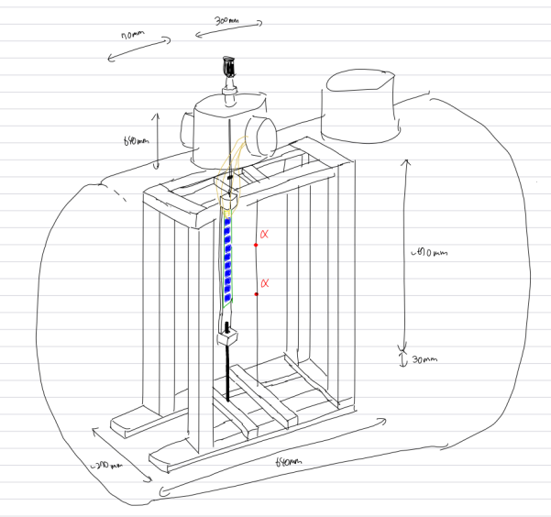
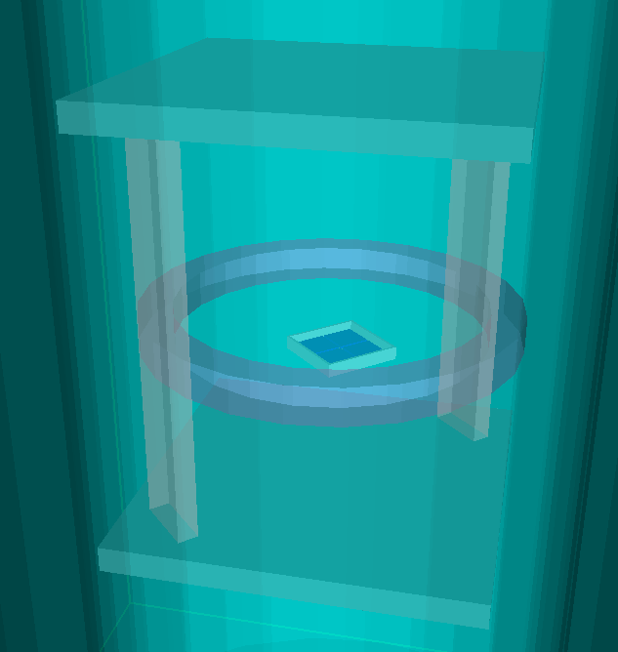
Additional angular dependence meas.
We plan to do two different type of tests.
Small chamber
Large chamber
Liquid Xe
gas Xe
α
α
~20 MPPCs
on moving stage
70cm
MPPC
(4 chips)
α
10cm
Quick setup, only 4 chips
Confirm angular dependence
Movable stage, 20~30 MPPCs.
Check the angular dependence and MPPC by MPPC variation of PDE
↑ Today’s topic

Slide 47
Energy reconstruction (w/ angular dependence)
Sum of # of p.e. (all MPPCs)
blue: w/o angular dependence
red: w/ angular dependence
25% decrease

