Slide 1
SiPM読み出しによる 高時間分解能 シンチレーションカウンターの開発
2013年9月20日
日本物理学会2013年秋季大会＠高知大学
素粒子物理国際研究センター
内山 雄祐
西村 美紀, 大谷 航
Matteo De Gerone
他, MEG collaborators

Slide 2
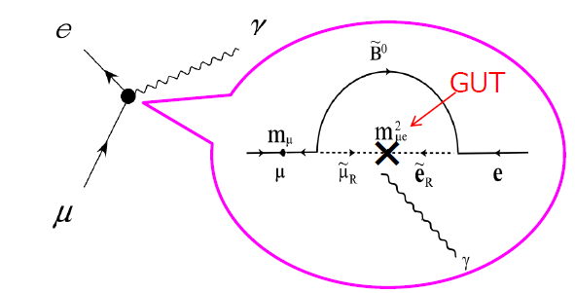
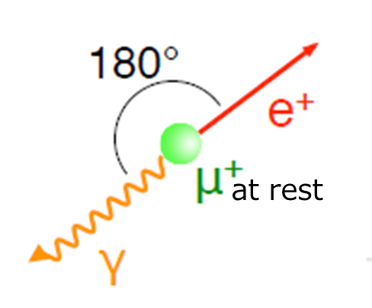
Motivation
Search for lepton-flavor-violating μ→eγ decay
Forbidden in SM
But enhanced in many BSM
MEG experiment
Searching for μ→eγ down to O(10⁻¹³)
Completed data-taking Aug.2013
Analysis for final result ongoing
Upgrade
Push down to O(10⁻¹⁴)
Approved by PSI, R&D progress
To start DAQ in 2016
Signature
52.8MeV (＝M_{μ}/2)
22pSE5 岩本
52.8MeV(＝M_{μ}/2)
Required to suppress accidental BG

Slide 3
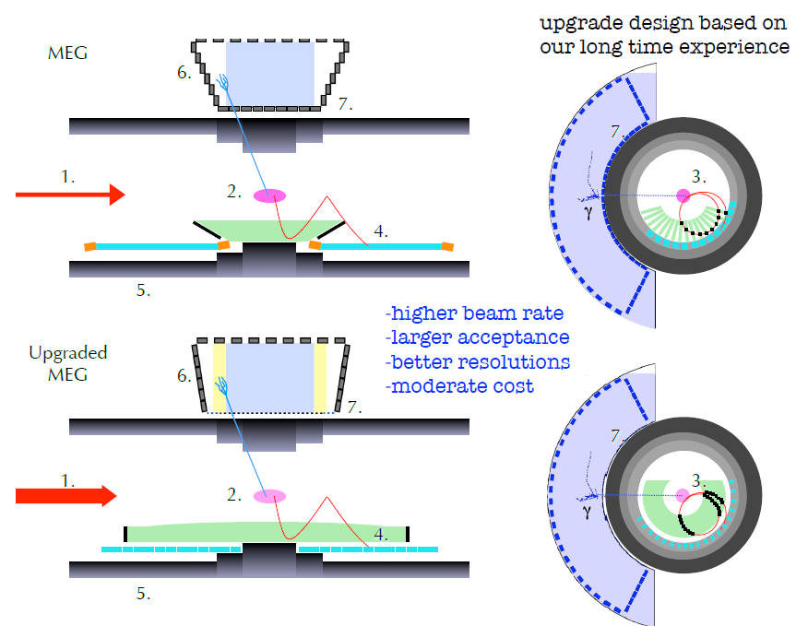
MEGアップグレード
全体像
MEG Upgrade Proposal
(http://arxiv.org/abs/arXiv:1301.7225)

Slide 4
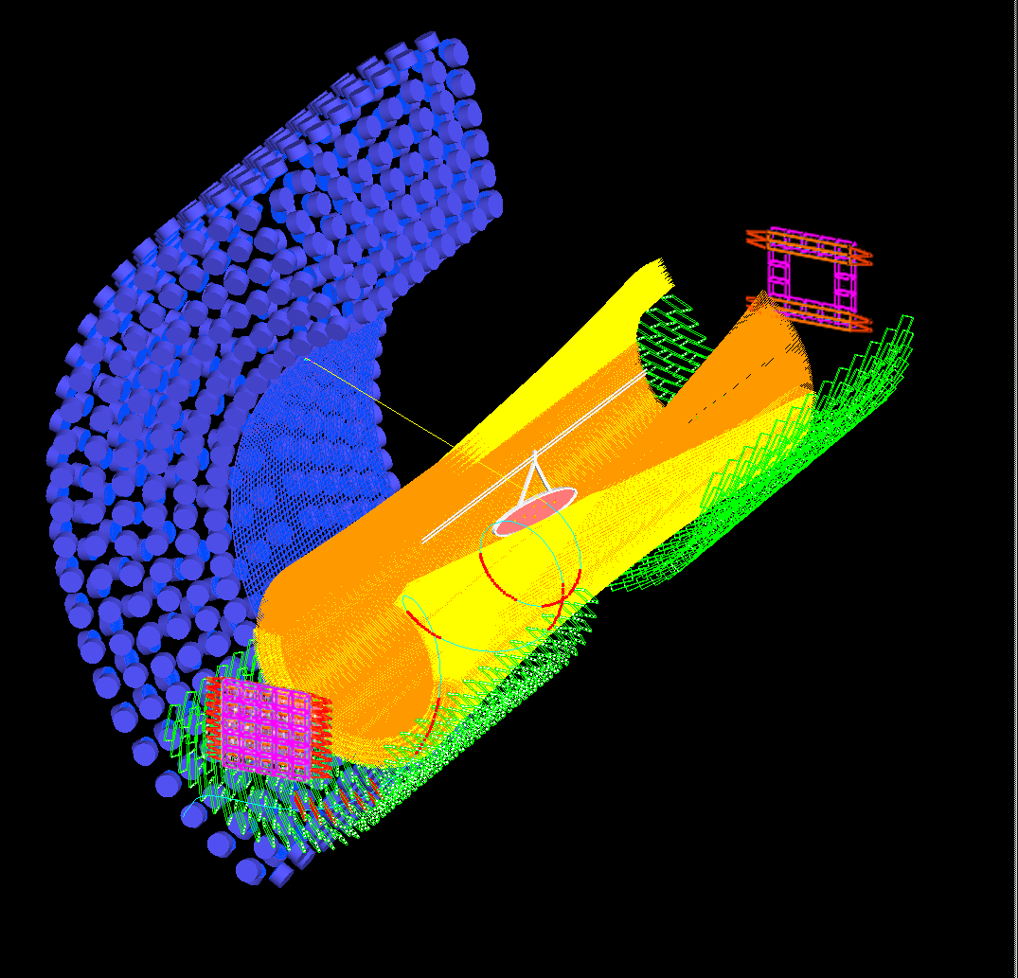
SiPM in MEG upgrade
液体キセノンガンマ線検出器
BG同定検出器
新たに導入を検討
GSO+プラシン ＋ファイバー
ガンマ線入射面をPMTから
MPPCに置き換える
真空紫外光に有感
大型
電荷測定・時間測定
～4000ch
陽電子時間測定器
高速プラスチックシンチレータ読み出し
近紫外光
高精度時間測定
～500 counters × 2ch (3000 SiPMs)

Slide 5
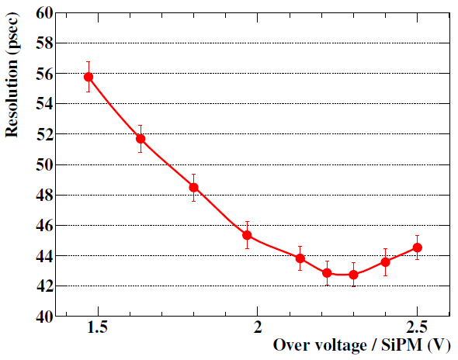
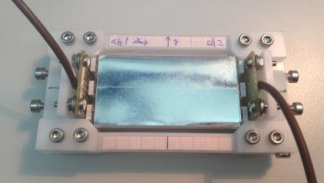
Previous results
BC422
6x3x0.5 cm³
3M mirror film
SiPM
Saint-Gobain BC422
(60×30×5 mm³)
Achieved excellent resolution of 43 ps(σ) at relatively high over-voltage
Observed deterioration at further over-voltage
Increase of dark noise, after pulsing

Slide 6
Test setup
3 SiPM in series connection
Waveform digitizer
Thermal chamber
Shaping amplifier
USB→PC
Scintillator：BC422, 60x30x5mm³
Sensor：3x3mm², 50μm-pixel SiPMs
Reference counter：BC422, 5x5x5mm³, 1 MPPC for trigger & collimation
⁹⁰Sr β-source (<2.28MeV)
Amplification & shaping (pole-zero cancellation)
High speed sampling with waveform digitizer
DRS
Input (4ch)

Slide 7
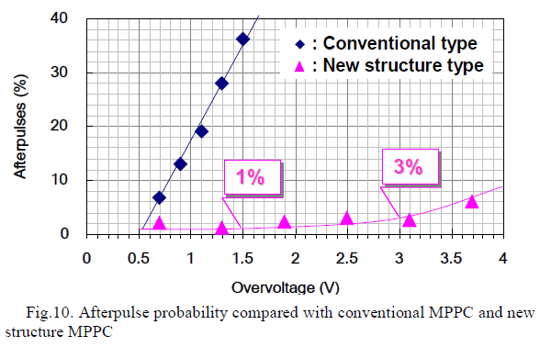
Topics today
T.Nagano et.al, IEEE NSS/MIC 2012
Further study to understand the timing resolution of plastic scintillation counter from SiPM properties
Detail comparison of different type of SiPMs
Recently, many manufacturers produce blue-sensitive SiPMs with ‘p-on-n’ structure
New MPPCs from Hamamatsu
New standard MPPC
New trench MPPC
HPK has recently developed new technologies
After pulse suppression
Trench for cross-talk suppression
Metal quench resistor
High fill factor for small pixel
Etc.
IEEE NSS/MIC 2012,
VCI 2013 Id:180
Pursue ultimate timing performance
of general scintillation counter

Slide 8
Single sensor properties

Slide 9
Test samples
Manufacturer | Model number | Type
HPK | S10362-33-050C | Conventional MPPC (Old) | Ceramic package
 | S10931-050P |  | Surface mount
 | S12572-050C(X) | New MPPC (Standard)
 | S12572-025C(X) |  | 25μm pixel
 | S12652-050C(X) | Trench-type MPPC
 | 3X3MM50UMLCT-B |  | Improved fill factor
AdvanSiD |  | NUV type
KETEK | PM3350 prototype A | Trench type
SensL | MicroFB-30050-SMT | B-series with fast output
 | MicroFB-30035-SMT |  | 35μm pixel
Common features:
3×3 mm² dimension, p-on-n structure

Slide 10
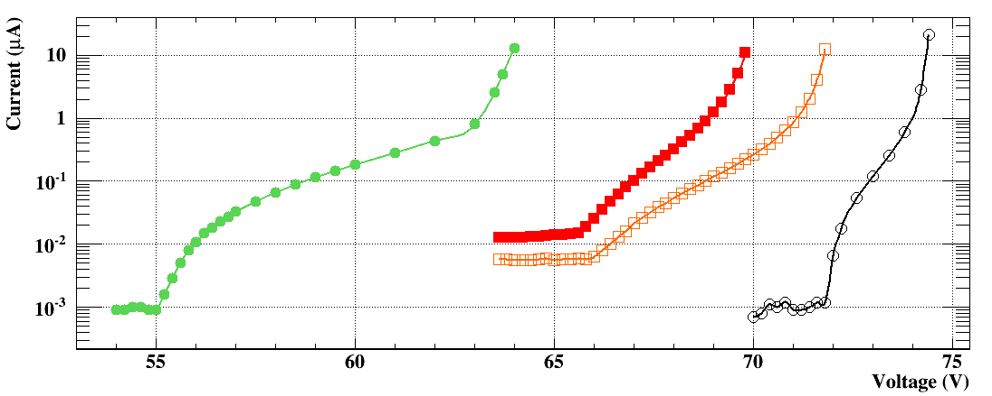
I-V characteristics
＠23℃
New MPPC
50μm
25μm
Trench MPPC
Old MPPC
8 V
4 V
2 V
Much wider operational range.
Breakdown voltages are lower by 5 V (standard), 15V (trench)

Slide 11
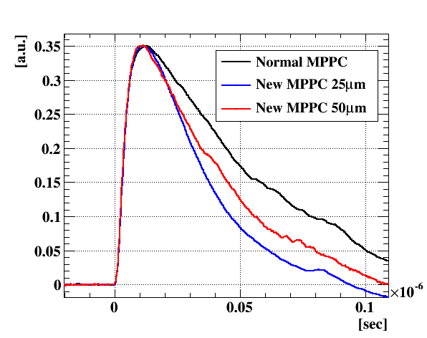
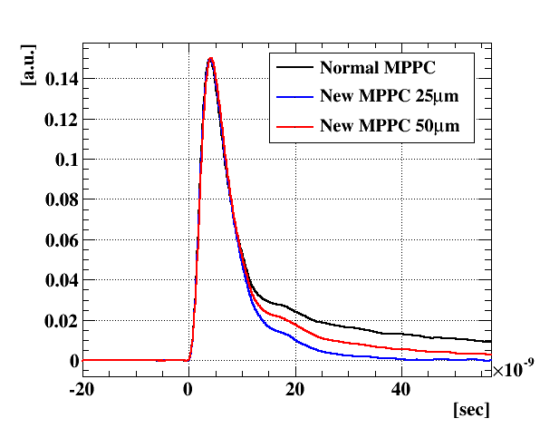
Snapshot of waveform
Old MPPC (S10362-33-050C)
20 ns
After shaping
New MPPC (S12572-050C(X))
Trench MPPC (S12652-050C(X))
Average waveform
Confirmed less after-pulsing

Slide 12
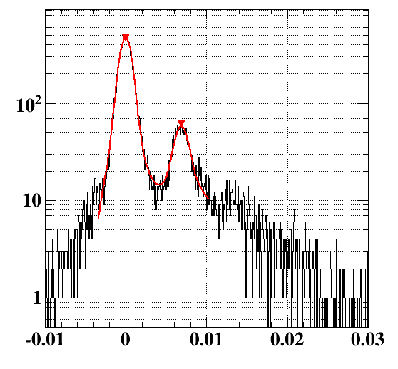
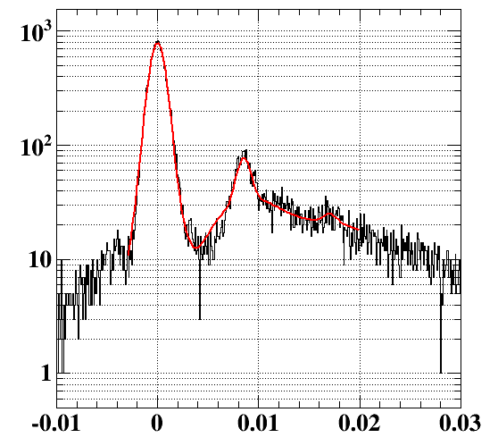
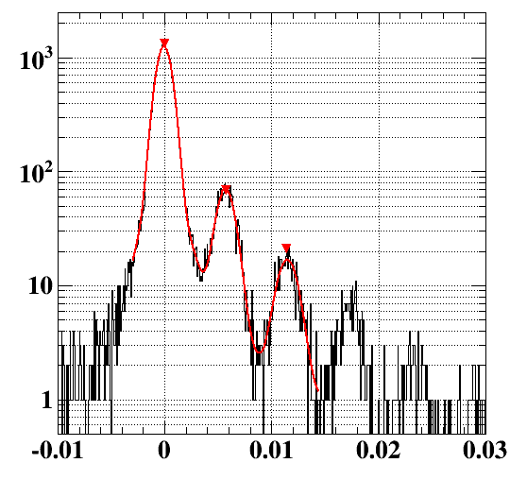
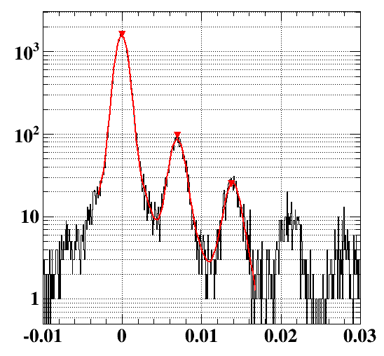
p.e. counting
Over-voltage ~2.0 V
Over-voltage ~2.5 V
Dark measurement
Random trigger
Photo-electron counting capability
Large improvement in the separation
0pe
1pe
アフターパルスにより連続的な分布に
2pe
Old MPPC
Charge (10⁹e)
New MPPC

Slide 13
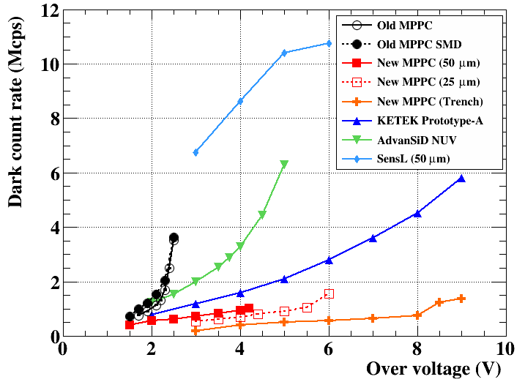
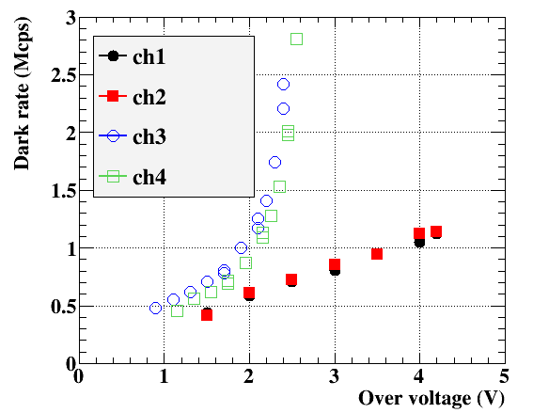
Dark count
＠23℃
SensL
New
Old
AdvanSiD
KETEK
Old MPPCs
New MPPCs
Kept controlled up to high V_{over} due to the after-pulse suppression

Slide 14
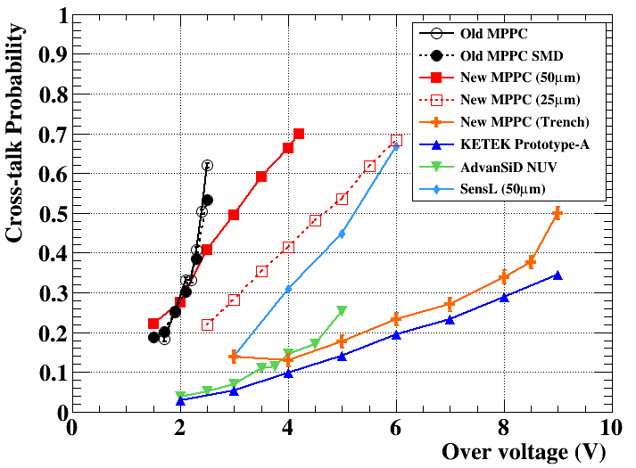
Cross talk
＠23℃
Standard SiPMs
Trench SiPMs
Cross-talk
Probability
$$≡\frac{\#≥2pe}{\#≥1pe}$$

Slide 15
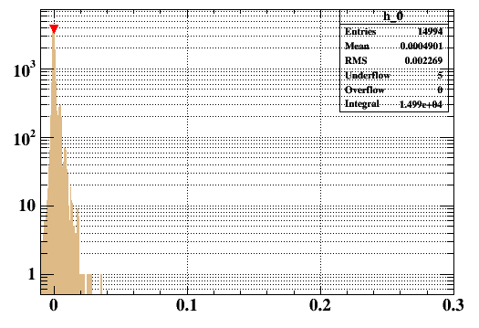
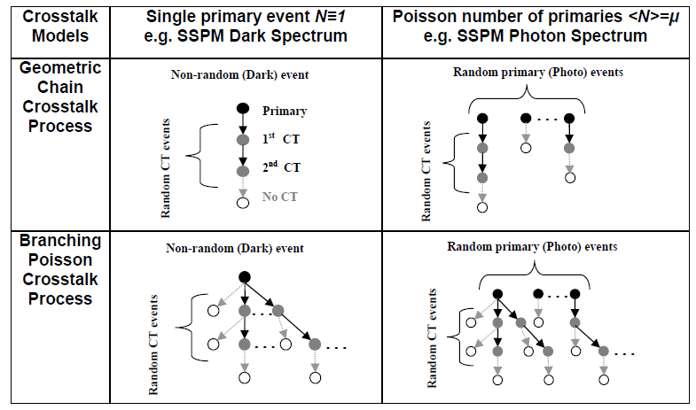
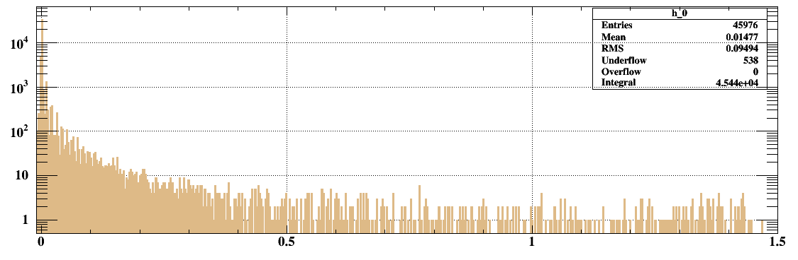
Cross talk
Standard NEW MPPC
Cross talk increases at high bias
Very long tail in charge distribution
Cross-talk process runaway
Big impact on energy measurement (excess noise factor)
Impact on time measurement?
1pe
2pe
V_{over}=1.5V
5pe
arXiv:1109.2014
1pe
V_{over}=4.0V
2pe
…
10pe
Saturation of electronics
100pe
Charge (10⁹e)

Slide 16
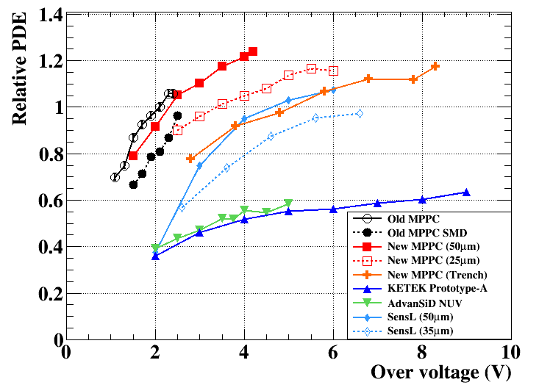
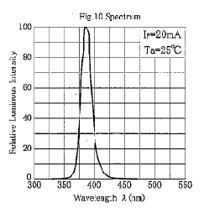
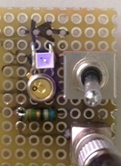
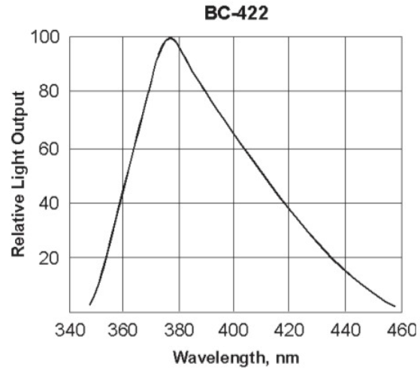
PDE with UV-LED
(Photo Detection Efficiency)
New50um
Measure relative PDE using UV-LED (~ scinti. Light)
Calculate PDE from 0 p.e. probability
25um
Trench
Old
SensL
AdvanSiD
KETEK
LED (~390nm)
Extended PDE at higher V_{over} for new MPPCs
Recovered fill factor for smaller pixel (25um)
Trench-type MPPC also shows good PDE due to relatively high fill factor (55%, ~10% lower than standard type)
Scintillator spectrum
LED2 (~365nm)

Slide 17
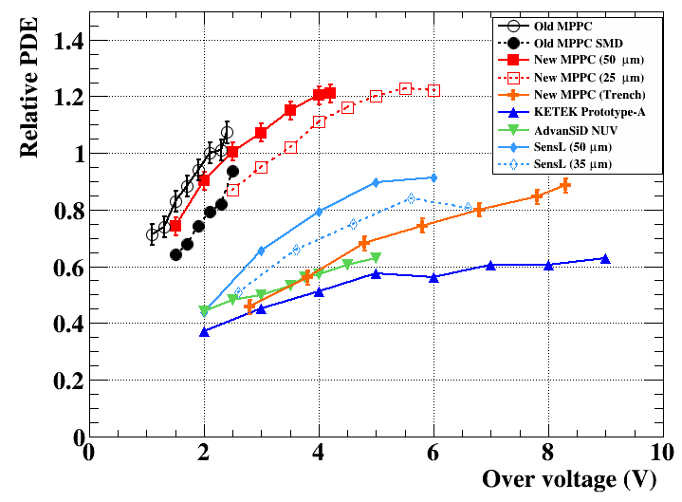
PDE with UV-LED
New50um
Measure relative PDE using UV-LED (~ scinti. Light)
Calculate PDE from 0 p.e. probability
25um
Old
SensL
Trench
AdvanSiD
KETEK
LED (~365nm)
Extended PDE at higher V_{over} for new MPPCs
Recovered fill factor for smaller pixel (25um)
Trench-type MPPC also shows lower PDE for short wavelength (?)
Scintillator spectrum
LED2 (~365nm)

Slide 18
PDE with UV-LED
New50um
25um
New50um
Trench
25um
Old
SensL
Old
SensL
Trench
AdvanSiD
KETEK
KETEK
AdvanSiD
LED (~390nm)
LED (~365nm)
*Relative scales for the two plots are not same
HPK MPPCs show higher PDE for near-UV
Extended PDE at higher V_{over} for new MPPCs
Recovered fill factor for smaller pixel (25um)
Trench-type MPPC also shows good PDE due to relatively high fill factor (55%, ~10% lower than standard type). But PDE is suppressed at shorter wave length (?)
LED2 (~365nm)

Slide 19
Scintillator signal readout by 3 MPPC series connection

Slide 20
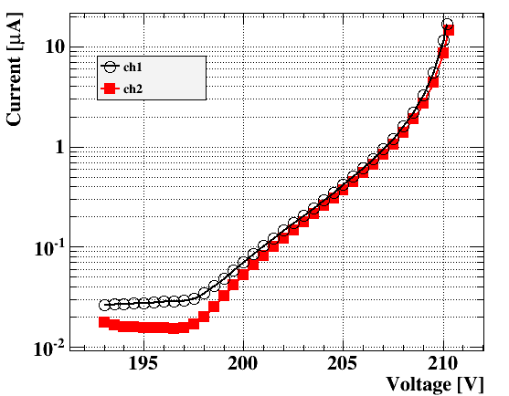
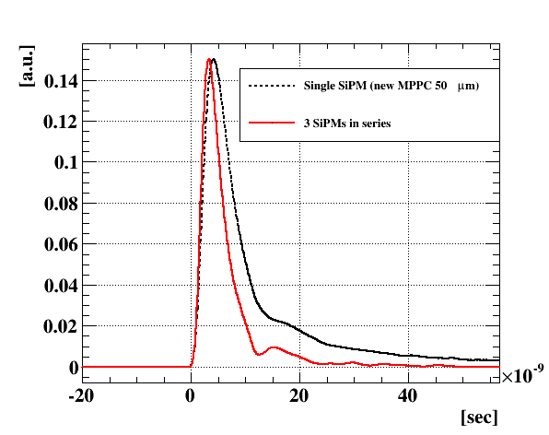
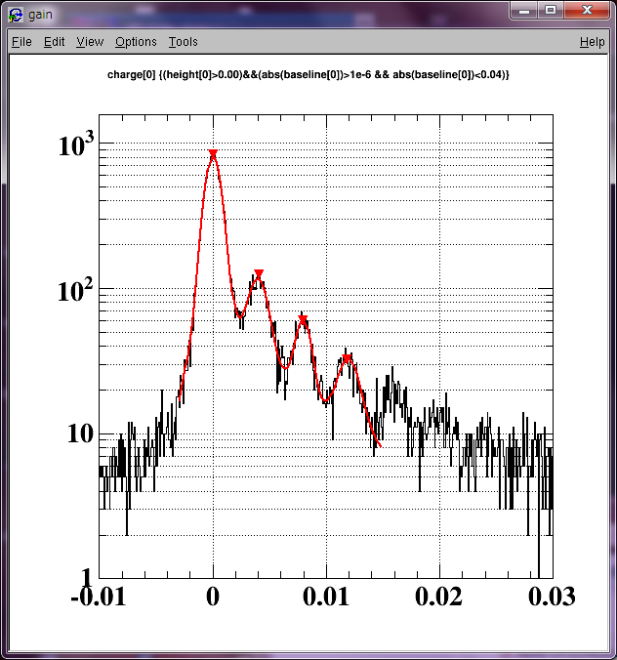
3 series connection
直列につないだ3つのセンサーを1チャンネルで読み出す
実効的に大面積化。検出光量の増加で分解能をあげる。
両端に3倍のバイアス電圧を供給。
共通電流で個々のセンサーにかかる電圧が調整される
Over-voltageが自動的に大体そろう
直列接続でキャパシタンス減少
シャープな波形
ゲイン減少 (~40%)
Over-voltage
~3.8 V /MPPC

Slide 21
Time resolution
BC422
6x3x0.5 cm³ No wrapping
Trench
New (25μm)
Old
New
Almost same resolution attained at each optimal bias. (No major improvement)
Trench-type shows slightly poorer resolution

Slide 22
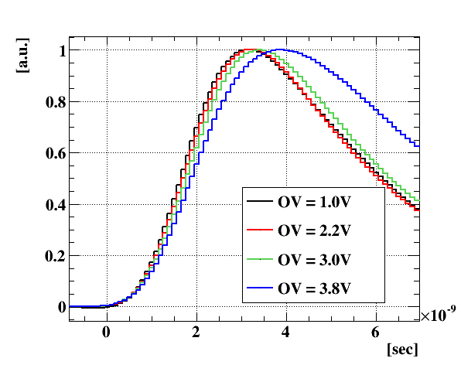
Rise time
Trench
New
New (25μm)
Old
Observe softening of waveform as V_{over} for standard new MPPC
Slower pulse shape for Trench MPPC
This sample is not the final version.
HPK is trying to improve this

Slide 23
Pulse timing
Pulse time by Constant-Fraction method
Old
$$t_{Counter}−t_{ref}$$
Trench
New
New (25μm)
!？
Faster charge collection by higher E-field
As a consequence of softened pulse shape, time measurement drifts for applied bias
→ Larger temperature dependence of time measurement
Old | 2.5 ps/℃
New | 5.5 ps/℃
New 25um | 2.8 ps/℃
Trench | 0.1 ps/℃

Slide 24
Temp vs Timing
40°C
30°C
20°C
25°C
20°C
30°C
Old MPPC (S10362-33-050C)
New MPPC (S12572-050C(X))
Bias voltage (V) (Over voltage/MPPC @23°C)
Bias voltage (V) (Over voltage/MPPC @23°C)
バイアス一定の場合の時間測定(mean)の温度依存性
高バイアス下での時間のドリフト(波形のなまり)により新型では温度依存性が大きくなってしまった。(5度の変化で~30ps)
温度変化の寄与(一様分布仮定)
30 ⊕ 30/√12 = 31.2 ps
問題となるレベルではない
検出器の分解能(最終目標値)
Temp. dependence of time measurement (mean) at fixed bias voltage
Due to the time drift (pulse shape softening) new MPPC has larger dependence (~30ps by 5℃ variation)

Slide 25
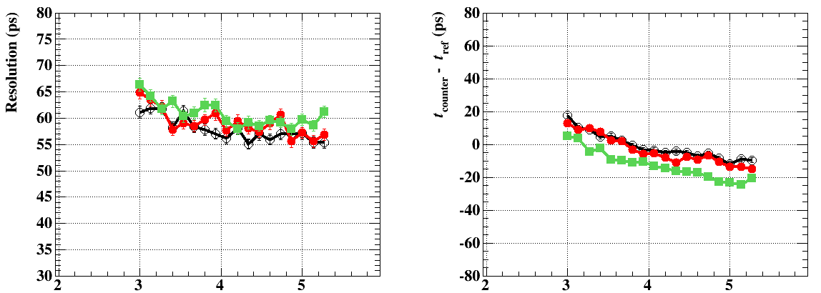
AdvanSiD
30°C
20°C
25°C
25°C
20°C
Stable!
30°C
MPPC attained
Bias voltage (V) (Over voltage/MPPC @23°C)
Bias voltage (V) (Over voltage/MPPC @23°C)
Breakdown coefficient
AdvanSiD: 24 mV/℃
KETEK： 16 mV/℃
10–15 ps poorer resolution
Good stability for wide bias range
No more care for temperature
MPPC Old: 49 mV/℃
MPPC New:59 mV/℃

Slide 26
まとめ
New MPPC
after pulseの大幅削減, 動作領域の拡大
パルス後の安定性向上。高計数率下測定で有効。
Trench-type, 加えてcross talk抑制
Small pixelでもfill factor改善で同等のPDE
時間測定の温度依存性
New MPPCで悪化
Trench-typeではKETEK, AdvanSiD同様安定
シンチレータ時間分解能
p.e. statisticsがドミナント → PDEが重要
近紫外光で高いPDEを有する浜松MPPCで高分解能
New MPPCでは到達分解能に大幅な改善は見られない。

Slide 27
 | After pulse, noise | Cross talk | PDE | Bias, Temp. stability | Time resolution
Old MPPC | △ | ▼ | ○ | △ | ◎
New MPPC (Standard) | ◎ | ▼ | ◎ | ▼ | ◎
New MPPC (25um) | ◎ | ▼ | ◎ | △ | ◎
New Trench MPPC | ◎ | ◎ | ○ | ◎ | ○
AdvanSiD NUV | ▼ | ○ | ▼ | ◎ | △
KETEK | ▼ | ◎ | ▼ | ◎ | ▼
◎ ○ △ ▼
Good
時間分解能追求ならStandard MPPC (50 or 25 μm pixel)
総合性能ならTrench MPPC

Slide 28
Scintillator
Fast scintillators from Saint-Gobain
properties | BC418 | BC420 | BC422 | BC404
Light Output [% Anthracene] | 67 | 64 | 55 | 68
Rise Time [ns] | 0.5 | 0.5 | 0.35 | 0.7
Decay Time [ns] | 1.4 | 1.5 | 1.6 | 1.8
Wavelength [nm] | 391 | 391 | 370 | 408
Attenuation Length [cm] | 100 | 110 | 8 | 140
Used in the beam test
Used in this study (Best )
Present MEG timing counter
Faster scintillator gives higher time resolution
P.e. at the earliest part are only effective
Scintillation with fast response given in near-UV light

Slide 29
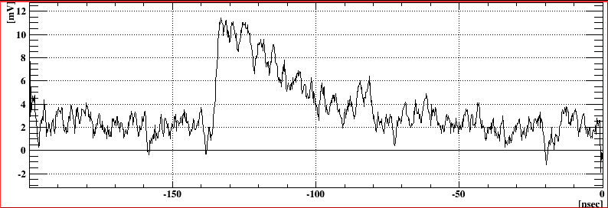
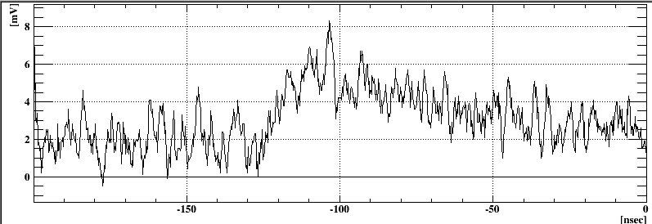
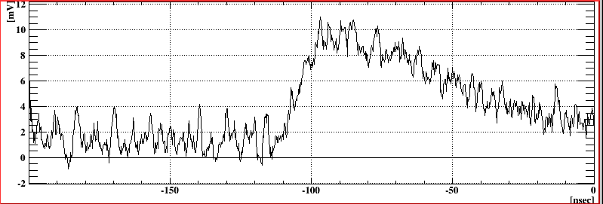
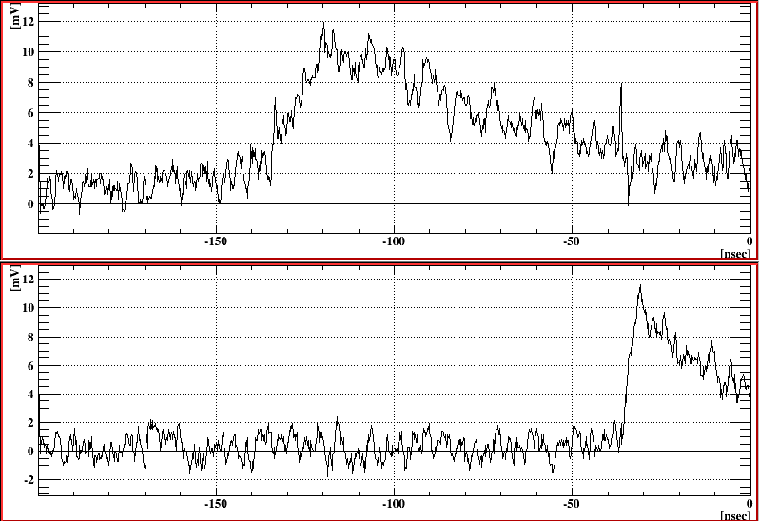
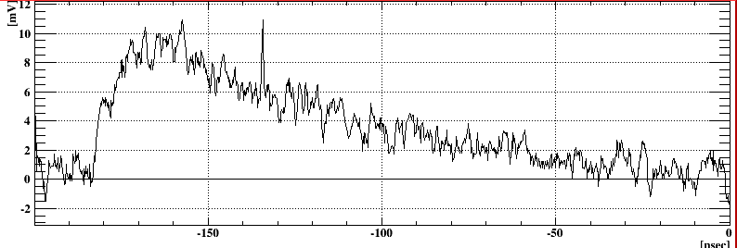
1 pe signal
New Standard, 4V
New Trench, 4V
New Trench, 9V
Trench型で大幅な波形のなまりを観測。

Slide 30
Temp. vs Resolution
Old MPPC (S10362-33-050C)
New MPPC (S12572-050C(X))
40°C
25°C
30°C
30°C
20°C
20°C
Bias voltage (V) (Over voltage/MPPC @23°C)
Bias voltage (V) (Over voltage/MPPC @23°C)
バイアス一定の場合の分解能の温度依存性
レファレンスカウンタは各温度でOver-voltageをそろえてある
新型では高バイアスをかけることで、到達分解能は安定に得られる。

Slide 31
Temp. vs Resolution
Old MPPC (S10362-33-050C)
New MPPC (S12572-050C(X))
40°C
25°C
30°C
30°C
20°C
20°C
Over voltage一定での分解能温度依存性。
新型(旧型)60mV/°C(55mV/°C)の温度係数を仮定して補正。

Slide 32
温度依存性・時間測定
20°C
25°C
20°C
30°C
40°C
30°C
Old MPPC (S10362-33-050C)
New MPPC (S12572-050C(X))
Bias voltage (Over voltage/MPPC @23°C) (V)
Bias voltage (Over voltage/MPPC @23°C) (V)
Over voltage一定での時間測定温度依存性。
新型(旧型)60mV/°C(55mV/°C)の温度係数を仮定して補正。
もし温度変化をバイアスコントロールでアクティブに補正できれば影響を最小限にできる。

Slide 33
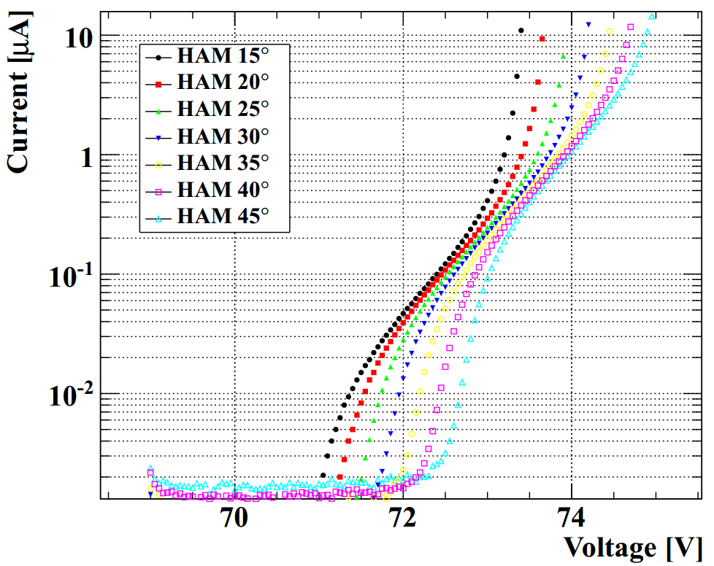
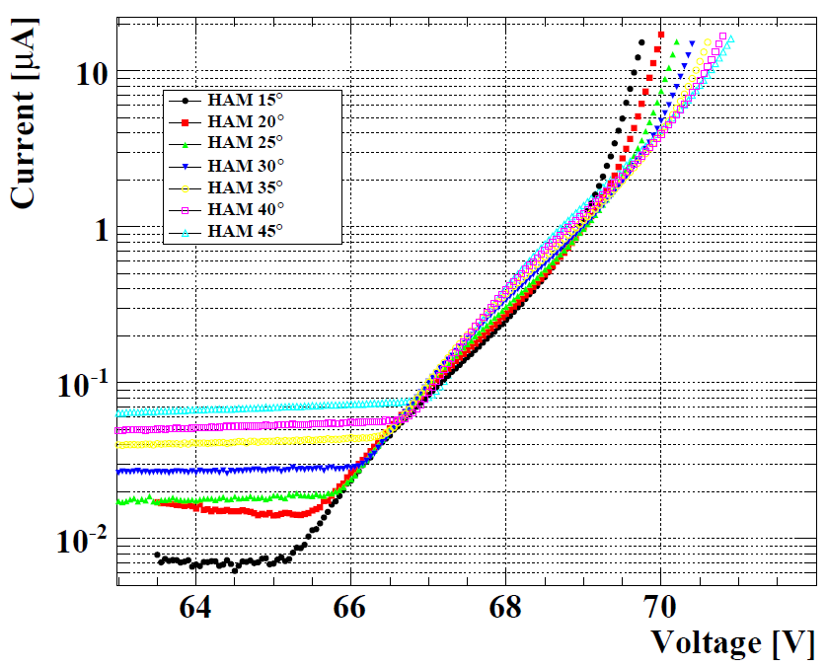
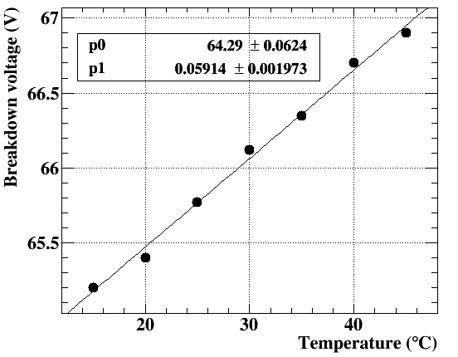
温度依存性
Old MPPC (S10362-33-050C)
New MPPC (S12572-050C(X))
降伏電圧の温度依存性
Old:49 mV/℃
New:59 mV/℃
参考:
AdvanSiDセンサー:24 mV/℃
KETEKセンサー：16 mV/℃
(どちらもp-on-n, blue sensitive type)

Slide 34
整形・増幅器
MPPCバイアス電圧
入力段減衰
１５０
MPPC
アンプ
アンプ
出力
ポールゼロ消去

Slide 35
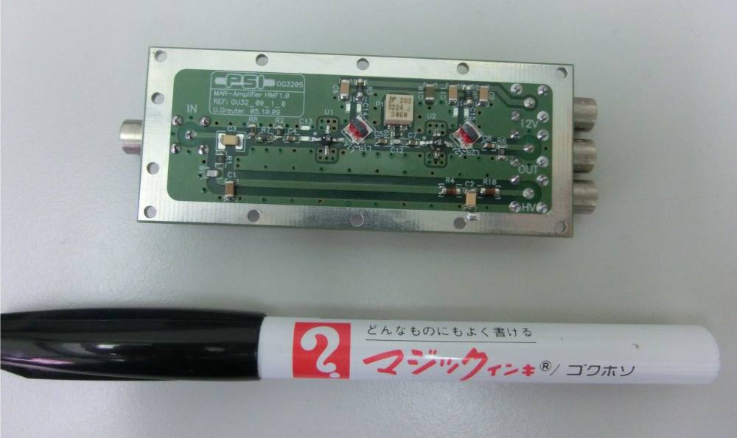
Shaping
For precise time measurement
Restore baseline by pole-zero cancellation, and
Extract fast rise-part
Pole-zero cancellation potentiometer 0 Ω (attenuated by 2)
200 Ω
1000 Ω
t_{rise}~1.7 ns
-150
-100
-50
0 (nsec)
Signal from scintillator （３MPPC in series connection）

Slide 36
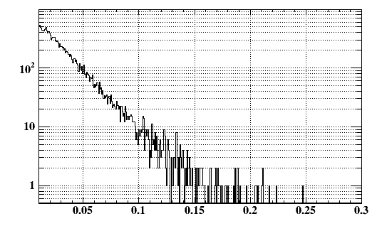
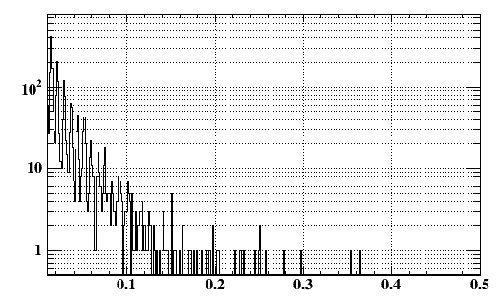
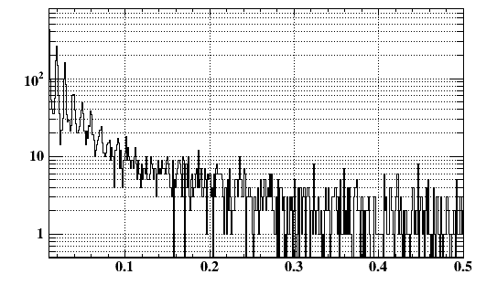
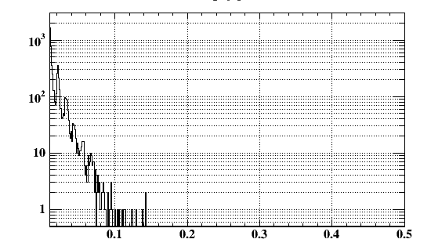
Excess noise factor
Old
V_{over}=2.4V
P_{crosstalk}=60%
New
V_{over}=2.5V
P_{crosstalk}=50%
New
V_{over}=4.2V
P_{crosstalk}=70%
Trench
V_{over}=8V
P_{crosstalk}=35%

Slide 37
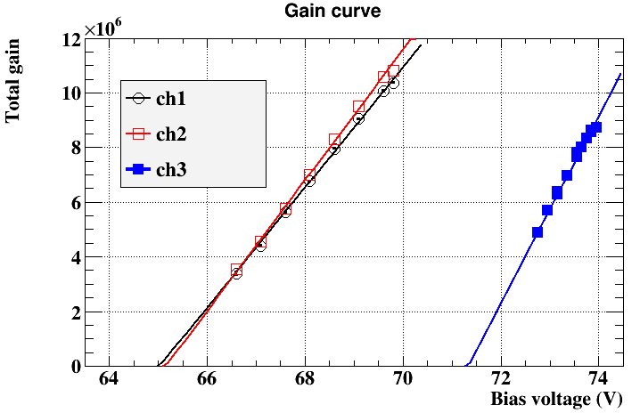
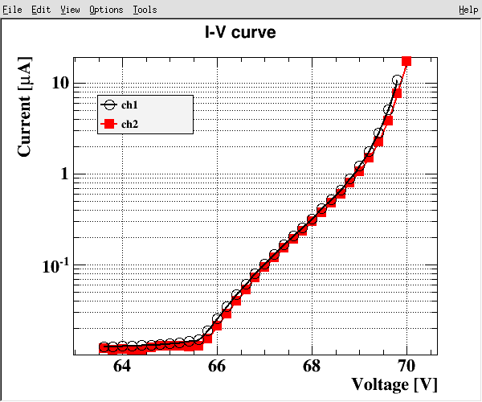
Gain
数光子ピークからゲインの見積もり
バイアス依存性
線形性はかねがねよい。
高バイアスでずれ？
同じover-voltageではゲインは従来型より低い。
New
Old
＠23℃
Total gain includes amp, splitter, offline shaping.

