Slide 1
MEG実験アップグレードに向けたMPPC読み出しによる 新しいタイミングカウンターの研究開発
西村美紀 (東大ICEPP)
松本悟、宮崎陽平(九大)
他 MEGコラボレーション
日本物理学会 2012年秋季大会
京都産業大学

Slide 2
outline
Introduction
MEG
Upgrade
Pixelated timing counter
Concept and expected performance
Single pixel study
Test with smaller counter
Construction and test of prototype of single pixel
Summary and Prospects

Slide 3
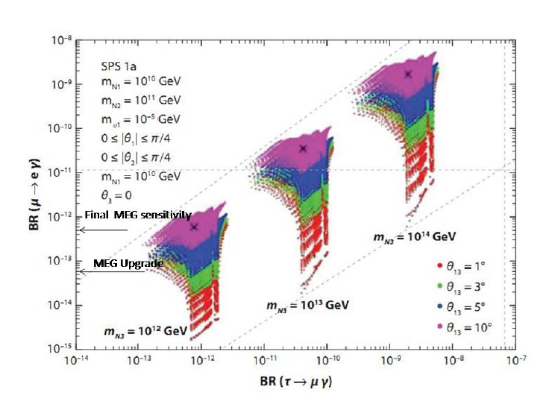
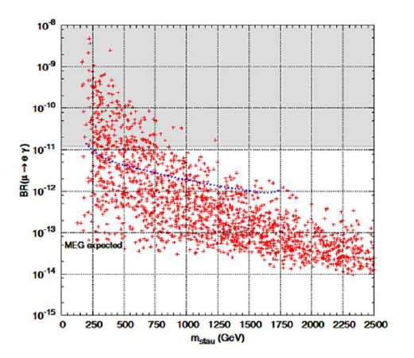
μ → eγ
SUSY-Seesaw
Search for charged lepton flavor violation (cLFV), μ $→$ eγ
Forbidden in the SM
Some models predict large branching ratios
Event Signature
$e^{+}$: 52.8 MeV
Gamma-ray : 52.8 MeV
Time coincidence
Back-to-back
Background
$μ^{+}→e^{+}ν_{e}{\overline{ν}}_{μ}γ$
Accidental background by Michel positron and gamma-ray ->dominant
Requirement
high intensity DC ${ μ}^{+}$ beam
high rate tolerable positron detector
high performance gamma-ray detector
the upper limit of $2.4×{10}^{−12}$
S.Antusch et al, JHEP 0611:090 (2006)
SUSY-GUT SO(10)
L.Calibbi et al, JHEP 0912:057 (2009)

Slide 4
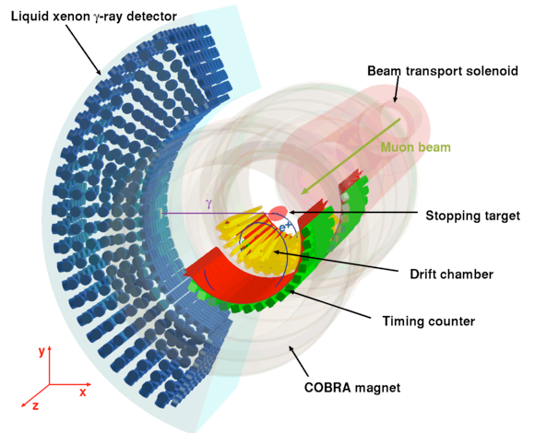
MEG
μ beam at PSI (Paul Scherrer Institute)
-> a muon stopping rate of $3×{10}^{7}$Hz
900L LXe gamma detector
Positron spectrometer
COBRA
Gradient magnetic field
-> sweep the positron out of the detector quickly
the same momentum
-> the same radius
Drift chamber
Momentum, decay vertex, emission angle and track length
Timing counter
Impact time
Most stringent upper limit of $2.4×{10}^{−12}$ in summer 2011
Sensitivity goal -> ~$6.0×{10}^{−13}$ in 2013

Slide 5
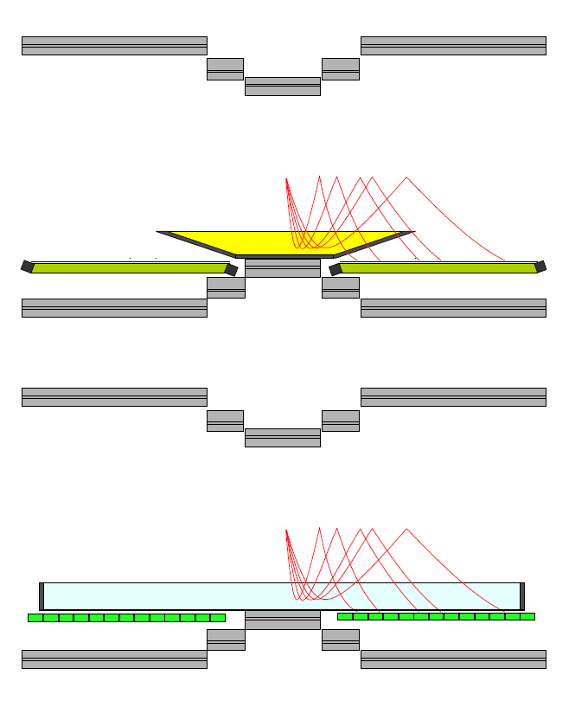
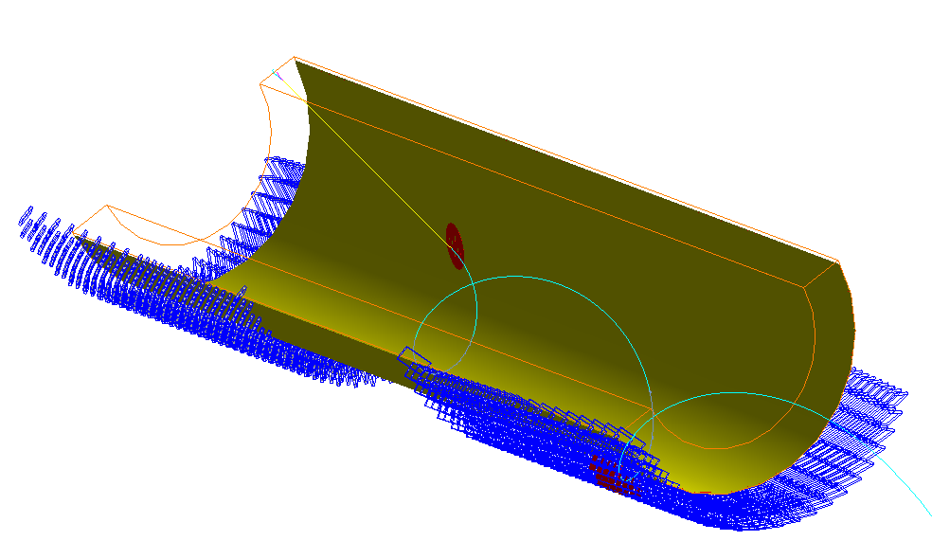
Upgrade
sensitivity goal -> $5×{10}^{−14}$
Improve detection efficiency
Improve resolutions
-> Background reduction
μ beam
a higher beam intensity
Xenon Calorimeter
Smaller photo-sensor
Positron spectrometer
Positron tracker
efficiency
->minimize material along the positrons
path to the timing counter
Resolution
->increase measurement points
Stereo wire drift chamber
Time projection chamber (TPC)
Timing counter
Pixelated Timing Counter
present
upgrade
Positron Tracker
2 option
Timing counter

Slide 6
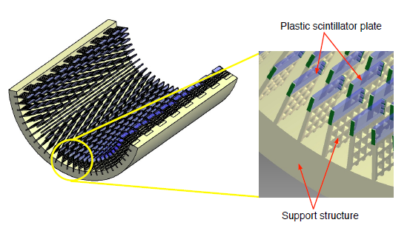
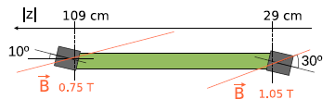
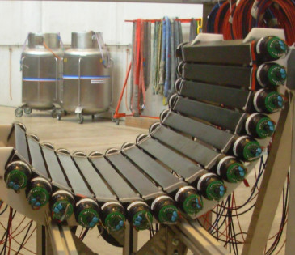
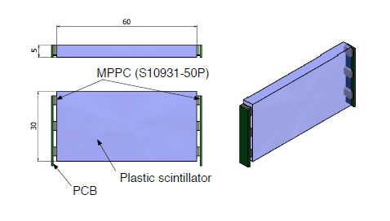
Pixelated Timing Counter
Scintillator
$×2$ (upstream, downstream side)
90cm
30cm
PMT
~400 pixels
upgrade
present
Composed of several hundreds of small scintillator plates with MPPC readout
A good timing resolution of single pixel
-> already proved by the μSR group at PSI
Using multiple hit time
Less pileup
Additional track information
Insensitivity to magnetic field
Operational in helium gas (with which COBRA is filled)
Flexible detector layout
60
5
30
Ultra-fast Plastic Scintillator
(still to be optimized)
-> Readout by waveform digitizer
(DRS developed at PSI)

Slide 7
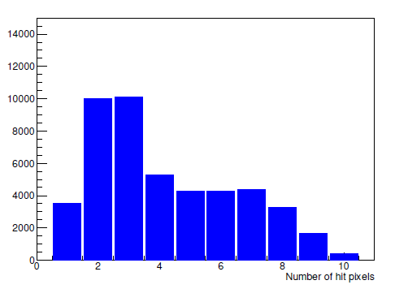
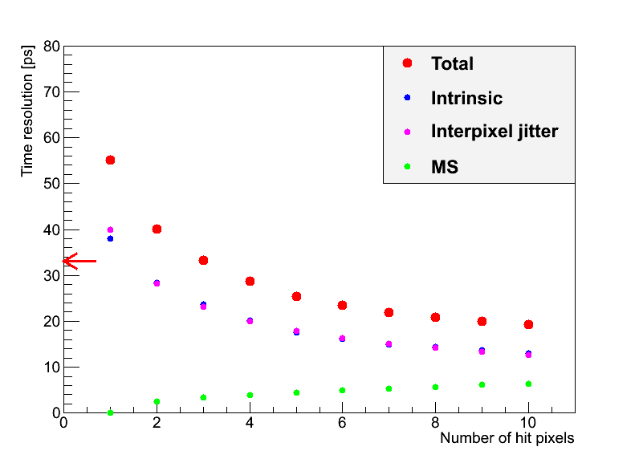
Expected Performance
Single pixel counter
μSR counter
(12x25x5, BC422: attenuation length~8cm, rise time 0.35ns)
$σ_{single}^{}=\frac{23ps}{\sqrt{kE[MeV]}}$ (measured)
($k=$ photon-sensor coverage)
MEG design
(30x60x5, BC418: attenuation length ~100cm, rise time 0.5ns)
$σ_{single}^{}=\frac{19ps}{\sqrt{kE[MeV]}}$ (MC) (->45ps)
Multiple hit
${σ^{2}}_{total}^{}\left(N_{hit}\right)=\frac{{σ^{2}}_{single}^{}}{N_{hit}}+\frac{{σ^{2}}_{inter−pixel}^{}}{N_{hit}}+{σ^{2}}_{MS}^{}\left(N_{hit}\right)$
⇒ the average time resolution :
30-35 ps (60% ↓)
$t_{eγ}$ resolution
$σ_{eγ}=$130 ps → 80 ps (40% ↓)
track length: 75 ps→ 11 ps
gamma side: 67 ps
Timing counter: 76ps → 30-35ps
# of hit counter (MC)
# of hit counter dependence
(current TC ~76ps)

Slide 8
Issues
Prove the performance for our application
Larger single counter
Readout system (cabling, electronics…)
Multiple hit principle
Other Possible Issues
Temperature coefficient of MPPC gain
The number of electronics channels (~ 800 pixels × 2 readout) and MPPCs (~ 800 pixels × 6)
Radiation hardness of MPPC
Today’s topic
Test with smaller counter (working at PSI μSR facility)
Basic performance measurement
Test of waveform digitizer readout
Effect of parallel connection
Construction and test of prototype of single pixel

Slide 9
Single pixel counter study

Slide 10
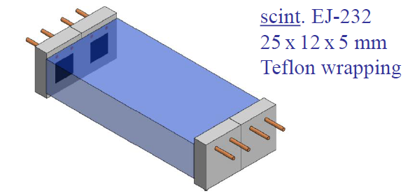
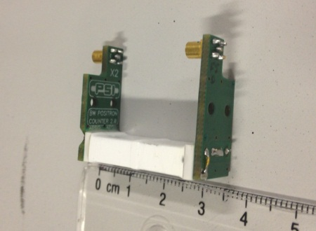
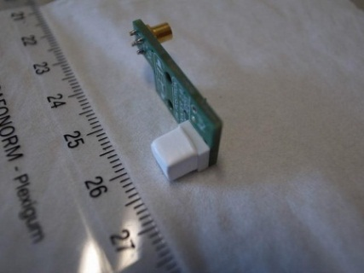
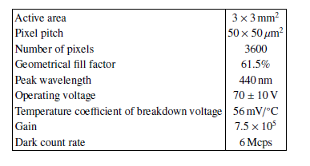
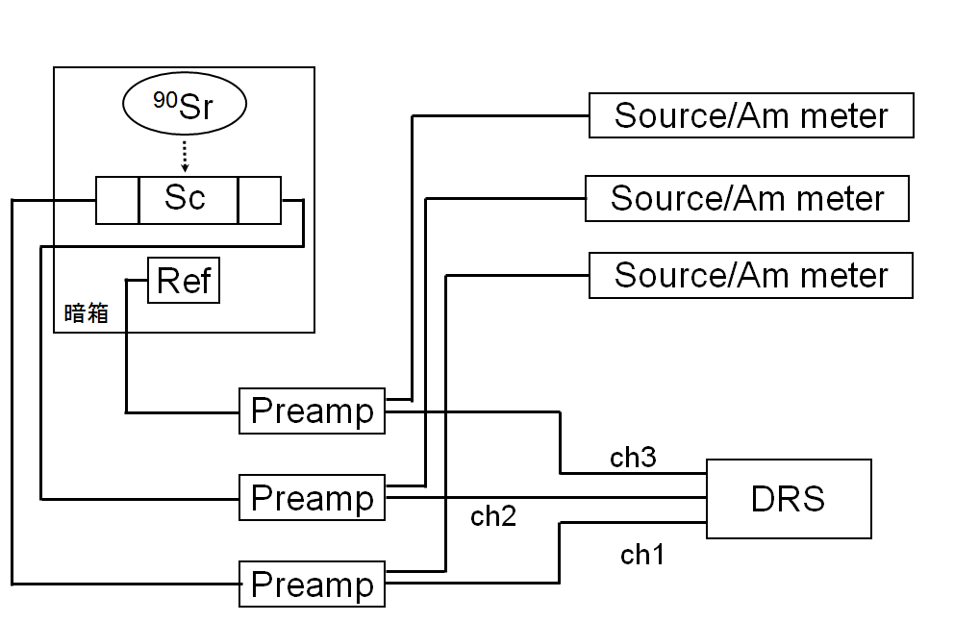
Set up
Test counter from μSR group
Reference counter
5×5×5 mm
Readout by a MPPC
-> collimate β-ray, scan position
trigger
Source Sr90 (~2MeV,β-ray)
Bias 140V~144V (~5.0μA)
Voltage preamp developed by PSI
Waveform digitizer sampling (DRS developed at PSI)
sampling rate -> 5GHz
(≒BC422)
2 MPPCs
Series connection
A. Stoykov et al. NDIP 2011
Test counter
Reference counter
HV source
HV source
HV source
HV source
KEITHLEY
6487 PICOAMMETER/VOLTAGE SOURCE
Hamamatsu Photonics MPPC S10362-33-050C

Slide 11
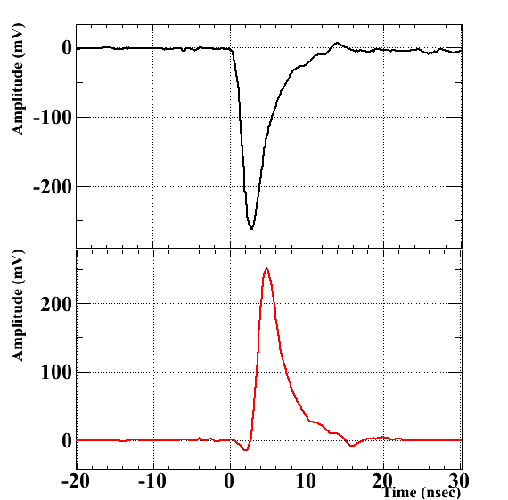
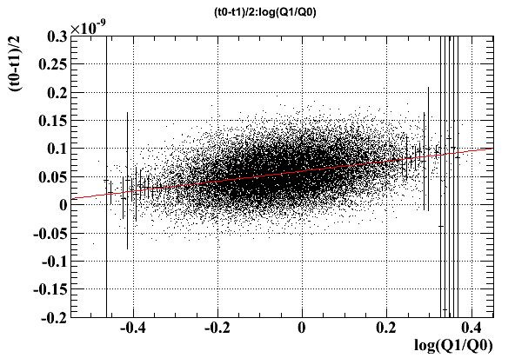
analysis
Timing measurement:
average from both sides
$\frac{t_{0}−t_{1}}{2}$
$\frac{t_{0}+t_{1}}{2}−t_{ref}$
Digital Constant Fraction
-> 8%, delay 2ns
Correction by the ratio each side charge $\text{log}\text{(}{Q_{1}}/{Q_{0}}\text{)}$ and the reference charge $1/Q_{ref}$
raw
CF
$$t_{0}$$
$$Q_{0}$$
$$t_{1}$$
$$Q_{1}$$

Slide 12
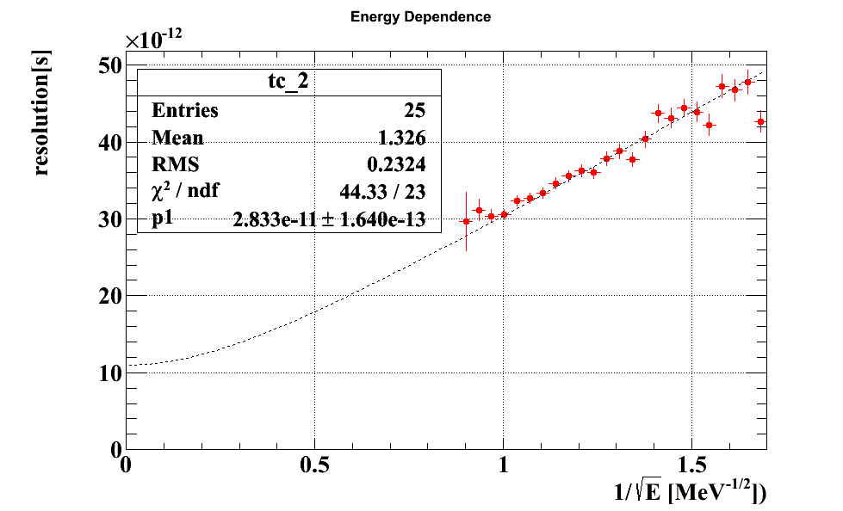
Intrinsic Resolution
$$σ{(k∙E)}^{0.5}=15 \text{ps}\text{∙}{\text{MeV}}^{0.5}$$
$$(k=0.3)$$
With waveform digitizer, the good timing resolution is obtained.
Timing resolution scales as square root of Npe
$$σ_{tot}=\sqrt{{σ_{E}}^{2}\frac{1}{E}+{σ_{offset}}^{2}}$$
$σ_{offset}\text{=11}\text{ps}$ (measured)
μSR group (TDC)
→ $σ{(k∙E)}^{0.5}=\text{23 }\text{ps}\text{∙}{\text{MeV}}^{0.5}$
(12x25x5mm EJ232 uniform irradiated)
$σ{(k∙E)}^{0.5}=\text{17} \text{ps}\text{∙}{\text{MeV}}^{0.5}$
(smaller counter φ6x0.3mm EJ232)

Slide 13
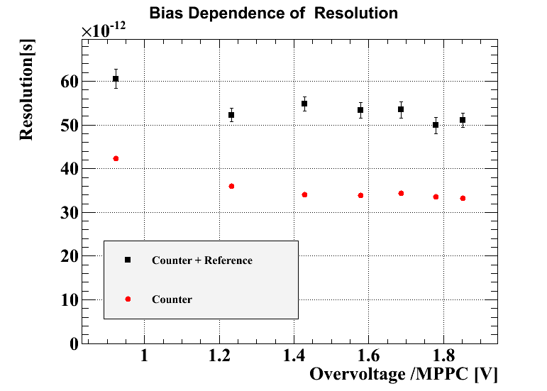
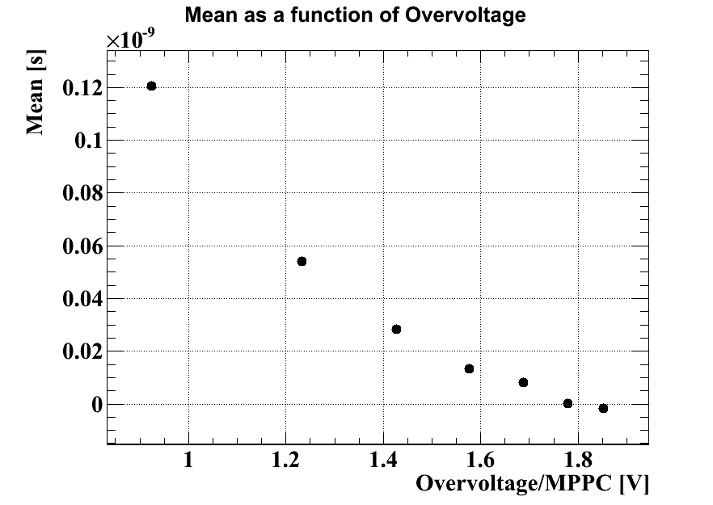
MPPC bias dependence
~100ps/V
44ps
$\frac{t_{0}+t_{1}}{2}−t_{ref}$
$\frac{t_{0}+t_{1}}{2}−t_{ref}$
$\frac{t_{0}−t_{1}}{2}$
Good resolution can be obtained stably over certain voltage.
Shift of the timing depending on bias voltage
(-> temperature variation could affect the timing performance)

Slide 14
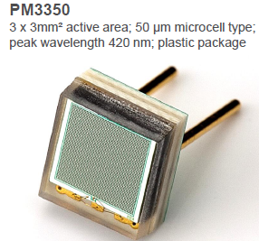
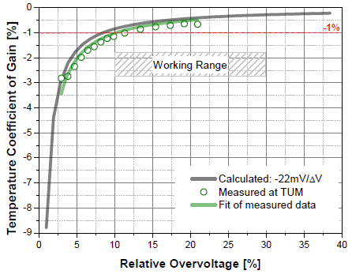
Temperature stability
The temperature coefficient of the breakdown voltage: 56mV/℃
-> gain variation: 5.6 %/℃
at overvoltage of 1V
(Hamamatsu MPPC S10931-050P)
In the COBRA, temperature changes 2-3℃ -> ~150mV -> ~15ps
Possible solutions
Improve temperature control of detector hut
SiPM with smaller temperature coefficient
->KETEK SiPM (PM3350)
gain variation: <1 %/℃
PhotoDet 2012, June 13-15, 2012, LAL Orsay, France

Slide 15
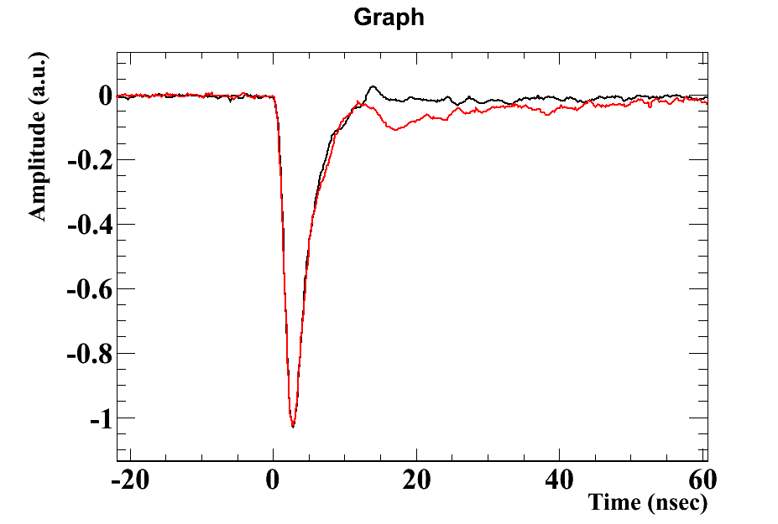
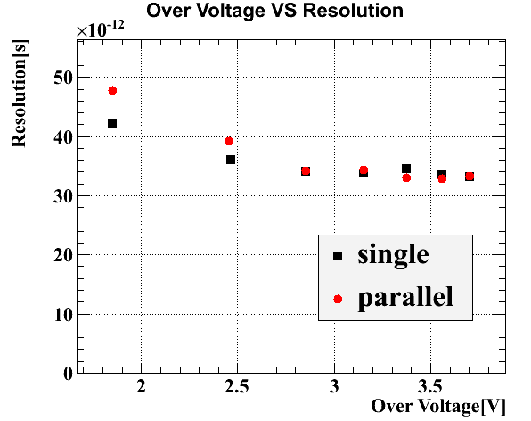
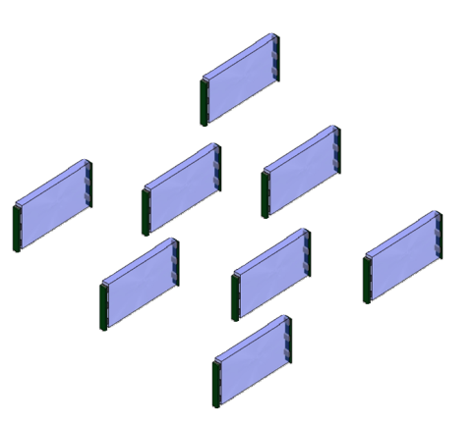
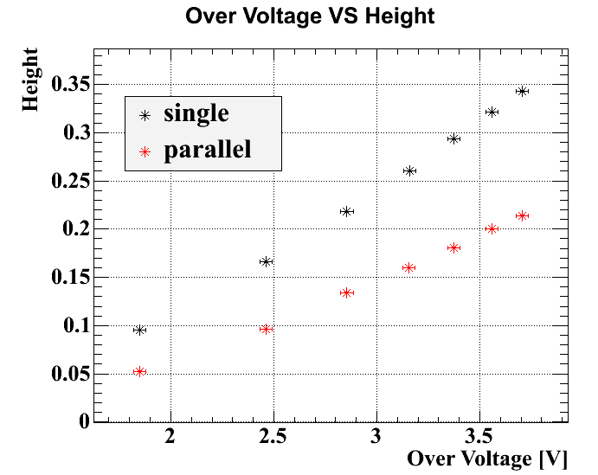
Parallel connection
connect outputs in parallel from two pixels located apart from each other
(Low pile up makes it possible.)
Channel reduction
Issues
Can not give bias voltage each counter
->Choose pairs of the same breakdown voltage
Capacitance ↑
->Change waveform, smaller signal
Though resolution becomes worse because of wave height decrease,
it does NOT change under higher over voltage.

Slide 16
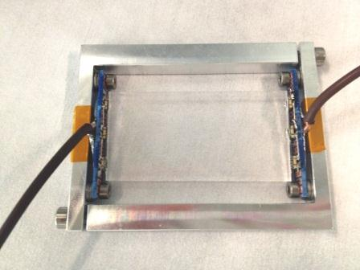
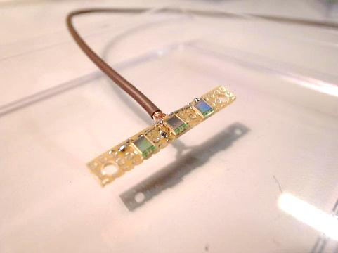
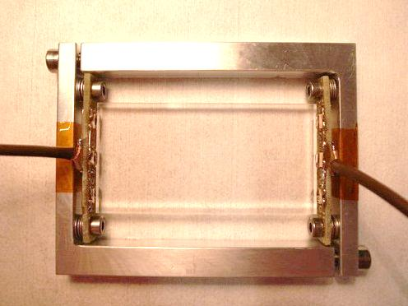
Pixel prototype
30×60×4.5 mm scintillator
Two types of scintillators
BC422: attenuation length 8cm
rise time 0.35ns
EJ228: attenuation length 100cm
rise time 0.5ns
3 MPPCs each side
MPPC: 3×3mm, 50μm pixel pitch
No wrapping (only total reflection)
Optical coupling with optical grease (OKEN6262A)
Expected performance
BC422 50.1
EJ228 44.7
4.5
60
30
Ultra-fast Plastic Scintillator
Design of the single pixel module
Three MPPCs on the PCB
Prototype counter

Slide 17
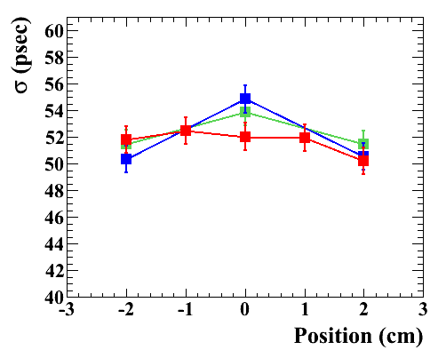
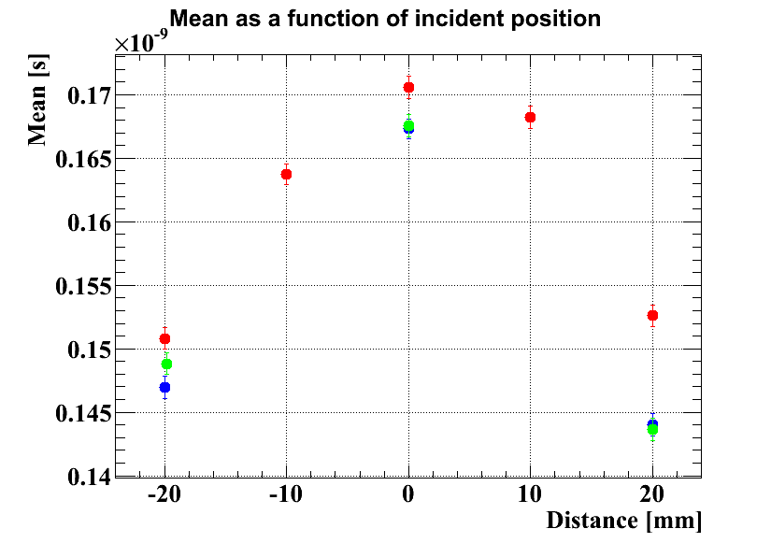
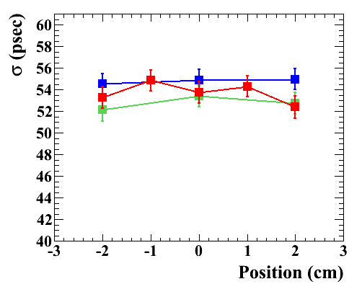
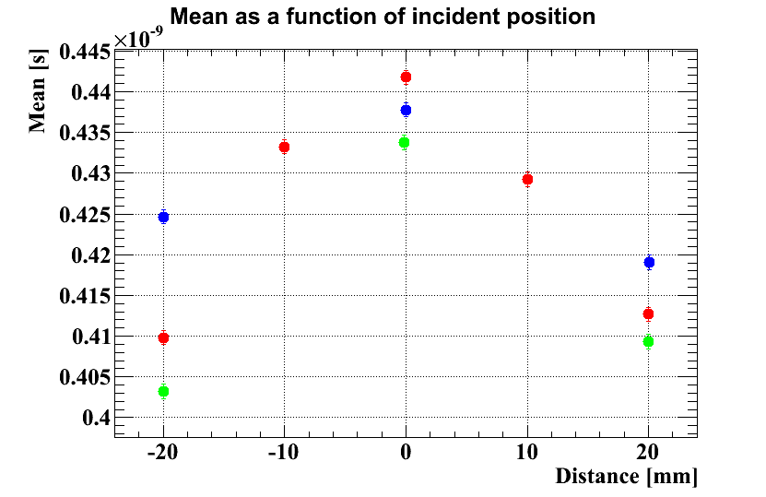
First test with prototype
counter
1cm
1cm
53.3 ps
(expected 50.1)
BC422
25ps
Average 53.4 ps
Moving-average 3 points, digital Constant-fraction at 8% fraction
EJ228
54.8ps
(expected 44.7)
Moving-average 3 points, ARC Constant-fraction with 3.5 ns delay and 8% fraction
Average 55.4 ps
40ps
Resolution doesn’t change so much.
Mean has a little position dependence .
Measured resolution is worse than expected one.
-> We couldn’t apply proper bias voltage to MPPC for some reasons.
reflector still to be optimized
Overall positron time resolution is a little worsened. 33ps -> 37ps (EJ228)

Slide 18
Summary and Prospects
summary
Pixelated timing counter with an improved timing resolution is under development for MEG upgrade.
Basic properties of single pixel were measured with smaller counter.
Good resolution confirmed
Bias dependence and effect of temperature variation are studied.
-> temperature control might be necessary.
Effect of parallel connection is small.
Construction and test of single pixel prototype is started.
Though it have not been optimized yet, reasonable resolution is already achieved.
prospects
Solve the problem that proper gain cannot be applied.
Optimize the single pixel performance (reflector, size)
Optimize the layout
Construct the prototype detector with several tens of pixels
Beam test
Prove multiple hit scheme

Slide 19
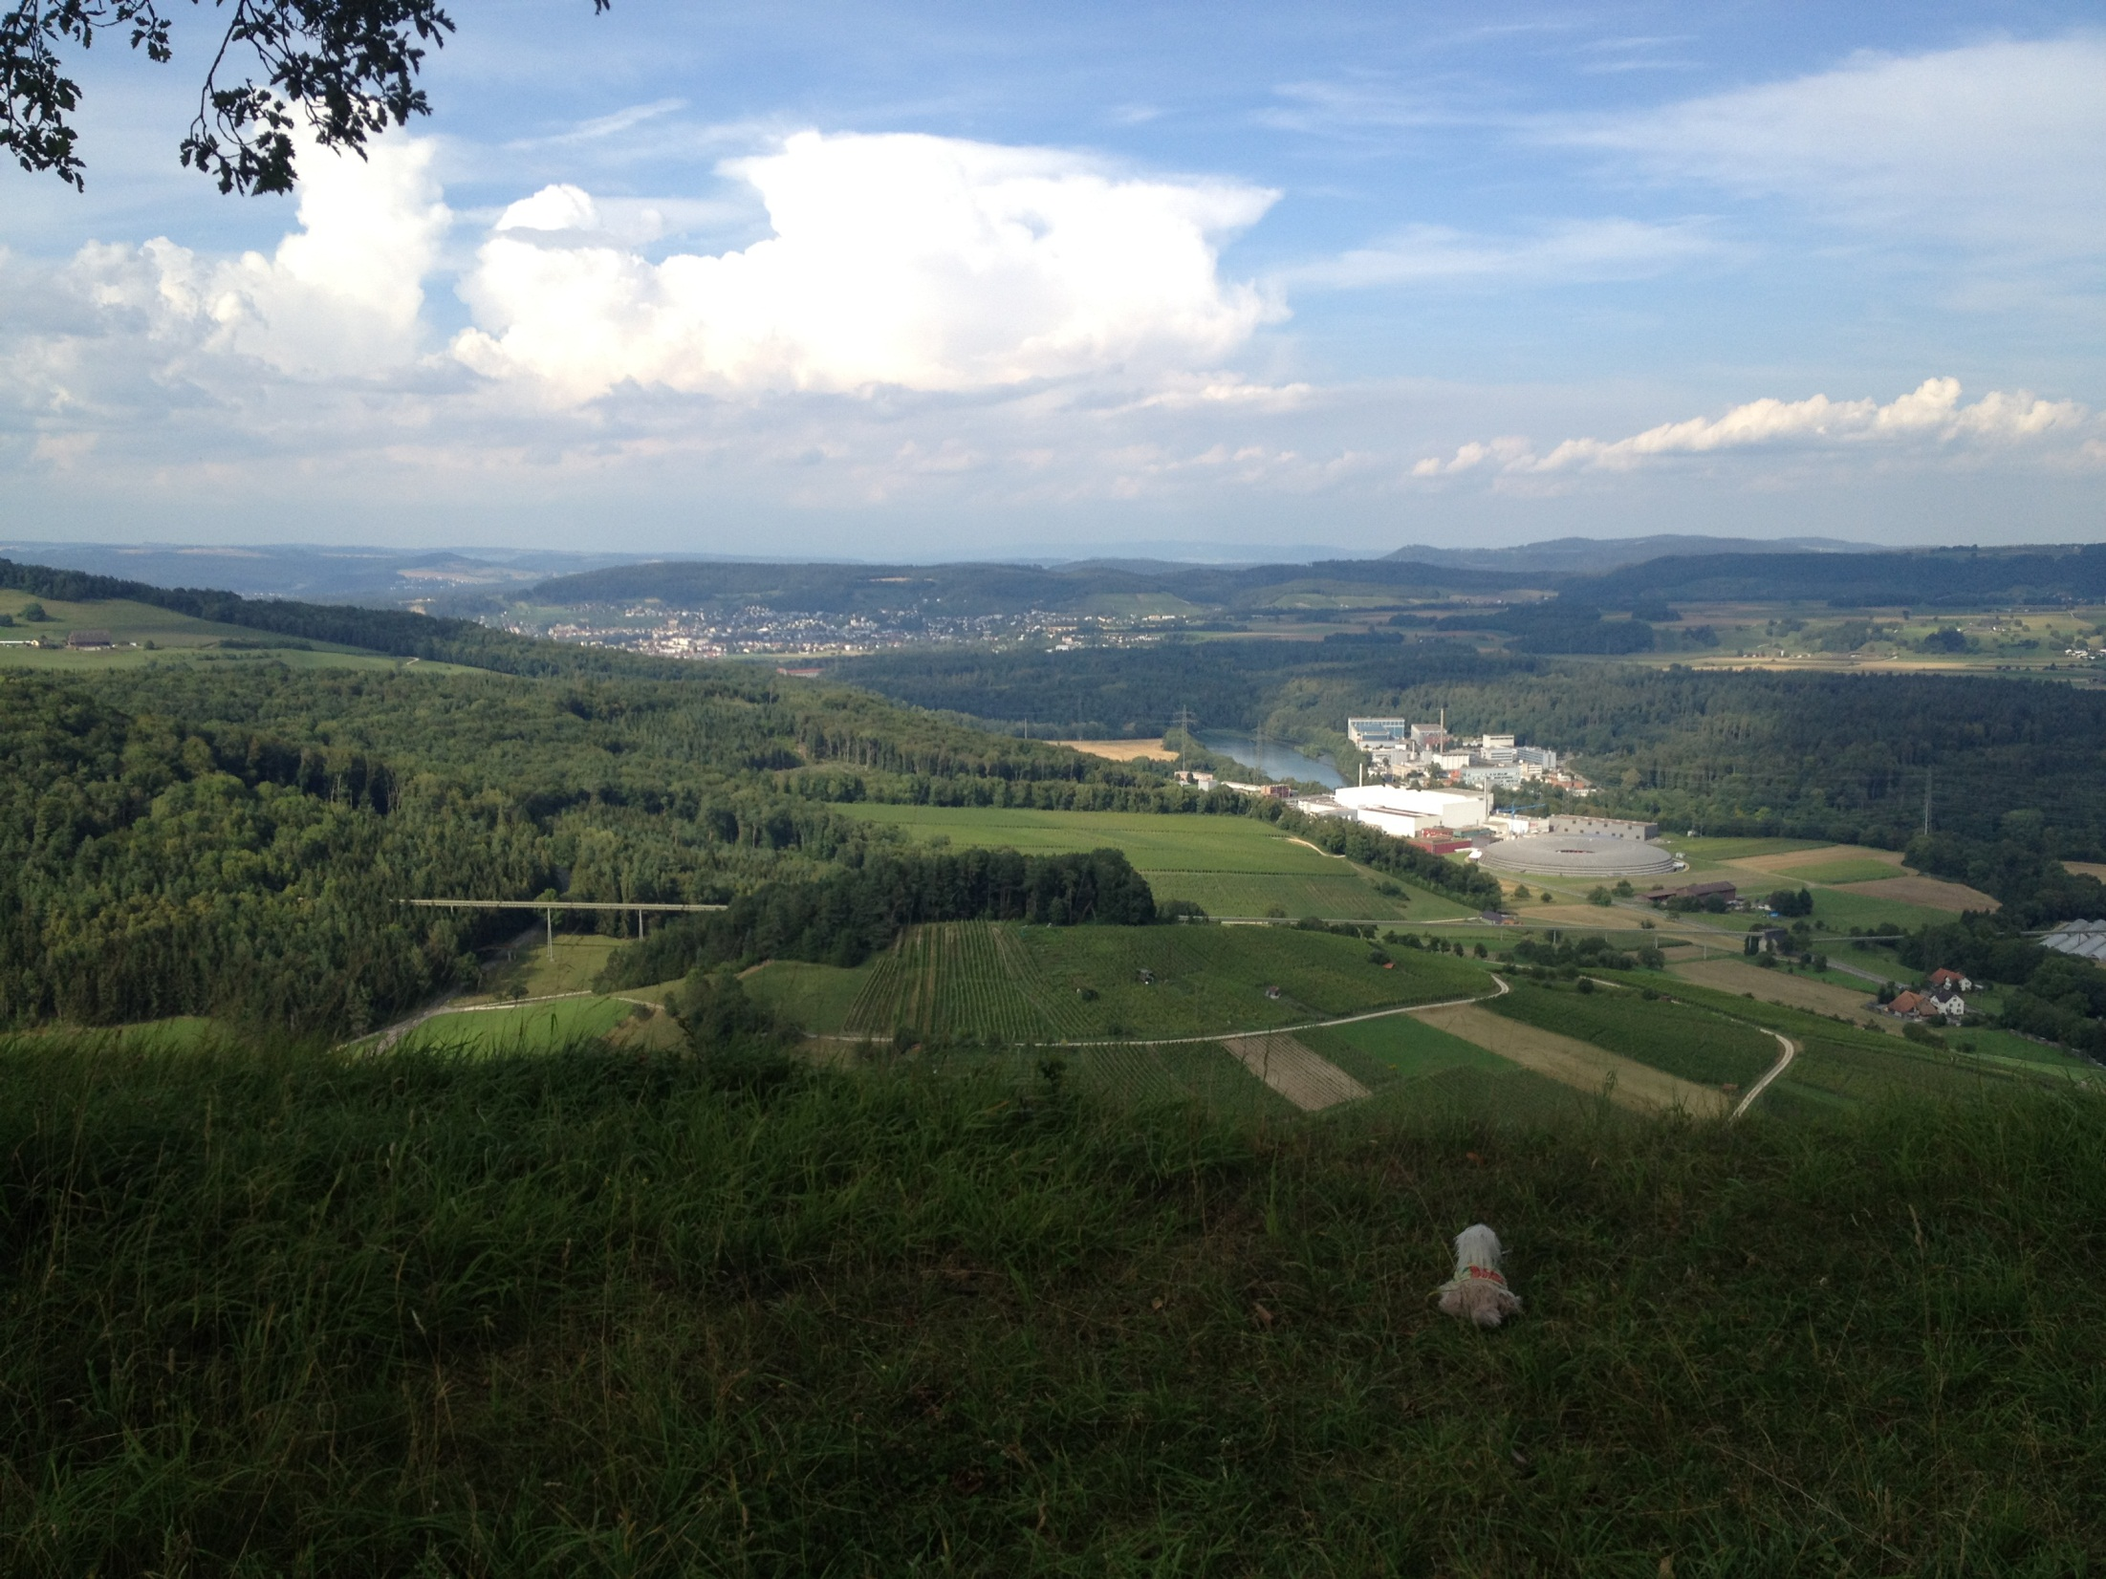
Thank you

Slide 20
Back up

Slide 21
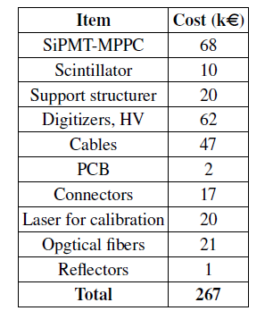
Cost
Cost estimate for the new pixelated timing counter

Slide 22
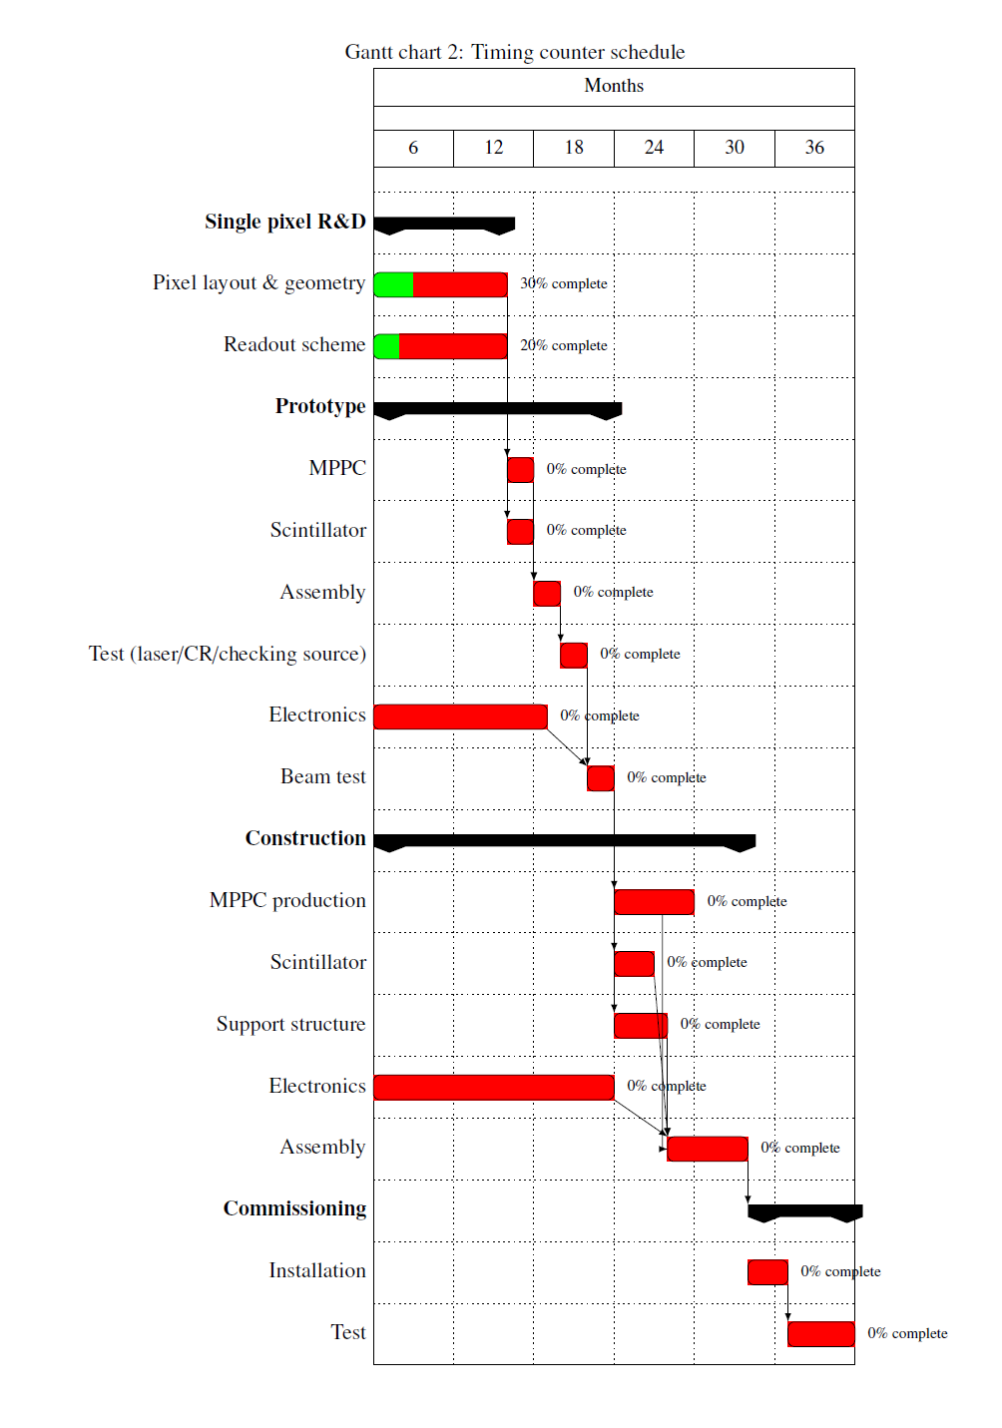
Time Schedule

Slide 23
Radial hardness
Results from the irradiation tests of Hamamatsu MPPC (S10362-33-050C) performed by the PSI SR group. Significant increase of dark current (top) and 15% gain degrease (middle) are observed, while the timing resolution is unchanged (bottom).
Courtesy of Dr. A. Stoykov of Paul Scherrer Institut.

Slide 24
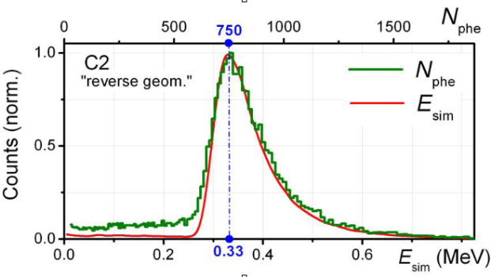
Charge -> Energy
A. Stoykov et al. NDIP 2011
Match the charge peak with energy peak(use μSR group’s result)
→ $E=4.6∙Q$

Slide 25
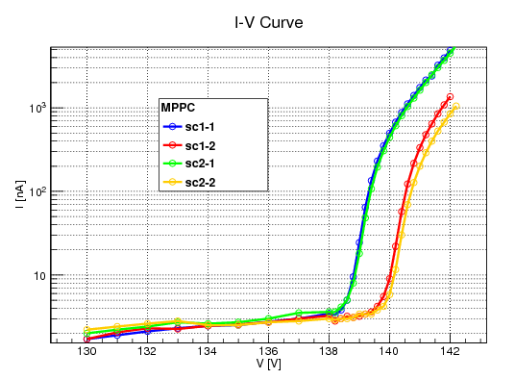
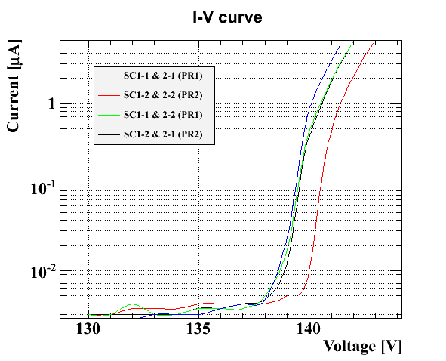
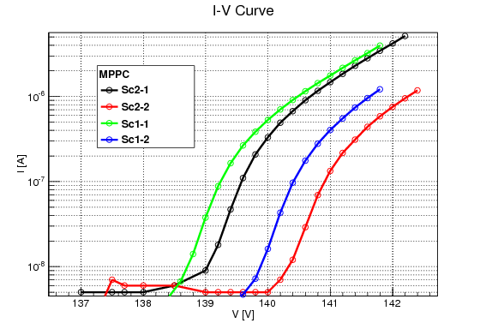
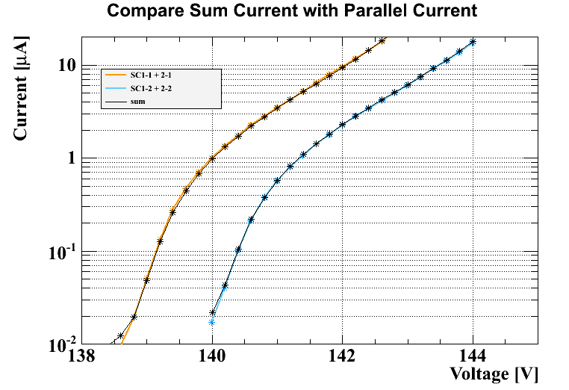
I-V curve
single
↑Parallel connection
Break down voltage

Slide 26
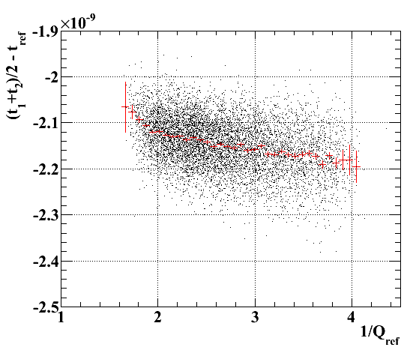
Reference charge dependence

Slide 27
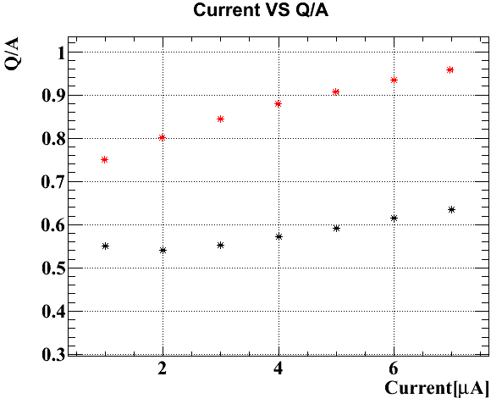
Single VS parallel(Q/A)

Slide 28
Electric noise
The one side of counter signal is divided two and connected DRS’s two channels respectively.

Slide 29
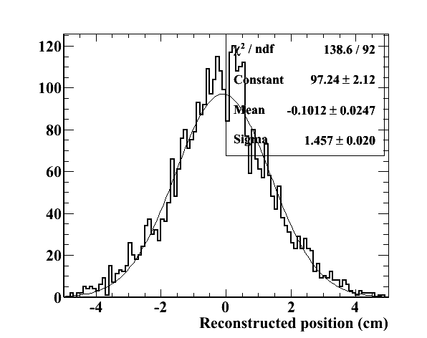
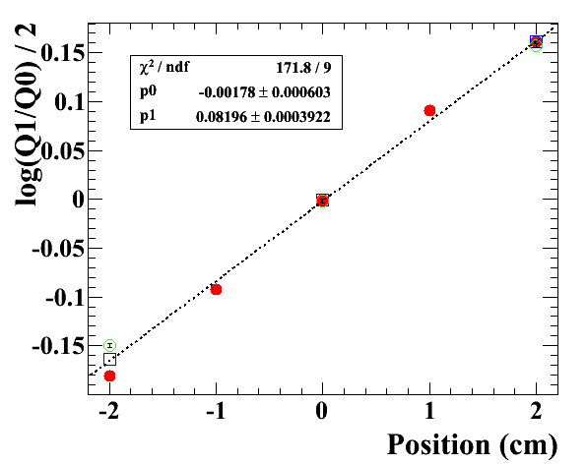
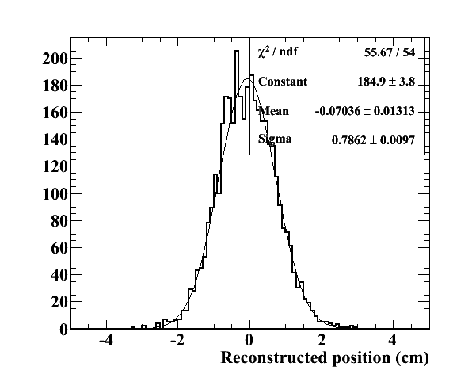
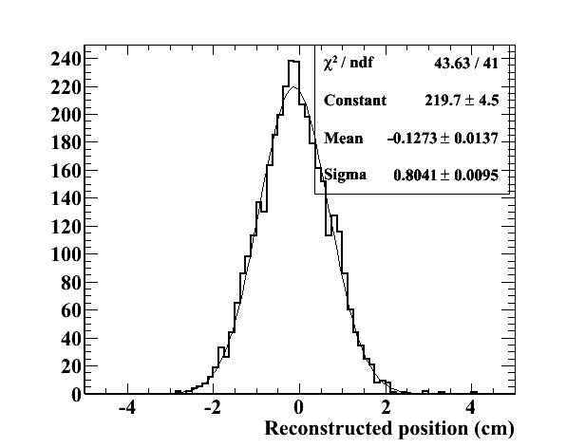
Position reconstruction
$$x$$
$x=0.5×λ\text{log}\frac{Q_{1}}{Q_{0}}$ -> attenuation length
$x=v×\frac{t_{1}−t_{0}}{2}$ -> scintillation light speed
$$t_{0}$$
$$Q_{0}$$
$$t_{1}$$
$$Q_{1}$$
BC422
EJ228
$$Q∝N_{0}e^{−\frac{L±x}{λ}}$$
↓
Since attenuation length is long, position reconstruction by charge does not work.
Resolution ~14.5 mm
BC422
EJ228
=> Using time difference is better for position reconstruction.
Resolution
~7-9 mm

Slide 30
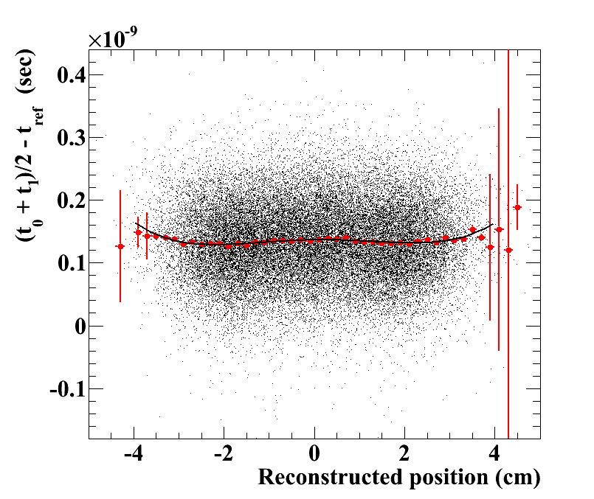
Position dependence (lsc)

Slide 31
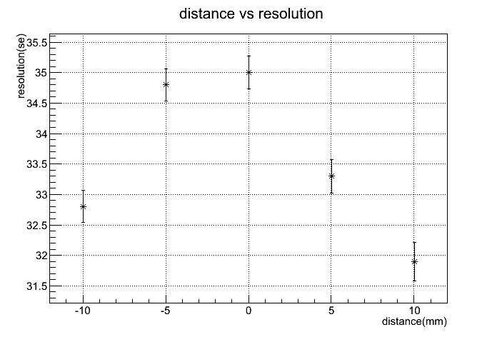
Position dependence(μSR)
Slight position dependence in resolution:
~ a few ps
Position dependent time bias: ~40ps

Slide 32
Properties of ultra-fast plastic scintillators from Saint-Gobain

Slide 33
New Tracker candidates

Slide 35
EJ228(100cm)
Notes:
プロット->どのくらい？

Slide 36
BC422(8cm)

